Slide 1
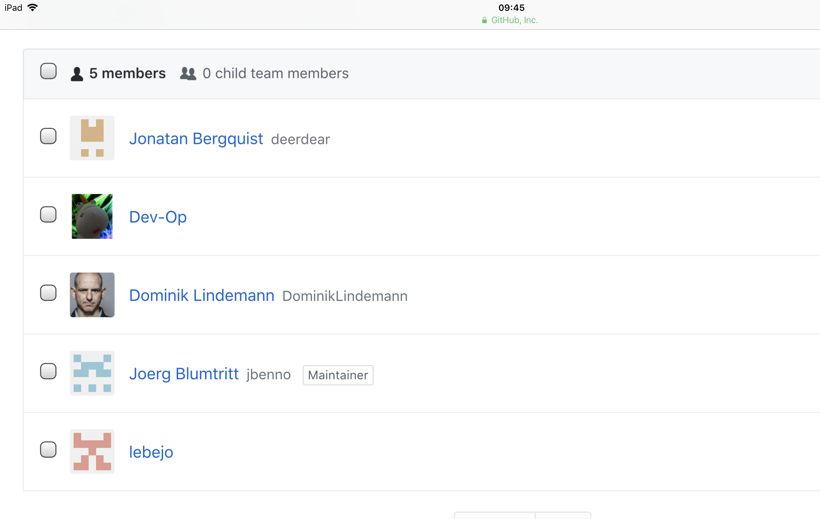

Slide 2
Homomorphic Encryption

Slide 3
Get information from data
without showing the data

Slide 4
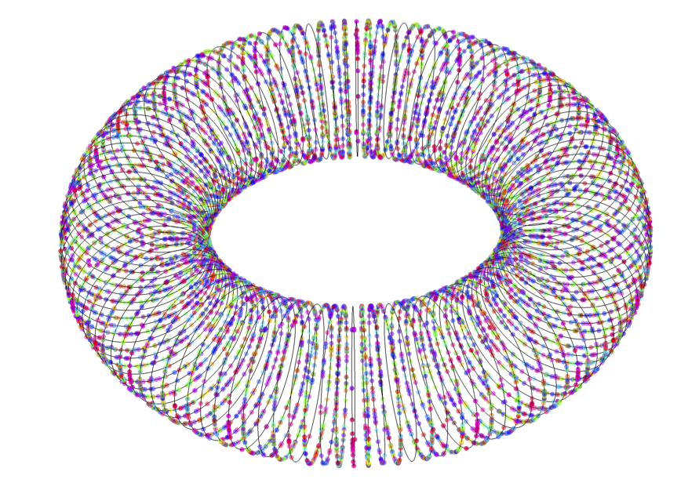

Slide 5
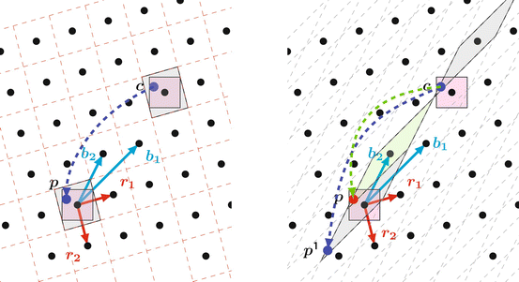

Slide 6
Not just pseudonymous
like hashes

Slide 7
GDPR compliant

Slide 8
GDPR compliant
Quantum resistant

Slide 9
Mobility case:

Slide 10
Mobility case:
Analyze geo-data

Slide 11
Mobility case:
Analyze geo-data
without revealing locations

Slide 12
Mobility case:
Analyze geo-data
without revealing locations
on an open blockchain

Slide 13
demo comes here

Slide 14
Mobility cases:
Geo-data
Identity
Financial transactions
…

