Slide 1

AUTOMATED CLAIM HANDLING
ON THE BLOCKCHAIN

Slide 2


REBECCA IS ALMOST THERE...

Slide 3
OH NO, SHE CRASHES

Slide 4
LUCKILY SHE’S FINE BUT THE BIKE IS BROKEN

Slide 5
NO PROBLEM, REBECCA HAS OUR SUPERCRISPY PERSONAL LIABILITY INSURANCE ☺

Slide 6
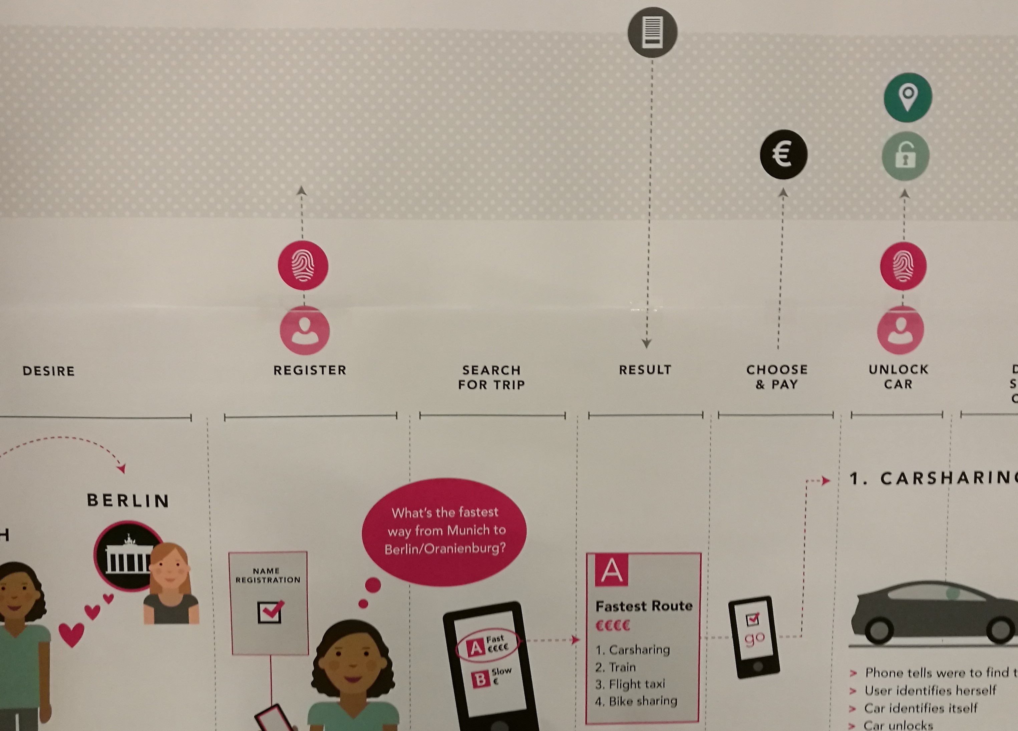

BEFORE STARTING HER JOURNEY
REBECCA GETS AN INSURANCE FOR THE TRIP
Blockchain
Only certified Insurers
Can add entries
0xabc123 is insured.
Max. coverage: 3000€.
r
REBECCA
ETH
INSURANCE
COMPANY
0xabc123

Slide 7
BEFORE STARTING HER JOURNEY
REBECCA RENTS A BIKE
BIKE
SHARER
Is 0xabc123 insured?
0xabc123 is insured.
Max. 3000€.
Payment
Smart Contract between Bike Sharer
and Insurance Company
Max. Coverage: 3000 €
REBECCA

Slide 8


AFTER THE CRASH
SMART CONTRACT IS TRIGGERED WITHOUT ANY INVOLVEMENT OF REBECCA
?
Possible triggers
BIKE
SHARER
Payout
INSURANCE
COMPANY
€

Slide 9
TECHNICAL DEMO

