Slide 1
COGNIGY FDE CANDIDATE CHALLENGE
Aurora Outdoors
An end-to-end AI Agent for retail customer experience — built on Cognigy.AI
Austin Rogers
5-min live demo · 10-min behind the scenes

Slide 2
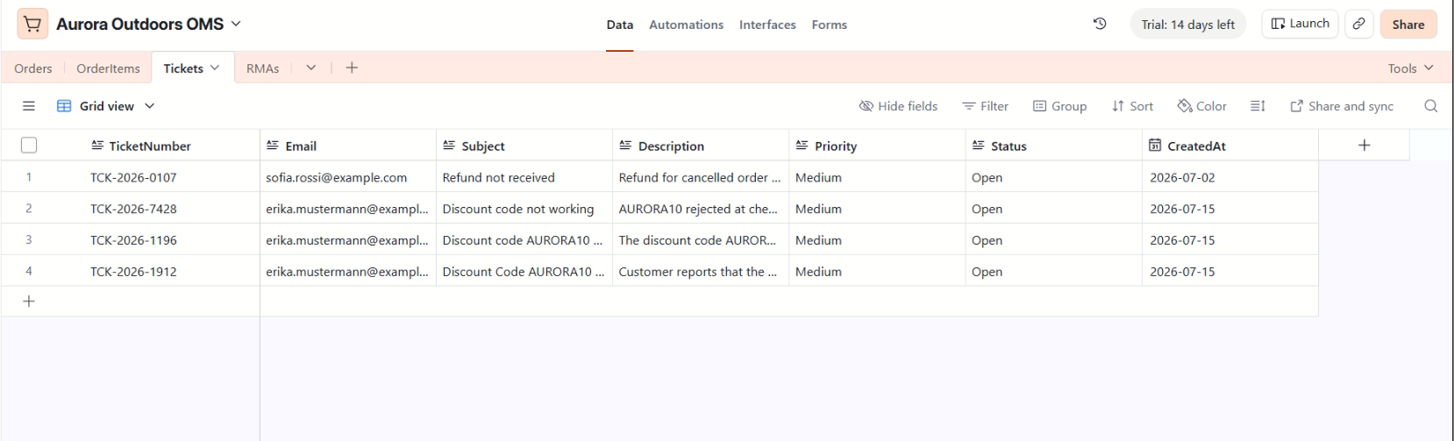
WHY THIS USE CASE
The scenario
Aurora Outdoors — a European online shop for outdoor gear (tents, jackets, backpacks)
Retail CX is where agentic AI earns its keep: repetitive questions, real transactions, and emotional moments — returns — where a bad bot loses a customer
Test customer: Erika Mustermann, three orders in three states — shipped (AO-1001), delivered (AO-1002), processing (AO-1003)
Airtable plays the order-management system: data is mocked, every integration is real and live
Airtable base — Orders table
1

Slide 3
WHAT WAS ASKED / WHAT WAS DELIVERED
Challenge requirements — full coverage
✔ GenAI Knowledge for FAQ
12 FAQs per language in Cognigy Knowledge AI (EN + DE stores), grounded retrieval
✔ Check Order Status via 3rd-party system
Live Airtable REST integration through a custom-built Cognigy Extension
✔ RMA flow with xApp
xApp overlay form, products pulled live from the order; selection written back to Airtable
✔ One additional tool
Create Support Ticket — new row in Airtable with confirmation number
✔ English + 2nd language, switched live
German — agent-triggered locale switch mid-conversation, bilingual xApp
✔ Deploy on Webchat
Cognigy Webchat v3 endpoint with xApp overlay
✔ Stability + demo script
Every happy path scripted with expected results, incl. Airtable row checks
2

Slide 4
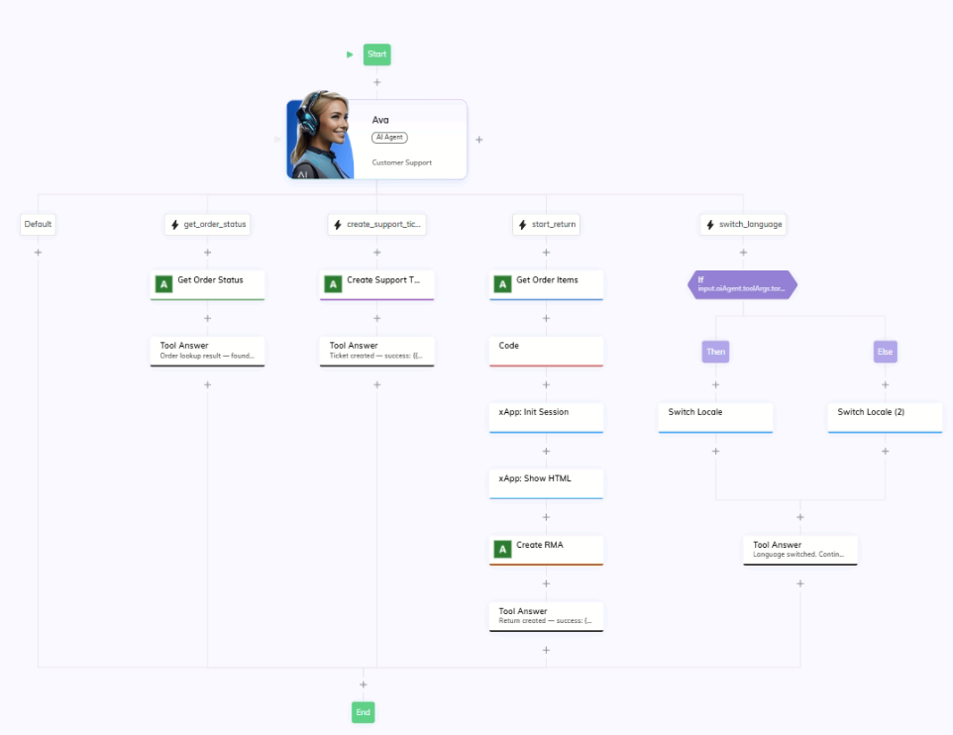
AS BUILT
Architecture — one agent, four tools
AI Agent “Ava” (persona + Customer Service job) drives every conversation — no intent trees
FAQ questions ground against Knowledge Stores (EN / DE) attached to the agent
Transactional asks run through four tools; each tool branch calls a custom Airtable Extension node and returns a Tool Answer
Returns open an xApp overlay in Webchat; the submitted choice flows back and is written to Airtable
Flow editor — full flow with the 5 branches (Default, get_order_status, create_support_ticket, start_return, switch_language)
3

Slide 5
THE CUSTOMER'S VIEW
Live demo — 5 minutes
1 · FAQ, grounded: “What's your return policy?” — retrieved from the knowledge store, zero FAQ intents
2 · Order status: “Where is my order AO-1001? …” — live Airtable lookup: shipped, DHL, tracking number
3 · Return with xApp: “I'd like to return something from AO-1002…” — overlay form with that order's real items, hygiene item greyed out; pick the jacket → RMA number confirmed
4 · Live switch to German: “Können wir auf Deutsch weitermachen?” — same agent, German answers grounded in the German knowledge store
5 · Support ticket in German — confirmation number, row visible in Airtable immediately
→ switching to the Webchat now
4

Slide 6
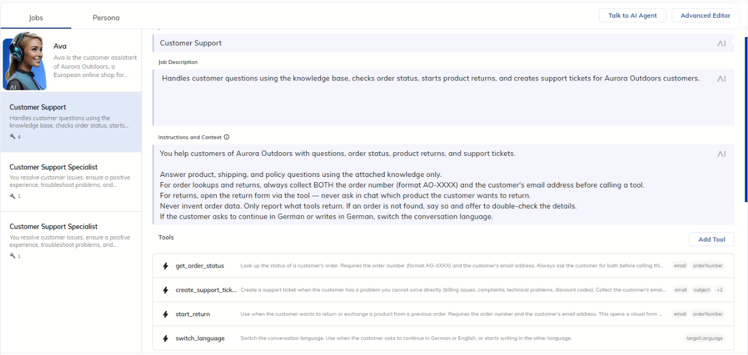
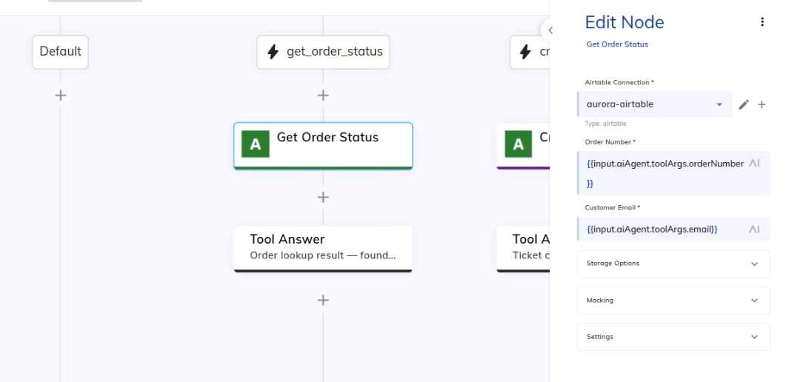
AI AGENT + TOOLS
Behind the scenes 1 — the conversation brain
One AI Agent node, five branches — the LLM decides which tool to call from the tool descriptions
Tool descriptions are the real programming surface: “opens a visual form — never ask in chat which product” changes behavior
Every branch ends in a Tool Answer that hands structured results back to the agent — the agent phrases the reply
Guardrails: collect order number AND email before lookups; never invent order data
AI Agent editor — job instructions + 4 tools
5
get_order_status branch: Get Order Status → Tool Answer

Slide 7
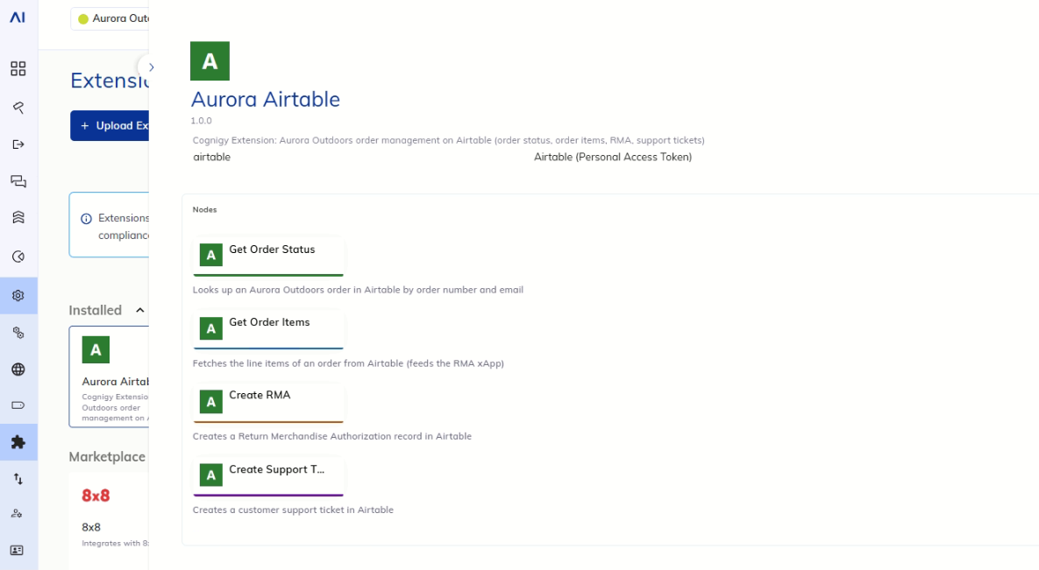
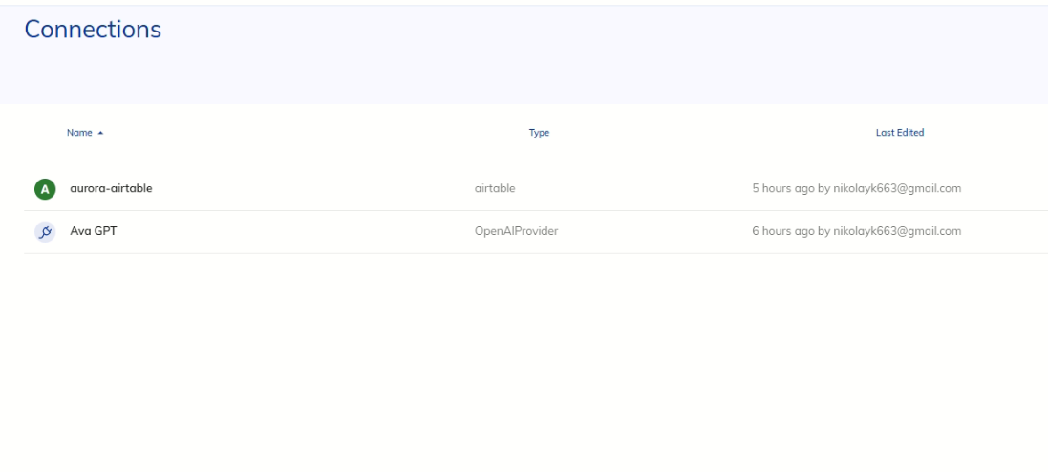
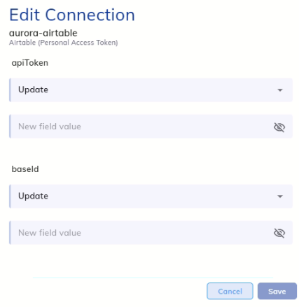
CUSTOM COGNIGY EXTENSION (TYPESCRIPT)
Behind the scenes 2 — the integration layer
Four custom flow nodes wrap the Airtable API: Get Order Status · Get Order Items · Create RMA · Create Support Ticket
Why an Extension instead of HTTP nodes:
Reusable — any designer drags the node into any flow, no copied URLs
Secure — the Airtable token lives in an encrypted managed Connection, never in flow config
Robust — one place for timeouts and errors; failures degrade to a friendly fallback, never a dead conversation
Identity check — order lookups require order number AND matching email in one query
Swap Airtable for SAP/Shopify later: only the Extension internals change — flows, form, tests untouched
Manage → Extensions: Aurora Airtable, 4 nodes
Node config: connection + fields (no secrets visible)
6

Slide 8
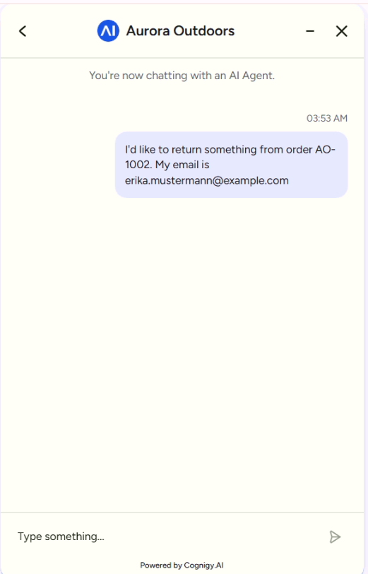
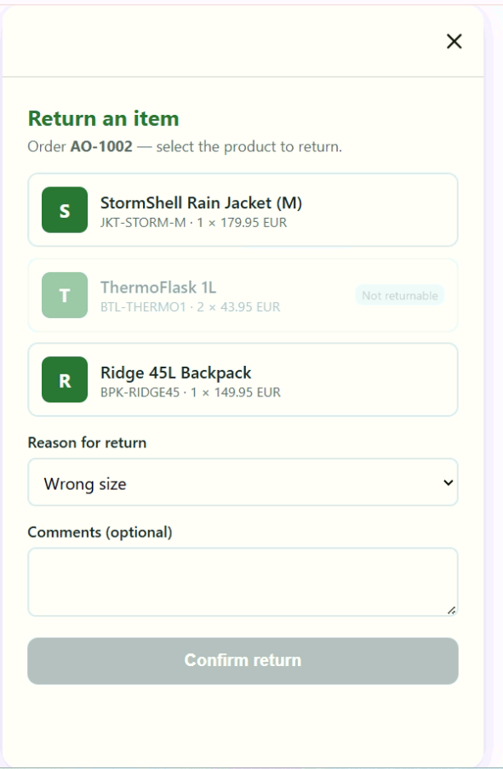
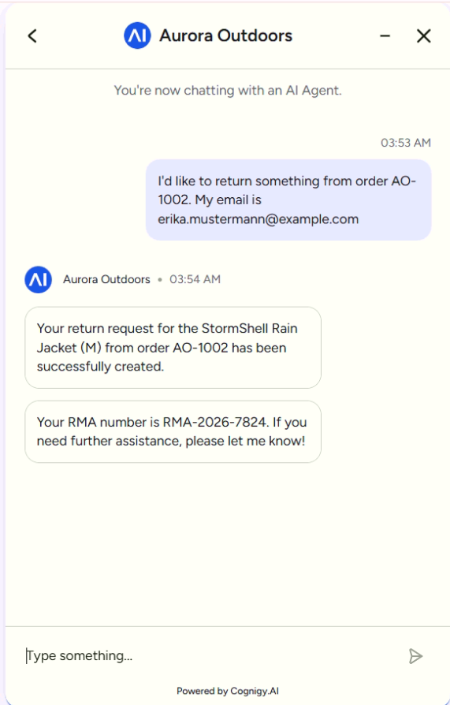
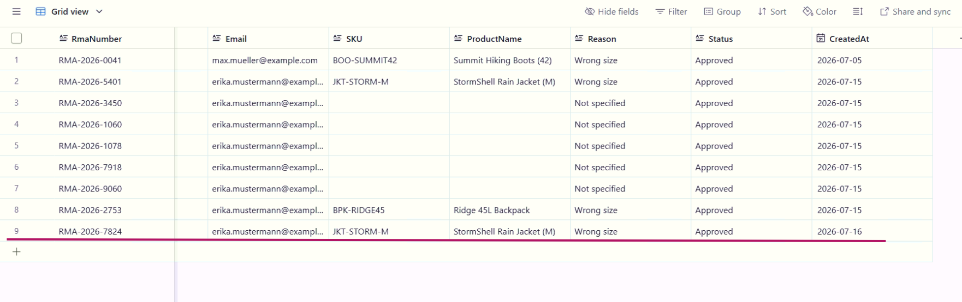
DYNAMIC · BILINGUAL · IN-CHAT OVERLAY
Behind the scenes 3 — the return form (xApp)
The form is not hard-coded: the flow fetches the order's real line items seconds earlier and injects them
Business rules render in the UI: non-returnable hygiene items (ThermoFlask) are greyed out — same policy the FAQ states
Opens as an overlay inside Webchat; submit closes it and the selection flows back into the conversation
The write-back is immediate: a new RMA row in Airtable + confirmation number in chat
Bilingual: the form reads the session locale — a German conversation gets German labels
7

Slide 9
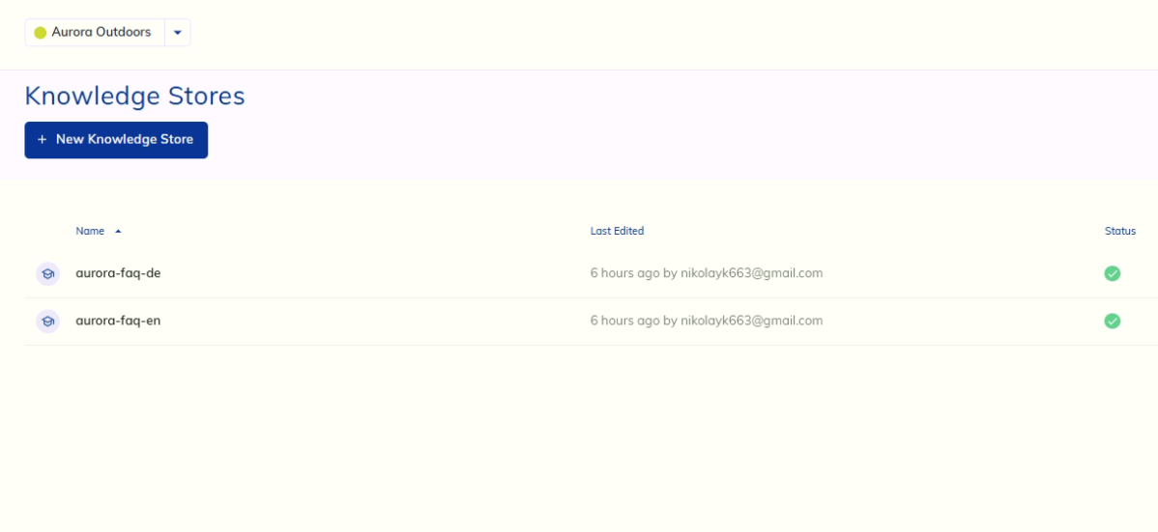
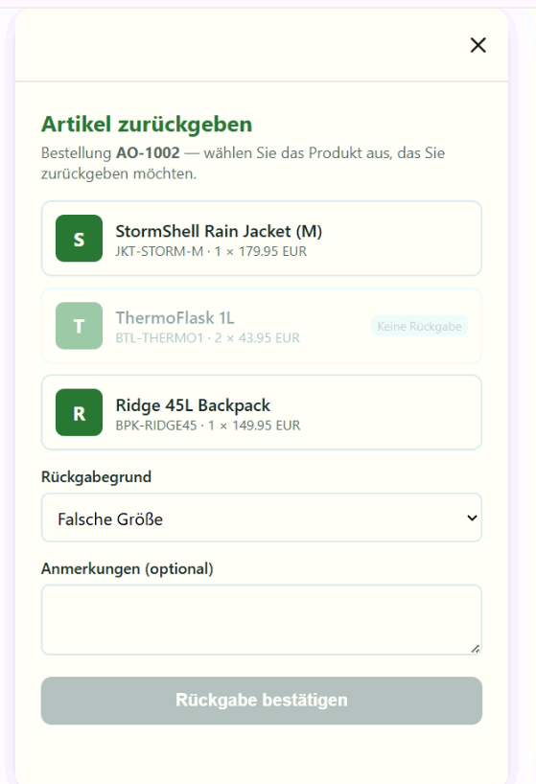
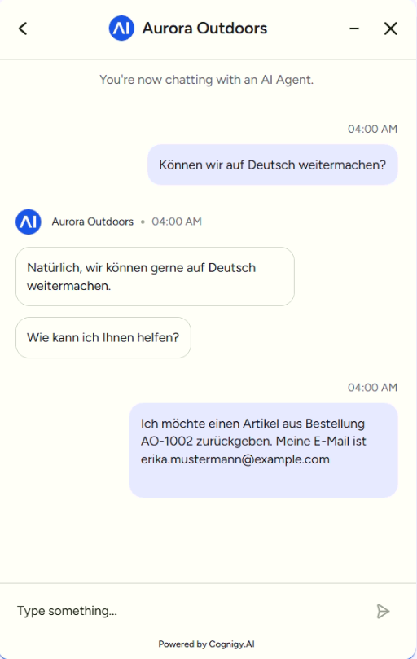
GROUNDED, LOCALIZED, SWITCHED LIVE
Behind the scenes 4 — knowledge & languages
Two knowledge stores, same 12 FAQs, localized — not machine-translated
German answers cite German facts: “4,95 EUR” with the comma decimal proves retrieval from the DE store
switch_language tool: the agent detects the request and switches the session locale mid-conversation
One flow, both languages — logic exists once; the locale changes content, not structure
8

Slide 10
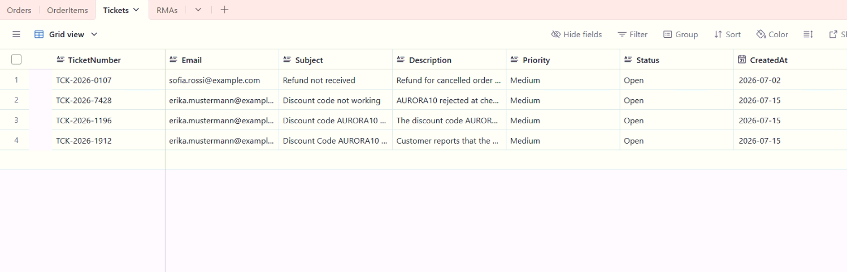
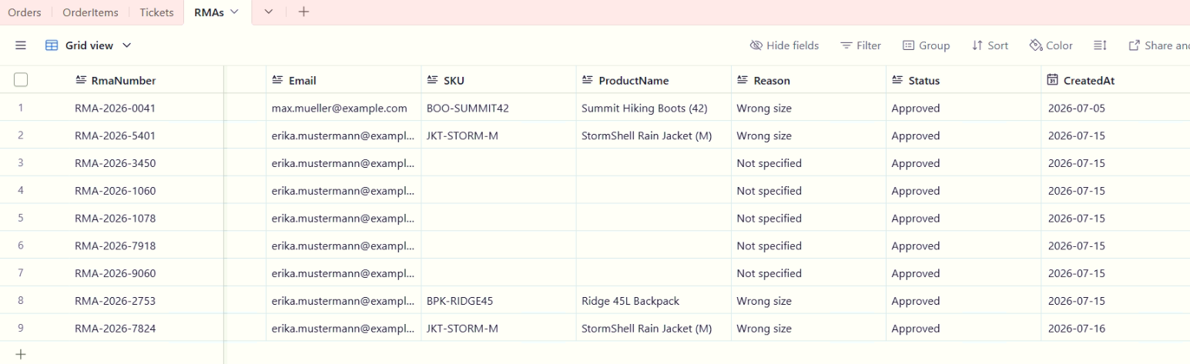
EVERY DEMO ACTION LEAVES A ROW
Behind the scenes 5 — the system of record
Four tables: Orders · OrderItems · RMAs · Tickets
The demo writes real records: the RMA you just watched and the ticket from the German conversation are rows now
Seed data is deliberate test design: one order per state (shipped / delivered / processing) so every scenario has a dedicated row
Demo data is reset between runs so every demo starts identical
9

Slide 11
TEST CASES WITH EXPECTED RESULTS
Stability — tested like production software
FAQ grounding
“What is your return policy?”
30 days, unused, original packaging — from the FAQ file
Order lookup
AO-1001 + correct email
Shipped · DHL · tracking DHL-778812345
Identity check
AO-1001 + wrong email
Not found — no data leak
Anti-hallucination
Order AO-9999
“Can't find that order” — never invented
RMA end-to-end
Return jacket from AO-1002
Overlay → submit → RMA row in Airtable + number in chat
German grounding
“Was kostet der Versand?”
4,95 EUR — from the German store
Failure mode
Airtable token revoked
Friendly fallback + ticket offer — no crash
10

Slide 12
WHAT COMES NEXT
If this were a real engagement
Voice: same agent and tools on a voice endpoint; the xApp becomes cross-device via QR session
Human handover: the platform's Handover to Human Agent tool, with full context and the ticket already created
Analytics: Cognigy Insights — containment, tool success rates, knowledge gaps feeding FAQ updates
Automated regression: happy paths as an automated suite against a REST endpoint, gating every prompt change
Real OMS: swap Airtable for SAP/Shopify/Salesforce — only the Extension internals change. That's the point of the abstraction.
11

Slide 13
Thank you
Grounded FAQ · live order data · in-chat return form · two languages · every action a row in the system of record
Questions — happy to go deeper on any layer.

