Slide 1
Project 3
Fayyaz Maredia
Micheal Peterson
Benjamin Hawn
Ryan Berger

Slide 2
Agile Methodology
Simple Environment: We used Cloud9 software so all of our code can be in the same place and seen by everyone, can be edited by everyone at the same time, and you can also compile the code. This was also helpful for paired programming, when two people were working on the same file. All of our final code was then submitted to github.
Team Interaction: We held SCRUM meetings every time we met and also held two weekly meetings to assign tasks from burn down list (found in github).
Adaptability: Our code can be easily modified for changing requirements. When the specifications for project was changed, we were easily able to change our program to meet them.

Slide 3
Test-Driven Development
Before we started the code, we made tests for each planned function. We then worked to pass the tests, and continued until all cases passed.
High-level: Tested each command before combining them in larger queries.
Low-level: For the Evaluate Condition function, we first got it to solve “==” for integers. Then, to solve all operators for integers. Then, to solve all operators for both integers and varchars.

Slide 4
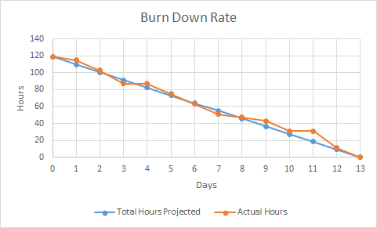
Burn Down Rate

Slide 5
Queries
Two queries our DBMS loaded with the real data can answer but howdy.tamu.edu cannot:
List all non-full classes from the CSCE department:
csen <- ((select (subj == "CSCE") course) & (select (rem > 0) enrollment));
List courses at a specific location (Ex. HRBB 113)
loc <- select (location == "HRBB 113") time;
Shown in live demonstration on next slide

Slide 6
Live Demonstration
We will show the demonstration on Cloud9.

