Slide 1


Dan Healy
BLOCKSTACK
FOR BEGINNERS

Slide 2

WHAT WILL EMERGE FROM THE CURRENT MANIA?
з
BITCOIN (DUH)
BLOCKSTACK!

Slide 3



Founded as “Onename” in 2014
HISTORY OF BLOCKSTACK
An identity system based on Namecoin
WHY DOES THIS MATTER?
Because blockstack’s fundamental innovation is in naming

Slide 4
ZOOKO’S TRIANGLE: PICK TWO!
HUMAN-MEANINGFUL
DECENTRALIZED
SECURE

Slide 5



ZOOKO’S TRIANGLE: EXAMPLES
Twitter is human meaningful and secure (unique), but not decentralized
Public/private (i.e. Bitcoin addresses) key pairs are decentralized and secure, but not human meaningful
Decentralized and human meaningful…no one does this. But conceptually, it’s easy to make an insecure (not unique) name if there is no central authority and no way of ensuring consensus

Slide 6



BUSTING ZOOKO’S TRIANGLE
WITH BLOCKCHAINS WE CAN BREAK ZOOKO’S TRIANGLE
The blockchain provides a single source of truth where you register names and store the hash of their value
Blockstack uses the Bitcoin blockchain to build a replacement for the Domain Name System: The Blockchain Name System (BNS)
The BNS replaces the DNS root servers (a trusted third party) with a blockchain based system

Slide 7

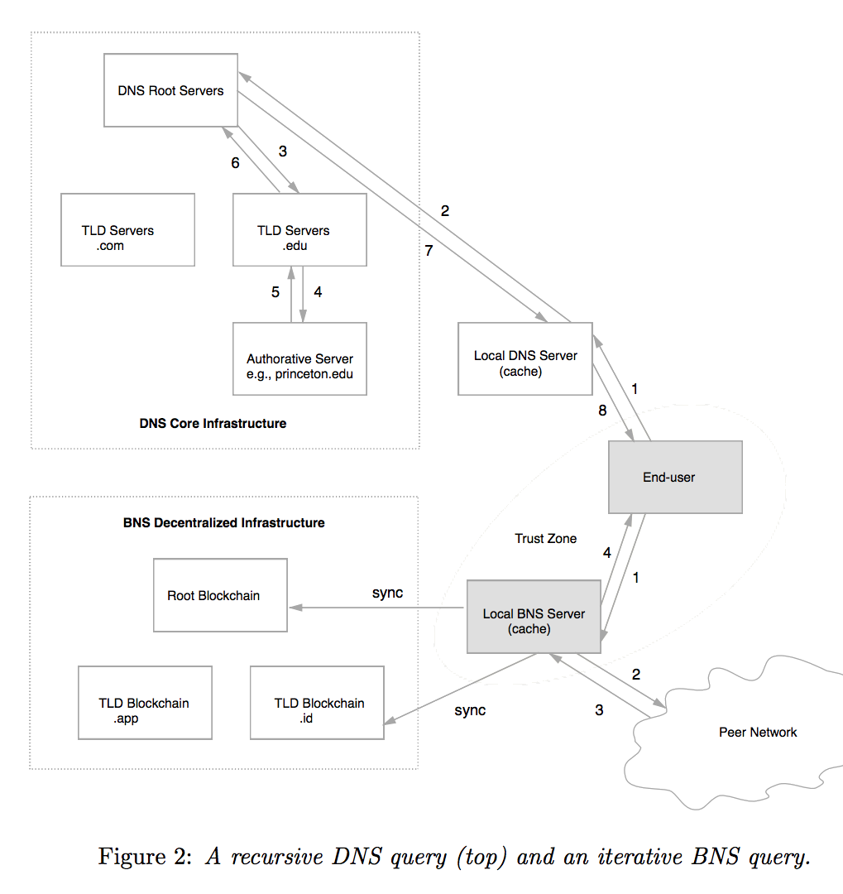
CHALLENGE:
UNDERSTANDING
THIS DIAGRAM
ALTERNATE TITLE:
A comparison of DNS and BNS
NOTE:
“Local BNS server” is your Blockstack core node

Slide 8


BENEFITS OF BNS
NO MORE SURVEILLANCE!
Enables
Decentralized
MORE
SECURE
Serverless
Applications

Slide 9
TECHNICAL DETAILS
But note that: Blockstack can be migrated if the underlying blockchain becomes insecure, because they reconstruct consensus using virtualchains (created via your Blockstack full node).
…ARE COMPLICATED. READ THE WHITEPAPER!
The network successfully migrated off of Namecoin

Slide 10
Alright, we have a new DNS. What next?
1
Follow this to its logical conclusion: decentralized storage
2
A Blockstack principle is that users, not corporations, etc., should own their own data
HOW DO WE ACCOMPLISH THIS?

Slide 11



ENTER “GAIA”
Uses storage providers like Amazon S3, Dropbox and Google Drive as “dumb drives”
Users store encrypted/signed data on their own Dropbox (or whatever) account
This way, get the performance benefits of S3, but all they see is an encrypted blob

Slide 12
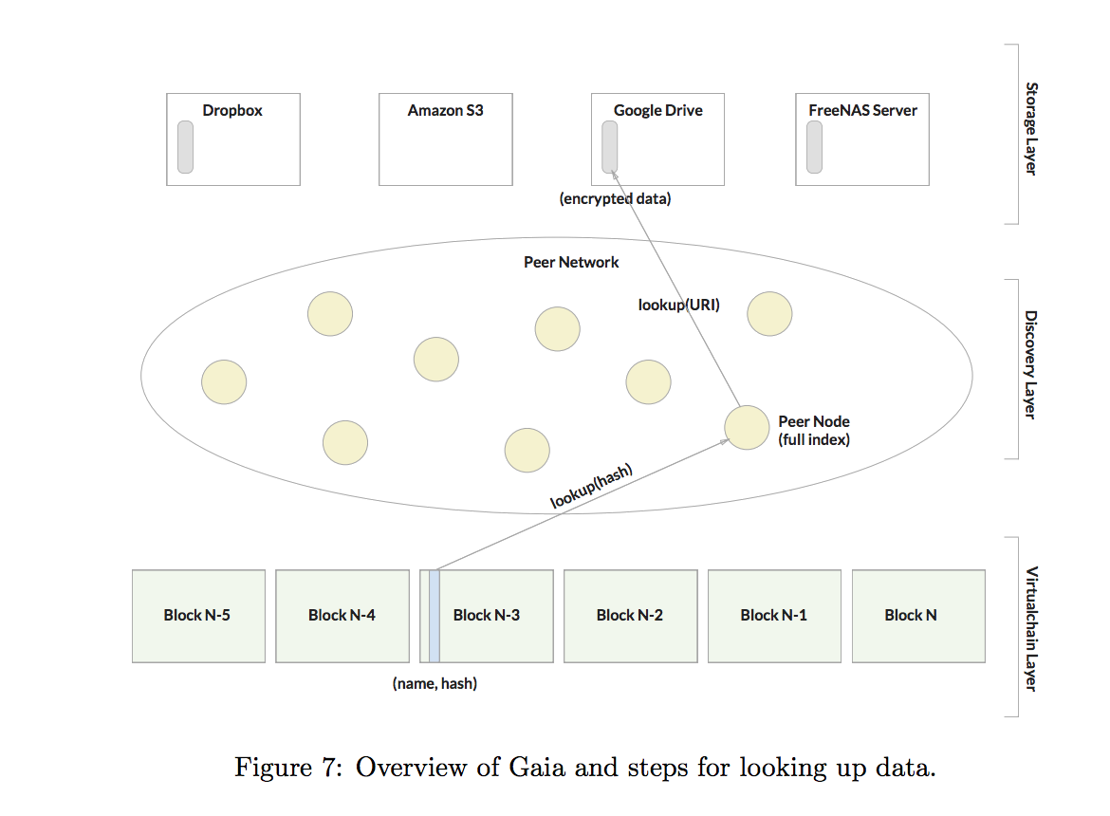
DIAGRAM 2:
DIAGRAM RELOADED

Slide 13


PRACTICAL IMPLICATIONS: SCALABILITY
ONLY STORE WHAT’S NECESSARY
Blockstack is a very light approach to dApps and the blockchain.
As a result, scaling prospects are bright

Slide 14

USING BLOCKSTACK
REMOVES SERVERS FROM THE EQUATION
Blockstack.js provides simple APIs for auth, storage, and (soon) payments
Enabling simple creation of decentralized apps

Slide 15


THE BLOCKSTACK
TOKEN: STACKS
THIS IS ITS OWN WHITE PAPER… BUT HERE ARE THE HIGHLIGHTS!
Blockstack recently raised ~50 million USD in a token sale, with the potential for another 50 million
What is the utility beyond fund raising?

Slide 16


STACKS
STAKEHOLDER (STACKHOLDER?) VOTING
INCENTIVE FOR DEVELOPERS TO BUILD
Eliminates reliance on Bitcoin, which may be going a digital gold route (scaling unclear); allows Blockstack to migrate blockchains if necessary
STACKS ENABLE LIGHT CLIENTS
NAMESPACE OPERATIONS

Slide 17



MINING STACKS
Proof of Burn
NEW STACKS RELEASED IN THREE WAYS:
App Rewards
Web of Trust

Slide 18



PROOF OF BURN
THE LAYER-1
blockchain token (Bitcoin) is destroyed by sending it to a nonrecoverable address
FUNCTIONALLY EQUIVALENT
to proof of work
THE LONGEST BLOCKCHAIN==
The one with the most proof of burn

Slide 19

APP REWARDS
First 4 years of Blockstack:
THE “BOOTSTRAPPING PERIOD”
During this time, elected App Reviewers will apportion Stack rewards to apps they deem worthy
App reviewers voted on by Genesis Block members and Stack holders (so OGs don’t have power forever)

Slide 20
WEB OF TRUST
NOT SUPER DETAILED YET
Basically, want to prevent Sybil attacks, onboard real humans without doing KYC (which they did for token sale)

Slide 21
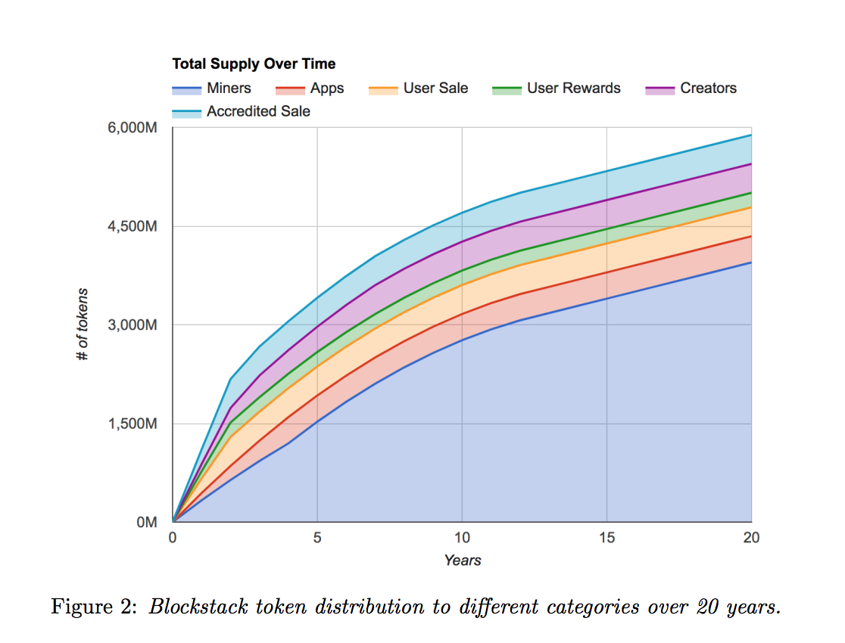
MINING OVER TIME

Slide 22




FINAL THOUGHTS: BLOCKSTACK’S
APPROACH TO GROWTH
Mining meant to incentive adoption and growth; 25 million dollar VC fund for Blockstack projects as well
Interesting to contrast Blockstack vs. Ethereum growth strategies; ICOs vs. VC and SAFT
The Blockstack Public Benefit Corporation will drive adoption of the platform
Get involved: Bounties, Pull Requests, and the Blockstack Lisboa Meetup! :)

Slide 23
FIN.

