Slide 2
About the presentation [1/3]
This template is designed for presentations at the Research and Academic Conference “Research and Technology - Step into the Future”

Slide 3
About the presentation [2/3]
Presentations are arranged in 15-minute time slots:
Each speaker is allowed 10 minutes for presentation
Followed by 5 minutes of discussion
Each session has a moderator, who will enforce the time schedule

Slide 4
About the presentation [3/3]
We recommend to prepare no more than 15 slides, excluding Title page, Objectives, Outline and Conclusions, which are mandatory
We also recommend not to use animations and slide transitions
Use the standard (4:3) slide size
Use 24pt or larger font for text body
Do not use sound effects
Arrive 10 minutes before your session to check the equipment

Slide 5
Objectives
Present the goal and motivation of your research

Slide 6
Outline
List 3-5 most important topics of your presentation

Slide 7
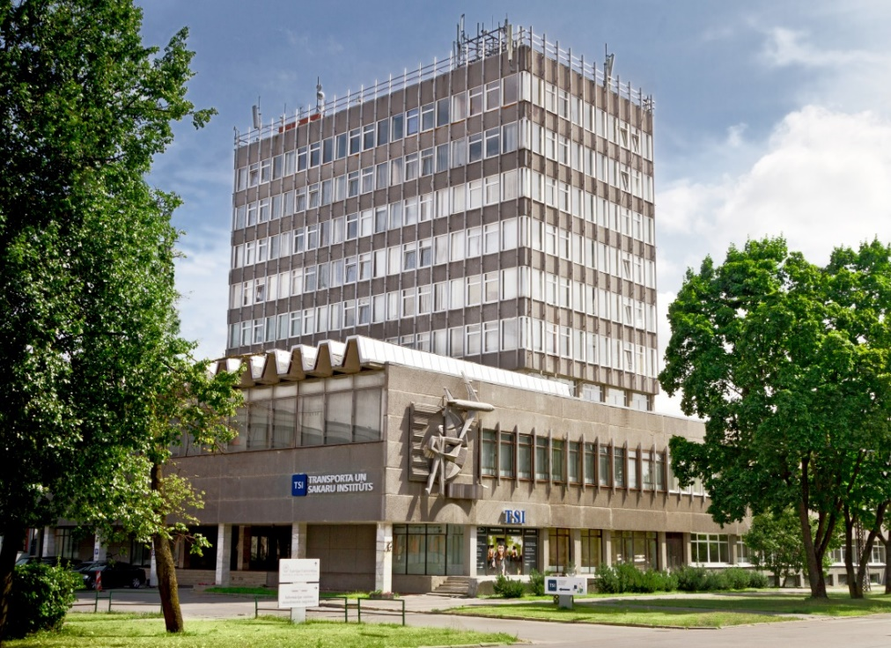
Presentation
Yellow, gray, pink, or light blue colors may become unreadable when projected
Use graphics to make your message clearer
This is the main conference building →

Slide 8
Acknowledgements
Do not forget about your funders, supervisors, or other people, who support your study

