Slide 1
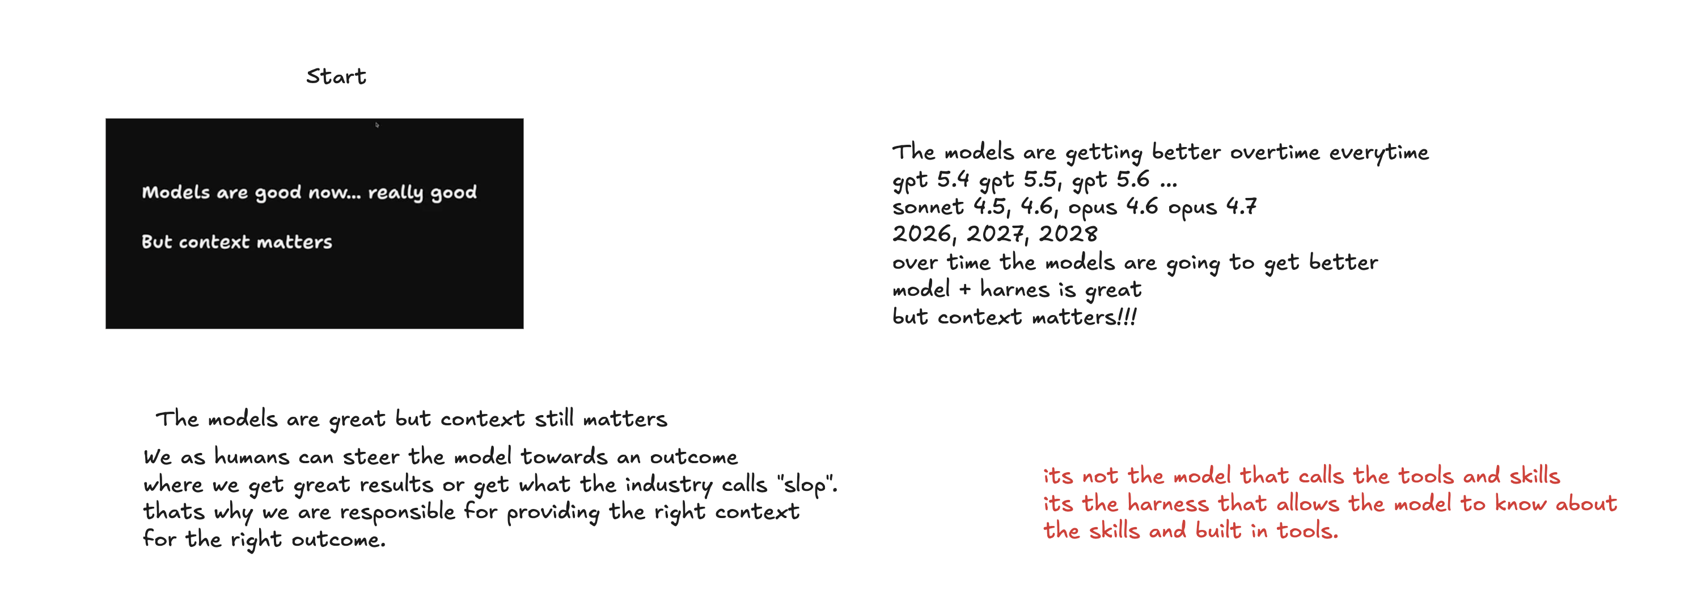
Models Are Strong. Context Still Matters.
Opening frame: model quality improves, but the harness and context shape the output.
Screenshot 2026-05-05 at 8.06.46 PM.png

Slide 2
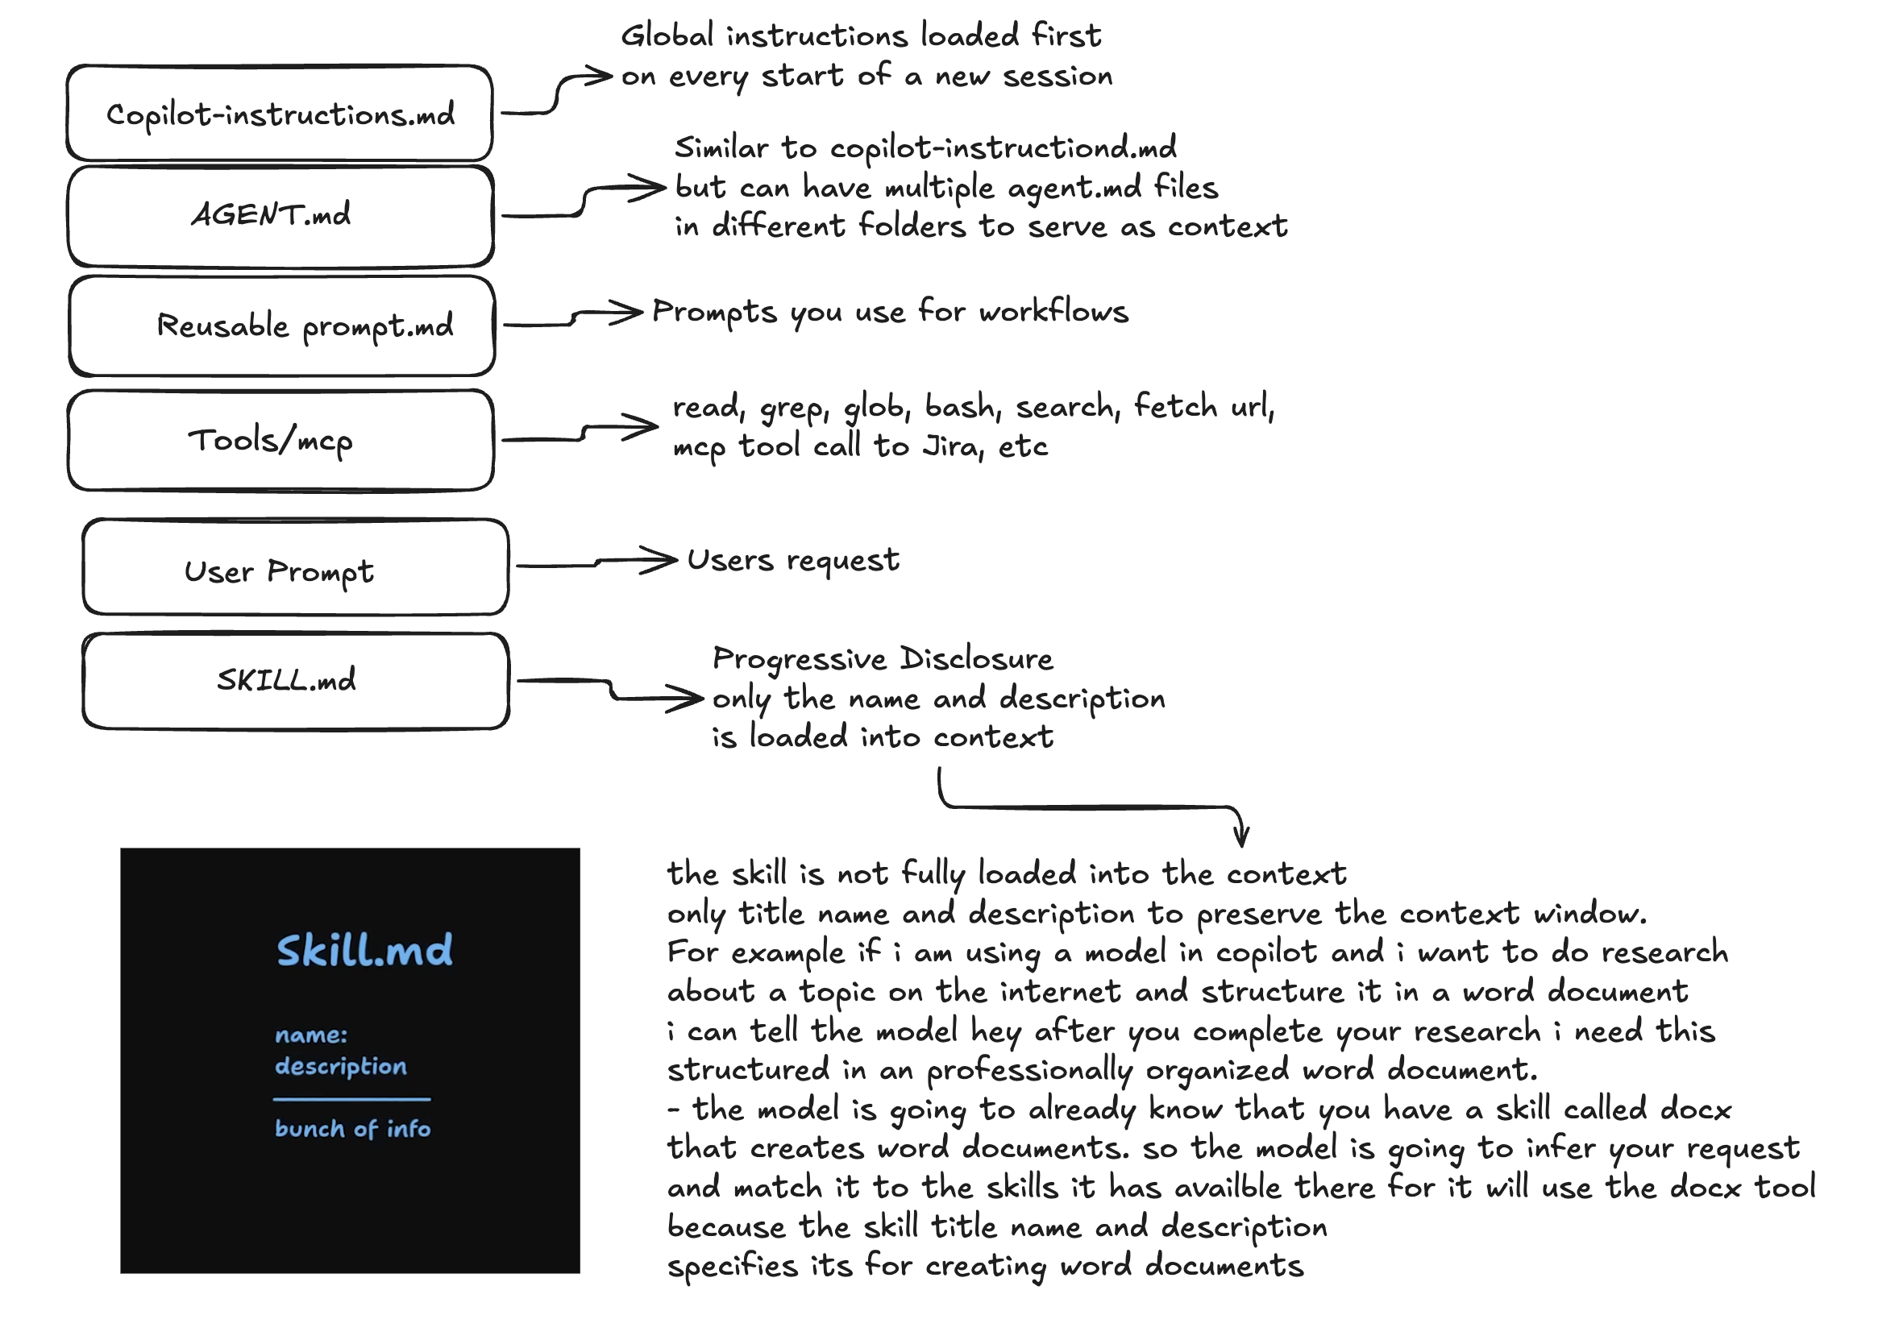
Context Stack for Agent Work
Global instructions, agent files, prompts, tools, user request, and skills all contribute context.
Screenshot 2026-05-05 at 8.07.22 PM.png

Slide 3
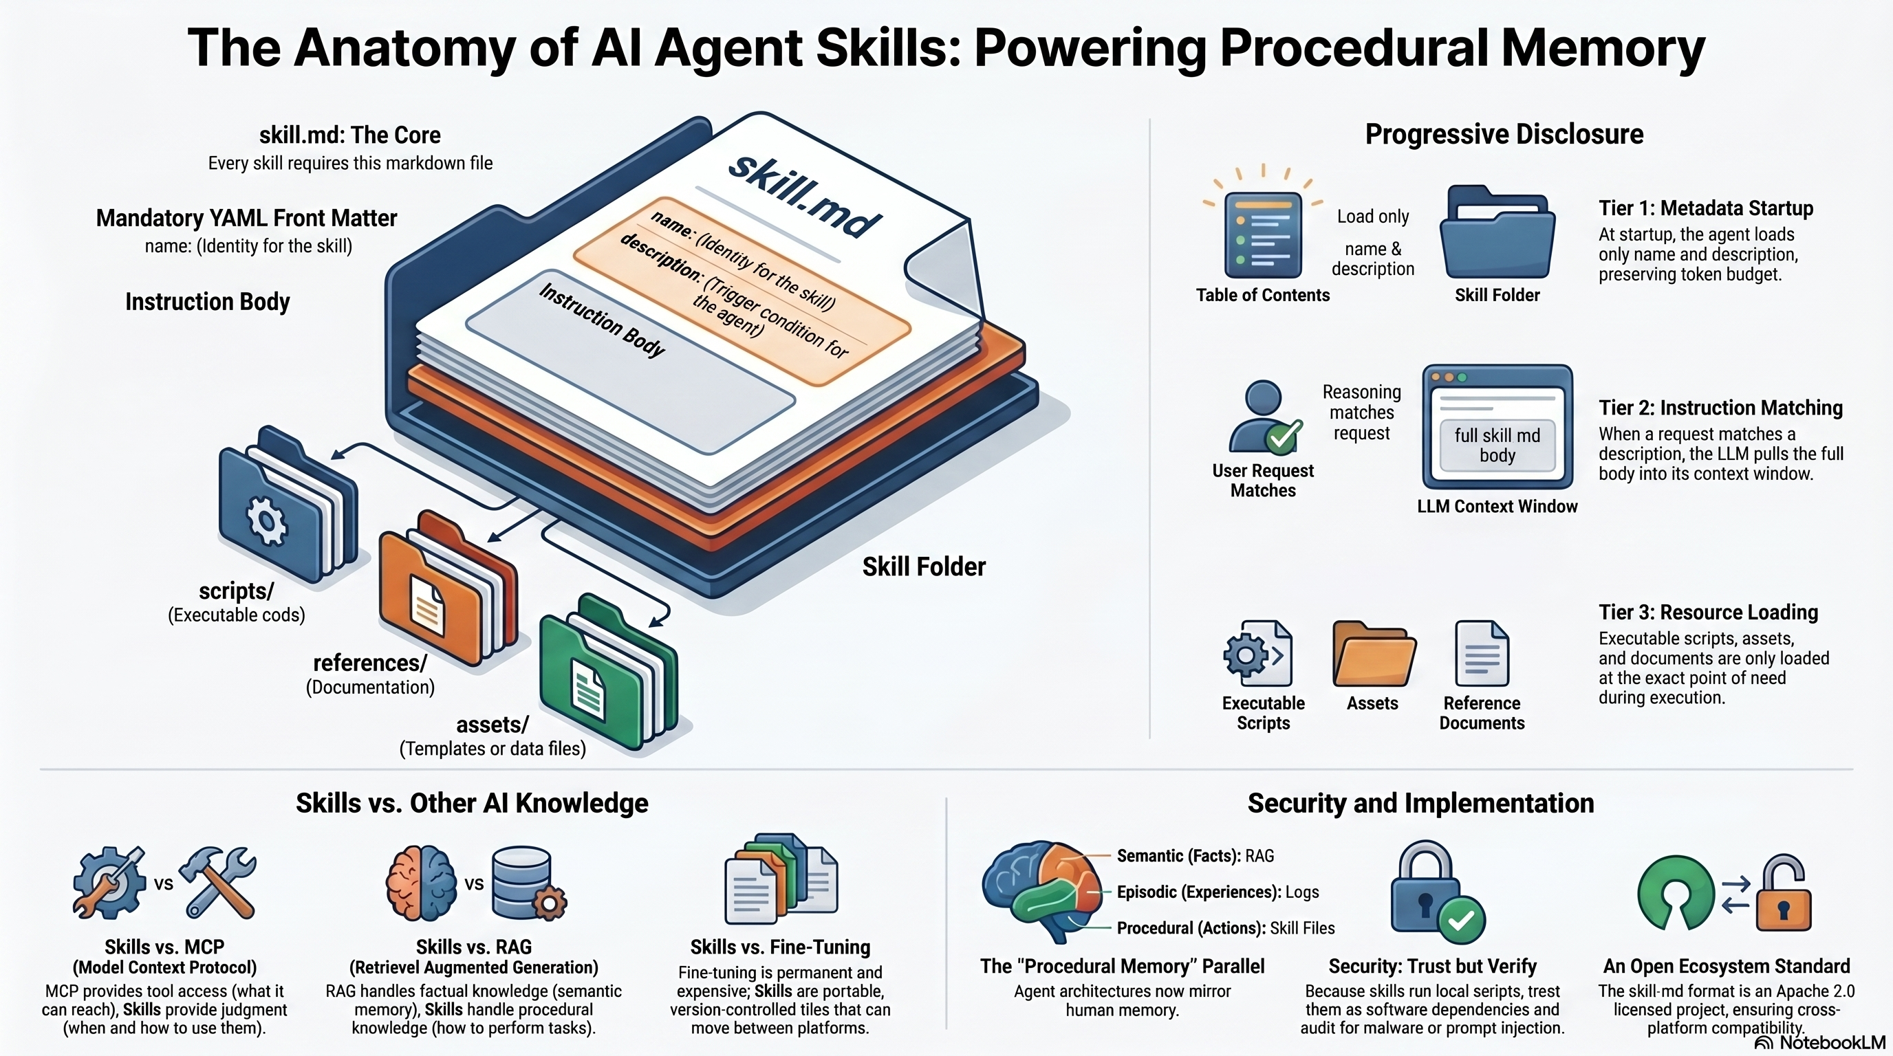
Anatomy of AI Agent Skills
Infographic view: skill.md, scripts, references, assets, and progressive disclosure.
unnamed (5).png

Slide 4

Procedural Memory and Skill Loading
Second infographic source: skills as portable procedural memory, distinct from MCP, RAG, and fine-tuning.
unnamed (4).png

