Slide 1

Open App Ideas

Slide 2

SmartGenie
Smart Home Rentals
1

Slide 3
SmartGenie - NEED
In India, the annual growth rate of smart homes is expected to grow by 43.6% resulting in a market of Rs. 481456.67 million by 2023.
Recent studies have helped to shed light on some key points
The real estate market has been expanding but as affordable housing is still an issue, a huge number of people especially young couples and working professionals settle for rented houses
Young professionals in cities usually have odd working hours and require services which can self-attend to some chores
Smart homes provide comfort which is attracting more number of Indians
Renting smart home an be tricky and expensive due to variation across rental policies as well as public awareness regarding appropriate smart home pricing
Landlords have been facing issues such as unpaid rent/maintenance, destruction of property, negligence of cleanliness, having a decentralized blockchain would solve these issues
In the last few years, India has seen a few startups for buying , selling and renting smart homes.

Slide 4
Smart Genie - The Prototype
Key stakeholders - Tenant, Proprietor, e-platforms, smart device vendors, hotels
The dapp can be an extension on existing online platforms like 99acres, olx, magicbricks, nestaway, airbnb, etc. It can also be installed on online platforms like makemytrip, goibibo, yatra.com, etc.
04
Platforms can have special discount tokens for tenants while placing request to rent
Each stakeholder shall register through a smart contract (can have multiple smart contracts for membership plans with different rates)
01
03
When a tenant selects a smart home, his agreement shall also be a smart contract
Legitimacy of all stakeholders shall be verified using digital signature
02

Slide 5
SmartGenie - Major Benefits
The proprietor and web platforms can have huge benefit , the dapp can be used to provide a service of “smart living demo” where in a customer planning to buy a smart home an be given a live experience of smart living by allowing customer to rent a place for 2 or 3 days on some nominal charges.
Smart device vendors can integrate with the dapp through registration to sell units of HVAC, pollution meter, smart meter, smart locks etc. which the tenant may self purchase and install in the smart hone
Dapp can be used for smart apartments such as Megapolis - pune, wherein multiple customer shall be interested in purchasing smart devices from vendors.
The dapp can be used by hoteliers where customers can be provided with smart rooms to experience a luxury stay.
Other benefits include easy documentation, easy maintenance, proper tenant records, manageable tenant payments, etc.

Slide 6












Existing Entrepreneurs

Slide 7

Recycle Route
Simplified waste management and recycling
2

Slide 8
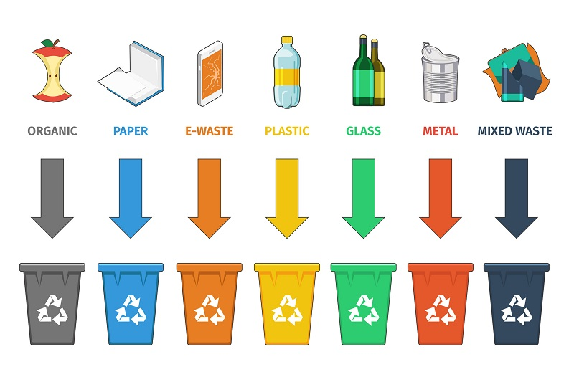
Recycle Route - Brief
There are 8 types of waste in India namely
Municipal waste
Plastic waste
E-waste
Biomedical waste
Construction and demolition waste
Hazardous waste
Battery waste
Radioactive waste
Waste can be divided generally into
- Organic
(all kinds of biodegradable waste),
dry (or recyclable waste) and
biomedical (or sanitary and hazardous waste)

Slide 9
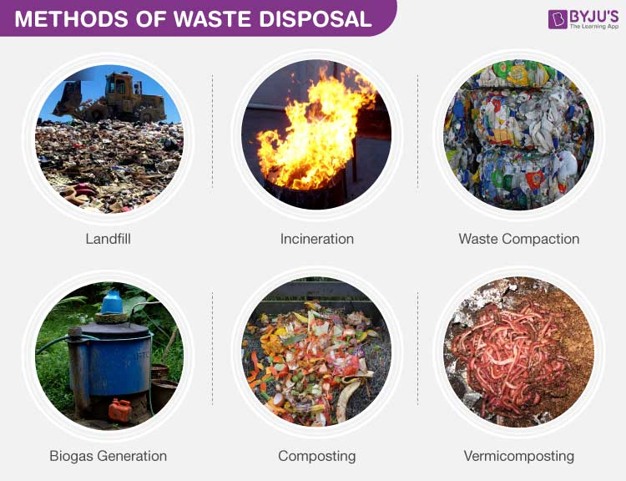
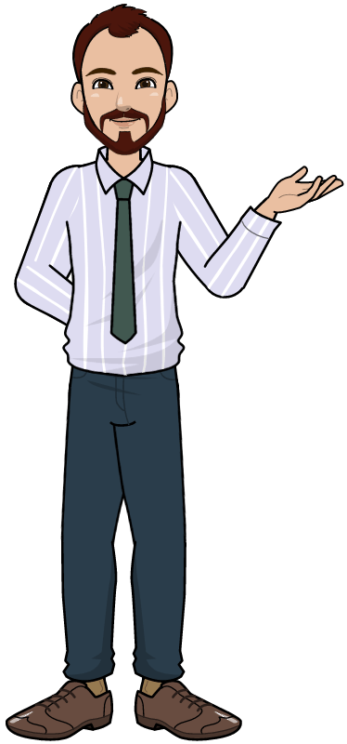
Recycle Route - Brief

Slide 10
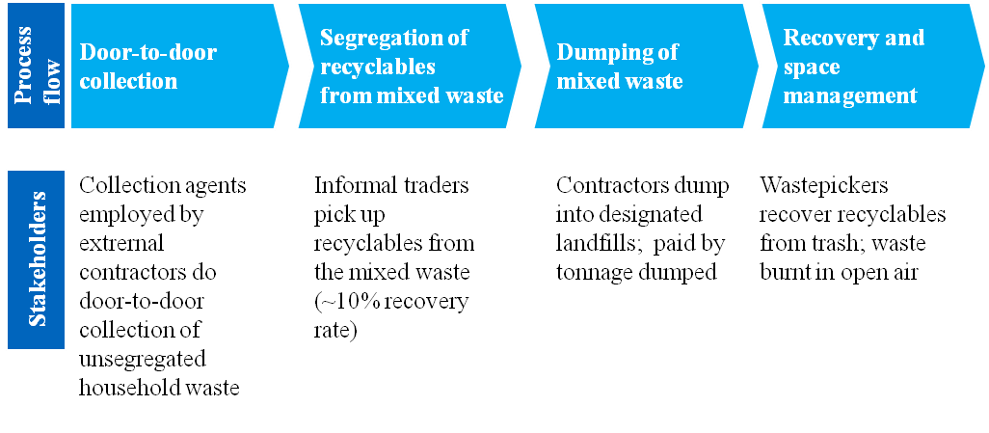
Recycle Route - Brief
The current process flow of waste management works as follows

Slide 11

Recycle Route - Brief
Individual private startups can be divided into three categories
Recycle startups - focus on recycling different types of wastes
Resale e-commerce - resale upgraded products or new products made from recycled waste
Waste treatment - focus on non harmful treatment of waste, few of them make biofuel, fertilizer etc.

Slide 12
Recycle Route - NEED
Multiple startups across the country have begun for waste management and recycling in the recent years
Some of them are really very efficient, though the below issues have been observed :
A large number of waste, especially e-waste goes untraced, burned, traded illegally every year
Government bodies have been failing at tracing different waste to their proper places of disposal
Much of the waste is treated in a sub-standard method or create health hazard (previous slide)
Non updation of waste records
Few disposal sites
Poor laws
Depletion of landfills
Startups have these issues
Limited area of service
Limited services
Lack of awareness

Slide 13
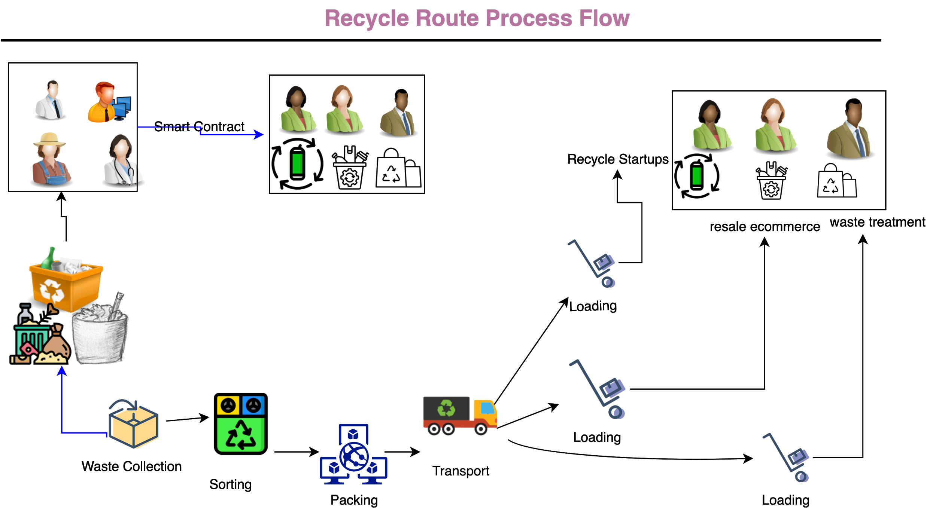

Recycle Route - The Prototype

Slide 14
Recycle Route - The Prototype
Each user who wants to recycle waste, shall enter into a smart contract with a stakeholder of his/her choice.
Waste collected from multiple users shall be sorted and packaged by the stakeholder and sent for recycle/ upgradation / disposal .
Each user shall get reward points for every disposal
Existing Startups may enter into smart contracts with other startups to act on merged ideas

Slide 15
Existing Entrepreneurs
Thalesgroup
Ecocentric
Ensyde
Cerebra
ATTERO
Binbag
Scrapshala
Anthill Creations
SKRAP
Saahas zero waste
Namo e-waste
Extracarbon
Gem enviro
Cashify
Banyan NATION
Citizengaze
Recykal
Antariksh waste ventures
Shayna Ecounified
Kabadiwala
Ishitva Robotic Systems
Phool
APChemi
Ziptrax cleantech
Hasiru Dala
Paperman
Vital Waste

Slide 16
Existing Entrepreneurs
Plastics for change
Eco recyling
Karma recycling
Indra water
Earth recycler
Synergy waste management
Paterson energy
Bintix
Raddiconnect
Encashea
Carbon masters
Plast shreddars
Rexaw recycling
GSM plastic industries
Green worms
Phabio enterprises
Smarterhomes
Bare necesseties
Loopworm
Padcare labs
Spruce up
Polycycl

Slide 17

Refrences
Statistica, https://www.statista.com/outlook/279/119/smart-home/india, data based on in-depth analysis
Downtoearth,https://www.downtoearth.org.in/blog/waste/e-waste-day-82-of-india-s-e-waste-is-personal-devices-61880
Teriin,https://www.teriin.org/article/e-waste-management-india-challenges-and-opportunities
Leewayhertz, https://www.leewayhertz.com/blockchain-waste-management
Thalesgroup, https://cpl.thalesgroup.com/india-ewaste-program
Delhigreens, https://delhigreens.com/2020/05/15/8-types-of-wastes-and-their-management-rules-in-india
https://www.epw.in/engage/article/institutional-framework-implementing-solid-waste-management-india-macro-analysis

Slide 18

THANK YOU

