Slide 1
CommomBatwa
A Common wallet Payment Solution.

Slide 2
Problem in Current System
When you purchase / recharge / bill payment / electricity bill/ CAB services payment or any type of utility payment we use the below platforms.
Amazon
Freecharge
Mobqwik
PayTM
Ola
UTS
etc.….
Sometimes we get rewards from this systems and we try to figure out what to do with it right..
Karu Kya ISKA..

Slide 3
Problem in Current System
In the same way we have rewards or gift card in many of this wallet
Where is the problem here. The problem is
Segregation of amount
I have
300 Super Coins in Flipkart 1
100 Reward Coin in Free Charge wallet
200 in Amazon Pay
400 in Mobiqwik
500 in ola pay
My Girlfriend gifted me gift card of 1000 from amazon
When I resigned, I got 3000 Giftcard from my friends on my last day.
I want to Buy a Cell phone or speaker which I need to purchase from and offline store or from Tata Cliq
Or I need to pay my electricity bill from amazon pay.. But how should I combine this amount or rewards to pay my bill.

Slide 4
An Open App Idea ☺
Make a common wallet (CommonBatwa) system which help to consolidate or combine this all-in-one reward.
What if they can inter-operate or get transferred from amazon pay to flipkart or to any other e-platform.
You get a freedom to buy anything from anywhere.
It will like Hub and Spoke model.

Slide 5
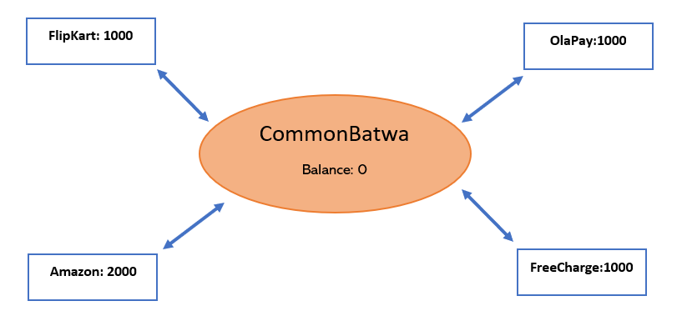
Different Wallet have some balance.

Slide 6
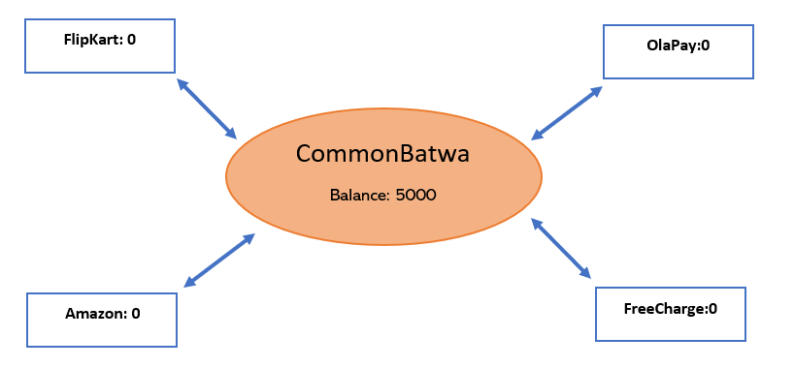
Reward get transferred to CommonBatwa

Slide 7
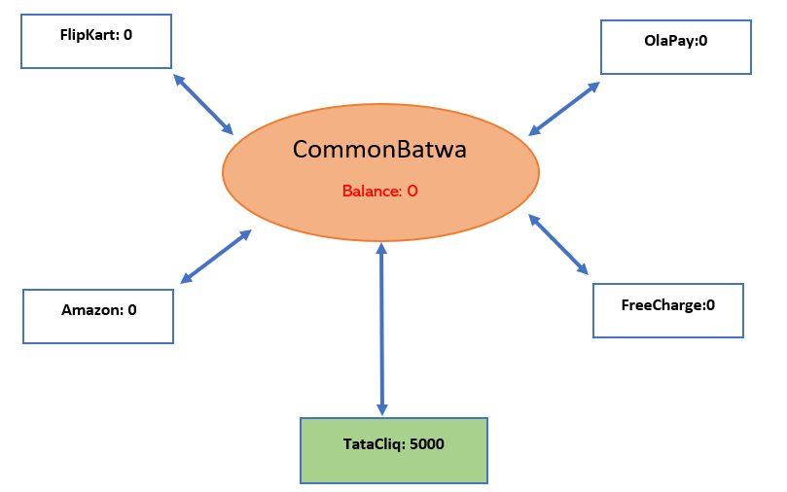
From CommonBatwa To Tata Cliq

Slide 8


So Come together and make this platform not only a
e-Platform
but a
WE Platform.

