Slide 1
S-PAY
Smart Payment Wallet

Slide 2

PROBLEM
Price fluctuation and variation on the online market places
Whenever user wants to buy something on online market places the price of the product varies with the time and also there is variation in price on different market places for the same product
Also when there is a sale or discount on products sometimes users miss out on the opportunity due to their inconvenience, unavailability of time and can’t take benefit from it.

Slide 3
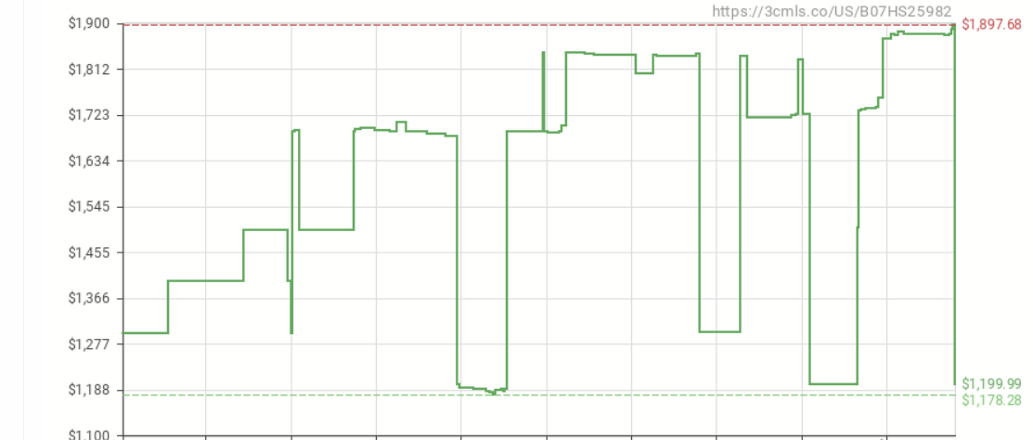
Price history
ASUS ROG Zephyrus S Laptop
As you can see in the graph the price variation of product with respect to time and also the price is different on different market places

Slide 4




Solution
Features that S-Pay will provide to overcome the mentioned problems
No. 1
It will compare the price of the product on different market places and give you the best price available
No. 2
Users can check the price history of the product on the respective platforms
No. 4
Users can do the automatic payment using smart contract feature on the app
No. 4
Transactions will be stored on the AION blockchain to prevent frauds

Slide 5
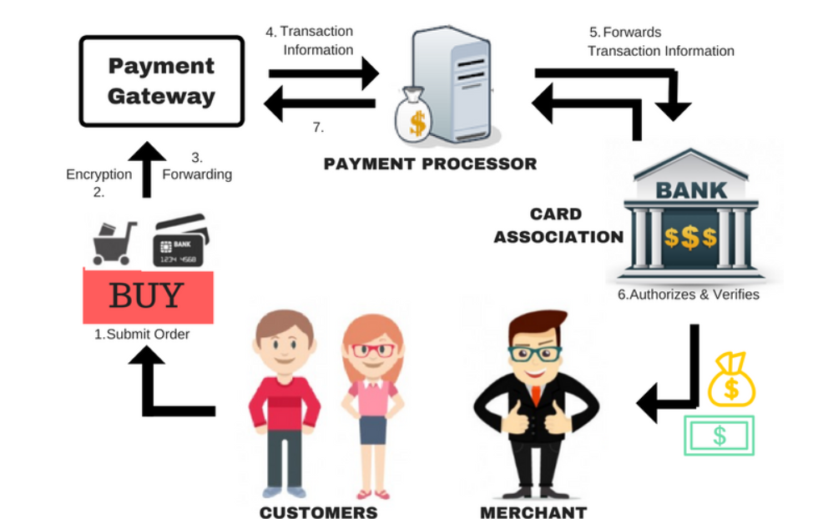
Techinal Overview
How web payments work
Whenever the payment is done on the online market places via any online payment methods the payment is done through online payment gateways.
Users don’t actually pay to the merchant directly here payment gateways acts as the middle man to verify payments.

Slide 6

Smart Contract Feature
How smart contract feature will work(Technical Overview)
If users wants to buy something he can choose to do the automatic payment via S-Pay.
Users can set the buying range according to their preference based on the product price history.
When the transaction is done vis S-Pay it will generate the smart contract between user and payment gateways which will be deployed on the AION blockchain.
Till the price comes down to users buying range the amount will be locked in on smart contract which will be equal to maximum buying range set by user.
When the price comes down the smart contract will do its magic and it will send the payment to payments gateways automatically and remaining amount to the users account.

Slide 7
Business Model
How S-Pay will generate revenue
Fees from card issuers.
Ads or offers within S-Pay
Using data
User will need to add funds into wallet using credit/debit cards for that we can negotiate fees with card issuers.
Offering ads, or specific product offers in cooperation with banks or other financial industry partners.
Using data for ads targeting(Indirect)
Its not a good option considering sensitivity of the data.

Slide 8
Thank You

