Slide 1
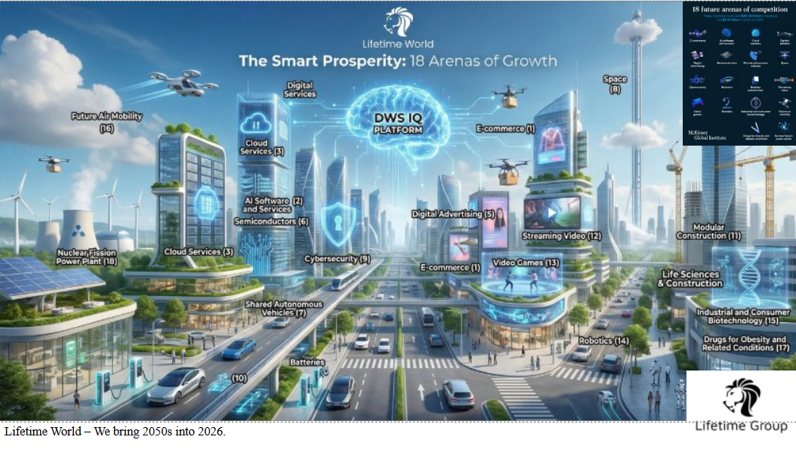

DWS IQ 6
Agentic Climate AI for EU Construction
Edge AI platform for 2028 embodied carbon compliance
Risto Anton Päärni
€150K SAFE @ €3.8M cap
Founder & CEO
Ecosummit 2026
Notes:
DWS IQ 6 – Ecosummit 2026 Investor Pitch
Startup: Lifetime Oy (Finland)
Product: DWS IQ 6 – Agentic Climate AI for EU Construction
Event: Ecosummit 2026
Goal: 5-minute startup pitch selection + follow-up meetings
Ecosummit 2026 Event Details
EventDateFocusEcosummit Berlin25-26 March 2026Climate tech & smart green startupsEcosummit AI7-8 October 2026AI for climate & sustainability
Website: ecosummit.net
Event Organizer Contact
Michael Hess – Founder, Ecosummit
ChannelContact📧 Emailjan@ecosummit.net📞 Phone+49 176 2120 8417🔗 LinkedInlinkedin.com/in/janmichaelhess📅 Calendlycalendly.com/ecosummit
Round Details
ParameterValueInstrumentSAFE (Simple Agreement for Future Equity)Amount€150,000Valuation Cap€3.8MDiscount20%Target AudienceClimate tech VCs, corporate/infrastructure investors
Pitch Deck Structure (10 Slides)
Slide 1: Title
Logo: Lifetime Oy
Headline: DWS IQ 6 – Agentic Climate AI for EU Construction
Subtitle: Edge AI platform for 2028 embodied carbon compliance
Founder: Risto Anton Päärni, Founder & CEO
Slide 2: Problem – EU Construction Compliance Crisis
2028 embodied carbon mandate for buildings >1,000 m²
Fit for 55: 55% emissions reduction target by 2030
Construction accounts for ~40% of EU CO₂ emissions
SMEs responsible for 63% of EU emissions but lack in-house AI teams
Today's reality: manual spreadsheets, expensive consultants, high cloud costs – not scalable
Slide 3: Solution – DWS IQ 6 Agents
Edge AI agents running on NVIDIA Jetson at the construction site
<100ms inference decisions
Automated embodied-carbon tracking and material/supplier choices
Offline-capable, solar-friendly, built for rough environments
Use cases: carbon tracking, material decisions, compliance automation
Slide 4: Why Now – Timing & Regulation
2028 embodied carbon mandate is a hard deadline (~24 months to prepare)
Fit for 55 and Industry 5.0 driving digital-green transition (€1T+ EU investment)
Cloud-only AI too slow/expensive for continuous site-level decisions (25× faster at edge)
Slide 5: Tech Architecture & Moat
Hybrid Stack:
Edge Layer: AWS IoT Greengrass + NVIDIA Jetson Orin Nano
Core Platform: Google Cloud Run + Groq API + LlamaStack
Client: Chromebook PWA
Data: Supabase (hot) + AWS S3 (cold)
Key Metrics:
515% hardware ROI annually
1.95-month payback per device
25× faster than cloud inference
€135k in startup credits = 6 years infrastructure runway
Slide 6: Market & Focus
Market Size: 3.5M construction companies in Europe
UK: 500k companies
Spain: 489k companies
France: 397k companies
Go-to-Market Strategy:
Tier 1: Lighthouse projects with Vinci, Bouygues, ACS, Strabag, Hochtief
Tier 2: Regional contractors (Porr, Eiffage, Skanska, Royal BAM, Balfour Beatty)
Tier 3: SME scale for volume play
Long-term: Manufacturing, logistics, real estate
Slide 7: Traction & Validation
~€140k in revenue from early customers/pilots
€333k/year projected cloud-cost savings vs pure-cloud competitors
2026 plan: 2-3 paid pilots with EU construction partners
Startup Program Wins:
AWS for Startups: $25,000 credits
Google for Startups: $100,000 credits
Groq for Startups: $10,000 credits
GitHub Enterprise: 20 seats + CI/CD
Slide 8: Business Model & Unit Economics
Revenue Model:
SaaS platform: Annual subscription
Edge hardware: Per-site pricing
Example pilot economics: €50-100k annual savings per customer
Customer Value:
OptionAnnual CostManual compliance (consultants)€80-150kCloud-only AI alternative€40-60kDWS IQ 6 (edge + SaaS)€15-30kNet customer savings€50-120k
Margin Targets: 70-80% gross margin, LTV:CAC 5:1+
Slide 9: Round & Use of Funds
The Ask: €150k SAFE @ €3.8M cap, 20% discount
Use of Funds (12 months):
40% Product V1 for construction
35% 2-3 paid pilot deployments
25% Scale to ~50 edge devices
12-Month Financial Projection:
MetricAmountCash Need€191,630Revenue (pilots)€140,000Edge Savings€333,000Month 12 Result+€281,370
Milestones:
Days 1-30: Foundation (Google Cloud + Groq setup)
Days 31-60: Pilot validation with EU partner
Days 61-90: Production launch
Month 12: Profitability + Seed Ready (€500k-1M)
Slide 10: Team & Why Us
Founder: Risto Anton Päärni
Background in industrial IT, AI, and sustainability
Email: risto@lifetime.fi
LinkedIn: linkedin.com/in/ristopaarni
Company Credentials:
ISO 27001 certified
EU data residency
GDPR compliant
Vision: DWS IQ as the "brain" for intelligent, low-carbon industries in Europe
Key Investment Highlights
Regulatory Tailwind: 2028 mandate creates urgent demand
Edge Moat: 25× faster, €333k/yr cost advantage vs. cloud-only solutions
Capital Efficient: €135k credits = 6 years infrastructure runway
Path to Profit: +€281k in Month 12, Seed-ready
Contact Information
Lifetime Oy (Startup)
Risto Anton Päärni
Founder & CEO, Lifetime Oy
📧 Email: risto@lifetime.fi
🔗 LinkedIn: linkedin.com/in/ristopaarni
📊 Crunchbase: Lifetime Oy
💻 GitHub: github.com/blogtheristo/dws6
Ecosummit (Event Organizer)
Michael Hess
Founder, Ecosummit
📧 Email: jan@ecosummit.net
📞 Phone: +49 176 2120 8417
🔗 LinkedIn: linkedin.com/in/janmichaelhess
📅 Schedule Meeting: calendly.com/ecosummit
🌐 Website: ecosummit.net
ROI & Runway Calculus
Hardware ROI Analysis
MetricValueCalculationNVIDIA Jetson investment~€54,20050 devices @ ~€1,084/unitAnnual ROI515%Edge savings / hardware costPayback period1.95 monthsHardware cost / monthly savingsMonthly cloud savings€27,750Edge inference vs. cloud compute Annual cloud savings€333,00012 × monthly savings
12-Month Runway Projection
SourceAmountStatusThis round (SAFE)€150,000RaisingAWS credits$25,000 (~€23k)✅ SecuredGoogle Cloud credits$100,000 (~€92k)✅ SecuredGroq credits$10,000 (~€9k)✅ SecuredPilot revenue€140,000ProjectedTotal runway~€414,00012+ months
Unit Economics Target
MetricTargetGross margin70-80%LTV:CAC ratio5:1+Customer annual savings€50-120kDWS IQ annual cost€15-30k

Slide 2
The Problem
EU Compliance Crisis
2028
63%
Embodied carbon mandate for buildings >1,000 m²
of EU emissions come from SMEs – but they lack in-house AI teams
55%
Today's Reality
Fit for 55: emissions reduction target by 2030
40%
Not scalable for real-time site decisions.
Construction's share of EU CO₂ emissions
Source: European Commission, Ramboll (2025)

Slide 3

The Solution
DWS IQ 6 Agents at the Site
Embodied Carbon Tracking
Real-time monitoring across supply chains and material deliveries
<100ms
Edge inference decisions
Material & Supplier Decisions
Automated low-carbon material selection and supplier scoring
Edge AI on NVIDIA Jetson
AI agents running directly at the construction site. No cloud latency. No internet dependency. Real decisions in real-time.
Compliance Automation
Automated roadmap for 2028 mandate and Fit for 55 targets
Built for Rough Environments
Rugged hardware designed for construction site conditions

Slide 4



Why Now
Timing & Regulatory Tailwinds
Hard Deadline
Industry 5.0 Wave
Cloud Limits
2028 embodied carbon mandate is not aspirational – it's a compliance deadline with penalties.
Digital-green twin transition is driving massive investment in AI + sustainability convergence.
Cloud-only AI is too slow and expensive for continuous site-level decisions. Edge is the answer.
~24 months to prepare
€1T+ EU investment
25× faster at edge
First movers gain advantage before compliance becomes crisis.

Slide 5



Tech Architecture & Moat
Hybrid Edge-Cloud Stack
515%
AWS IoT Greengrass
NVIDIA Jetson Orin
Hardware ROI annually
1.95
25×
Google Cloud Run
Groq API
LlamaStack
Months payback
Faster than cloud
🛡️ Startup Credits Runway
Chromebook PWA
Supabase + AWS S3
€135k credits = 6 years runway
$180/month operating cost (86% cheaper than AWS-only)

Slide 6


Market & Focus
3.5M Construction Companies in EU
3.5M
Construction companies in EU
For credibility, case studies, and enterprise validation
TOP MARKETS
For repeatable revenue and geographic expansion
LONG-TERM EXPANSION
Manufacturing & construction SMEs responsible for 63% of EU emissions
Manufacturing, logistics, and real estate sectors with similar carbon compliance needs.
Self-serve platform for digital-green twin transition
Source: Statista, Deloitte (2024)

Slide 7

Traction & Validation
Revenue + Strategic Program Wins
EARLY REVENUE
STARTUP PROGRAM WINS
~€140k
AWS for Startups
$25k
Edge computing infrastructure
from pilots & early customers
Google for Startups
$100k
Core platform credits
PROJECTED CLOUD SAVINGS
€333k/year
Groq for Startups
$10k
vs. pure-cloud competitors
LPU inference credits
GitHub Enterprise
✓
📅 2026 Plan
20 seats + CI/CD
2-3 paid pilots with EU construction or manufacturing partners
ISO 27001 • EU data residency • GDPR

Slide 8


Business Model & Unit Economics
SaaS + Edge Hardware with 515% ROI
REVENUE MODEL
CUSTOMER VALUE CALCULATION
SaaS PLATFORM
EDGE HARDWARE
Annual subscription
Per-site pricing
Example pilot economics:
€50-100k
Annual savings per enterprise customer
HARDWARE ROI
PAYBACK
⚡ Edge Advantage
515%
1.95 mo
€27,750/month cloud cost avoidance. €333k/year competitive moat. Target 70-80% gross margin, LTV:CAC 5:1+.

Slide 9


Round & Use of Funds
12-Month Runway to Profitability
12-MONTH FINANCIAL PROJECTION
RAISING
€150k
SAFE @ €3.8M cap, 20% discount
USE OF FUNDS (12 MONTHS)
MILESTONE: MONTH 12
NEXT ROUND
Profitability + Seed Ready
€500k-1M
DAYS 1-30
DAYS 31-60
DAYS 61-90
Foundation
Pilot validation
Production

Slide 10




Team & Why Us
EU-Based, Security-First
OUR VISION
Risto Anton Päärni
DWS IQ as the "brain" for intelligent, low-carbon industries in Europe
Founder & CEO
Background in industrial IT, AI, and sustainability. Building climate tech for intelligent industries.
WHY INVEST NOW
Regulatory tailwind: 2028 mandate creates urgent demand
Edge moat: 25× faster, €333k/yr cost advantage
Capital efficient: €135k credits = 6 years infrastructure runway
Path to profit: +€281k in Month 12, Seed-ready
ISO 27001
EU Data
GDPR
Let's discuss how DWS IQ 6 can transform climate compliance
Certified
Residency
Compliant
risto@lifetime.fi • Ecosummit 2026
dws6

