Slide 1
bayes

Slide 2
subsets
All different combinations
U
A
B

Slide 3
subsets
A^-B
A^B
B^-A

Slide 4
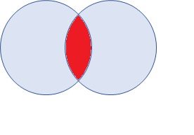
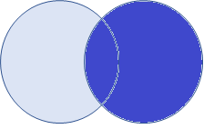
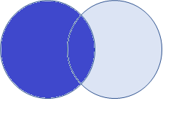
Conditional probabilities
A
B
P(A|B) given
P(B|A) given

Slide 5
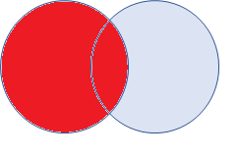
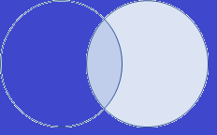
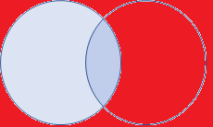
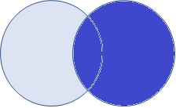
Conditional probabilities
A
B
P(A|-B) given
P(-A|B) given

Slide 6
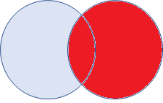
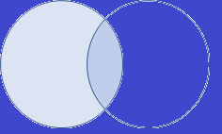
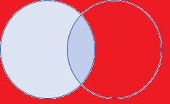
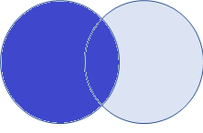
Conditional probabilities
A
B
P(B|-A) given
P(-B|A) given

Slide 7
Rule of Bayes
How to calculate conditional probabilitie of event A, with information about the conditional probability of event B?
P(A|B) = alfa * P(B|A)*P(A)
P(A|B) = P(B|A)*P(A) / P(B)
First thing you wanna know is the overlap( P(A^B))
The given B makes the difference, this is represented by alfa
Diff equals: subset is respectively to P(B). So alfa = 1/P(B)
Thus: P(A|B) = P(A^B)/P(B)

Slide 8
Principle of Bayes
The whole idea of Bayes is that P(A^B) can be represented respectively from A, and respectively from B:
P(A^B) = P(A|B)*P(B)
P(A^B) = P(B|A)*P(A)
Writing this out:
P(A|B)*P(B) = P(B|A)*P(A)
With one tiny trick:
P(A|B) = P(B|A)*P(A) / P(B)

Slide 9
Simplified
In other words:
P(A|B) = how many people of A are in B?
(A in B = A^B) in some sense
So how many people are in A and B, respectively to the population of B

Slide 10
Rules of Bayes – write it out
P(A|B) = P(B|A)*P(A) / P(B)
Some important equations:
P(A|B) = P(A^B)/P(B)
And thus, P(A^B) = P(A|B)*P(B)
(chance of A in B, resp to B -> chance of A^B, resp to the whole Population)
Why do you need these equations?
Because, figuring out P(B) with the information about A, means you have to split P(B) into 2 parts:
P(A^B) calculated by P(B|A)*P(A)
P(-A^B) calculated by P(B|-A)*P(-A)

