Slide 1
UCT Micromanagement in Real Time Strategy Games
Related work
Kilian Demeulemeester
Björn Holm
KTH, 2014, DD2438 Artificial Intelligence and Multi Agent Systems

Slide 2
Related works in micromanagement
Fast Heuristic Search for RTS Game Combat Scenarios
  Alpha-Beta search for micromanagement
UCT for Tactical Assault Planning in Real-Time Strategy Games
  UCT for deciding which groups should attack where

Slide 3
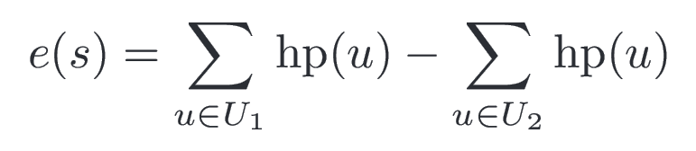
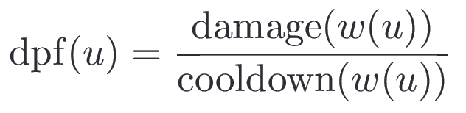
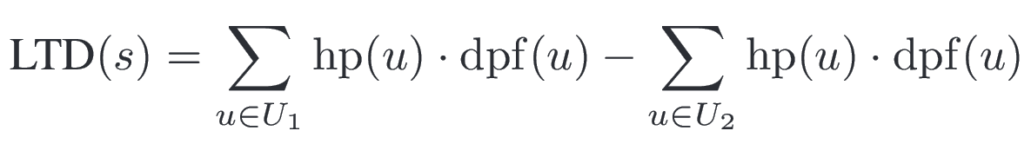
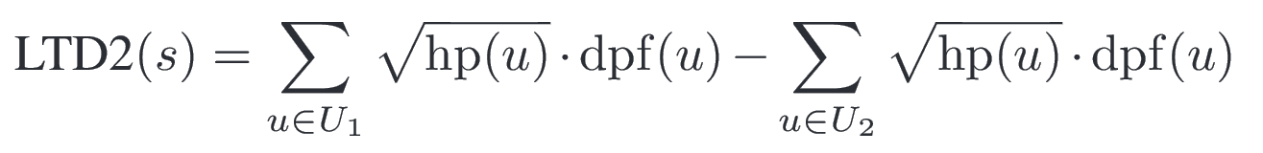
Fast Heuristic Search for RTS Game Combat Scenarios
  Evaluation functions

Slide 4
Fast Heuristic Search for RTS Game Combat Scenarios
  Experiments
Simulated (very simplified) game
n vs n units where 2 ≤ n ≤ 8
Symmetrical starting positions
5 ms per frame
15 pixel movements

Slide 5
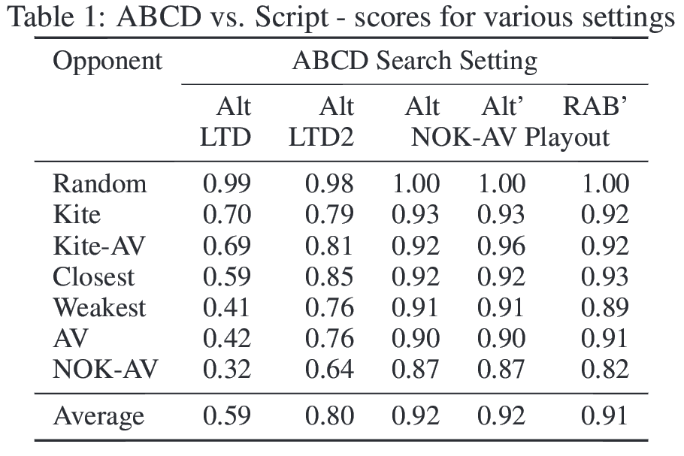
Fast Heuristic Search for RTS Game Combat Scenarios
  Experiment results

Slide 6
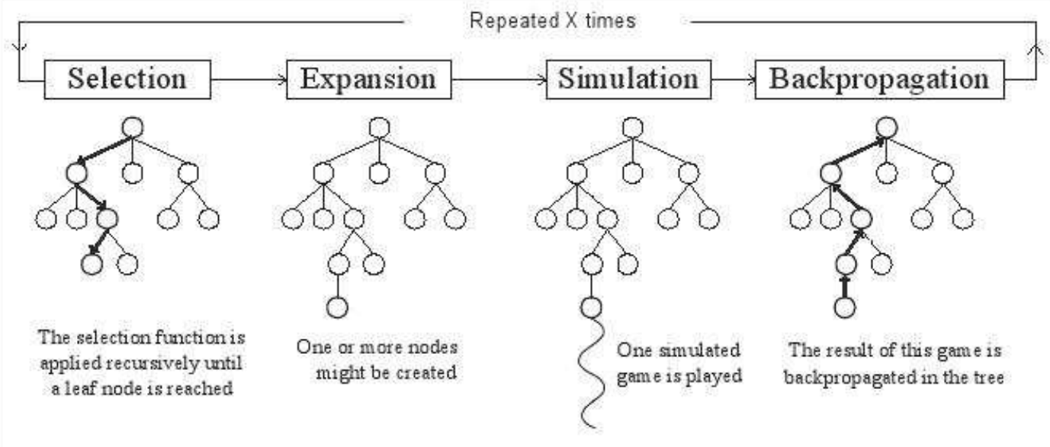
UCT – Upper Confidence Bounds for Trees
UCT is the most popular algorithm in the MCTS, Monte Carlo Search Tree, family. [3]
MCTS general approach:

Slide 7
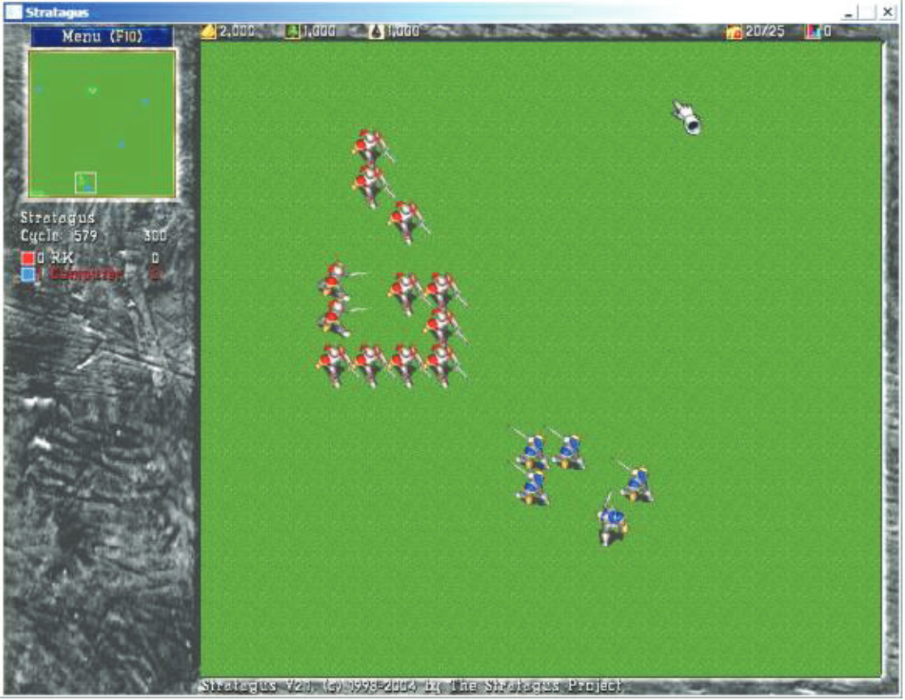
UCT for Tactical Assault Planning in Real-Time Strategy Games
Wargus
For group
movements
Both player
and opponent
groups
predefined
and spacially
separated

Slide 8
UCT for Tactical Assault Planning in Real-Time Strategy Games
  Experiments
10 to 20 units per side, divided in 2 to 5 groups
Played out in-game?

Slide 9
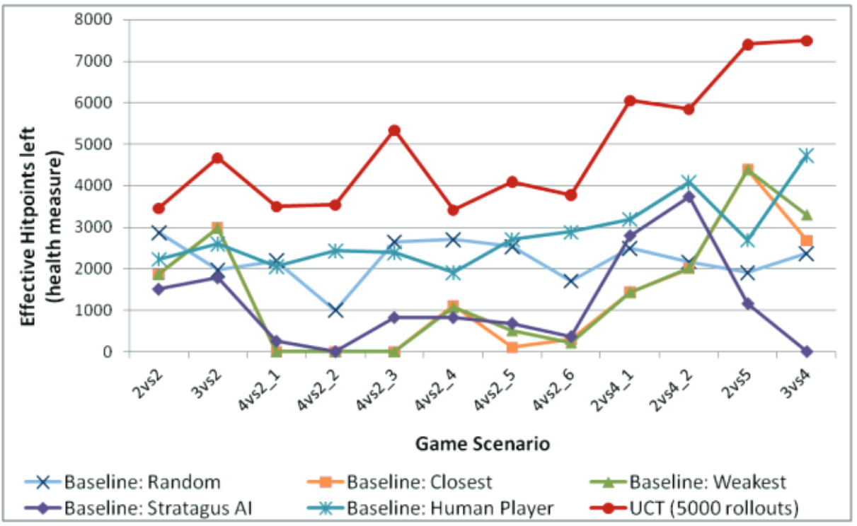
UCT for Tactical Assault Planning in Real-Time Strategy Games
  Experiment results
UCT optimising for HP
Not realtime
(yet)

Slide 10
References
1. Fast Heuristic Search for RTS Game Combat Scenarios
David Churchill, Abdallah Saffidine and Michael Buro
https://skatgame.net/mburo/ps/aiide12-combat.pdf
2. UCT for Tactical Assault Planning in Real-Time Strategy Games
Radha-Krishna Balla and Alan Fern
http://ijcai.org/papers09/Papers/IJCAI09-018.pdf
3. A Survey of Monte Carlo Tree Search Methods
http://www.cameronius.com/cv/mcts-survey-master.pdf

