Slide 1

Sensitivity Analysis of Hidden Markov Models
Seifemichael Amsalu ( PhD Candidate)
Advisor:-
Abdollah Homaifar, PhD

Slide 2
Outline
Introduction
Literature Review
Hidden Markov Models (HMMs)
Sensitivity Analysis in HMMs
Methods
Proposed Method
Conclusion
Future Works

Slide 3
Introduction
Sensitivity analysis is a general technique for investigating the robustness of the output of a mathematical model
Our focus is on parameter sensitivity analysis, which is a standard technique for studying how the output of a model varies with variation of its parameters
Used to identify those parameters for which an accurate assessment seems important
The results used as a basis for parameter tuning, as well as for studying the robustness of the model output to changes in the parameters
Here the focus is on enhancing techniques for sensitivity analysis in HMMs, using results from research in Bayesian networks

Slide 4
HMMs
One of the popular methods for modeling sequential and/or temporal data
Simple enough that you can actually estimate the parameters from data and efficiently made inference
Rich enough to handle real world applications

Slide 5
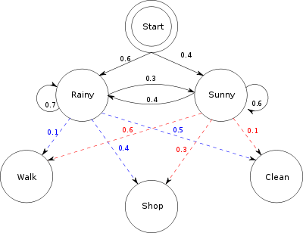
HMMs
Initial Vector
Rainy | Sunny
0.6 | 0.4
Transition Matrix
Observation Matrix
 | Rainy | Sunny
Rainy | 0.7 | 0.3
Sunny | 0.4 | 0.6
 | Walk | Shop | Clean
Rainy | 0.1 | 0.4 | 0.5
Sunny | 0.6 | 0.3 | 0.1

Slide 6
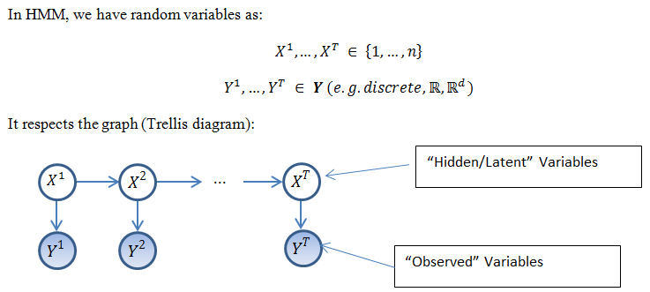
HMMs

Slide 7
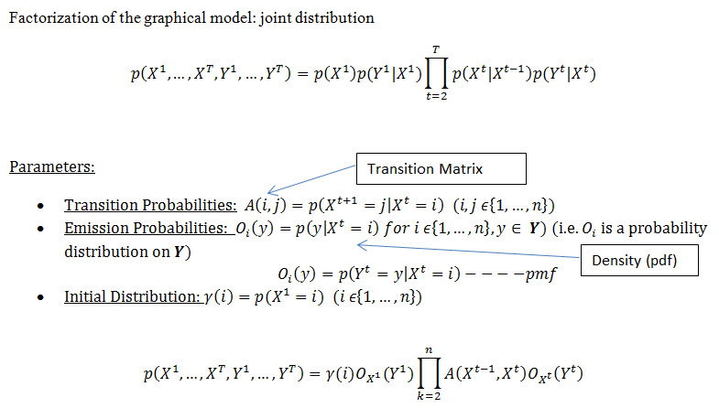
HMMs

Slide 8
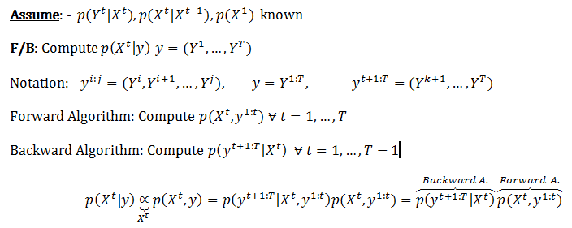
HMMs
Forward-Backward (F/B) Algorithm

Slide 9
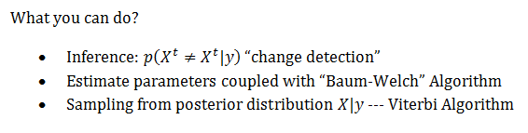
HMMs
Forward-Backward (F/B) Algorithm (Contd.)

Slide 10
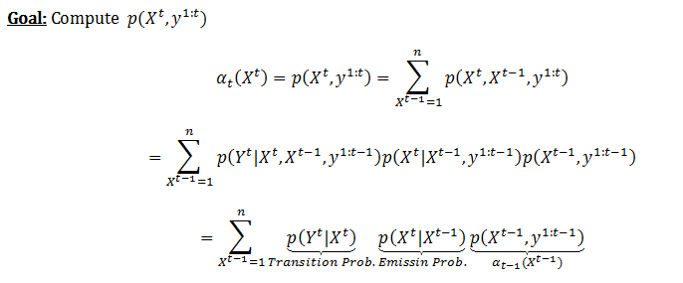
HMMs
Forward Algorithm

Slide 11
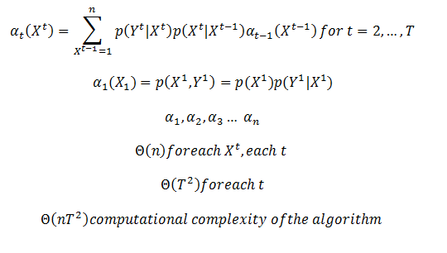
HMMs
Forward Algorithm (Contd.)

Slide 12
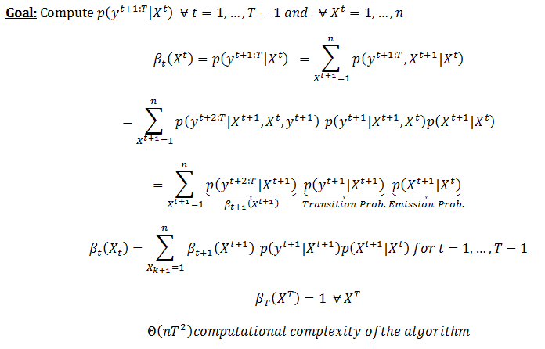
HMMs
Backward Algorithm

Slide 13
Sensitivity Analysis in HMMs
Usually performed by means of a perturbation analysis where a small change is applied to the parameters, upon which the output of interest is re-computed [3], [4]
Recently, it was demonstrated that the relation between model parameters and output probabilities in HMMs can also be described by simple mathematical functions, similar to Bayesian network sensitivity functions [5]
For determining these functions for HMMs, however, no algorithms exist
[3] P.-A. Coquelin, R. Deguest, R. Munos, Sensitivity analysis in HMMs with application to likelihood maximization, in: Advances in Neural Information Processing Systems, vol. 22, 2009, pp. 387395.
[4] A.Yu. Mitrophanov, A. Lomsadze, M. Borodovsky, Sensitivity of hidden Markov models, Journal of Applied Probability 42 (2005) 632642.
[5] Th. Charitos, L.C. van der Gaag, Sensitivity properties of Markovian models, in: Proceedings of Advances in Intelligent Systems Theory and Applications Conference (AISTA), Luxembourg, IEEE Computer Society, 2004.

Slide 14
Sensitivity Analysis in HMMs
It was suggested to represent the HMM as a dynamic Bayesian network, unrolled for a fixed number of time slices, and to apply existing Bayesian network sensitivity analysis algorithms [5]
In [6] argue that these methods are inefficient for the purpose of computing HMM sensitivity functions, due to the fact that the repetitive character of the HMM, with the same parameters occurring for each time step, is not exploited in the computation
In [6] two new algorithms are introduced, that build on existing algorithms for HMMs in order to compute the constants of the HMM sensitivity function
In addition, It presents a new algorithm that is specially tailored to the computation of sensitivity functions directly from HMMs
[6] S. Renooij, Efficient sensitivity analysis in hiddenMarkovmodels, in: PetriMyllymaki, Teemu Roos, TommiJaakkola, (Eds.), Proceedings of the Fifth European Workshop on Probabilistic Graphical Models, HIIT Publications 2010-2, Helsinki, 2010, pp. 241248.

Slide 15
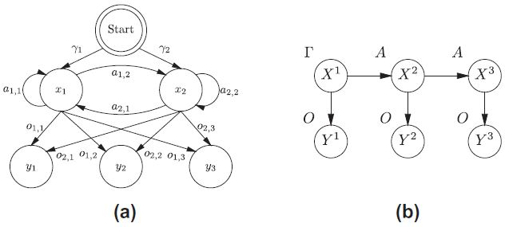
Sensitivity Analysis in HMMs
Fig. 1. A hidden Markov model representation (a) and its dynamic Bayesian network representation, unrolled for three time slices (b) [6]
[6] S. Renooij, Efficient sensitivity analysis in hiddenMarkovmodels, in: PetriMyllymaki, Teemu Roos, TommiJaakkola, (Eds.), Proceedings of the Fifth European Workshop on Probabilistic Graphical Models, HIIT Publications 2010-2, Helsinki, 2010, pp. 241248.

Slide 16
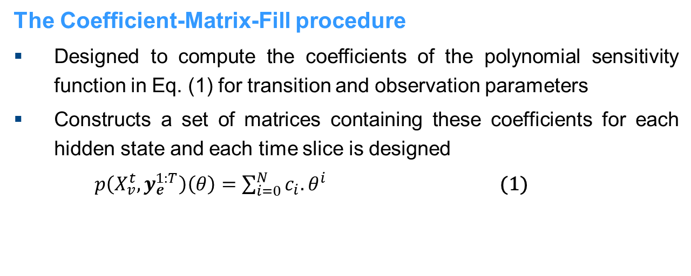
Methods
The Coefficient-Matrix-Fill procedure
Designed to compute the coefficients of the polynomial sensitivity function in Eq. (1) for transition and observation parameters
Constructs a set of matrices containing these coefficients for each hidden state and each time slice is designed
$p\left(X_{v}^{t},y_{e}^{1:T}\right)\left(θ\right)=\sum_{i=0}^{N}{c_{i}{.θ}^{i}}$ (1)

Slide 17
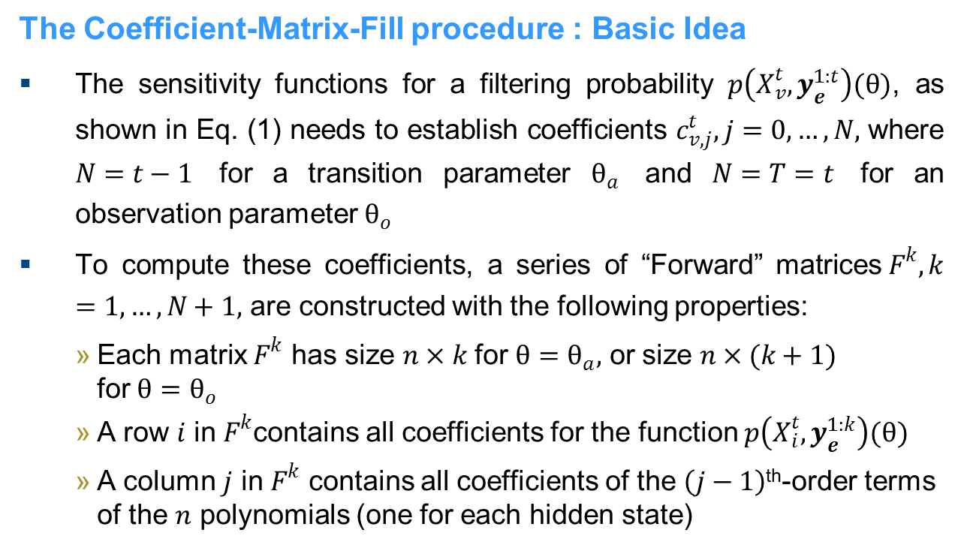
Methods
The Coefficient-Matrix-Fill procedure : Basic Idea
The sensitivity functions for a filtering probability $p\left(X_{v}^{t},y_{e}^{1:t}\right)(θ)$, as shown in Eq. (1) needs to establish coefficients $c_{v,j}^{t}, j=0, …,N,$ where $N=t−1$ for a transition parameter $θ_{a}$ and $N=T=t$ for an observation parameter${ θ}_{o}$
To compute these coefficients, a series of “Forward” matrices$F^{k}, k=1, …, N+1,$ are constructed with the following properties:
Each matrix $F^{k}$ has size $n×k$ for ${θ=θ}_{a},$ or size $n×(k+1)$ for${θ=θ}_{o}$
A row $i$ in $F^{k}$contains all coefficients for the function $p\left(X_{i}^{t},y_{e}^{1:k}\right)(θ)$
A column $j$ in $F^{k}$ contains all coefficients of the $\left(j−1\right)$^{th}-order terms of the $n$ polynomials (one for each hidden state)

Slide 18
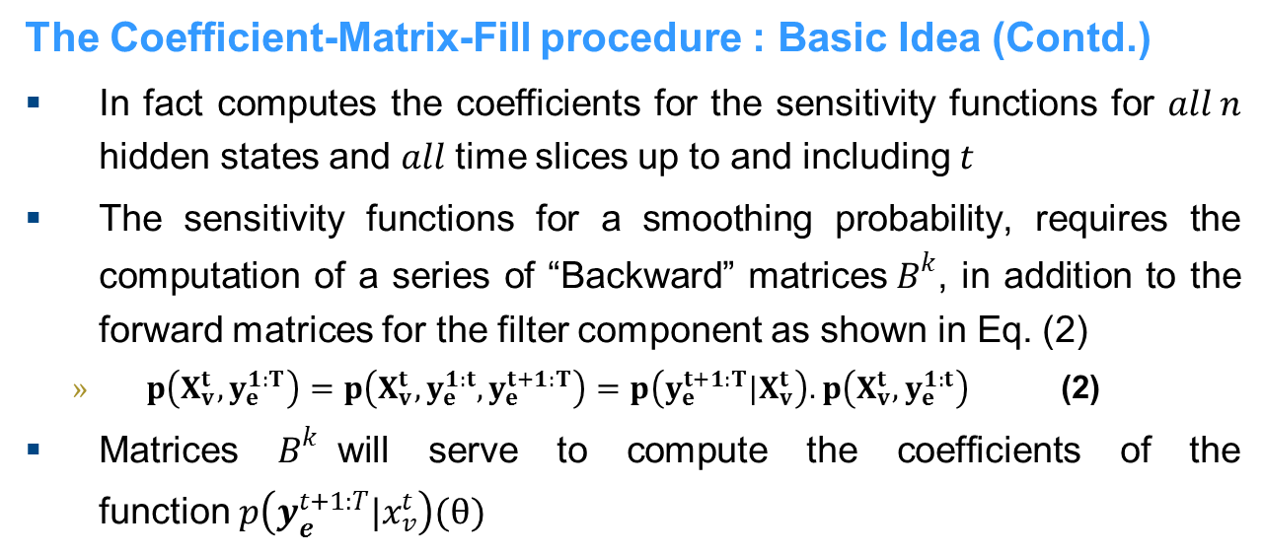
Methods
The Coefficient-Matrix-Fill procedure : Basic Idea (Contd.)
In fact computes the coefficients for the sensitivity functions for $all n$ hidden states and $all$ time slices up to and including$t$
The sensitivity functions for a smoothing probability, requires the computation of a series of “Backward” matrices${ B}^{k}$, in addition to the forward matrices for the filter component as shown in Eq. (2)
$p\left(X_{v}^{t},y_{e}^{1:T}\right)=p\left(X_{v}^{t},y_{e}^{1:t},y_{e}^{t+1:T}\right)=p\left(y_{e}^{t+1:T}|X_{v}^{t}\right).p\left(X_{v}^{t},y_{e}^{1:t}\right)$ (2)
Matrices $B^{k}$will serve to compute the coefficients of the function$p\left(y_{e}^{t+1:T}|x_{v}^{t}\right)(θ)$

Slide 19
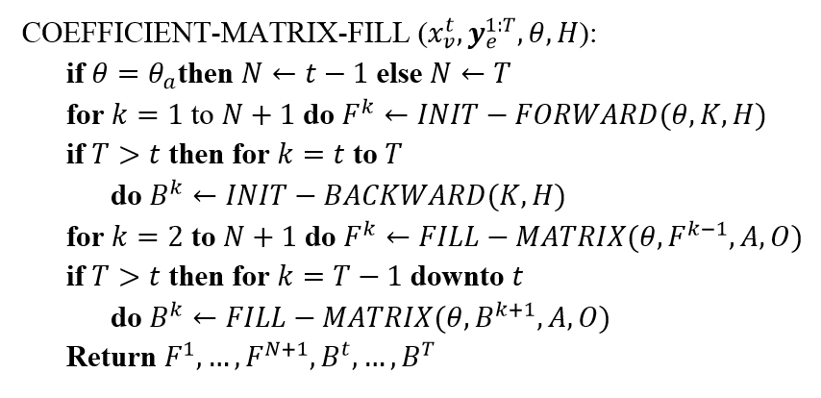
Methods
The Coefficient-Matrix-Fill procedure (Contd.)
Fig. 1. High-level summary of the Coefficient-Matrix-Fill procedure

Slide 20
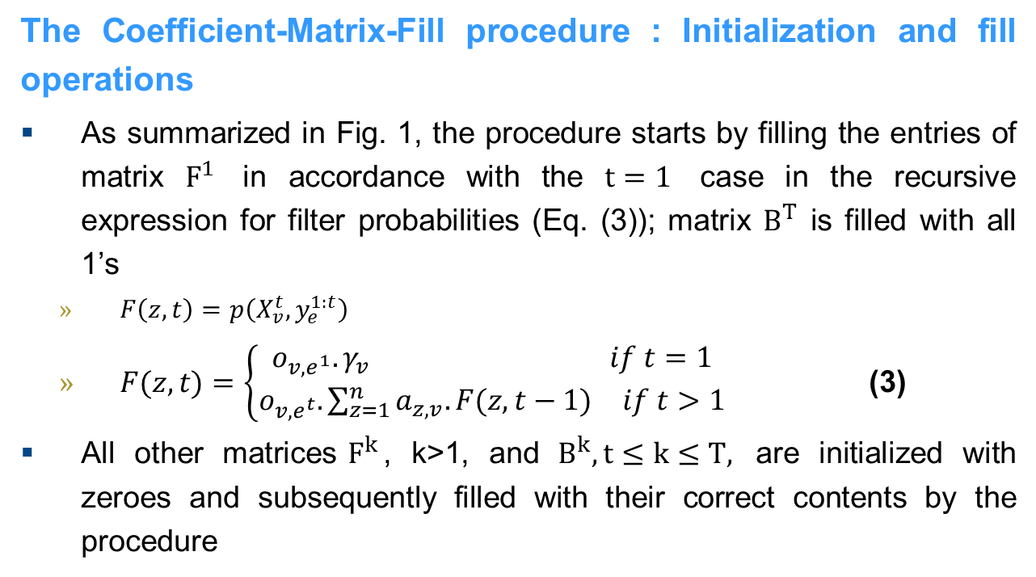
Methods
The Coefficient-Matrix-Fill procedure : Initialization and fill operations
As summarized in Fig. 1, the procedure starts by filling the entries of matrix $F^{1}$ in accordance with the $t=1$ case in the recursive expression for filter probabilities (Eq. (3)); matrix $B^{T}$ is filled with all 1’s
$F\left(z,t\right)=p\left(X_{v}^{t},y_{e}^{1:t}\right)$
$F(z,t)=\left\{\begin{aligned}\begin{matrix}o_{v,e^{1}}.γ_{v} & if t=1\end{matrix} \\ \begin{matrix}o_{v,e^{t}}.\sum_{z=1}^{n}{a_{z,v}.F(z,t−1)} & if t>1\end{matrix}\end{aligned}\right.$ (3)
All other matrices$F^{k}$, k>1, and $B^{k}, t≤k≤T,$ are initialized with zeroes and subsequently filled with their correct contents by the procedure

Slide 21
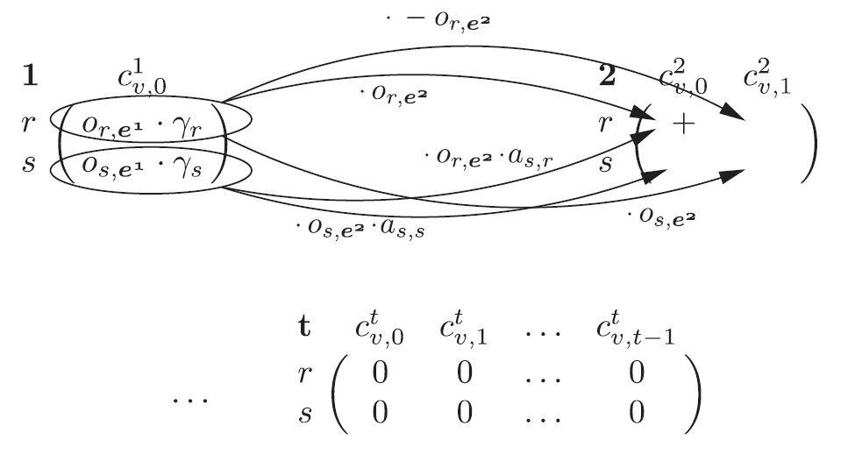
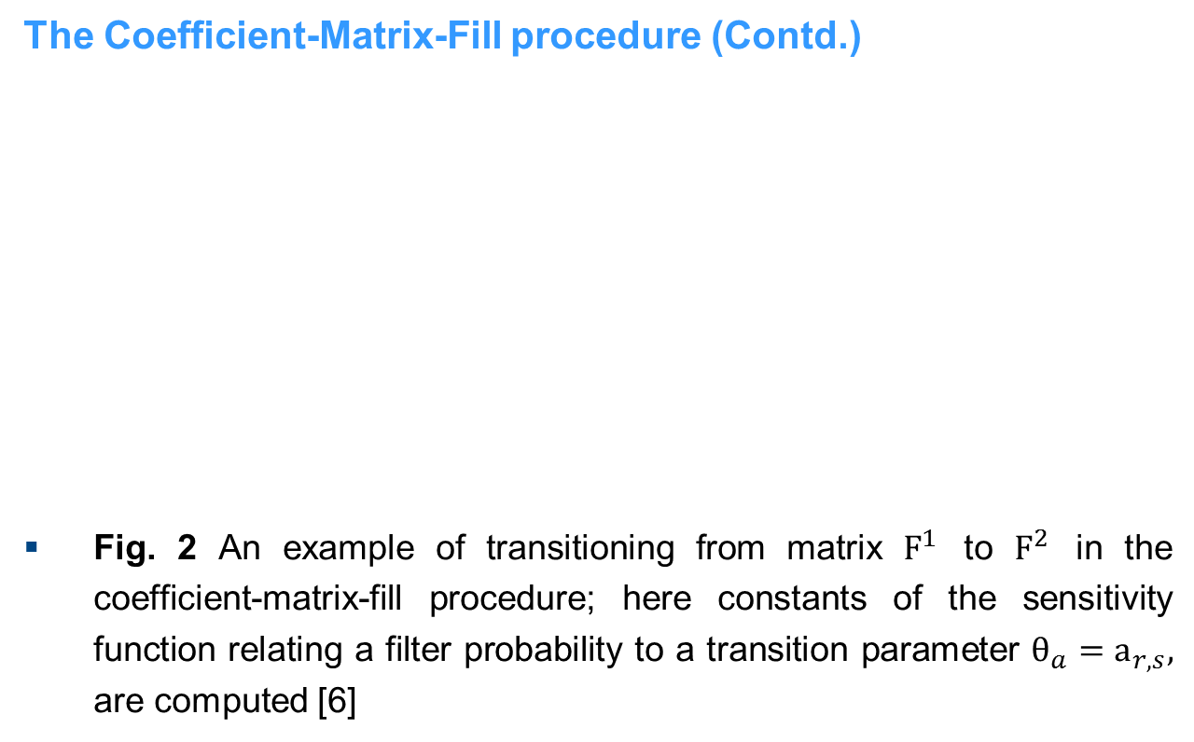
Methods
The Coefficient-Matrix-Fill procedure (Contd.)
Fig. 2 An example of transitioning from matrix $F^{1}$ to $F^{2}$ in the coefficient-matrix-fill procedure; here constants of the sensitivity function relating a filter probability to a transition parameter $θ_{a}=a_{r,s},$ are computed [6]

Slide 22
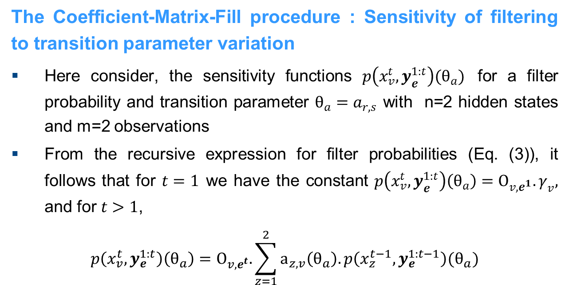
Methods
The Coefficient-Matrix-Fill procedure : Sensitivity of filtering to transition parameter variation
Here consider, the sensitivity functions $p\left(x_{v}^{t},y_{e}^{1:t}\right)(θ_{a})$ for a filter probability and transition parameter $θ_{a}=a_{r,s}$ with n=2 hidden states and m=2 observations
From the recursive expression for filter probabilities (Eq. (3)), it follows that for $t=1$ we have the constant $p\left(x_{v}^{t},y_{e}^{1:t}\right)\left(θ_{a}\right)=O_{v,e^{1}}.γ_{v},$ and for $t>1$,
$$p\left(x_{v}^{t},y_{e}^{1:t}\right)\left(θ_{a}\right)=O_{v,e^{t}}.\sum_{z=1}^{2}{a_{z,v}\left(θ_{a}\right).p\left(x_{z}^{t−1},y_{e}^{1:t−1}\right)(θ_{a})}$$

Slide 23
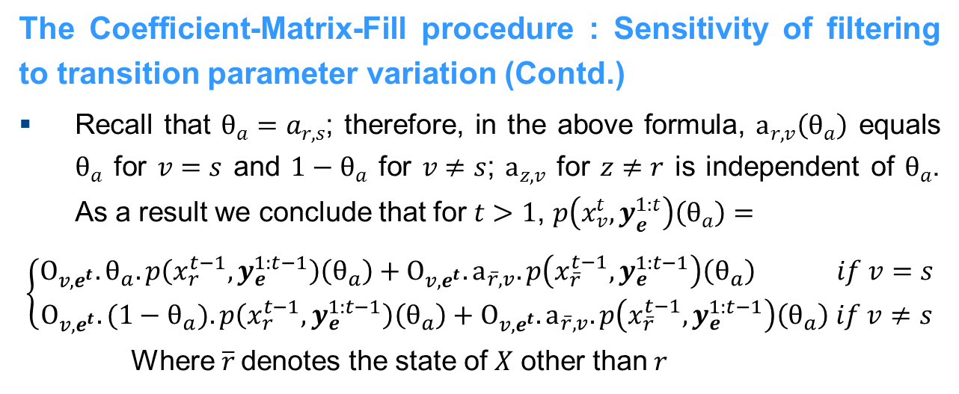
Methods
The Coefficient-Matrix-Fill procedure : Sensitivity of filtering to transition parameter variation (Contd.)
Recall that $θ_{a}=a_{r,s}$; therefore, in the above formula, $a_{r,v}\left(θ_{a}\right)$ equals $θ_{a}$ for $v=s$ and ${1−θ}_{a}$ for $v≠s$; $a_{z,v}$ for $z≠r$ is independent of $θ_{a}$. As a result we conclude that for $t>1$, $p\left(x_{v}^{t},y_{e}^{1:t}\right)\left(θ_{a}\right)=$
$$\left\{\begin{aligned}O_{v,e^{t}}.θ_{a}.p\left(x_{r}^{t−1},y_{e}^{1:t−1}\right)\left(θ_{a}\right)+O_{v,e^{t}}.a_{\overline{r},v}.p\left(x_{\overline{r}}^{t−1},y_{e}^{1:t−1}\right)\left(θ_{a}\right) if v=s \\ O_{v,e^{t}}.{(1−θ}_{a}).p\left(x_{r}^{t−1},y_{e}^{1:t−1}\right)\left(θ_{a}\right)+O_{v,e^{t}}.a_{\overline{r},v}.p\left(x_{\overline{r}}^{t−1},y_{e}^{1:t−1}\right)\left(θ_{a}\right) if v≠s\end{aligned}\right.$$
Where $\overline{r}$denotes the state of $X$ other than$r$

Slide 24
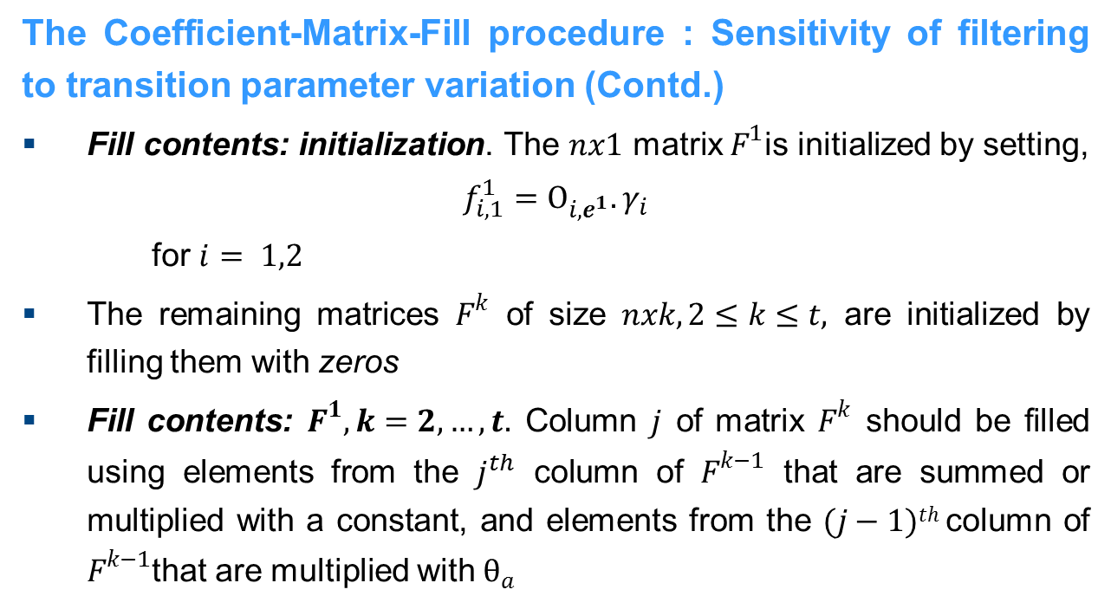
Methods
The Coefficient-Matrix-Fill procedure : Sensitivity of filtering to transition parameter variation (Contd.)
Fill contents: initialization. The $nx1$ matrix $F^{1}$is initialized by setting,
$$f_{i,1}^{1}=O_{i,e^{1}}.γ_{i}$$
for $i= 1,2$
The remaining matrices $F^{k}$ of size $nxk, 2≤k≤t,$ are initialized by filling them with zeros
Fill contents: $F^{1}, k=2, …, t.$ Column $j$ of matrix $F^{k}$ should be filled using elements from the $j^{th}$ column of $F^{k−1}$ that are summed or multiplied with a constant, and elements from the $(j−1)th$ column of $F^{k−1}$that are multiplied with$θ_{a}$

Slide 25
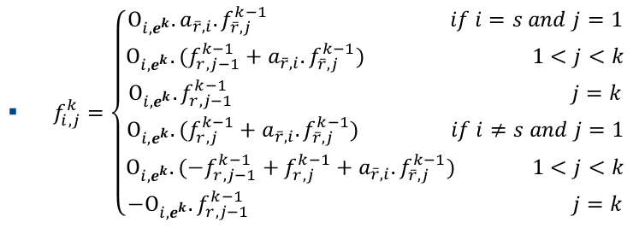
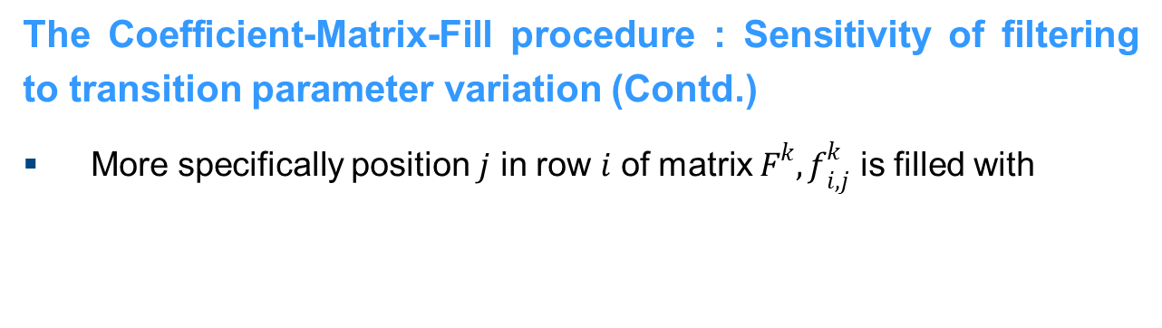
Methods
The Coefficient-Matrix-Fill procedure : Sensitivity of filtering to transition parameter variation (Contd.)
More specifically position $j$ in row $i$ of matrix $F^{k}, f_{i,j}^{k}$ is filled with

Slide 26
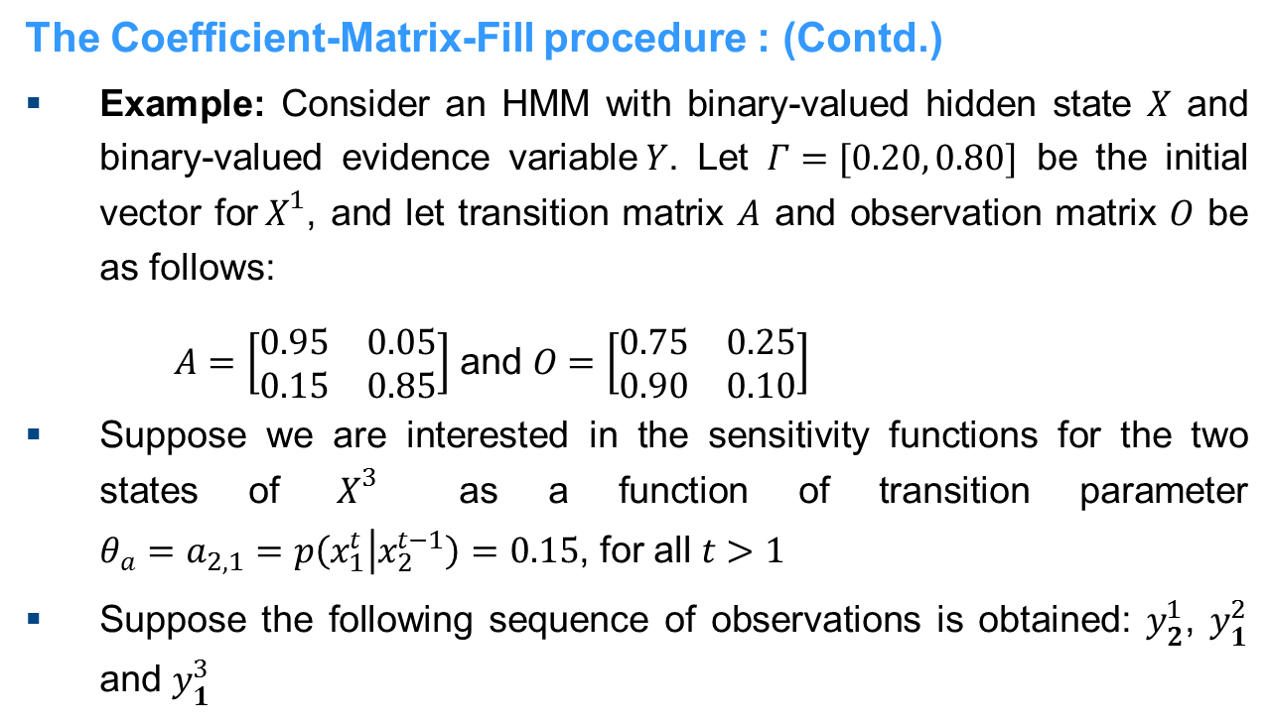
Methods
The Coefficient-Matrix-Fill procedure : (Contd.)
Example: Consider an HMM with binary-valued hidden state $X$ and binary-valued evidence variable$Y$. Let $Γ=[0.20, 0.80]$ be the initial vector for${ X}^{1}$, and let transition matrix $A$ and observation matrix $O$ be as follows:
$A=\left[\begin{matrix}0.95 & 0.05 \\ 0.15 & 0.85\end{matrix}\right]$ and $O=\left[\begin{matrix}0.75 & 0.25 \\ 0.90 & 0.10\end{matrix}\right]$
Suppose we are interested in the sensitivity functions for the two states of ${ X}^{3}$ as a function of transition parameter $θ_{a}=a_{2,1}=p\left(x_{1}^{t} | x_{2}^{t−1}\right)=0.15$, for all $t>1$
Suppose the following sequence of observations is obtained: $y_{2}^{1}$, $y_{1}^{2}$ and $y_{1}^{3}$

Slide 27
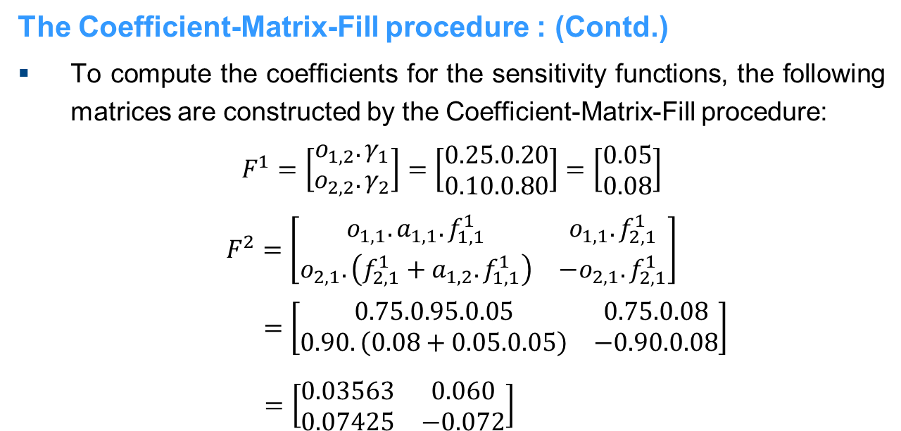
Methods
The Coefficient-Matrix-Fill procedure : (Contd.)
To compute the coefficients for the sensitivity functions, the following matrices are constructed by the Coefficient-Matrix-Fill procedure:
$$F^{1}=\left[\begin{matrix}o_{1,2}.γ_{1} \\ o_{2,2}.γ_{2}\end{matrix}\right]=\left[\begin{matrix}0.25.0.20 \\ 0.10.0.80\end{matrix}\right]=\left[\begin{matrix}0.05 \\ 0.08\end{matrix}\right]$$
$$F^{2}=\left[\begin{matrix}o_{1,1}.a_{1,1}.f_{1,1}^{1} & o_{1,1}.f_{2,1}^{1} \\ o_{2,1}.\left(f_{2,1}^{1}+a_{1,2}.f_{1,1}^{1}\right) & {−o}_{2,1}.f_{2,1}^{1}\end{matrix}\right]$$
$$=\left[\begin{matrix}0.75.0.95.0.05 & 0.75.0.08 \\ 0.90.\left(0.08+0.05.0.05\right) & −0.90.0.08\end{matrix}\right]$$
$=\left[\begin{matrix}0.03563 & 0.060 \\ 0.07425 & −0.072\end{matrix}\right]$

Slide 28
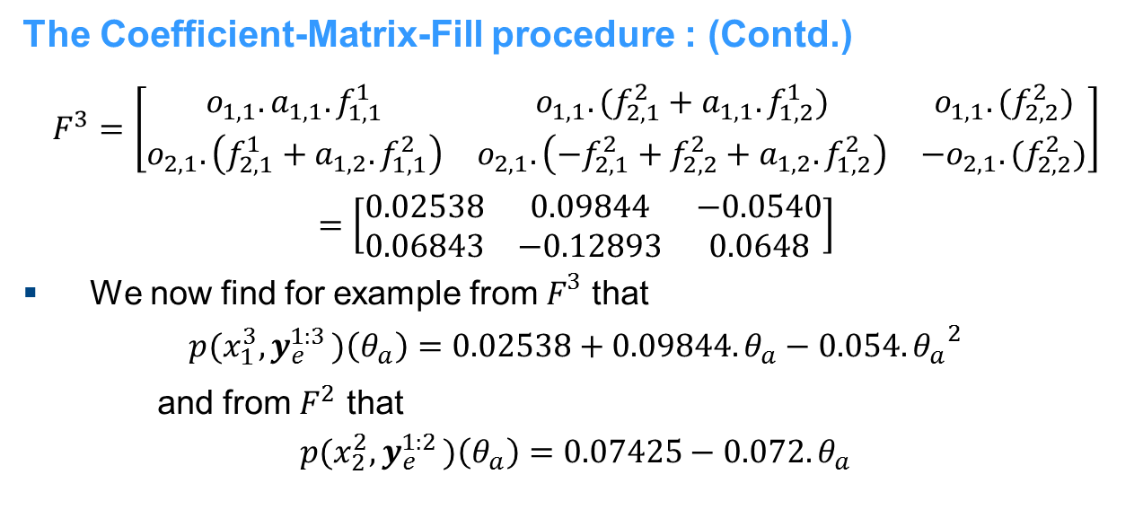
Methods
The Coefficient-Matrix-Fill procedure : (Contd.)
$$F^{3}=\left[\begin{matrix}o_{1,1}.a_{1,1}.f_{1,1}^{1} & o_{1,1}.(f_{2,1}^{2}+a_{1,1}.f_{1,2}^{1}) & o_{1,1}.(f_{2,2}^{2}) \\ o_{2,1}.\left(f_{2,1}^{1}+a_{1,2}.f_{1,1}^{2}\right) & o_{2,1}.\left(−f_{2,1}^{2}+f_{2,2}^{2}+a_{1,2}.f_{1,2}^{2}\right) & −o_{2,1}.(f_{2,2}^{2})\end{matrix}\right]$$
$$=\left[\begin{matrix}0.02538 & 0.09844 & −0.0540 \\ 0.06843 & −0.12893 & 0.0648\end{matrix}\right]$$
We now find for example from $F^{3}$ that
$$p(x_{1}^{3}{,y}_{e}^{1:3})\left(θ_{a}\right)=0.02538+0.09844.θ_{a}−0.054.{θ_{a}}^{2}$$
and from $F^{2}$ that
$$p(x_{2}^{2}{,y}_{e}^{1:2})\left(θ_{a}\right)=0.07425−0.072.θ_{a}$$

Slide 29
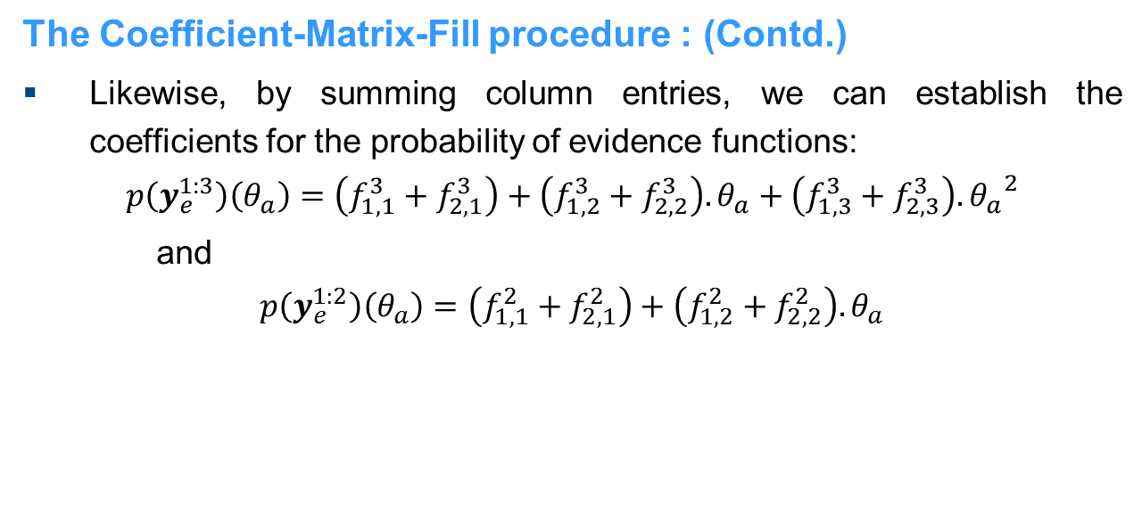
Methods
The Coefficient-Matrix-Fill procedure : (Contd.)
Likewise, by summing column entries, we can establish the coefficients for the probability of evidence functions:
$$p\left(y_{e}^{1:3}\right)\left(θ_{a}\right)=\left(f_{1,1}^{3}+f_{2,1}^{3}\right)+\left(f_{1,2}^{3}+f_{2,2}^{3}\right).θ_{a}+\left(f_{1,3}^{3}+f_{2,3}^{3}\right).{θ_{a}}^{2}$$
and
$$p\left(y_{e}^{1:2}\right)\left(θ_{a}\right)=\left(f_{1,1}^{2}+f_{2,1}^{2}\right)+\left(f_{1,2}^{2}+f_{2,2}^{2}\right).θ_{a}$$

Slide 30

Methods
The Coefficient-Matrix-Fill procedure : (Contd.)
Together these give the following sensitivity functions for two filtering tasks:
$$p\left(x_{1}^{3} | y_{e}^{1:3}\right)\left(θ_{a}\right)=\frac{−0.054.{θ_{a}}^{2}+0.09844.θ_{a}+0.02538}{0.0108.{θ_{a}}^{2}−0.03049.θ_{a}+0.09381}$$
and
$$p\left(x_{2}^{2} | y_{e}^{1:2}\right)\left(θ_{a}\right)=\frac{−0.072.θ_{a}+0.07425}{−0.012.θ_{a}+0.10988}$$
which are displayed in Fig. 2

Slide 31
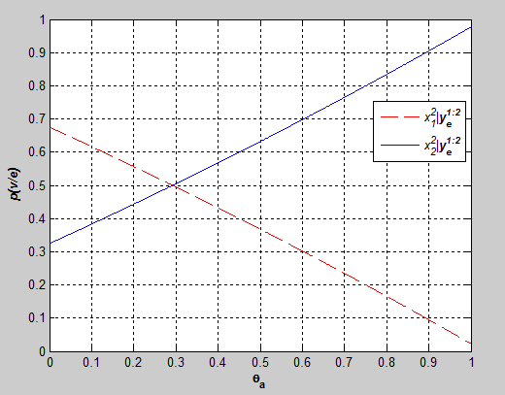
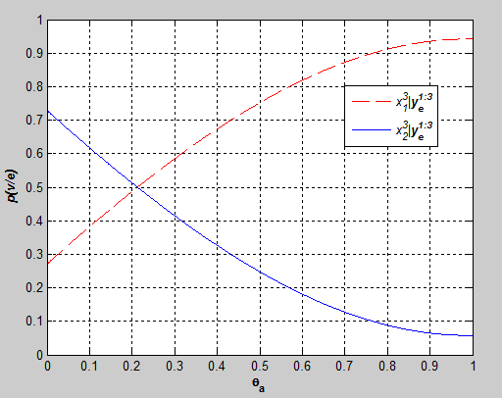

Methods
The Coefficient-Matrix-Fill procedure : (Contd.)
Fig. 3. Sensitivity functions $p\left(x_{v}^{2} | y_{e}^{1:2}\right)\left(θ_{a}\right)$ for both states of $X^{2}$(a), and $p\left(x_{v}^{3} | y_{e}^{1:3}\right)\left(θ_{a}\right)$ for both states of $X^{3}$(b)
(a)
(b)

Slide 32
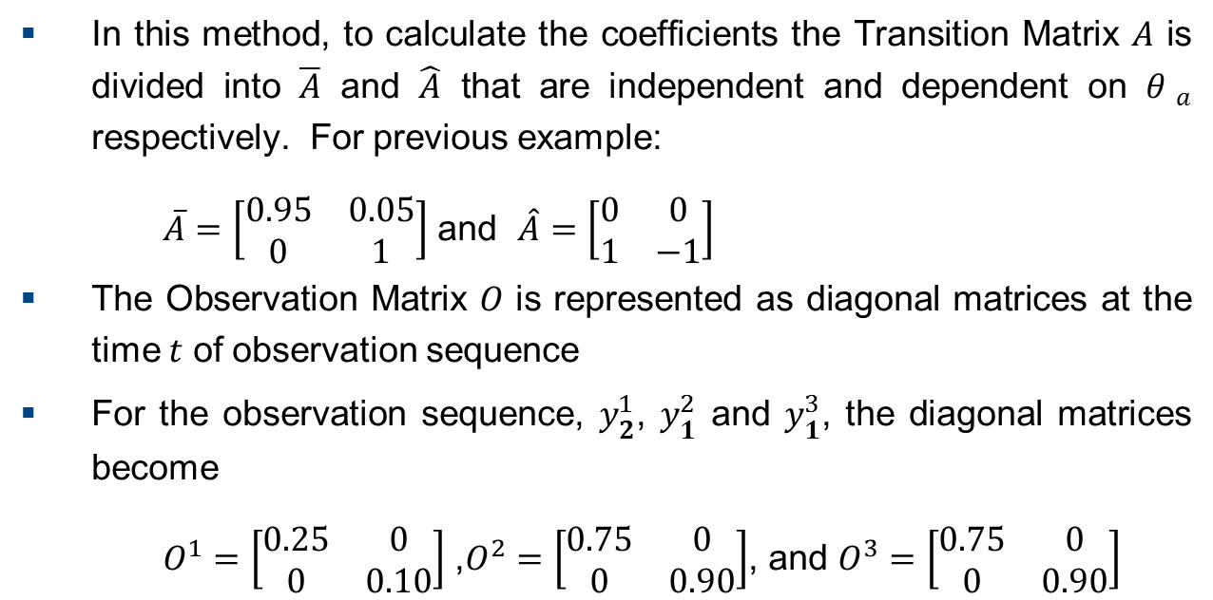
Proposed Method
In this method, to calculate the coefficients the Transition Matrix $A$ is divided into $\overline{A}$ and $\hat{A}$ that are independent and dependent on ${θ }_{a}$ respectively. For previous example:
$\overline{A}=\left[\begin{matrix}0.95 & 0.05 \\ 0 & 1\end{matrix}\right]$ and $\hat{A}=\left[\begin{matrix}0 & 0 \\ 1 & −1\end{matrix}\right]$
The Observation Matrix $O$ is represented as diagonal matrices at the time $t$ of observation sequence
For the observation sequence, $y_{2}^{1}$, $y_{1}^{2}$ and $y_{1}^{3}$, the diagonal matrices become
$O^{1}=\left[\begin{matrix}0.25 & 0 \\ 0 & 0.10\end{matrix}\right]$ ,$O^{2}=\left[\begin{matrix}0.75 & 0 \\ 0 & 0.90\end{matrix}\right]$, and $O^{3}=\left[\begin{matrix}0.75 & 0 \\ 0 & 0.90\end{matrix}\right]$

Slide 33
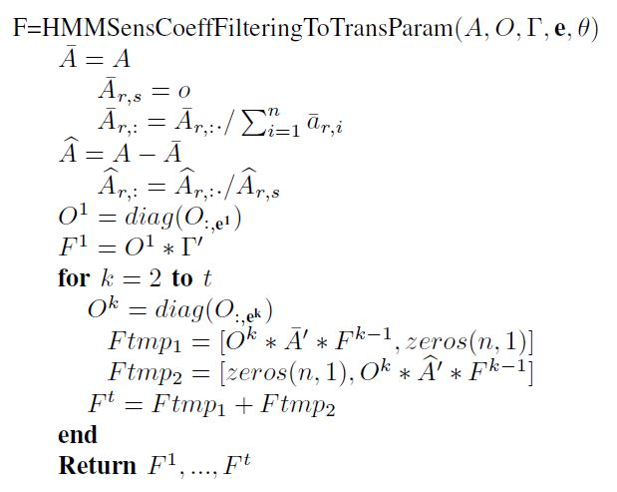
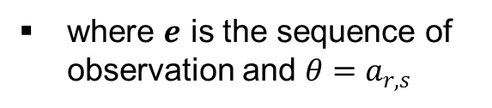
Proposed Method
Once the Transition and Observation matrices are represented as above, the sensitivity coefficients are computed with matrix multiplication as shown in the following function
where $e$ is the sequence of observation and $θ=a_{r,s}$

Slide 34
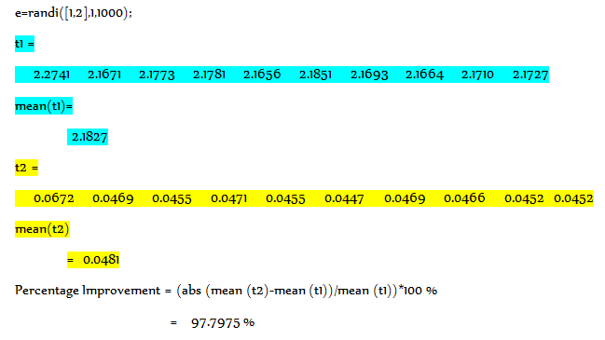
Proposed Method

Slide 35
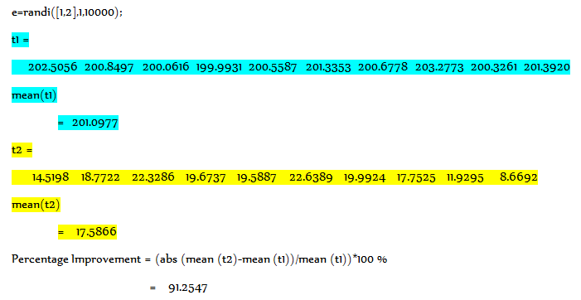
Proposed Method

Slide 36
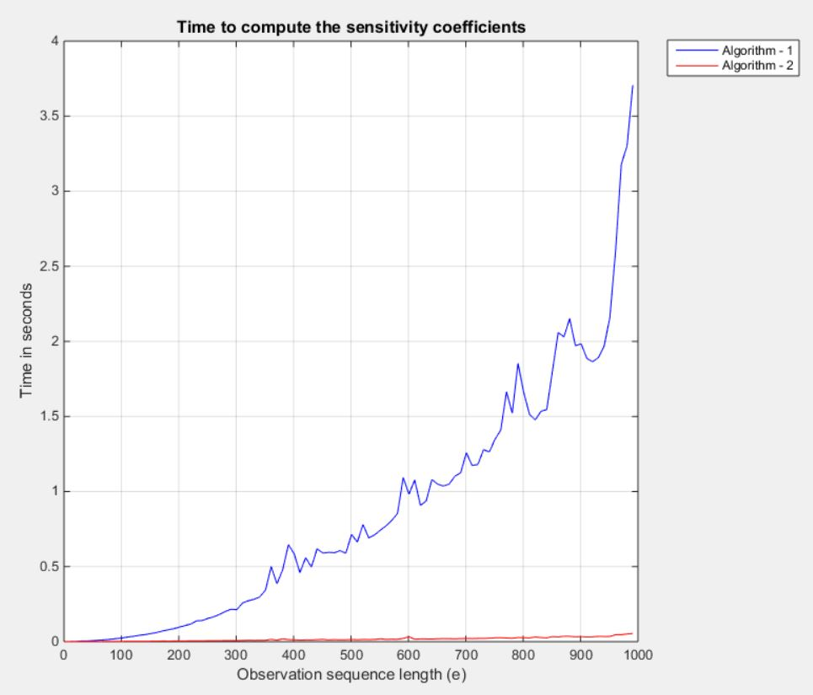
Proposed Method
Fig. 4. Time in seconds to compute the sensitivity coefficients for an observation sequence length from 1 to 1000 with a step size of 10
Algorithm -1 is Coefficient-Matrix-Fill procedure
Algorithm-2 is Proposed Method

Slide 37
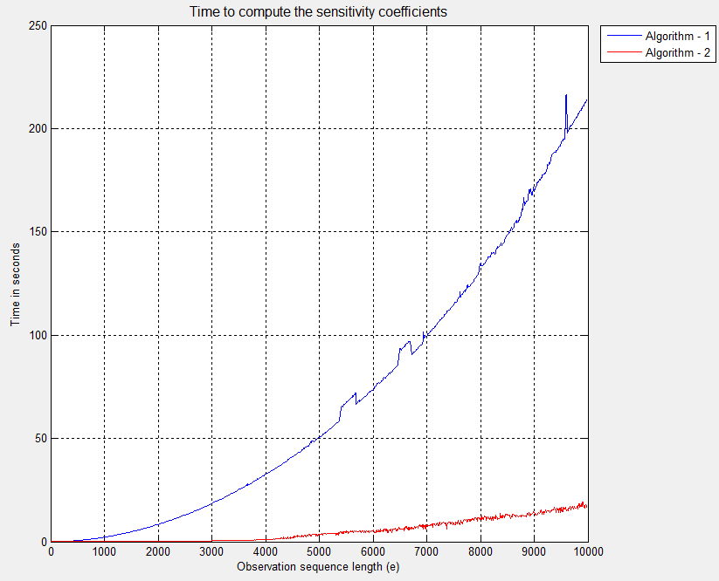
Proposed Method
Fig. 5. Time in seconds to compute the sensitivity coefficients for an observation sequence length from 1 to 10000 with a step size of 10

Slide 38
Conclusion
It is shown that it is more efficient to compute the coefficients for the HMM sensitivity function directly from HMMs
The proposed method exploits the simplified matrix formulation for HMMs
A simple algorithm that computes the coefficients for the sensitivity function for all hidden states and all time steps is presented
It is differ from other approaches in:
Do not depend on a specific computational architecture
Do not require a Bayesian network representation of HMM
The proposed method has shown significant improvement over coefficient matrix procedure in computational time

Slide 39
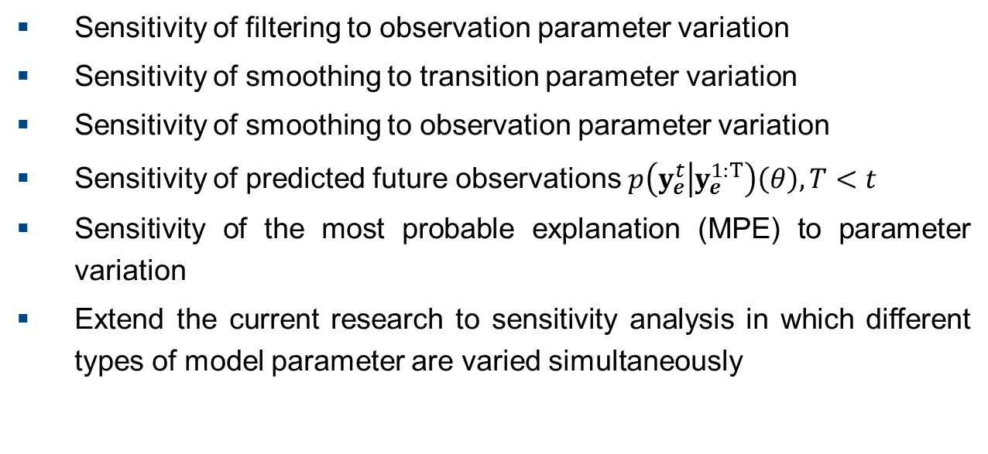
Future Works
Sensitivity of filtering to observation parameter variation
Sensitivity of smoothing to transition parameter variation
Sensitivity of smoothing to observation parameter variation
Sensitivity of predicted future observations $p\left(y_{e}^{t} | y_{e}^{1:T}\right)\left(θ\right), T<t$
Sensitivity of the most probable explanation (MPE) to parameter variation
Extend the current research to sensitivity analysis in which different types of model parameter are varied simultaneously

Slide 40
Reference
H. Chan, A. Darwiche, When do numbers really matter?, Journal of Artificial Intelligence Research 17 (2002)
L.C. van der Gaag, S. Renooij, V.M.H. Coup, Sensitivity analysis of probabilistic networks, in: Advances in Probabilistic Graphical Models, Springer Series: Studies in Fuzziness and Soft Computing, vol. 213, 2007, pp. 103124
P.-A. Coquelin, R. Deguest, R. Munos, Sensitivity analysis in HMMs with application to likelihood maximization, in: Advances in Neural Information Processing Systems, vol. 22, 2009, pp. 387395.
A.Yu. Mitrophanov, A. Lomsadze, M. Borodovsky, Sensitivity of hidden Markov models, Journal of Applied Probability 42 (2005) 632642
Th. Charitos, L.C. van der Gaag, Sensitivity properties of Markovian models, in: Proceedings of Advances in Intelligent Systems Theory and Applications Conference (AISTA), Luxembourg, IEEE Computer Society, 2004
S. Renooij, Efficient sensitivity analysis in hiddenMarkovmodels, in: PetriMyllymaki, Teemu Roos, TommiJaakkola, (Eds.), Proceedings of the Fifth European Workshop on Probabilistic Graphical Models, HIIT Publications 2010-2, Helsinki, 2010, pp. 241248
S. Russell, P. Norvig, Artificial Intelligence: A Modern Approach, third ed., Prentice Hall, 2010
H. Chan, A. Darwiche, Sensitivity analysis in Bayesian networks: from single to multiple parameters, in: M. Chickering, J. Halpern (Eds.), Proceedings of the Twentieth Conference on Uncertainty in Artificial Intelligence, AUAI Press, Arlington, VA, 2004, pp. 67–75

Slide 41
Reference
Th. Charitos, Reasoning with Dynamic Networks in Practice, Ph.D. Thesis, Utrecht University, The Netherlands, 2007
P. Dymarski (Ed.), Hidden Markov Models, Theory and Applications, InTech Open Access Publishers, 2011
P.-A. Coquelin, R. Deguest, R. Munos, Sensitivity analysis in HMMs with application to likelihood maximization, in: Advances in Neural Information Processing Systems, vol. 22, 2009, pp. 387–395
A.Yu. Mitrophanov, A. Lomsadze, M. Borodovsky, Sensitivity of hidden Markov models, Journal of Applied Probability 42 (2005) 632–642
L. Rabiner and B. Juang, ”An introduction to hidden Markov models,” IEEE ASSP Mag., vol. 3, no. 1, pp. 4-16, Jan. 1986.
L. Rabiner, ”A tutorial on hidden Markov models and selected applications in speech recognition,” Proc. IEEE, vol. 77, no. 2, pp. 257-286, Feb. 1989.
L. Baum and T. Petrie, ”Statistical inference for probabilistic functions of finite state Markov chains,” Ann. Math. Stat., vol. 37, no. 6, pp. 1554-1563, Dec. 1966.

Slide 42
?

