Slide 1

Game Theory and its Applications in Multi-Agent Systems
Nima Namvar PhD Student

Slide 2
Outline
Introduction
Matching Games
Stackelberg Games
Coalition Games
Future works

Slide 3
Part1: Introduction

Slide 4
Multi-agent Systems
Agent capabilities:
Sensing the environment
Interaction with the environment and other agents
Taking autonomous decisions
They are designed to mimic human behavior
Multi-agent system is a system composed of multiple interacting intelligent agents that can interact, collaborate, and act together in order to perform different tasks.

Slide 5
Goals of Designing Multi-Agent Systems
Simulating the way humans act in their environment
interact with one another,
cooperatively solve problems
Task-distribution
Enhancing their problem solving performances by competition.

Slide 6
Communication in Heterogeneous Cooperative Networks
Wireless communication is necessary in multi-agent systems:
Mobility
Sharing the information
Communicating with control-centers
Negotiating task-scheduling

Slide 7
Challenges of designing a wireless network
Power constraints for nodes using batteries or energy harvesting
Ability to cope with node failures (resilience)
Mobility of nodes
Heterogeneity of nodes
Different capabilities
Different resources
Different demands
Scalability to large scale of deployment
Ability to withstand harsh environmental conditions

Slide 8
How to Model the Network?
A proper network design and communication protocol, should capture the following elements in the model:
Heterogeneity of the nodes
Interaction among the nodes
Decision making algorithm
Context information
How to model such different aspects of the protocol?
Game theory provides a suitable framework

Slide 9
Game Theory
Definition:
Game theory consists of mathematical models and techniques developed in economics to analyze interactive decision processes, predict the outcomes of interactions, identify optimal strategies.
Elements of Game:
Elements of Game | Example in wireless network
Set of players | Nodes in the wireless network, agents, servers
Strategies | modulation scheme, Coding rate, transmit power level, forwarding packet or not.
Payoffs | Performance metrics (e.g. Throughput, Delay, SINR)

Slide 10
Game Theory
Three specially useful games in network design
Matching games
Resource allocation
Task scheduling
Stackelberg games
Optimization of agent’s performance
Coalition games
Modeling the cooperation among the agents

Slide 11
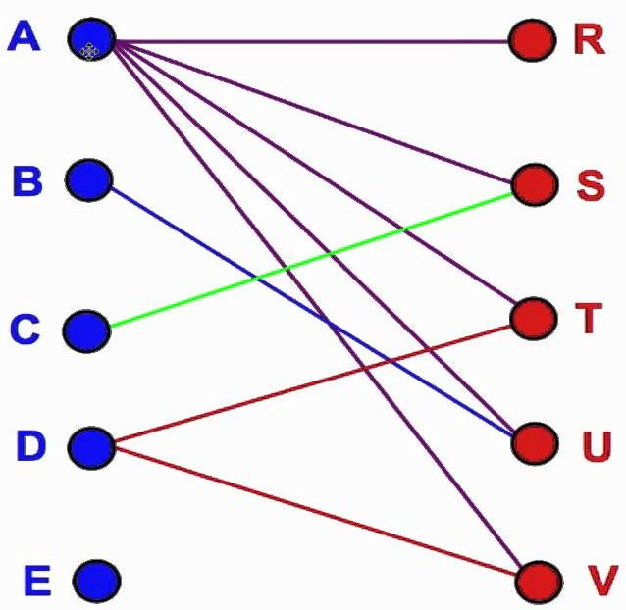
Part II: Matching Games

Slide 12
Introduction
Examples
Matching channels and agents
Matching resources and users
Matching tasks and groups of cooperating agents
Existing Theories:
Matching Theory
Contract Theory

Slide 13
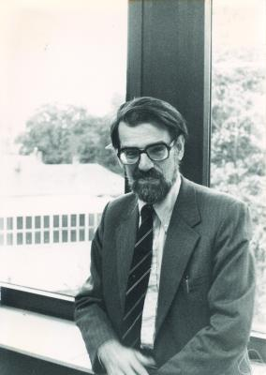
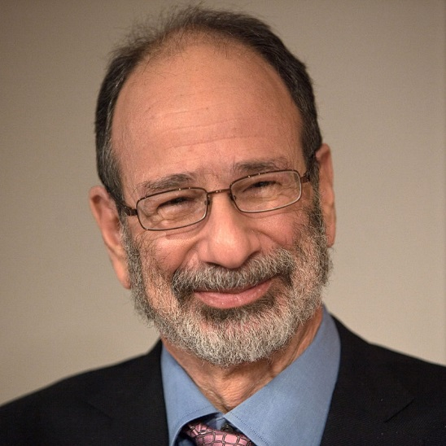
Matching Theory
The Nobel Prize in Economics: 2012
Lloyd Shapley and Alvin Roth
Alvin Roth
Generated further analytical developments
Lloyd Shapley
Developed the theory in the 1960s

Slide 14
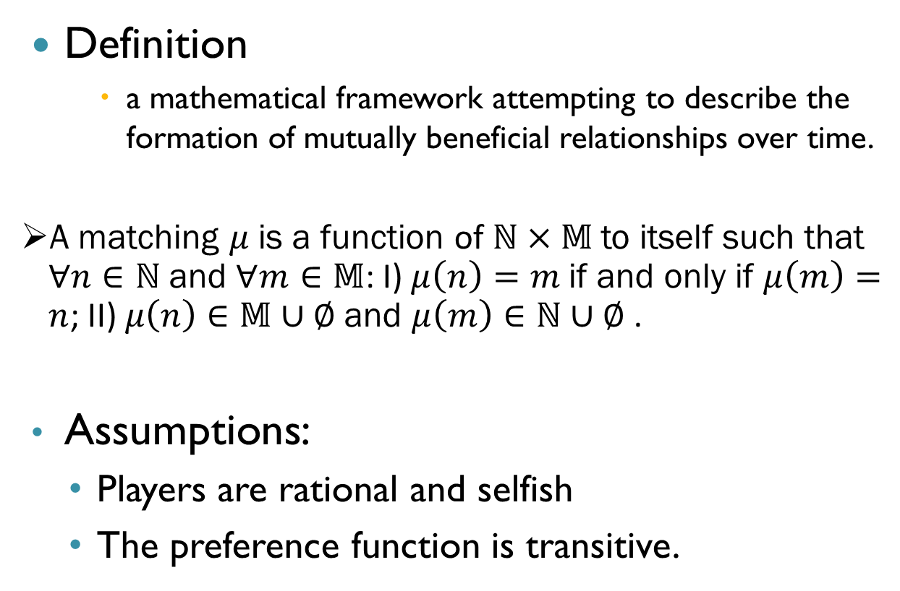
Matching Theory
Definition
a mathematical framework attempting to describe the formation of mutually beneficial relationships over time.
A matching $μ$ is a function of $ℕ×𝕄$ to itself such that $∀n∈ℕ$ and $∀m∈𝕄$: I) $μ\left(n\right)=m$ if and only if $μ\left(m\right)=n$; II) $μ\left(n\right)∈𝕄∪∅$ and $μ\left(m\right)∈ℕ∪∅$ .
Assumptions:
Players are rational and selfish
The preference function is transitive.

Slide 15
Matching Problem with Complete Preference List
Three types of matching problems
One-to-one (stable marriage)
Assigning channels to agents
One-to-many (college admissions)
Assigning servers to agents
Many-to-many (complex scenarios)

Slide 16
Solution Concepts
We seek to find a stable matching such that
There does not exist any pair of players, i and j matches, respectively to players, a and b but..
j prefers a to b and a prefers j to i
How can we find a stable matching?
many approaches(minimizing sum/ max of ranks, minimizing diff of total ranks, Gale and Shapley algorithm)
Most popular: Deferred acceptance or GS algorithm
Illustrated via an example

Slide 17
Example 1: Matching partners
Adam
Fran
Bob
Geeta
Carl
Heiki
David
Irina
women and men be matched
respecting their individual preferences

Slide 18
Example 1: Matching partners
The Gale-Shapley algorithm can be set up in two alternative ways:
men propose to women
women propose to men
Each man proposing to the woman he likes the best
Each woman looks at the different proposals she has received (if any)
retains what she regards as the most attractive proposal (but defers from accepting it) and rejects the others
The men who were rejected in the first round
Propose to their second-best choices
The women again keep their best offer and reject the rest
Continues until no men want to make any further proposals
Each of the women then accepts the proposal she holds
The process comes to an end

Slide 19
Here Comes the Story…
Geeta, Heiki, Irina, Fran
Adam, Bob, Carl, David
Adam
Fran
Irina, Fran, Heiki, Geeta
Carl, David, Bob, Adam
Bob
Geeta
Geeta, Fran, Heiki, Irina
Carl, Bob, David, Adam
Carl
Heiki
Irina, Heiki, Geeta, Fran
Adam, Carl, David, Bob
David
Irina

Slide 20
Search for possible matching
X
Adam
Geeta
David
Heiki
Blocking Pair
Geeta prefers Carl to Adam!
Bob
Irina
Carl
Fran
Carl likes Geeta better than Fran!

Slide 21
Stable Matching
Adam
Heiki
David
Irina
Bob and Irina are not a blocking pair
Unfortunately,
Irina loves David better!
Stable Matching: a matching without blocking pairs
Bob
Fran
Carl
Geeta
Bob likes Irina better than Fran!

Slide 22
GS Algorithm
×
1: a c b d e a: 2 1 3 4 5
2: c a e b d b: 2 1 4 5 3
3: b a e d c c: 1 2 3 5 4
4: c b d e a d: 3 1 4 2 5
5: c d b e a e: 4 3 1 2 5
×
1, 2, 3, 4 ,5
represent men
a, b, c, d,e
represent women
×
×
×
×
×
×
no blocking pairs
Notes:
(3,b) is not a blocking pair since b has a better guy than 3.

Slide 23
Properties of Matching
The setup of the algorithm have important distributional consequences
it matters a great deal whether
the right to propose is given to the women or to the men
If the women propose
the outcome is better for them than if the men propose
Conversely, the men propose
leads to the worst outcome from the women’s perspective
Optimality is defined on each side, difficult to guarantee on both sides
The matching may not be unique

Slide 24

Part III: Stackelberg Games

Slide 25
Stackelberg Games
Stackelberg models are a classic real-life example of bi-level programming.
The upper level is called leader. It makes the first move and has all relevant information about the possible actions the follower might take in response to his own actions.
On the other hand, the follower usually observes and reacts optimally to the actions of the leader.
The leader solves a Stackelberg competition model in order to determine the optimal actions which he should take.

Slide 26
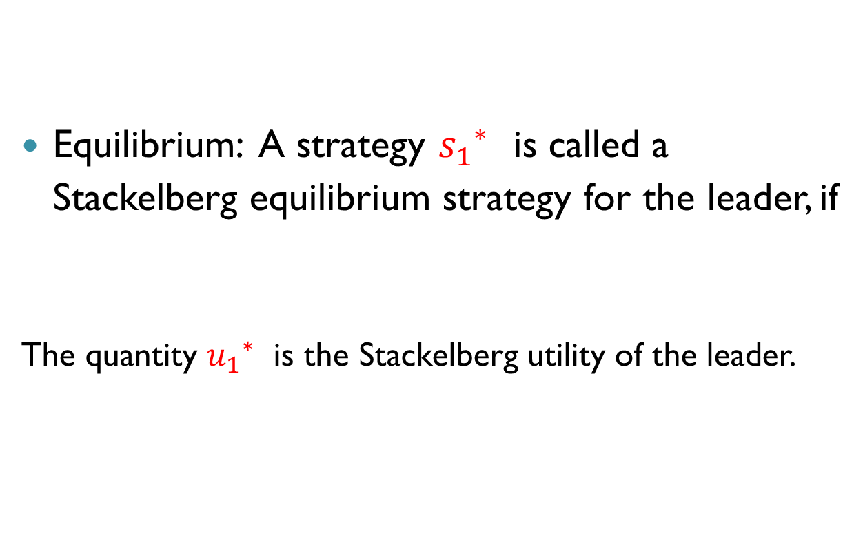
Definition: Stackelberg Equilibrium
Equilibrium: A strategy ${s_{1}}_{}^{∗}$ is called a Stackelberg equilibrium strategy for the leader, if
The quantity ${u_{1}}_{}^{∗}$is the Stackelberg utility of the leader.

Slide 27
Applications
Whenever there is hierarchy in decision making process, Stackelberg game is suitable for modeling.
Cognitive radio: resource allocation
Relay networks: bandwidth allocation
Optimal Control

Slide 28
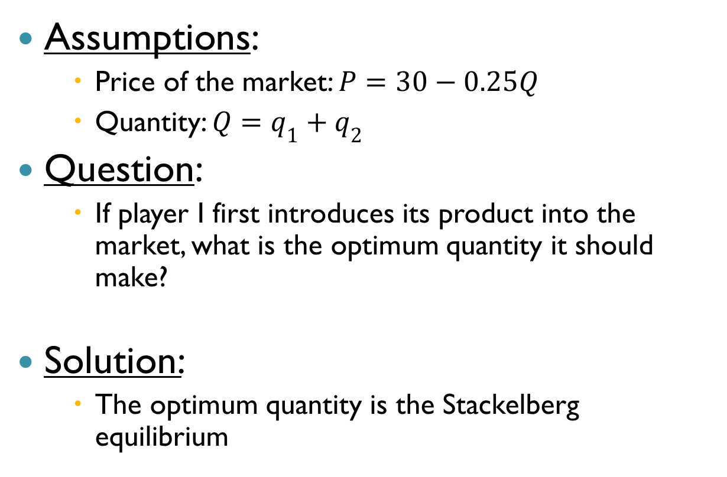
Example I: simple firm production
Assumptions:
Price of the market: $P=30−0.25Q$
Quantity: $Q=q_{1}+q_{2}$
Question:
If player I first introduces its product into the market, what is the optimum quantity it should make?
Solution:
The optimum quantity is the Stackelberg equilibrium

Slide 29





Example I continued…
Response function of follower:
Plugging it into utility function of leader, we get:
$$π_{2}=\left(30−0.25q_{1}−0.25q_{2}\right)q_{2}−q_{2}$$
$$\frac{∂π_{2}}{∂q_{2}}=0$$
$$q_{2}=58−0.5q_{1}$$
$$π_{1}=\left(30−0.25q_{1}−0.25(58−0.5q_{1})\right)q_{1}−q_{1}$$
$$\frac{∂π_{1}}{∂q_{1}}=0$$
$$q_{1}=58$$
$$q_{2}=29$$

Slide 30
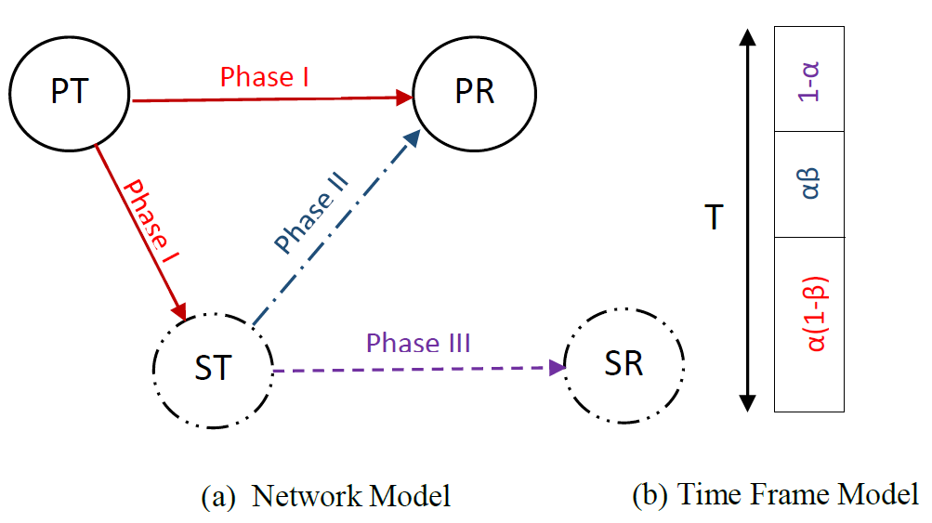
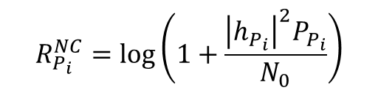

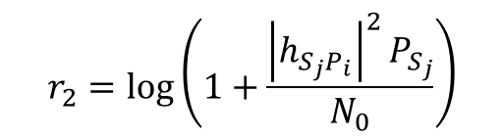
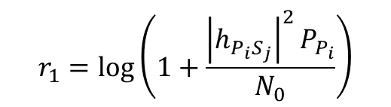
Example II: Time Allocation in Cognitive Radio
Transmission rate:
Primary user (leader) utility:
$$R_{P_{i}}^{NC}=\log\left(1+\frac{{\left|h_{P_{i}}\right|}^{2}P_{P_{i}}}{N_{0}}\right)$$
$$r_{1}=\log\left(1+\frac{{\left|h_{P_{i}S_{j}}\right|}^{2}P_{P_{i}}}{N_{0}}\right)$$
$$r_{2}=\log\left(1+\frac{{\left|h_{S_{j}P_{i}}\right|}^{2}P_{S_{j}}}{N_{0}}\right)$$
$$R_{P_{i}}^{C}\left(α_{ij},β_{ij},P_{S_{j}}\right)=min\left(\left(1−α_{ij}\right)r_{1},α_{ij}β_{ij}r_{2}\right)$$

Slide 31
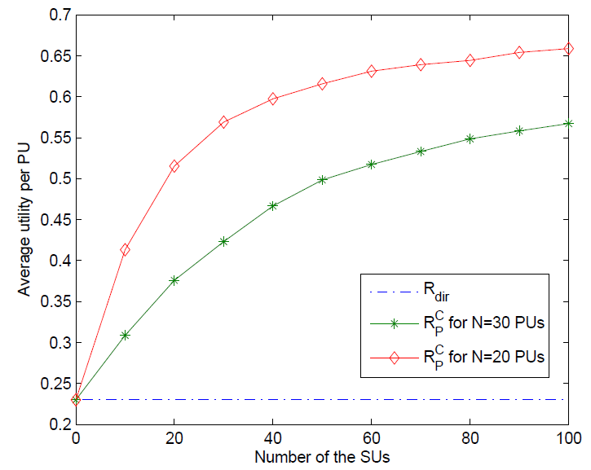
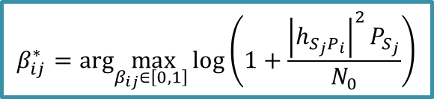

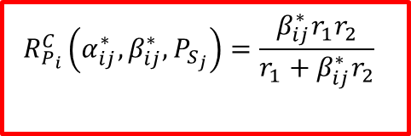
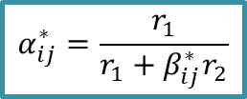
Optimum Time Sharing Parameters
Using backward induction according to Stackelberg game; we can find the optimum values for ${(α}_{ij},β_{ij})$ as:
$$β_{ij}^{∗}=arg\max_{β_{ij}∈\left[0,1\right]}\log\left(1+\frac{{\left|h_{S_{j}P_{i}}\right|}^{2}P_{S_{j}}}{N_{0}}\right)$$
$$α_{ij}^{∗}=\frac{r_{1}}{r_{1}+{β_{ij}^{∗}r}_{2}}$$
$$R_{P_{i}}^{C}\left(α_{ij}^{∗},β_{ij}^{∗},P_{S_{j}}\right)=\frac{β_{ij}^{∗}{r_{1}r}_{2}}{r_{1}+{β_{ij}^{∗}r}_{2}}$$

Slide 32

Part IV: Coalition Games

Slide 33
Coalition Games
Robot Networks witness a highly complex and dynamic environment whereby the nodes can interact and cooperate for improving their performance.
In this context, cooperation has emerged as a novel communication paradigm that can yield tremendous performance gains from the physical layer all the way up to the application layer

Slide 34
a significant amount of research efforts has been dedicated to studying cooperation in wireless networks.
Examples of cooperation:
MIMO: reduction of BER
Relay forwarding: throughput increase, improving connectivity

Slide 35
But…. What is the cost of cooperation? The impact on the network structure? How to model it?
Challenges of modeling:
Cooperation entails cost: power
It is desirable to have a distributed algorithm
Solution? Coalition game theory

Slide 36
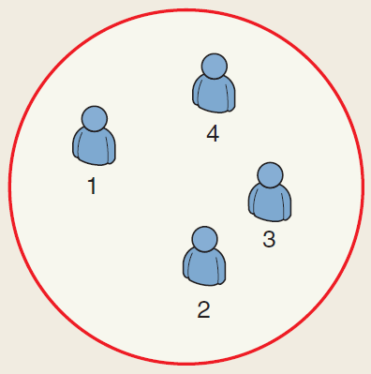
Cooperative Coalitional Game Theory
Canonical Coalition Game
It is beneficial to all players to join the coalition. Grand coalition is the optimal solution
Main objective:
properties and stability of grand coalition
how to distribute gain from cooperation in fair manner between player (Core)
Pay-off allocation solution : Core, Shapley value

Slide 37
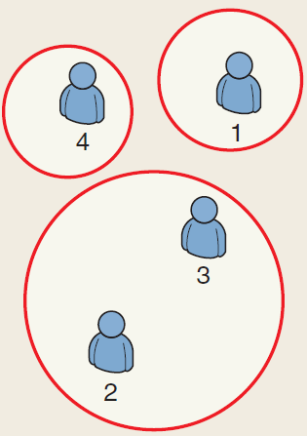
Cooperative Coalitional Game Theory
Coalition Formation Game
Forming a coalition brings gains to its members, but the gains are limited by a cost for forming the coalition
Main objective
optimal coalition size
assess the structure’s characteristics

Slide 38
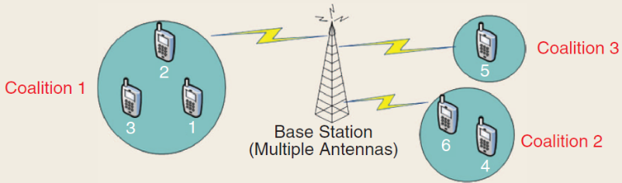
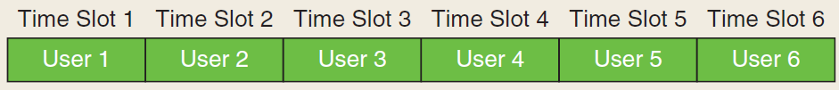
Application in Wireless Network
Virtual MIMO
A single transmitter sends data in a TDMA system to multiple receivers.
Non-cooperative approach:
Sending the data in an allotted slot.
Cooperative approach:
For improving their capacity, the receivers form coalitions, whereby each coalition S is seen as a single user MIMO that transmits in the slots that were previously held by the users of S.

Slide 39
Applications:
Distributed task allocation in multi-agent systems
Network formation in multihop networks
Distributed collaborating environment sensing

Slide 40
Conclusion
Game theory is a suitable mathematical framework to model and analyze the interaction among the agents.
Three types of game are of special interest in protocol designing for wireless networks:
Matching games
Stackelberg games
Coalition games

Slide 41
Future work
Power control in heterogeneous networks, considering different scenarios for the users, QoS, capacity, etc.
Designing distributed algorithms for coalition games which can be efficiently implemented within the network.
Matching algorithm when the preferences of the agents are dynamic and change.

Slide 42
References
[1] N. Namvar, W Saad, B Maham, S Valentin; “A context-aware matching game for user association in wireless small cell networks”, IEEE International Conference on Acoustics, Speech and Signal Processing (ICASSP), 2014.
[2] N. Namvar, F Afghah, “Spectrum sharing in cooperative cognitive radio networks: A matching game framework”, IEEE 49th Annual Conference on Information Sciences and Systems (CISS), Feb. 2015
[3] N. Namvar, W Saad, B Maham, “Cell Selection in Wireless Two-Tier Networks: A Context-Aware Matching Game”, EAI Endorsed Transactions on Wireless Spectrum 14
[4] N. Namvar, N. Bahadori, F. Afghah, “D2D Peer Selection for Load Distribution in LTE Networks”, IEEE 49th Asilomar Conference on Signals, Systems and Computers, 2015.
[5] Z. Han, D. Niyato, W. Saad, T. Başar, and A. Hjørungnes, "Game Theory in Wireless and Communication Networks: Theory, Models, and Applications," in print, Cambridge University Press, 2011.

Slide 43

Perhaps it is good to have a beautiful mind, but an even greater gift is to discover a beautiful heart.
-John Nash
Thank You!

