Slide 1
CS ANALYTICAL LABORATORY
An opportunity brief.
Market, growth paths,
and the agentic-AI question.
Prepared by Bruce Longley · TSI-Citadel
For Alan Weiss · Chief Financial Officer · CS Analytical Laboratory
May 2026 · bruce@tsicitadel.ai

Slide 2
WHY THIS BRIEF
TSI-CITADEL · OPPORTUNITY BRIEF
Why we're sending this
CS Analytical has been on our
watchlist for two years.
The last six months made the
watchlist a working file.
The Clifton expansion, RM Analytical, USP <382>, and the GLP-1
wave all landed in the same quarter. That is the signal.
Prepared for Alan Weiss · CFO, CS Analytical Laboratory · Confidential
02 / 13

Slide 3
THE COMPANY
TSI-CITADEL · OPPORTUNITY BRIEF
CS Analytical at a glance — outside view
The only cGMP-built,
FDA-regulated lab in the world
dedicated to container testing.
Where
What
Who
Recent moves
Clifton, New Jersey.
Expansion under way to
double the current footprint.
USP <1207> deterministic
portfolio: helium leak, vacuum
decay, HVLD, laser-headspace.
USP <382>, Annex 1, microbial.
Founding-team pedigree on
the world's first cGMP CCIT
lab. PhD-staffed, founder-led,
client-facing scientists.
RM Analytical (raw materials,
Feb 2026). Micro testing —
USP <87>, <788>. USP/EP gas.
Lab doubling (May 2026).
Prepared for Alan Weiss · CFO, CS Analytical Laboratory · Confidential
03 / 13

Slide 4
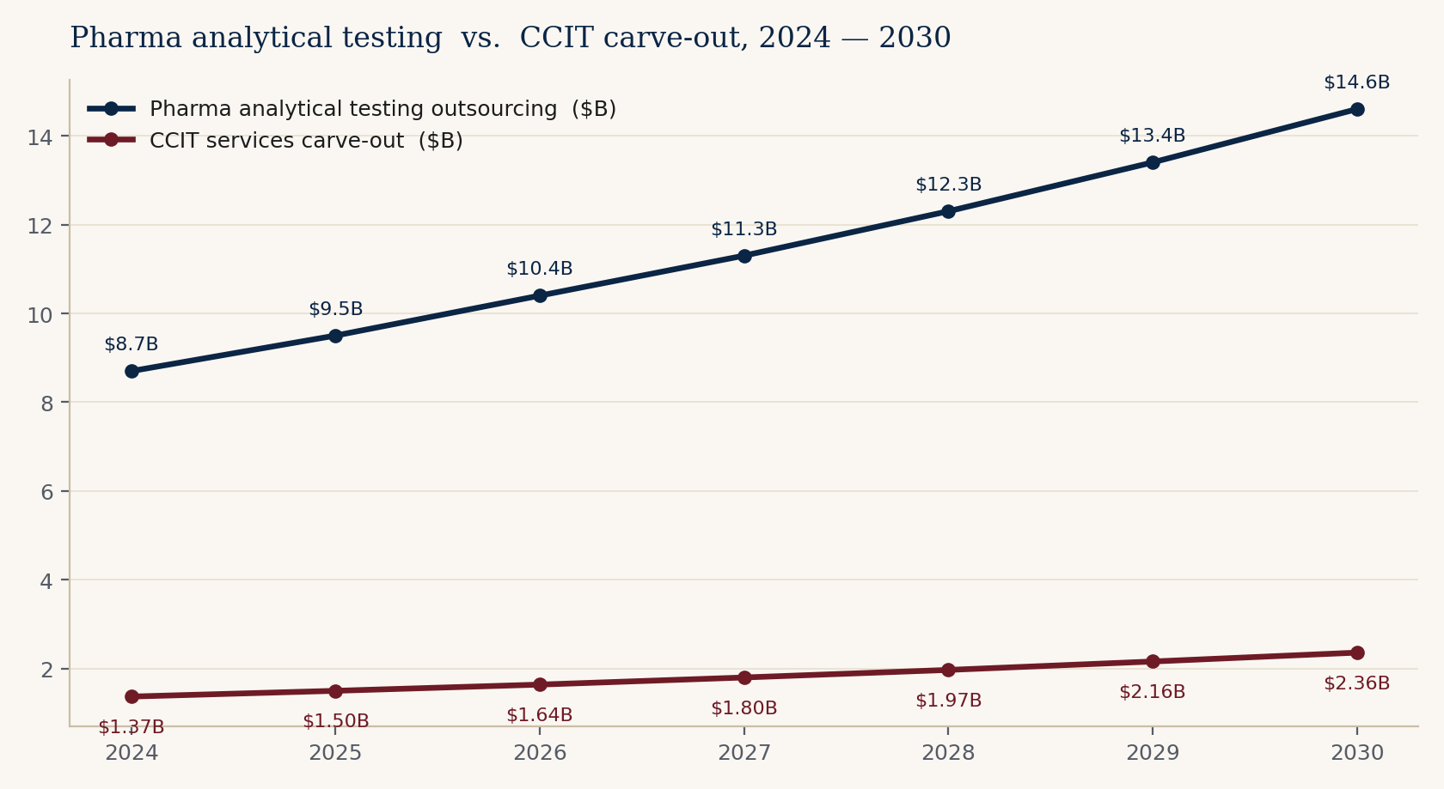
THE MARKET
TSI-CITADEL · OPPORTUNITY BRIEF
What sits in front of you
A $9.5 B host market —
and a $1.5 B niche moving with it.
Pharma analytical testing
outsourcing: $9.5 B (2025),
~9% CAGR through 2030.
CCIT services carve-out:
$1.5 B (2025), ~9-10% CAGR.
$2.4 B by 2030.
No single CCIT-pure provider
holds more than mid-single
digit share. The room is open.
Sources (composite midpoints, 2026): Precedence Research, Market Research Future, Data Horizzon, Roots Analysis.
Prepared for Alan Weiss · CFO, CS Analytical Laboratory · Confidential
04 / 13

Slide 5
TAILWINDS
TSI-CITADEL · OPPORTUNITY BRIEF
Four forces, one quarter
Each of these alone would justify
a faster plan. All four landed at once.
USP <382>
Annex 1 convergence
GLP-1 / PFS wave
Biologics share
Effective Dec 1, 2025.
System-level functional
suitability testing of
elastomeric components.
Responsibility shifts to
the drug manufacturer.
EU GMP Annex 1 now
mandates validated
deterministic CCIT.
Visual inspection alone
is no longer acceptable.
Global alignment is here.
Prefilled syringe market
$9.7 B (2025) → $18.1 B
(2031). GLP-1 autoinjectors
at 15.6% CAGR. Shift to
COP barrels. Volumes
punish defect rates.
Biologics now ~40% of
FDA novel approvals.
Every one ships in a
sterile primary container.
Glass-delamination recalls
are in the news again.
Prepared for Alan Weiss · CFO, CS Analytical Laboratory · Confidential
05 / 13

Slide 6
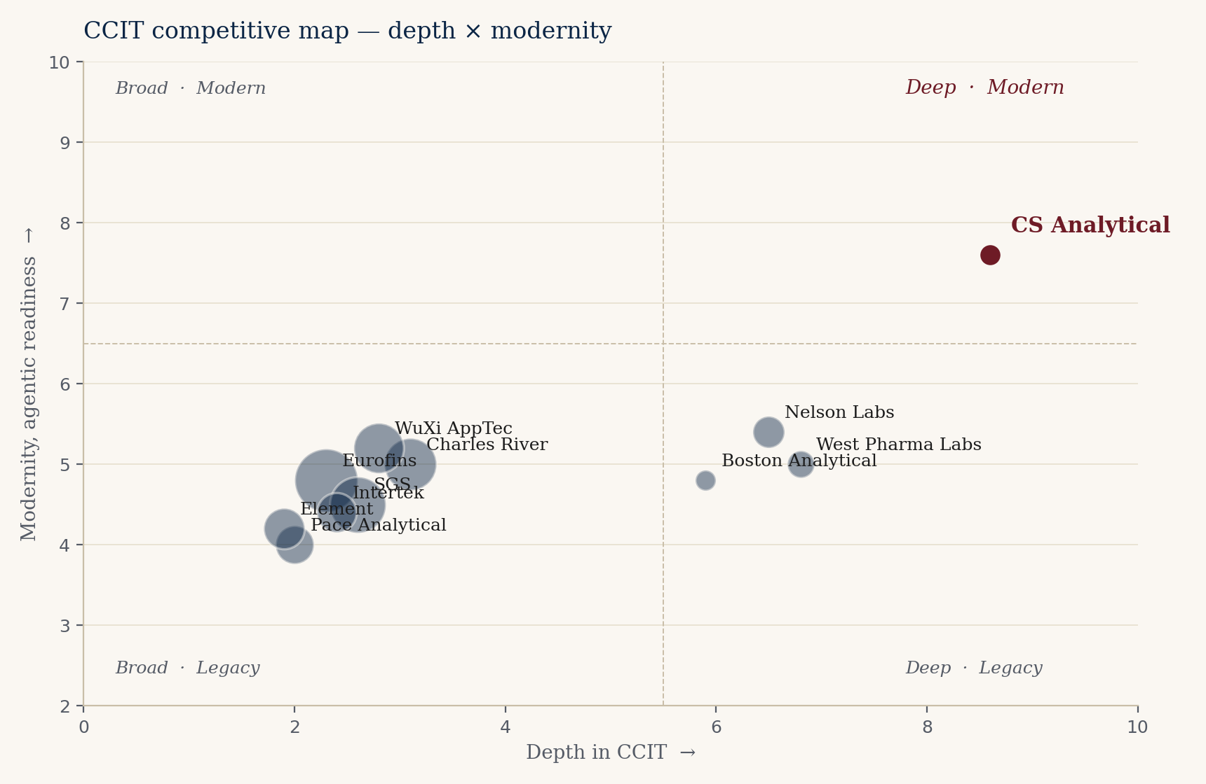
THE COMPETITIVE FIELD
TSI-CITADEL · OPPORTUNITY BRIEF
Who else is in the room
Generalists are broad. Specialists
are few. The corner is open.
Eurofins, SGS, Charles River,
WuXi, Pace, Intertek, Element
— broad, deep pockets, shallow
on CCIT specifically.
Nelson Labs, Boston Analytical,
West Pharma Labs — credible
specialists, slower to modernize.
The deep-and-modern corner is
structurally empty. CS Analytical
is the credible occupant.
Prepared for Alan Weiss · CFO, CS Analytical Laboratory · Confidential
06 / 13

Slide 7
ALREADY IN MOTION
TSI-CITADEL · OPPORTUNITY BRIEF
What CS Analytical is already doing right
This is not a turnaround brief.
It is an acceleration brief.
RM Analytical launch
Clifton expansion
Micro & gas testing
USP <382> readiness
Feb 2026. Raw material and
excipient testing under a sister
brand. Genuine adjacent revenue.
May 2026. Doubling the lab
footprint. Capacity is being built
ahead of demand, not behind it.
USP <87> biological reactivity,
USP <788> particle size, USP/EP
gas. Cross-sell into existing book.
Already running elastomer
functionality. The Dec 2025 wave
will find capacity here, not
elsewhere.
Prepared for Alan Weiss · CFO, CS Analytical Laboratory · Confidential
07 / 13

Slide 8
ORGANIC GROWTH — NO AI REQUIRED
TSI-CITADEL · OPPORTUNITY BRIEF
Five paths that don't require an AI partner
Each is buildable on the
existing team and footprint.
01
USP <382> wave capture
Be the named lab for the post-Dec 2025 elastomer functional-suitability rush.
02
GLP-1 / PFS HVLD productization
Productized high-voltage leak detection for COP-barrel autoinjectors. Repeatable, high-margin.
03
Annex 1 European mandate
EU GMP Annex 1 deterministic CCIT requirement opens European sponsors. Reciprocal-recognition path.
04
Cell, gene & cryo container methods
New container formats with no incumbent method. Highest margin per study in the market.
05
Regulatory consulting carve-out
Productize the advisory work the team gives away today. Higher margin than the bench.
Prepared for Alan Weiss · CFO, CS Analytical Laboratory · Confidential
08 / 13

Slide 9
AGENTIC AI — TSI-CITADEL ANGLE
TSI-CITADEL · OPPORTUNITY BRIEF
Where TSI-Citadel multiplies what's here
The healthcare agentic-AI category
is tracking 9× growth, 2024 → 2030.
These are the five we'd build first.
Regulatory intel
Market radar
BD operations
Scientific surveillance
Continuous monitoring of USP,
EP, JP, PIC/S, FDA 483s, warning
letters. Resolves changes against
client filed methods. The single
highest-value agent post-<382>.
FDA filings, ClinicalTrials.gov,
conference rosters, container-
vendor releases. Daily ingest,
weekly BD shortlist with
evidence linked.
Outbound drafting, qualification,
follow-up, meeting prep, post-call
summary. Returns founder and
scientist time.
Daily distillation of CCIT, HVLD,
leak-detection, vendor white-
paper literature. Methods surface
before the client asks.
Prepared for Alan Weiss · CFO, CS Analytical Laboratory · Confidential
09 / 13

Slide 10
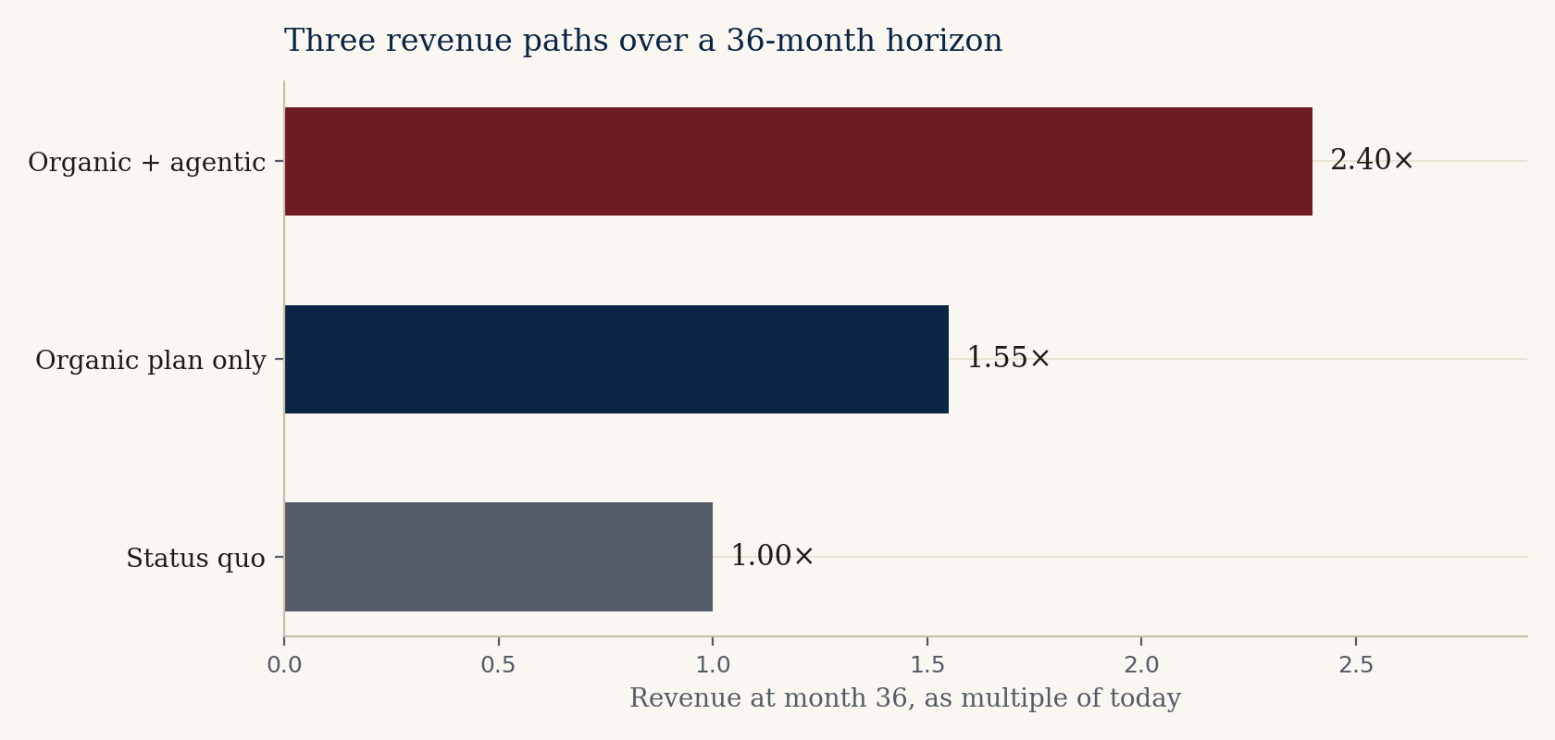
ROI SHAPE — FOR THE CFO
TSI-CITADEL · OPPORTUNITY BRIEF
Three readings of the same 36 months
Status quo. Organic. Organic + agentic.
PAYBACK ON THE AGENTIC LAYER
Conservative case: 9-12 months.
Carried by founder-calendar
recovery and quote-cycle reduction
alone.
Aggressive case: 4-6 months.
Driven by net-new BD opportunities
the radar surfaces and the
proposal agent closes.
Capital required: low six figures.
Not a transformation. A bolt-on.
Prepared for Alan Weiss · CFO, CS Analytical Laboratory · Confidential
10 / 13

Slide 11
ADJACENT OPPORTUNITIES
TSI-CITADEL · OPPORTUNITY BRIEF
Where else this team could play
Adjacencies, not pivots.
Optional, not required.
Combination products
Cross-center (CDER + CDRH) submissions. Few incumbent labs are
ready. Margin profile is favorable.
Device sterilization validation
ISO 11135 / 11137 adjacency to existing container work. Natural cross-
sell into the same sponsor base.
Compounding pharmacy testing
USP <797>, <800>. Different regulatory floor; same testing physics.
Fragmented buyer base, less competition.
Veterinary biologics
Same containers, smaller competitive set, USDA channel.
Underpriced relative to human-side work.
Industry training & certification
The team's reputation is a productizable asset. Course revenue
is high margin and is itself a BD funnel.
Prepared for Alan Weiss · CFO, CS Analytical Laboratory · Confidential
11 / 13

Slide 12
RISKS — NAMED, NOT GLOSSED
TSI-CITADEL · OPPORTUNITY BRIEF
What we'd want to disagree about
Three CFO-relevant risks,
three handlings.
Capital timing
Lab expansion + RMA build + agentic spend in one fiscal year.
Handling: sequence the agentic spend behind the lab build;
agentic stack pays for itself in <12 months.
Margin dilution from adjacencies
Raw-material and micro work carries lower gross margin than
CCIT. Handling: hold the CCIT premium pricing while RMA scales;
use agentic intel to keep CCIT pipeline full.
Agentic-AI hallucination in regulated context
An agent that flags a false USP change can damage a sponsor
relationship. Handling: human-in-the-loop on every flag that
touches a client filed method. Suggested, not authoritative.
Prepared for Alan Weiss · CFO, CS Analytical Laboratory · Confidential
12 / 13

Slide 13
IF YOU WANTED TO WORK WITH US
TSI-CITADEL · OPPORTUNITY BRIEF
How TSI-Citadel would engage
Light footprint. Boxed scope.
Measurable from day one.
DAYS 1 — 30
DAYS 31 — 60
DAYS 61 — 90
Diagnostic
Two agents live
Decide
Sit with the BD, regulatory,
and operations leads. Map
the data feeds, the cycles,
and the moments. No code
yet. A written read-out and
a go / no-go at day 30.
Regulatory-intel and market-
radar agents, wired to real
feeds. Daily output to a
named internal user. First
measurable lift inside the
period.
Joint readout. Numbers. The
three remaining agents are
built only if the first two have
earned them. The CFO
holds the gate, by design.
Prepared for Alan Weiss · CFO, CS Analytical Laboratory · Confidential
13 / 13

Slide 14
THE NEXT CONVERSATION
Read the long form
on a plane.
Then tell us where
we're wrong.
Bruce Longley
TSI-Citadel
bruce@tsicitadel.ai

