Slide 1
CS ANALYTICAL LABORATORY
An executive brief
on market, opportunity,
and the case for agentic AI.
Prepared for Al Weiss
By Brian Mulhall · Chief Executive Officer · CS Analytical
May 2026

Slide 2
THE THESIS
CS ANALYTICAL · EXECUTIVE BRIEF
One sentence.
Container Closure Integrity is the
single most regulated, most ignored,
and most under-served line item
on a sterile-drug spec sheet.
CS Analytical exists to fix that — and to scale the
fix with agentic AI partners.
Prepared for Al Weiss · Confidential
02 / 12

Slide 3
THE OPERATOR
CS ANALYTICAL · EXECUTIVE BRIEF
Brian Mulhall — Chief Executive Officer
Thirty years building the labs the
industry actually trusts.
1990s
Late 1990s
2002 — 2015
2015 — today
Sales, marketing,
and national management
at Organon (Schering Plough)
and Ferring.
VP, Pharmaceutical Services,
SGS US Testing — chemistry,
microbiology, and toxicology
across the U.S. and Canada.
Founded Whitehouse
Analytical Laboratories.
Built to 48 FTE, 25,000 sq ft.
Sold in 2015.
CEO, Leak Detection Associates.
Advisor and BD lead, Visikol.
Now CEO, CS Analytical.
Architect of the first FDA-regulated, cGMP Container Closure Integrity Testing laboratory in the world — the work that informed USP <1207>.
Prepared for Al Weiss · Confidential
03 / 12

Slide 4
THE COMPANY
CS ANALYTICAL · EXECUTIVE BRIEF
CS Analytical Laboratory
A center of excellence,
not a generalist lab.
Specialty depth
Regulatory posture
Operator's company
CCIT done at a level the
big labs can't staff for —
helium leak, HVLD, vacuum
decay, dye ingress, methods
development, validation.
Built to USP <1207>.
cGMP from the floor up.
Methods filed, not promised.
The inspectors already
know the address.
Founder-led, scientist-staffed,
client-facing PhDs. No
hand-offs. The person
running your study is the
person who designed it.
Prepared for Al Weiss · Confidential
04 / 12

Slide 5
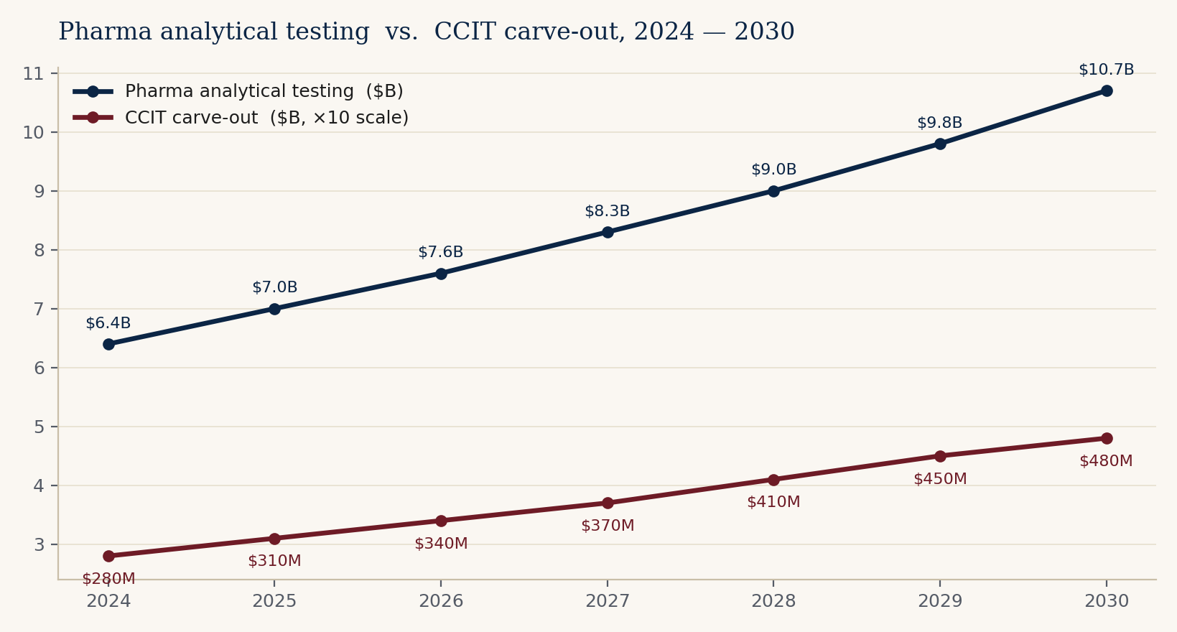
THE MARKET
CS ANALYTICAL · EXECUTIVE BRIEF
Where the money sits
A $6–7 B contract analytical market —
and a $300 M niche growing twice as fast.
Pharma analytical testing
overall: $6.4 B, ~9% CAGR.
CCIT carve-out: $280 M
today → $475 M by 2030.
That is the bet:
the carve-out grows faster
than the host market — and
CS Analytical is built for the
carve-out, not the host.
Figures are illustrative composites of publicly cited industry ranges (Grand View, Markets and Markets, BioPlan). Intended for strategic discussion.
Prepared for Al Weiss · Confidential
05 / 12

Slide 6
TAILWINDS
CS ANALYTICAL · EXECUTIVE BRIEF
Why now
Four forces are pushing CCIT
from afterthought to gating step.
Biologics
GLP-1s
Cell, gene, mRNA
USP <1207>
Roughly 40% of FDA novel
approvals are biologics. Every
one of them ships in a sterile
primary container.
Multi-pen, pre-filled,
high-volume launches.
Integrity defects scale
with volume.
Cryo storage. Closed systems.
No room for leak. Methods
don't yet exist for half of
these formats.
Deterministic methods are
the expectation. Probabilistic
methods are increasingly
defensive only.
Prepared for Al Weiss · Confidential
06 / 12

Slide 7
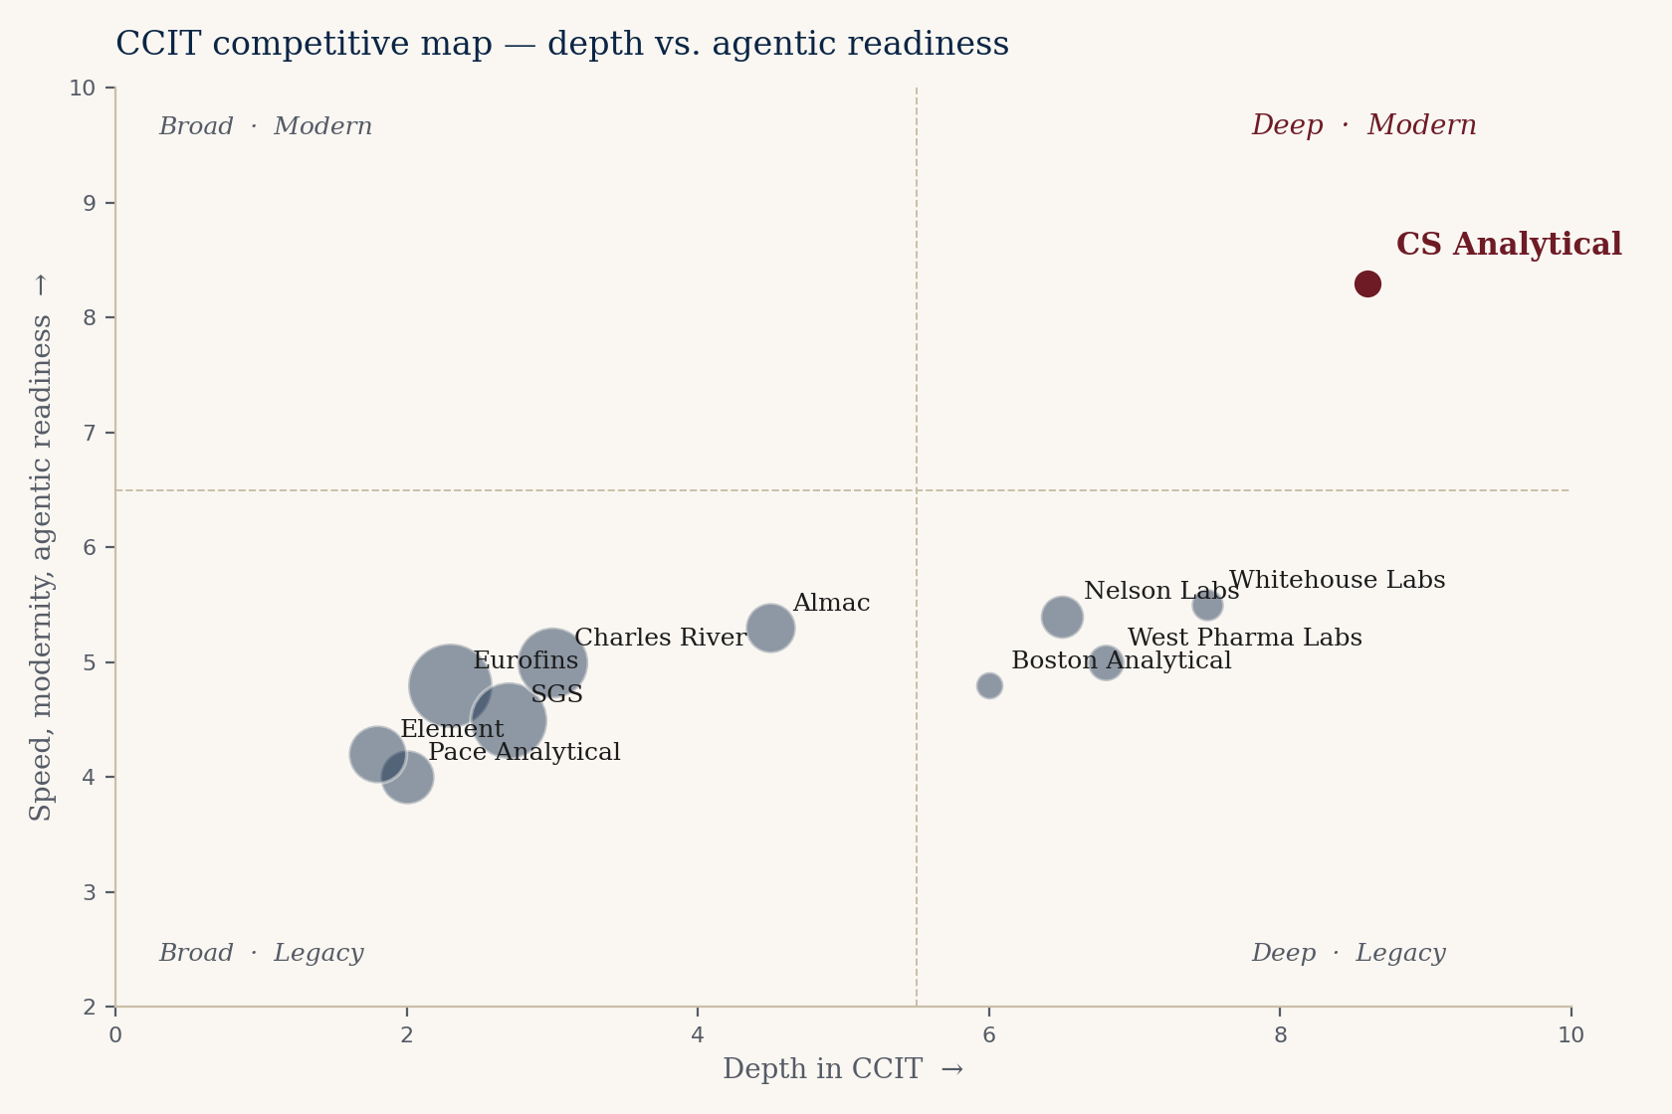
THE FIELD
CS ANALYTICAL · EXECUTIVE BRIEF
Who is in the room
Big labs are broad. CCIT
specialists are few.
The big-five generalists —
Eurofins, SGS, Charles River,
Pace, Element — win on
footprint and pricing power.
The specialists — Nelson Labs,
Whitehouse, Boston Analytical,
West — win on depth in one
or two modalities.
The upper-right quadrant —
deep AND modern AND fast —
is essentially empty. That is
the CS Analytical position.
Prepared for Al Weiss · Confidential
07 / 12

Slide 8
THE EDGE
CS ANALYTICAL · EXECUTIVE BRIEF
Why clients pick us
Vendor-neutral, method-led,
founder-accountable.
Vendor-neutral
We own no leak-detection platform — so we recommend the right one. PTI, LDA, Bonfiglioli, ATEQ — we run them all and tell you which fits your container.
Method-led, not box-led
We start with the molecule, the container, and the failure mode. The instrument is the last decision, not the first.
Founder-accountable
Brian signs the study report. There is no account manager between the client and the scientist.
Built to be inspected
Every CS Analytical method is filed with FDA-readiness as the design goal — not a retrofit.
Prepared for Al Weiss · Confidential
08 / 12

Slide 9
GROWTH VECTORS
CS ANALYTICAL · EXECUTIVE BRIEF
Where we want to go
Five vectors. Sequenced, not
stacked.
01
Sterile-injectable CCIT
The core. Defend, deepen, raise price.
02
Cell & gene cryo containers
New methods, new formats. First mover.
03
Pre-filled syringe / autoinjector
GLP-1 wave demands repeatable HVLD.
04
Combination products & device-led
FDA cross-center — few labs are ready.
05
Regulatory consulting carve-out
Sell the brain, not just the bench.
Prepared for Al Weiss · Confidential
09 / 12

Slide 10
THE AGENTIC LAYER
CS ANALYTICAL · EXECUTIVE BRIEF
Where TSI Citadel multiplies us
We are a 48-person lab.
Agentic AI gives us a 480-person reach.
Market radar
Regulatory intelligence
BD operations
Scientific literature
Continuous scan of FDA filings,
clinical trials, conference rosters,
container-vendor catalogs — turned
into a weekly BD shortlist.
Track USP, EP, JP, PIC/S changes
in real time. Flag the ones that
break a client's filed method.
Outbound, qualification, follow-up,
meeting prep. The work that
adds no science but consumes
founder hours.
Daily distillation of CCIT, HVLD,
helium-leak, and container-vendor
literature. Methods updates surfaced
before the customer asks.
Prepared for Al Weiss · Confidential
10 / 12

Slide 11
NINETY DAYS
CS ANALYTICAL · EXECUTIVE BRIEF
What we'd do first
Three workstreams, ninety days,
one readout.
DAYS 1—30
DAYS 31—60
DAYS 61—90
Stand up the agentic stack
Pilot two growth vectors
Package and price
TSI Citadel agents wired to FDA,
ClinicalTrials.gov, USP, EP, PIC/S,
conference rosters, container-vendor
release feeds. Weekly BD digest live.
Cryo-container method development and
autoinjector HVLD. Two named pilot
clients each. Methods drafted, quotes
out, first revenue booked.
Productized CCIT-as-a-service tier.
Regulatory-consulting carve-out
priced. Public case studies (two)
with client co-sign.
Prepared for Al Weiss · Confidential
11 / 12

Slide 12
THE ASK
CS ANALYTICAL · EXECUTIVE BRIEF
What we'd love your help on
An introduction. A read. A reaction.
Introduction
A warm hand-off to the TSI Citadel team — at the
level where the agentic-platform partnership
conversation can actually begin.
A read
Twenty minutes of your eyes on the long-form
market brief. Tell us where the thesis is thin and
where it's right.
A reaction
If you see a client, a partner, or a hire we should
be in front of — say the name. We'll do the rest.
Prepared for Al Weiss · Confidential
12 / 12

Slide 13
THANK YOU
The right work,
in the right container,
at the right cadence.
Brian Mulhall
Chief Executive Officer · CS Analytical Laboratory
brian.mulhall@csanalytical.com

