Slide 1
CS ANALYTICAL LABORATORY
An opportunity brief.
Market, growth paths,
and the agentic-AI question.
Prepared by Bruce Longley · TSI-Citadel
For Alan Weiss · Chief Financial Officer · CS Analytical Laboratory
May 2026 · bruce@tsicitadel.ai

Slide 2
THE THESIS
TSI-CITADEL · OPPORTUNITY BRIEF
Why we're sending this
Three industry shifts compounded
in one six-month window.
USP <382> · Dec 1 2025
FDA agentic AI · Dec 1 2025
Nelson Labs publicly acquisitive · May 2026
Elastomer functional suitability
shifts to the drug manufacturer.
USP: 'early adoption is encouraged.'
All FDA employees — including
inspectors — receive secure
agentic AI. Regulator is no longer
agentically naive.
Sotera Health Q1 2026: 'exploring
strategic acquisitions to enhance
Nelson Labs' pharmaceutical
capabilities.' NJ precedent exists.
Prepared for Alan Weiss · CFO, CS Analytical Laboratory · Confidential
02 / 17

Slide 3
THE COMPANY
TSI-CITADEL · OPPORTUNITY BRIEF
CS Analytical at a glance — outside view
The only cGMP-built,
FDA-regulated lab in the world
dedicated to container testing.
Where & what
Who — leadership
Recent moves
Position
Clifton, NJ. Doubling lab
space, May 2026. USP <1207>
deterministic portfolio plus
USP <382>, <87>, <788>,
gas, micro.
Brian Mulhall, CEO. Alan Weiss,
CFO, leading finance, BD, HR.
Brandon Zurawlow, CSO —
PDA TR-86 contributor.
Founder-led, PhD-staffed.
RM Analytical launch (Feb 2026).
Clifton doubling (May 2026).
Interphex 2026 showcase: IV bag
CCIT, <382>, cell-therapy
distribution testing.
Vendor-neutral. Method-led.
Founder-accountable on every
study. Inspected by design,
not retrofit.
Prepared for Alan Weiss · CFO, CS Analytical Laboratory · Confidential
03 / 17

Slide 4
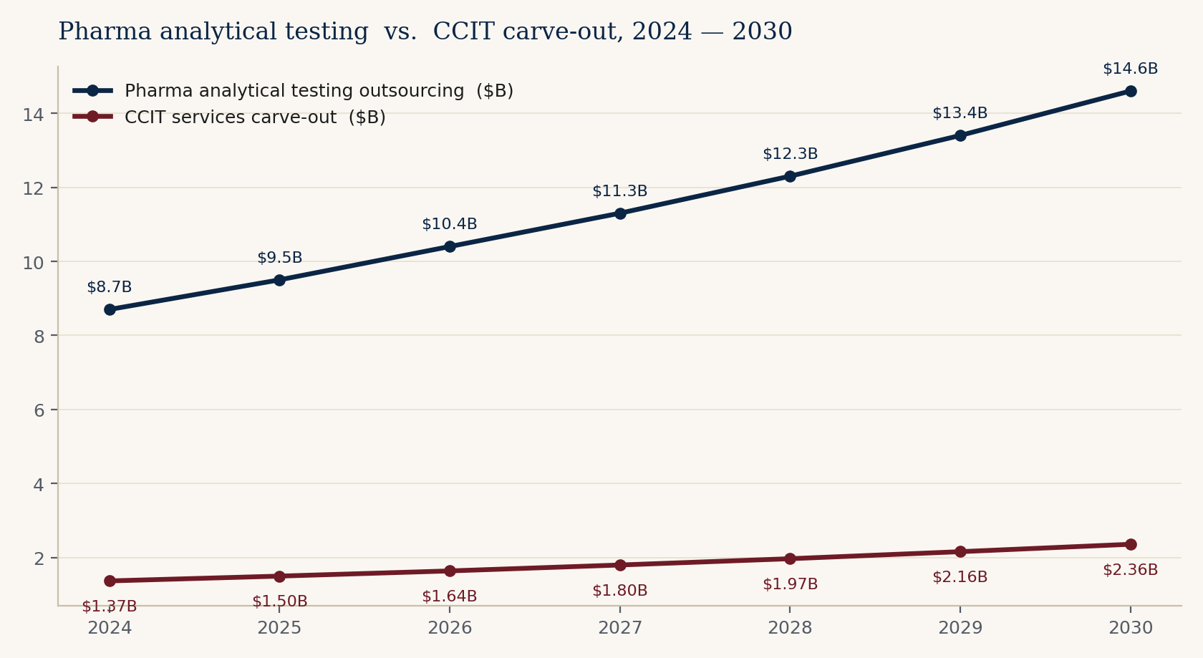
THE MARKET
TSI-CITADEL · OPPORTUNITY BRIEF
What sits in front of you
A $9.5 B host market —
and a $1.5 B niche moving with it.
Pharma analytical testing
outsourcing: $9.5 B (2025),
~9% CAGR through 2030.
CCIT services carve-out:
$1.5 B (2025), ~9-10% CAGR.
$2.4 B by 2030.
BioPlan 2025: outsourcing
budgets surged 11%, U.S.
captured 75% of intentions.
Top-5 CDMOs hold only 15%.
Sources: Precedence Research, Grand View, MarketsAndMarkets, BioPlan Associates 22nd Annual Report (Jul 2025). Composite midpoints.
Prepared for Alan Weiss · CFO, CS Analytical Laboratory · Confidential
04 / 17

Slide 5
TAILWINDS
TSI-CITADEL · OPPORTUNITY BRIEF
Five forces, one quarter
Each alone would justify a faster plan.
All five landed in the same window.
USP <382>
Annex 1 convergence
GLP-1 / PFS wave
503B sterility crisis
Biologics share
Dec 1, 2025. System-level
elastomer testing. Burden
shifts to drug manufacturer.
USP: 'early adoption
encouraged.'
EU GMP Annex 1 requires
validated deterministic CCIT.
Grade A bioContamination
limit = zero. Lyo pre-batch
sterilization enforced.
Prefilled syringes
$9.7B → $18.1B by 2031.
GLP-1 autoinjectors at
15.6% CAGR. COP barrels
adopted; methods reset.
GenoGenix Jul 2025 recall.
ProRx Oct 2025: 36,000+
semaglutide vials. 1,150
adverse events filed YTD.
503B is now CCIT-buying.
~40% of FDA novel
approvals. Every one in a
sterile primary container.
Glass-delamination recalls
back in 2026 headlines.
Prepared for Alan Weiss · CFO, CS Analytical Laboratory · Confidential
05 / 17

Slide 6
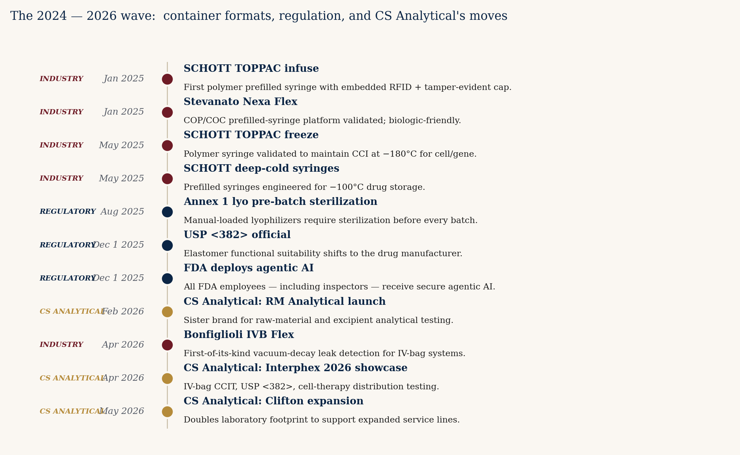
THE CONTAINER-FORMAT WAVE
TSI-CITADEL · OPPORTUNITY BRIEF
New containers. New methods. No incumbent.
Each new format below is a discrete
CCIT method-development engagement.
None of the generalists
has these formats validated.
CS Analytical's CSO has
publicly presented on
cryogenic CCIT — the only
specialty lab with the
credential to claim that
ground.
Every launch above is a
billable engagement waiting
to be sized.
Prepared for Alan Weiss · CFO, CS Analytical Laboratory · Confidential
06 / 17

Slide 7
WHY NOW
TSI-CITADEL · OPPORTUNITY BRIEF
December 1, 2025. Two things became official.
The regulator is no longer agentically naive.
USP <382>
Elastomeric Component Functional Suitability — official.
System-level testing. Responsibility shifts from elastomer
supplier to drug manufacturer. USP: 'early adoption is encouraged.'
The FDA — same day
Agentic AI deployed to all FDA employees. Secure GovCloud, no
training on industry submissions. Supports pre-market review,
post-market surveillance, INSPECTIONS, and compliance.
Prepared for Alan Weiss · CFO, CS Analytical Laboratory · Confidential
07 / 17

Slide 8
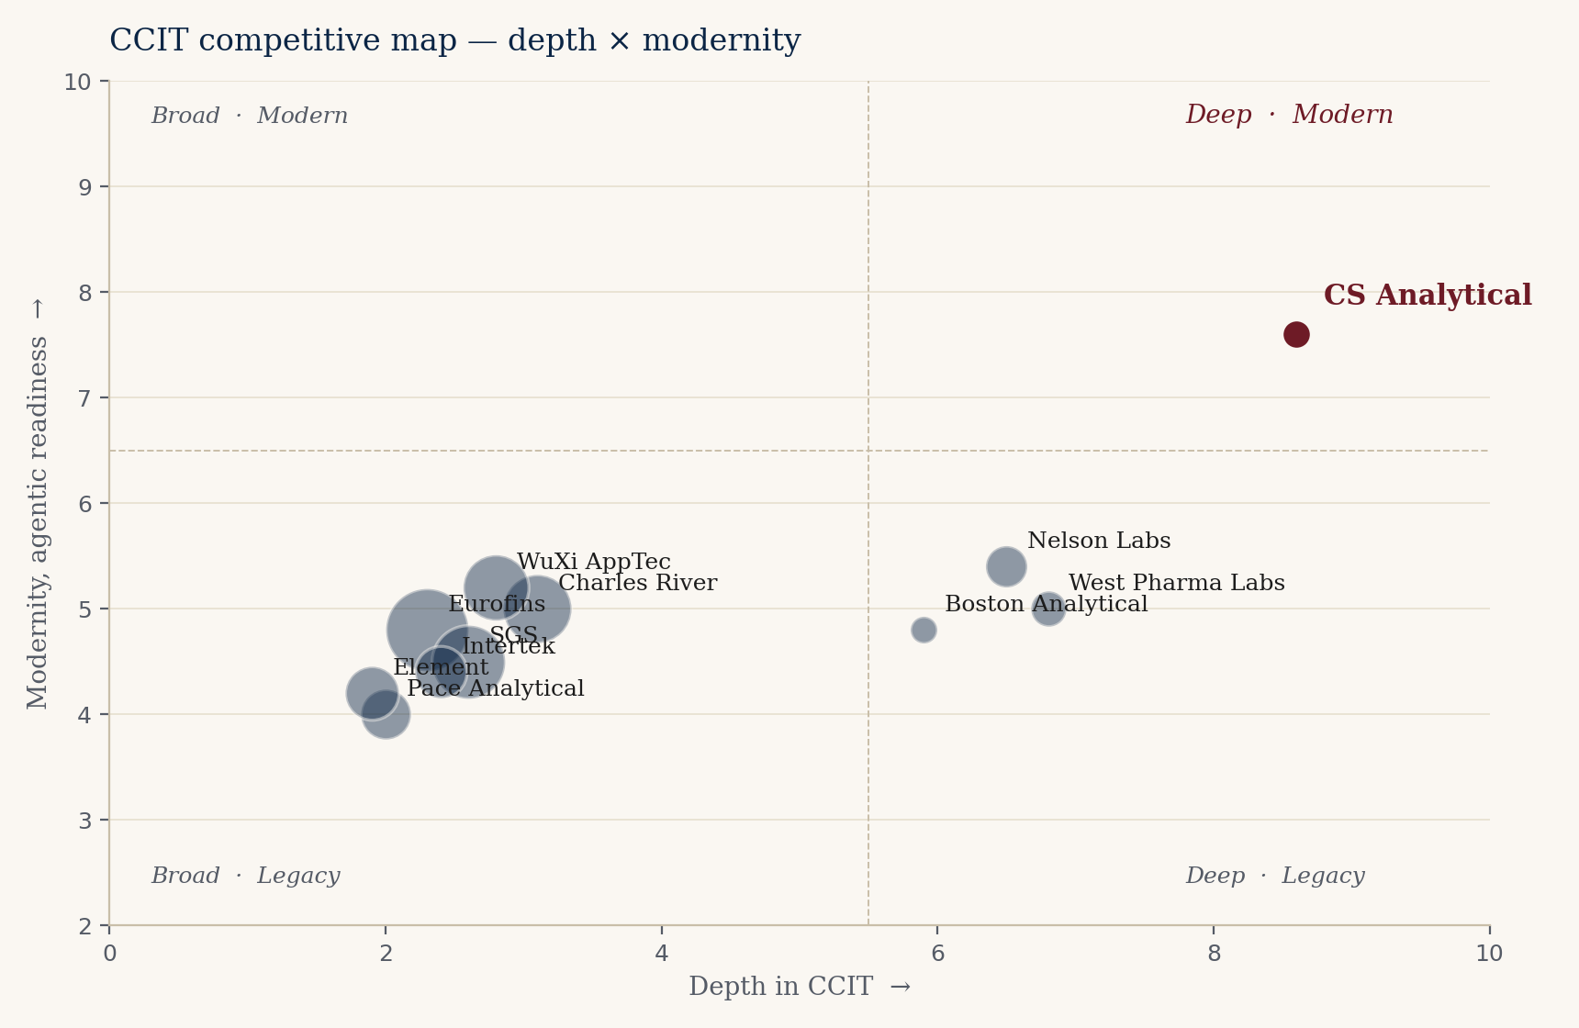
THE COMPETITIVE FIELD
TSI-CITADEL · OPPORTUNITY BRIEF
Who else is in the room
Generalists are broad.
Specialists are scaling. The corner is open.
Three competitive moves in
the last six months:
Nelson Labs doubling
cleanrooms and publicly
acquisitive (Sotera Q1).
West Pharma 165k sq ft
Dublin (Mar 2026) for
GLP-1 vertical integration.
Eurofins adding 157k m²
of lab space in 2025-2026.
The deep-and-modern
corner remains empty.
Prepared for Alan Weiss · CFO, CS Analytical Laboratory · Confidential
08 / 17

Slide 9
ALREADY IN MOTION
TSI-CITADEL · OPPORTUNITY BRIEF
What CS Analytical is already doing right
This is not a turnaround brief.
It is an acceleration brief.
RM Analytical launch · Feb 2026
Clifton expansion · May 2026
Micro, gas, IV bag
Interphex 2026 showcase
Raw material and excipient
testing under a sister brand.
Adjacent revenue. Cross-sell
into existing base.
Doubling the lab footprint.
Capacity built ahead of
demand, not behind it.
USP <87>, <788>, USP/EP gas,
IV bag CCIT. Each is
cross-sell into existing
sponsor relationships.
Public commitment to IV bag,
USP <382>, and cell-therapy
ISTA/ASTM distribution
testing. Ahead of competitors.
Prepared for Alan Weiss · CFO, CS Analytical Laboratory · Confidential
09 / 17

Slide 10
ORGANIC GROWTH — NO AI REQUIRED
TSI-CITADEL · OPPORTUNITY BRIEF
Five paths that don't require an AI partner
Each is buildable on the
existing team and footprint.
01
USP <382> wave capture
Named lab for the post-Dec 2025 elastomer rush.
02
GLP-1 / PFS HVLD productization
HVLD for COP-barrel autoinjectors. Repeatable, high-margin.
03
Annex 1 European mandate
EU GMP Annex 1 opens European sponsors. Reciprocal-recognition path.
04
Cell, gene & cryo container methods
No incumbent method. Highest margin per study. CSO credential.
05
Regulatory consulting carve-out
Productize the advisory work the team gives away today.
Prepared for Alan Weiss · CFO, CS Analytical Laboratory · Confidential
10 / 17

Slide 11
AGENTIC AI — TSI-CITADEL ANGLE
TSI-CITADEL · OPPORTUNITY BRIEF
Where TSI-Citadel multiplies what's already here
McKinsey: 35-45% productivity gain
across 270 pharma workflows.
Five agents we would build first.
USP <382>
wave-capture
Container-
format radar
Inspection-
readiness mirror
CAR-T cryo
method pipeline
Strategic-
optionality tracker
Monitors every 483 / WL
for elastomer findings.
Resolves to sponsor list.
Drafts targeted outreach.
Tracks SCHOTT, Stevanato,
BD, West, Bonfiglioli
launches. Sizes the
method-dev opportunity.
Mirror to FDA's own
agentic inspector. Predicts
what AI-augmented
inspectors will find.
Phase II/III CAR-T radar.
Cryo container choices.
Failure-rate economics
(3.87% — 25%) drive demand.
CFO-only quarterly view.
Comparable transactions,
acquirer activity, market
position. Board-friendly.
Prepared for Alan Weiss · CFO, CS Analytical Laboratory · Confidential
11 / 17

Slide 12
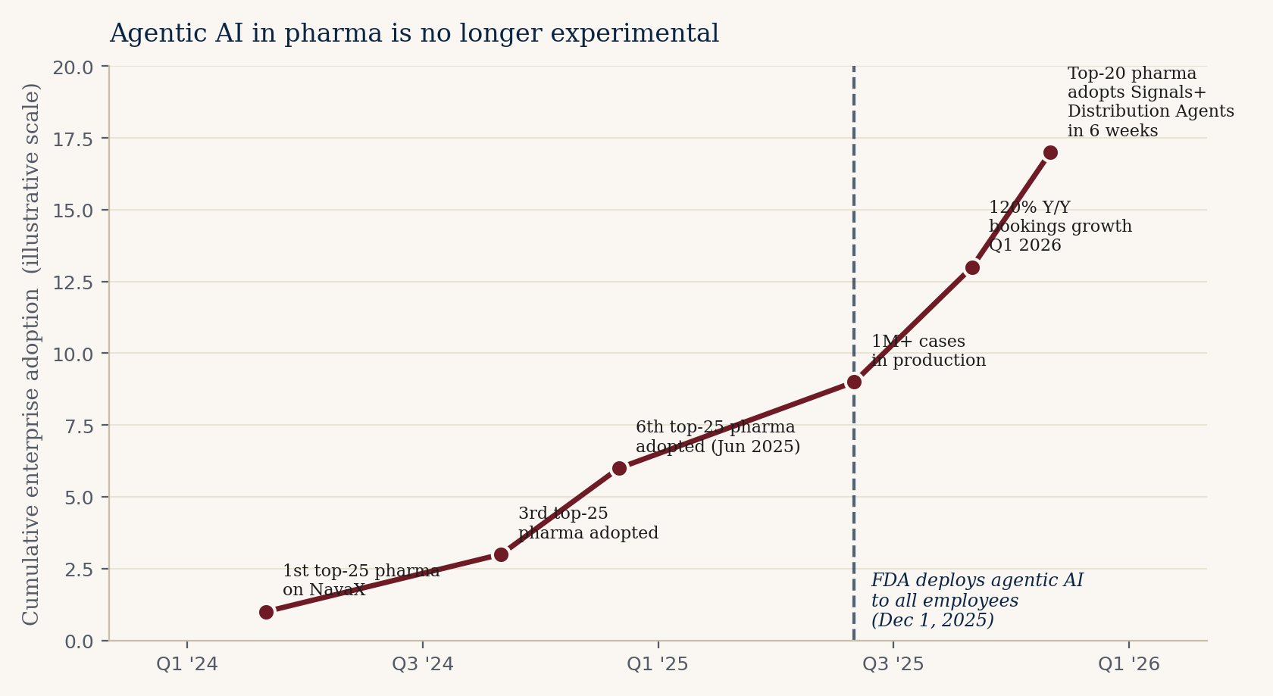
THE AGENTIC LAYER IS ALREADY COMMERCIAL
TSI-CITADEL · OPPORTUNITY BRIEF
Six top-25 pharmas. One million cases. 95% accuracy.
Agentic AI in pharma is no longer experimental.
ArisGlobal NavaX: 1M+ safety
cases. 95%+ accuracy. 30%+
efficiency gain. 120% Y/Y
bookings Q1 2026.
Sixth top-25 pharma adopted
by Jun 2025. Top-20 adopted
Signals + Distribution Agents
in 6 weeks from launch.
FDA itself deployed agentic
AI Dec 1, 2025. The question
is no longer if. It is who,
when, and at what tempo.
Prepared for Alan Weiss · CFO, CS Analytical Laboratory · Confidential
12 / 17

Slide 13
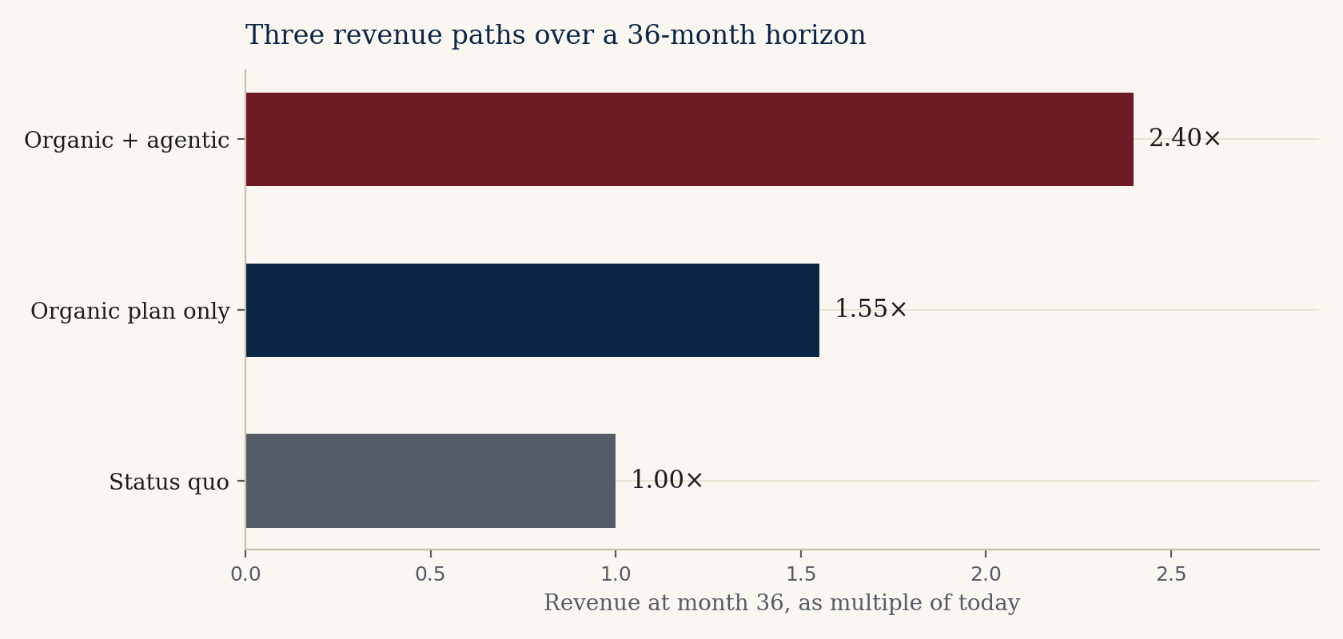
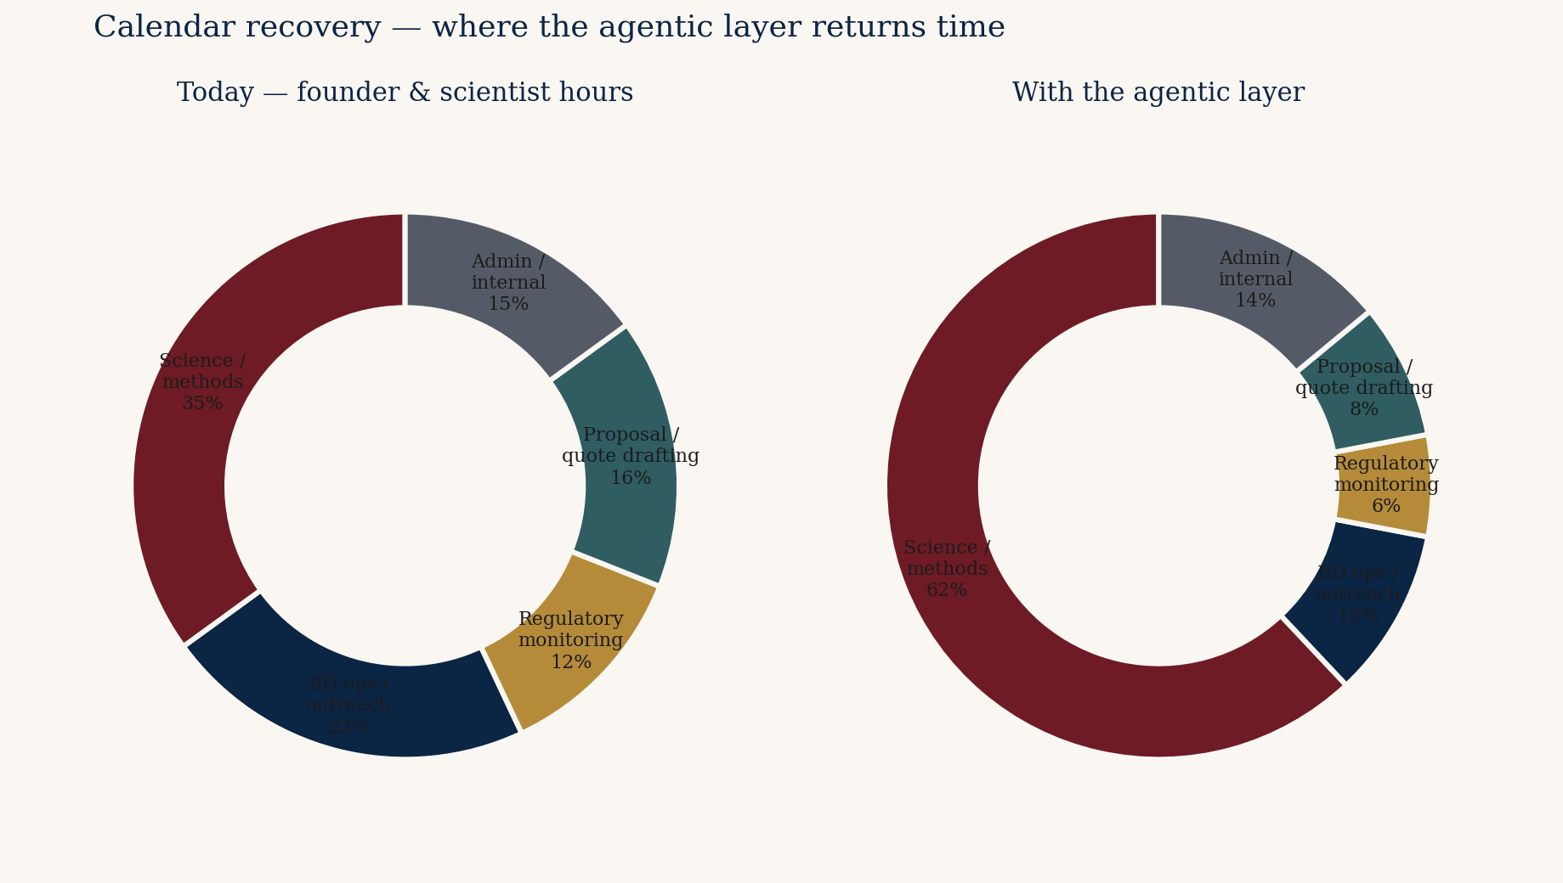
ROI SHAPE — FOR THE CFO
TSI-CITADEL · OPPORTUNITY BRIEF
Three revenue paths. One calendar recovery.
Conservative pays for itself.
Aggressive changes the category.
Strategic optionality: Nelson Labs (Sotera) publicly named pharmaceutical-capability acquisitions as a 2026 priority. The 2018 Gibraltar Labs (NJ) precedent is on the record. Life-sciences tools subsector trades at 18-25× EBITDA on recurring-revenue characteristics.
Prepared for Alan Weiss · CFO, CS Analytical Laboratory · Confidential
13 / 17

Slide 14
STRATEGIC OPTIONALITY
TSI-CITADEL · OPPORTUNITY BRIEF
Nelson Labs has done this before. In New Jersey.
The Gibraltar precedent.
AUGUST 2018
MAY 2026
The transaction
The statement
Sotera Health's Nelson Labs
acquires Gibraltar Laboratories.
Fairfield, NJ. Family-owned since
1970. FDA-registered. ISO 17025
accredited. USP-compendial
microbiology and analytical
chemistry. Two tri-state-area
facilities.
Sotera Health Q1 2026 earnings
call: 'Targeted acquisitions or
partnerships could add testing
capability, regional sterilization
access, or technology depth.'
Management 'exploring strategic
acquisitions to enhance Nelson
Labs' pharmaceutical capabilities.'
The structural parallel is uncomfortable to ignore.
Prepared for Alan Weiss · CFO, CS Analytical Laboratory · Confidential
14 / 17

Slide 15
ADJACENT OPPORTUNITIES
TSI-CITADEL · OPPORTUNITY BRIEF
Where else this team could play
Adjacencies, not pivots.
Optional, not required.
Combination products
Cross-center (CDER + CDRH) submissions. Few labs ready.
Device sterilization validation
ISO 11135 / 11137 adjacency. Same sponsor base.
Cell-therapy distribution
ISTA/ASTM testing for live-cell packaging. Already in Interphex slate.
Smart-packaging integrity
Embedded RFID + tamper-evident integrity (TOPPAC infuse class).
Compounding pharmacy
USP <797> / <800>. Fragmented buyer base, less competition.
Veterinary biologics
Same containers. USDA channel. Underpriced.
Prepared for Alan Weiss · CFO, CS Analytical Laboratory · Confidential
15 / 17

Slide 16
RISKS — NAMED, NOT GLOSSED
TSI-CITADEL · OPPORTUNITY BRIEF
What we'd want to disagree about
Three CFO-relevant risks,
three handlings.
Capital timing
Lab expansion + RMA + agentic in one fiscal year. Sequence
agentic behind the lab build; agentic pays back in <12 months.
Margin dilution from adjacencies
RMA and micro carry lower margin than CCIT. Hold CCIT pricing
while RMA scales; use agentic intel to keep core pipeline full.
Hallucination in regulated context
Human-in-the-loop on every agent flag that touches a filed
method. Agents are suggestive, not authoritative — by design.
Prepared for Alan Weiss · CFO, CS Analytical Laboratory · Confidential
16 / 17

Slide 17
IF YOU WANTED TO WORK WITH US
TSI-CITADEL · OPPORTUNITY BRIEF
How TSI-Citadel would engage
Light footprint. Boxed scope.
The CFO holds the gate at day 30 and day 90.
DAYS 1 — 30
DAYS 31 — 60
DAYS 61 — 90
Diagnostic
Two agents live
Decide
Map data feeds, regulatory
cycles, inquiry-to-quote workflow.
Deliver: exposure map, BD pipeline
seed, regulatory-intel trial.
No code yet. Go / no-go at day 30.
Regulatory-intel and market-radar
agents wired to real feeds. Daily
output to a named internal user.
First measurable lift inside
the period.
Joint readout. Numbers. The three
remaining agents are built only if
the first two have earned them.
Fixed pricing at outset.
The CFO holds the gate.
Prepared for Alan Weiss · CFO, CS Analytical Laboratory · Confidential
17 / 17

Slide 18
THE NEXT CONVERSATION
Read the long form
on a plane.
Then tell us where
we're wrong.
Bruce Longley
TSI-Citadel
bruce@tsicitadel.ai

