Slide 1
The Effects of Active Queue Management on Web Performance
Long Le, Jay Aikat, Kevin Jeffay and F. Donelson Smith Department of Computer Science
University of North Carolina at Chapel Hill
Presented by
Alexander Afanasyev
April 28, 2009
Notes:
Hello everybody. My name is Alex and today I’ll be presenting the evaluation of the impact of active queue management of WEB performance.
Web was selected not by accident. It is one of the most popular services in the internet and, moreover, the response times, which are the main subject of the Active Queue Management (AQM), can have significant impact on user-perceived quality of service.

Slide 2
Outline
Is something wrong with routing performance?
Default FIFO queuing has a number of problems
Active Queue Management (AQM) can help, but has its costs
What are the AQM solutions?
Random Early Dropping (RED, Adaptive RED)
Proportional Integrator (PI)
Random Exponential Marking (REM)
Does AQM really help?
Some algorithms can improve standard TCP performance in some environments.
AQM can reduce channel utilization or increase latency
Notes:
So. Let's start from the basic questions.
_Is something wrong with routing performance?_ Yes and no. Yes, because there are number problems caused by conventional FIFO buffer management. No, because the problems occur only if channels are working near their capacity limit, what is unlike situation for ISP. But anyways, in some environments, AQM can improve performance.
_Is AQM available?_ Again Yes and No. There are dozen of algorithms, but neither was proven to work perfectly, neither was actually deployed (enabled by default). We will briefly go over three AQM algorithms - Adaptive RED, Proportional Integrator and Random Exponential Marking.
_Does the AQM really help?_ Same Yes and No answer. We can always find the network environment where AQM is superior to FIFO and always can find a counter environment characteristics. As we can see later, in particular environments, the Web traffic can, depending on algorithm, benefit or from AQM rules.

Slide 3
FIFO problems
Packets are dropped on queue overflow
Potential cause of flow synchronization problem
Some congestion avoidance (CA) algorithms wouldn’t be aware until loss is detected
A lot of packets can be dropped due to congestion before CA detects congestion state
A lot of network resources will be wasted to retransmit lost packets
Increased response latency (RTT) and jitter in “near-congestion” state
Big FIFO buffers are considered optimal
2-4 times bandwidth-delay-product
100ms x Link Capacity
Flows can usurp the bottleneck link
Problem – Solutions - Evaluations - Discussion
Notes:
How bad is FIFO? On of the main disadvantages of FIFO is not directly connected to FIFO itself. The most of TCP congestion control algorithms relies on packet loss as a primary (and sometimes the one) signaling mechanism to infer about network state. FIFO drops only if queue overflows, which means a lot of drops can be done at the same time, which may lead to TCP flow synchronization, which may lead to channel load fluctuation and serious underutilization.
Another problem caused by TCP congestion control algorithms is tendency to keep high level of buffering. This means increased response time for every request and potentially can increase level of jitter in RTT measurements.
The recognized best practice is to have queue size at the router as a 2-4 times per average bandwidth delay product (i.e., channel capacity multiplied by average propagation delay of all passing flows).
One more problem is fairness problem. Selfish flows can usurp the bottleneck by sending a lot of data - keeping the queue at the saturation point. This causes all other data to be dropped upon arrival.

Slide 4
AQM can help. Can it?
Routers know exact queues state of their links
They can send reports to the senders to limit rate
When link is congested?
Queue is not empty?
Queue is almost full?
How router should react to congestion?
Drop all new packets?
Drop a portion of new and old packets?
Just report (ECN) to the sender to slow-down
Problem – Solutions - Evaluations - Discussion
Notes:
OK. Let's assume FIFO is bad. Can AQM provide us a simple and universal solution? Certainly, AQM is performed on routers which know exact information about its queue states. But how this information can be employed? Does router need to consider congestion when queue contain non zero amount of packets? Or there is some threshold below which queueing is allowed? Other, no less interesting question, is how AQM should react if congestion is detected? Drop old? Drop new? Random drop? Maybe just mark and hope that sender will eventually decrease a sending rate?
There are no definite answers on these questions. As a result, we have a dozen of different AQM approaches

Slide 5
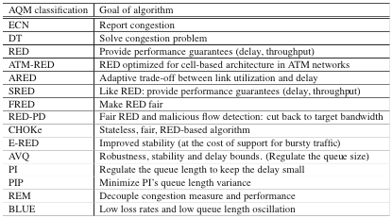
AQM solutions*
* K. Graffi, K. Pussep, N. Liebau, and R. Steinmetz, “Taxonomy of Active Queue Management Strategies in Context of Peer-to-Peer Scenarios,” Technische Universitat Darmstadt, Germany, Tech. Rep, 2007
Problem – Solutions - Evaluations - Discussion
Notes:
I got this table from the recent TechReport, but absolutely certain that this is not complete list of AQM. In paper ARED, PI and REM algorithm were evaluated, with and without support of ECN. That is, without support - all control is done using packet dropping, with ECN - more intelligent way to inform TCP sender to slow down.

Slide 6
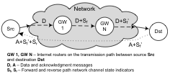
AQM solutions: ECN (rfc3168)
If link is congested, routers set ECN bit in the IP packets (S_{f})
TCP receiver echoes back ECN information in ACK response (S_{f}’)
TCP sender treats ACK packets with ECN as congestion indication
Problem – Solutions - Evaluations - Discussion
Notes:
Let's go briefly over the considered algorithms. ECN is defined by RFC3168 by designating two bits from DiffServ IP header. General idea is to mark packets with ECN bit if a router (GW1, GWn on the slide) considers link to be congested. That is original message D would come to destination as a D plus some indication Sf. If the receiver supports ECN, it would include indication about the congestion state in the path into TCP header (IP header collects information about path state, TCP header echoes this information). The sender should react on ECN signal as it would detect a packet loss.

Slide 7
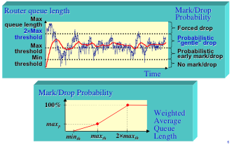
AQM solutions: Adaptive RED
Problem – Solutions - Evaluations - Discussion
Notes:
Adaptive RED is an actual AQM algorithm, which preventively (randomly) drops incoming and already present packet in queue if it size increased certain threshold. Original RED contain two thresholds min and max, which corresponds to linear increase of drop probability and if queue is more than max, then probability is 1. The Adaptive variant extends it by third threshold, but essentially the idea remain the same. When queue is between min and max - probability increases linearly, when between max and max2 - more rapid linear, instead of sudden, increase of probability.

Slide 8
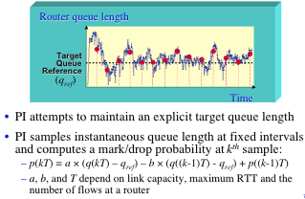
AQM solutions: Proportional Integrator (PI)
Problem – Solutions - Evaluations - Discussion
Notes:
Proportional Integrator tries to limit buffering but a bit differently. It has one queuing threshold (so called queue reference), which selected a baseline. Periodically (~10ms) it recalculates the drop probability as a function of instantaneous size of the current queue value, last queue value and last probability. Such math allows to take into account queueing trends (if queue is decreasing there is no need to drop) and, in the same time, allows some bursts of traffic to go through.

Slide 9
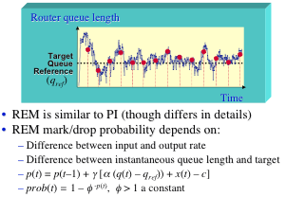
AQM solutions: Random Exponential Marking (REM)
Problem – Solutions - Evaluations - Discussion
Notes:
Essentially the same idea is behind the Random Exponential Marking algorithm. It takes into account not only the queue sizes, but also the input/output rates (x(t) - forwarding rate and C is capacity). That is, if forwarding rate is less then capacity, the queue will eventually decrease without any need to drop/mark packets. Otherwise, the marking/dropping probability is some exponential function.

Slide 10

AQM evaluations: Methodology
“Live simulation” in lab test-bed
Synthetic WEB traffic using UNC HTTP model [SIGMETRIC 2001, MASCOTS 2003]
Randomization of request/reply sizes, user think time
Persistent connection emulation
FreeBSD router implementation
1Gbps bottleneck calibration, 100Mbps simulation
Problem – Solutions - Evaluations - Discussion
Notes:
Let's move to the actual experiments and results. For the experiment they had build a laboratory testbed, where synthetic WEB traffic was generated using available model. In particular, this synthetic traffic include random request and reply sizes, random "user" think time (intervals between requests), the emulation of persistent connection (several requests within one TCP connection). One of the most interesting parts was the calibration task. The calibration using 1Gbps bottleneck capacity instead of 100Mbps gives a reference point of "uncongested" link. In other word, the maximum achievable effectiveness if network is uncongested.

Slide 11
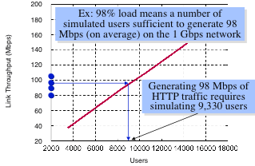
AQM evaluation: Calibration
Problem – Solutions - Evaluations - Discussion
Notes:
The be able to feel the impact of AQM, the throughput was calibrated to generate various high load traffics 80%, 90%, and 98%, or 80Mbps, 90Mbps and 98Mbps. After calibration, test was run using appropriate AQM algorithm and 100Mbps bottleneck link size.

Slide 12
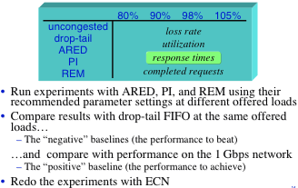
AQM evaluation: Plan
Problem – Solutions - Evaluations - Discussion

Slide 13
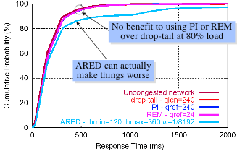
AQM evaluation: 80% Load Signaling by packet drops
50% requests complete within 128ms
Problem – Solutions - Evaluations - Discussion
Notes:
OK. The results. In first experiments the only signaling mechanism of the congestion state for the TCP connections was selected packet drops.
First, it should be noted, that in all their tests for all algorithms, the 50% of all requests was processed within first 128ms. This result shows, that at 80% load FIFO, PI and REM give the same result as in the case of uncongested network, which means of practically absence of congestion. They also noticed the strange behavior of ARED. Even without queueing ARED have negative impact on response time and they couldn't find any proper set of parameters which improves situation.

Slide 14
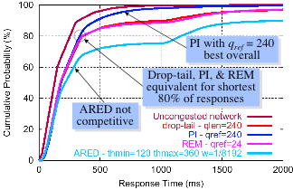
AQM evaluation: 90% Load Signaling by packet drops
Problem – Solutions - Evaluations - Discussion
Notes:
The next simulation at 90% load reveals slightly better performance of PI algorithm. And as we can see all algorithms has degradation comparing to the uncongested network, which is an indication of actual congestion events.

Slide 15
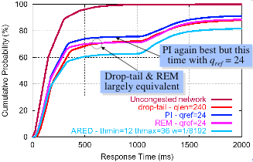
AQM evaluation: 98% Load Signaling by packet drops
Problem – Solutions - Evaluations - Discussion
Notes:
98% load decreases the response time of all queue managements algorithms. PI again performs better, but it need to be adjusted to new environment, and, actually, shows not really perfect results, comparing to PI and conventional FIFO.

Slide 16
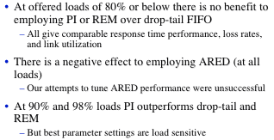
AQM evaluation: Summary Signaling by packet drops
Problem – Solutions - Evaluations - Discussion
Notes:
The results we just seen wasn't in a favor of AQMs. ARED performs very bed, PI and REM just slightly better. And the impact can be seen if link utilization is more than 80%, which is questionable frequently.
Let's see results of the same experiments, but when primary signal is not a drop, but explicit signaling using ECN.

Slide 17
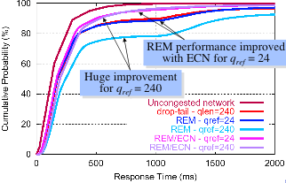
AQM evaluation: 90% Signaling comparison (packet drop vs ECN)
Problem – Solutions - Evaluations - Discussion
Notes:
REM, in its case, has substantial improvement if ECN is enabled. Moreover, the tuning parameters makes practically no difference, as it was without ECN. From the graph we can say, that 98% of request has been served within 1second

Slide 18
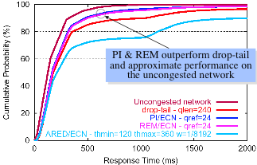
AQM evaluation: 98% load ECN signaling
Problem – Solutions - Evaluations - Discussion
Notes:
The comparison to PI algorithm shows, that both has superior performance to FIFO algorithm and have very similar characteristics in a wide range of tuning parameters.

Slide 19
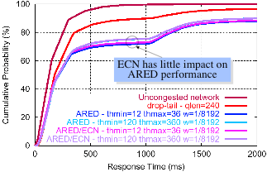
AQM evaluation: 90% load ECN signaling
Problem – Solutions - Evaluations - Discussion
Notes:
As we can see, enabling ECN has practically no impact on ARED. On of the possible explanation, presented in the paper was that during the congestion event ECN packets has the same probability to be lost as DATA packets (prevention of selfish behavior). That's, their ARED implementation is counting probability on packet basis, not on byte basis.

Slide 20
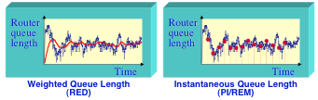
Discussion: Why ARED appears to be bad?
Weighted queue length doesn’t allow to react effectively in face of bursty traffic
ARED “packet mode” implies small packets (SYN, ACKs) to have same probability to be dropped as big ones. But this doesn’t explain “bad” behavior if ECN is employed.
Problem – Solutions - Evaluations - Discussion
Notes:
On of the possible explanation, presented in the paper was that during the congestion event ECN packets has the same probability to be lost as DATA packets (prevention of selfish behavior). That's, their ARED implementation is counting probability on packet basis, not on byte basis.
Another point is that weighted queue length used in ARED can not effectively reflect the real situation.

Slide 21
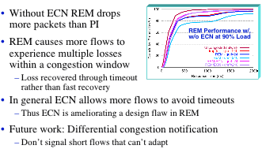
Discussion ECN improves performance of PI and REM
Problem – Solutions - Evaluations - Discussion
Notes:
Paper conclusion

Slide 22
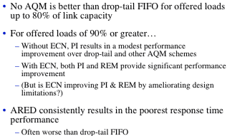
Discussion Paper conclusions
Problem – Solutions - Evaluations - Discussion
Notes:
Paper conclusion

Slide 23
What was hidden in the experiments?
Only WEB traffic was simulated
Other TCP traffic may have different patterns and thus AQM would have different impact on them
Presence of UDP traffic can have worse impact if AQM is present
Fairness wasn’t considered
Small incentives for ISPs to implement AQM
All experiments show good response time for majority of connections
Almost nobody runs their networks at 90-98% load
Only the standard TCP implementation was considered. Probable cause of ARED unsatisfactory results
More than 40 variants of pure Host-to-Host congestion control algorithms exist
Standard TCP has imperfect performance in the simulated environments (100Mb/1Gb links)
Paper doesn’t talk about AQM performance issues
Only 3 AQM algorithms were examined
Problem – Solutions - Evaluations - Discussion
Notes:
What should we get from the evaluation?
AQM can have positive impact on network performance? Yes
ECN can substantially improve performance? Also yes.
Are the conclusion definite? Absolutely No.
They consider only Synthetic and only WEB traffic. However WEB is one of the popular applications, it is not the only one, and of course, not the most traffic generating application.
UDP and non TCP-friendly (flows without congestion control) would have big impact on the final results.
Flow fairness wasn't considered as a part of the evaluation
But the most importantly, they consider only a standard TCP congestion control implementation in the environment, which is known to be not very suitable for it, especially for short connections like TCP.

Slide 24
Questions?
The Effects of Active Queue Management on Web Performance
What is wrong with routing performance?
Default FIFO queuing has a number of problems
Active Queue Management (AQM) can help, but has its costs
What are the AQM solutions?
Random Early Dropping (RED, Adaptive RED)
Proportional Integrator (PI)
Random Exponential Marking (REM)
Does AQM really help?
Some algorithms can improve standard TCP performance in some environments.
AQM can reduce channel utilization or increase latency

