Slide 1
The Effects of Active Queue Management on Web Performance
Long Le, Jay Aikat, Kevin Jeffay and F. Donelson Smith Department of Computer Science
University of North Carolina at Chapel Hill
Presented by
Alexander Afanasyev
April 28, 2009

Slide 2
Outline
What is wrong with routing performance?
Default FIFO queuing has a number of problems
Active Queue Management (AQM) can help, but has its costs
What are the AQM solutions?
Random Early Dropping (RED, Adaptive RED)
Proportional Integrator (PI)
Random Exponential Marking (REM)
Does AQM really help?
Some algorithms can improve standard TCP performance in some environments.
AQM can reduce channel utilization or increase latency

Slide 3
FIFO problems
Packets are dropped on queue overflow
Potential cause of flow synchronization problem
Some congestion avoidance (CA) algorithms wouldn’t be aware until loss is detected
A lot of packets can be dropped due to congestion before CA detects congestion state
A lot of network resources will be wasted to retransmit lost packets
Increased response latency (RTT) and jitter in “near-congestion” state
Big FIFO buffers are considered optimal
2-4 times bandwidth-delay-product
100ms x Link Capacity
Flows can usurp the bottleneck link
Problem – Solutions - Evaluations - Discussion

Slide 4
AQM can help. Can it?
Routers know exact queues state of their links
They can send reports to the senders to limit rate
When link is congested?
Queue is not empty?
Queue is almost full?
How router should react to congestion?
Drop all new packets?
Drop a portion of new and old packets?
Just report (ECN) to the sender to slow-down
Problem – Solutions - Evaluations - Discussion

Slide 5
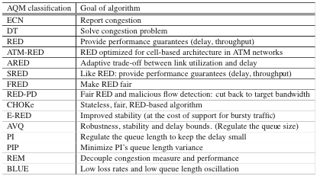
AQM solutions*
* K. Graffi, K. Pussep, N. Liebau, and R. Steinmetz, “Taxonomy of Active Queue Management Strategies in Context of Peer-to-Peer Scenarios,” Technische Universitat Darmstadt, Germany, Tech. Rep, 2007
Problem – Solutions - Evaluations - Discussion

Slide 6
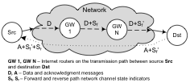
AQM solutions: ECN (rfc3168)
If link is congested, routers set ECN bit in the IP packets (S_{f})
TCP receiver echoes back ECN information in ACK response (S_{f}’)
TCP sender treats ACK packets with ECN as congestion indication
Problem – Solutions - Evaluations - Discussion

Slide 7
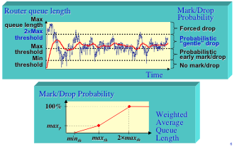
AQM solutions: Adaptive RED
Problem – Solutions - Evaluations - Discussion

Slide 8
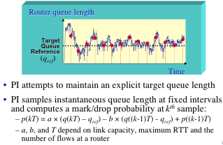
AQM solutions: Proportional Integrator (PI)
Problem – Solutions - Evaluations - Discussion

Slide 9
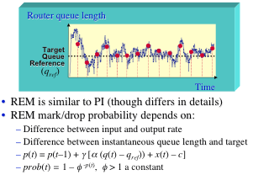
AQM solutions: Random Exponential Marking (REM)
Problem – Solutions - Evaluations - Discussion

Slide 10

AQM evaluations: Methodology
“Live simulation” in lab test-bed
Synthetic WEB traffic using UNC HTTP model [SIGMETRIC 2001, MASCOTS 2003]
Randomization of request/reply sizes, user think time
Persistent connection emulation
FreeBSD router implementation
1Gbps bottleneck calibration, 100Mbps simulation
Problem – Solutions - Evaluations - Discussion

Slide 11
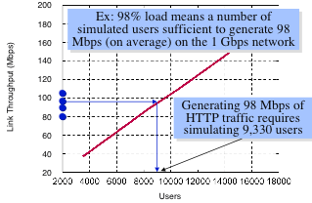
AQM evaluation: Calibration
Problem – Solutions - Evaluations - Discussion

Slide 12
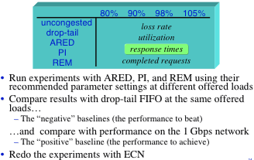
AQM evaluation: Plan
Problem – Solutions - Evaluations - Discussion

Slide 13
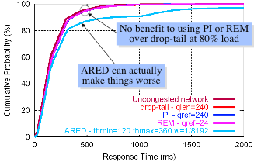
AQM evaluation: 80% Load Signaling by packet drops
50% requests complete within 128ms
Problem – Solutions - Evaluations - Discussion

Slide 14
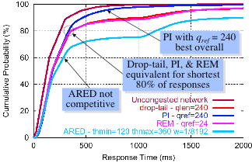
AQM evaluation: 90% Load Signaling by packet drops
Problem – Solutions - Evaluations - Discussion

Slide 15
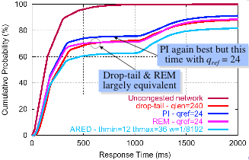
AQM evaluation: 98% Load Signaling by packet drops
Problem – Solutions - Evaluations - Discussion

Slide 16
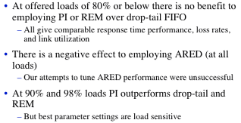
AQM evaluation: Summary Signaling by packet drops
Problem – Solutions - Evaluations - Discussion

Slide 17
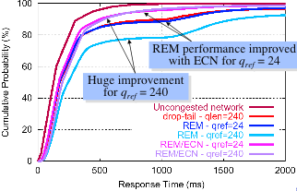
AQM evaluation: Signaling comparison (packet drop vs ECN)
Problem – Solutions - Evaluations - Discussion

Slide 18
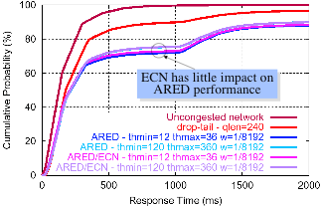
AQM evaluation: 90% load ECN signaling
Problem – Solutions - Evaluations - Discussion

Slide 19
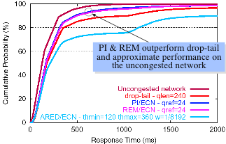
AQM evaluation: 98% load ECN signaling
Problem – Solutions - Evaluations - Discussion

Slide 20
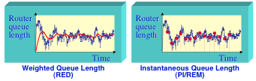
Discussion: Why ARED appears to be bad?
Weighted queue length doesn’t allow to react effectively in face of bursty traffic
ARED “packet mode” implies small packets (SYN, ACKs) to have same probability to be dropped as big ones. But this doesn’t explain “bad” behavior if ECN is employed.
Problem – Solutions - Evaluations - Discussion

Slide 21
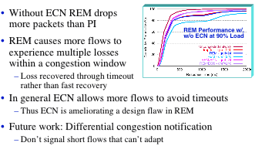
Discussion ECN improves performance of PI and REM
Problem – Solutions - Evaluations - Discussion

Slide 22
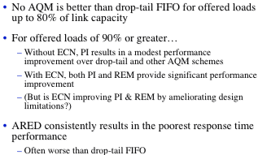
Discussion Paper conclusions
Problem – Solutions - Evaluations - Discussion

Slide 23
What was hidden in the experiments?
Only WEB traffic was simulated
Other TCP traffic may have different patterns and thus AQM would have different impact on them
Presence of UDP traffic can have worse impact if AQM is present
Fairness wasn’t considered
Small incentives for ISPs to implement AQM
All experiments show good response time for majority of connections
Almost nobody runs their networks at 90-98% load
Only the standard TCP implementation was considered. Probable cause of ARED unsatisfactory results
More than 40 variants of pure Host-to-Host congestion control algorithms exist
Standard TCP has imperfect performance in the simulated environments (100Mb/1Gb links)
Paper doesn’t talk about AQM performance issues
Only 3 AQM algorithms were examined
Problem – Solutions - Evaluations - Discussion

Slide 24
Questions?
The Effects of Active Queue Management on Web Performance
What is wrong with routing performance?
Default FIFO queuing has a number of problems
Active Queue Management (AQM) can help, but has its costs
What are the AQM solutions?
Random Early Dropping (RED, Adaptive RED)
Proportional Integrator (PI)
Random Exponential Marking (REM)
Does AQM really help?
Some algorithms can improve standard TCP performance in some environments.
AQM can reduce channel utilization or increase latency

