Slide 1
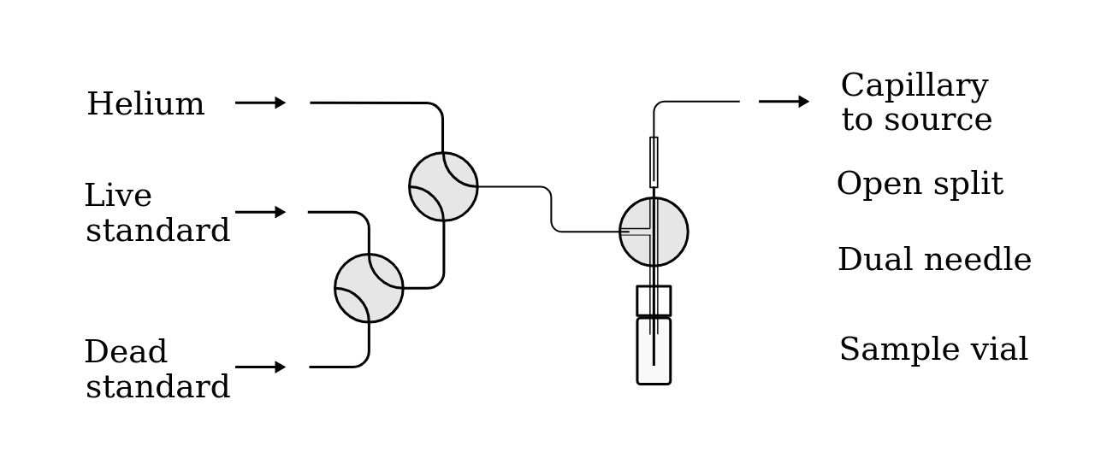
Carbonate method
Acidify
10-30mg carbonate
Yields 2-6mL CO2 @ ~1ATM
Backfill to 1ATM with helium
Displace gas to open split with 100 uL/min helium
Introduce mixture to source @ 30 uL/min
Acquire data: 90s x 10 measurements.

Slide 2
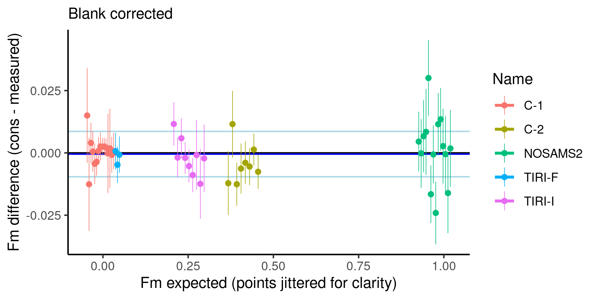
Consensus standards

Slide 3
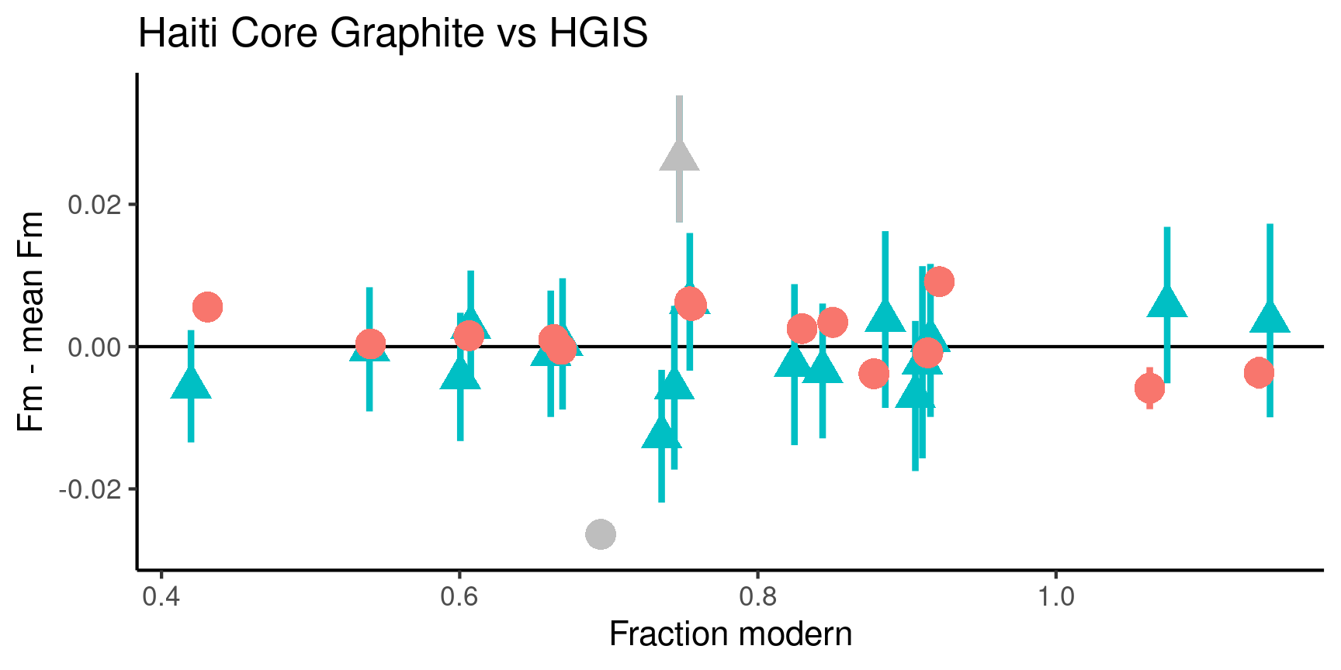
Haiti core carbonates

Slide 4
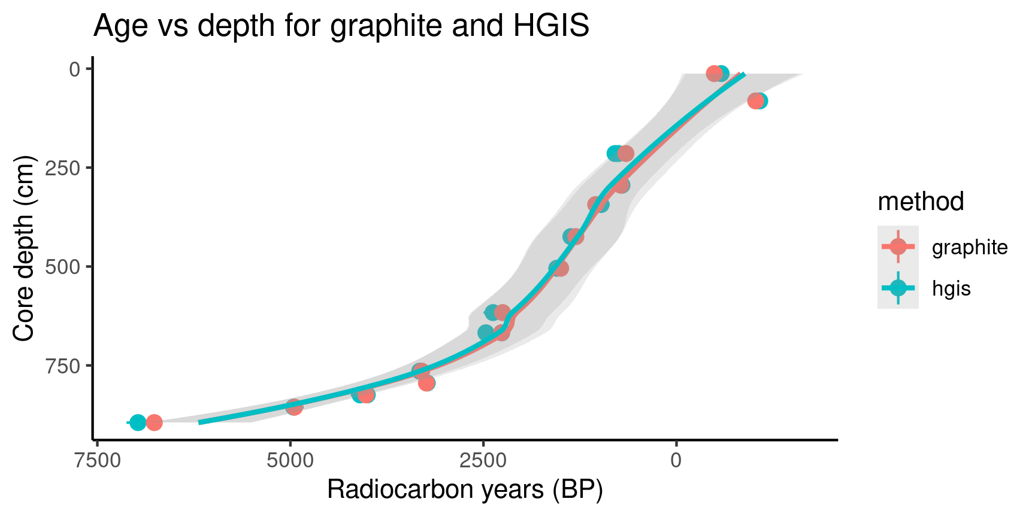
Age Model Comparison

