Slide 1

Project Work Phase-I [BCS685] Review-II
presentation on
Self-Adapting Kernel
(using Newton Semismooth Method)
Presented By
Kole Vaibhav [1EP22CS049]
Vikash Langpoklakpam [1EP22CS121]
Wani Furkan [1EP22CS124]
M Chand S [1EP222CS056]
Under the Guidance of
Mr. Arun Kumar S
Professor
Department of CSE, EPCET

Slide 2
Introduction
Domain: Operating System and Kernel Optimization.
Focuses on implementing machine learning techniques to self-optimizing kernel for better resource management and overall system improvement.
Project Overview:
Title: Self-Optimizing Kernel Using Semismooth Newton Method
Develop an adaptive, self-optimizing kernel scheduler that utilizes machine learning to dynamically manage system resources.
AI-Driven Scheduling that learns system behavior and adjusts CPU scheduling in real-time.
Significance:
Feedback: Integrates real-time feedback with predictive analysis.
Real-Time Adaptation: Responds dynamically to changing workload conditions.

Slide 3
Problem Statement
Traditional operating system schedulers rely on static algorithms and heuristics that struggle to efficiently allocate resources in modern computing environments. As hardware architectures and workloads become increasingly complex, these schedulers face several limitations :
Static Scheduling Policies: Fixed rules limit adaptability to real-time workload changes.
Inefficient Resource Utilization: Traditional scheduling does not optimize CPU usage, leading to bottlenecks.
Lack of Intelligent Adaptation: Conventional schedulers cannot learn and improve based on execution patterns.
High Energy Consumption: Poorly optimized scheduling increases power consumption.

Slide 4
Literature Survey
Author | Title | Year | Description | Merits | Demerits
L. Qin, Z. Song, and R. Zhang, | A General Algorithm for Solving Rank-one Matrix Sensing | 2024 | A simplified Gradient Descent speeds up matrix reconstruction, cutting load times and boosting AI efficiency in Quantum Systems and ML. | The method offers improved convergence rates and scalability for large-scale optimal transport problems. | The algorithm's specialized nature may limit its use in other kernel optimizations, requiring customization for better integration.
Z. Song, J. Yin, and L. Zhang | Solving Attention Kernel Regression Problem via Pre-conditioner | 2024 | The model retains a long-term context window to predict memory usage and adapt to user workflows without relying on a database. | Pre-conditioning enhances convergence, stability, and memory in kernel regression. | The pre-conditioner's effectiveness depends on data and kernel characteristics, with poorly formatted data reducing accuracy.

Slide 5
Author | Title | Year | Description | Merits | Demerits
T. Lin, M. Cuturi, and M. I. Jordan | A Specialized Semismooth Newton Method for Kernel-Based Optimal Transport | 2024 | The model maintains a long-term context window to predict memory usage and adapt to user workflows without relying on a database. | The versatile algorithm enhances computational efficiency and integrates easily into various rank-one matrix sensing problems. | The algorithm's generality may lead to suboptimal performance in cases requiring tailored solutions.
P. Oppermann | Writing an OS in Rust | 2025 | Rust's memory safety and strong typing enhance kernel stability, reducing vulnerabilities compared to traditional C-based OS development. | Rust ensures memory safety, enhances concurrency, and supports modern hardware for a safer, maintainable kernel. | The strict borrow checker and no standard library in bare-metal development add complexity, requiring custom abstractions..

Slide 6
Author | Title | Year | Description | Merits | Demerits
Intel Corporation. | Intel® 64 and IA-32 Architectures Software Developer’s Manual. | 2025 | Intel® 64 and IA-32 architectures provide a robust OS execution environment with backward compatibility and advanced optimizations. | The manual details system architecture, aiding kernel and bootloader development.. | The architecture's complexity and features create a steep learning curve, requiring effort to optimize interactions and avoid bottlenecks.

Slide 7
Existing System
Traditional operating system kernels rely on static scheduling algorithms and fixed heuristics to manage system resources such as CPU scheduling, memory allocation, and process prioritization.
Limitation:
Static Scheduling & Lack of Adaptability: They cannot adjust scheduling policies based on real-time system performance.
Inefficient Resource Utilization: CPU, memory, and I/O management are reactive rather than predictive, leading to inefficiencies.
High Latency & Energy Consumption: Static algorithms do not optimize power consumption, leading to higher energy use.
Lack of AI-Driven Optimization: They lack self-learning capabilities to predict future workloads and optimize scheduling accordingly.

Slide 8
Proposed System
The proposed system introduces a self-optimizing kernel that dynamically adapts to workload changes using machine learning (ML) inference and automated decision-making, overcoming the limitations of traditional static kernel designs.
Key Enhancements Over Traditional Systems:
Self-Learning Scheduler - Continuously monitors system behavior and adjusts scheduling in real-time
Predictive Resource Management - Anticipates memory and CPU needs before they occur
Automated Decision Making - Intelligently allocates CPU time based on application importance
Optimized Performance & Energy Efficiency - Intelligently balances workloads across CPU cores reducing energy consumption by allocating only necessary resources

Slide 9
Objectives
The primary objective of this project is to implement:
Smart Memory Management: Optimize memory allocation, caching, and RAM usage based on real-time patterns.
AI-Powered Optimization: Use a localized AI model to learn user behavior and enhance resource management.
Faster Performance: Reduce delays, prevent unnecessary swaps, and speed up data access.
Intelligent Scheduling: Replace fixed memory policies with adaptive AI-driven decision-making.
Long-Term Adaptability: Continuously improve system efficiency without manual adjustments.

Slide 10
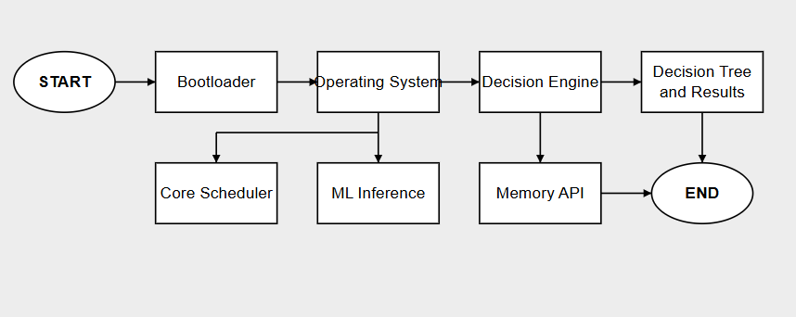
System Architecture

Slide 11
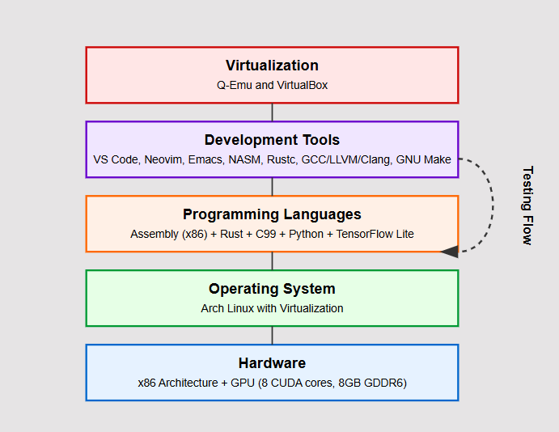

Slide 12
Proposed Hardware and Software Requirement
Hardware Requirements
System
A Computer with x86 Processor Architecture
Graphics Card with minimum 8 CUDA cores and 8 GB GDDR6 memory
Input Devices
A Keyboard
A Mouse

Slide 13
Software Requirements
Operating System
Arch Linux (rolling release) with Virtualization for Kernel Testing
Programming Language
Assembly [x86 architecture]
Rust for memory safety
C [99] for bare-metal programming
Python for model training
TensorFlow Lite for running AI model on Kernel

Slide 14
Development Environment/Filter
Visual Studio Code, NeoVim, Emacs
NASM for Assembly Compilation
Rustc for Rust Compilation
GCC 11.0+, LLVM 14.0+, and Clang 16.0+ for C Compilation and Testing
GNU Make 4.4 for automated building, testing and general-purpose compilation
Q-Emu and VirtualBox for OS emulation

Slide 15
Project Work Timeline
 | FEB | MARCH | APRIL | MAY | JUNE | JULY | AUG | SEP | OCT
REQUIREMENT SPECIFICATION
DESIGN
IMPLEMENTATION
TESTING
DEPLOYMENT
DOCUMENTATION
SPANNING

Slide 16
~iso@root: Hello, World!

Slide 17



Assembly [stub file]
C [Bootloader]
Rust [OS Takeover and Logic]

Slide 18
Conclusion
AI-Driven Optimization: Uses a localized AI model to learn user behavior and optimize resource allocation in real-time.
Smart Memory Management: Predicts memory demands and enhances data handling for reduced latency.
Adaptive Scheduling: Dynamically manages workloads to prevent bottlenecks and improve efficiency.
Intelligent Caching : Keeps frequently used data accessible, minimizing unnecessary swaps.
Key Components : Includes an ML inference engine, decision engine, and memory scheduler API for seamless performances.

Slide 19
3,000+ Lines of Code
Rust [system control]
THANK YOU

