Slide 1
Data Sources
Downloadable dataframes from UN trading site [Accuracy = 90%]
AI scraped data with strict rules [Accuracy = 60%]
Some manual data for presentation and explanation purposes [Accuracy = 90%]
Web scraping for description and images [Accuracy = 100%]
API

Slide 2
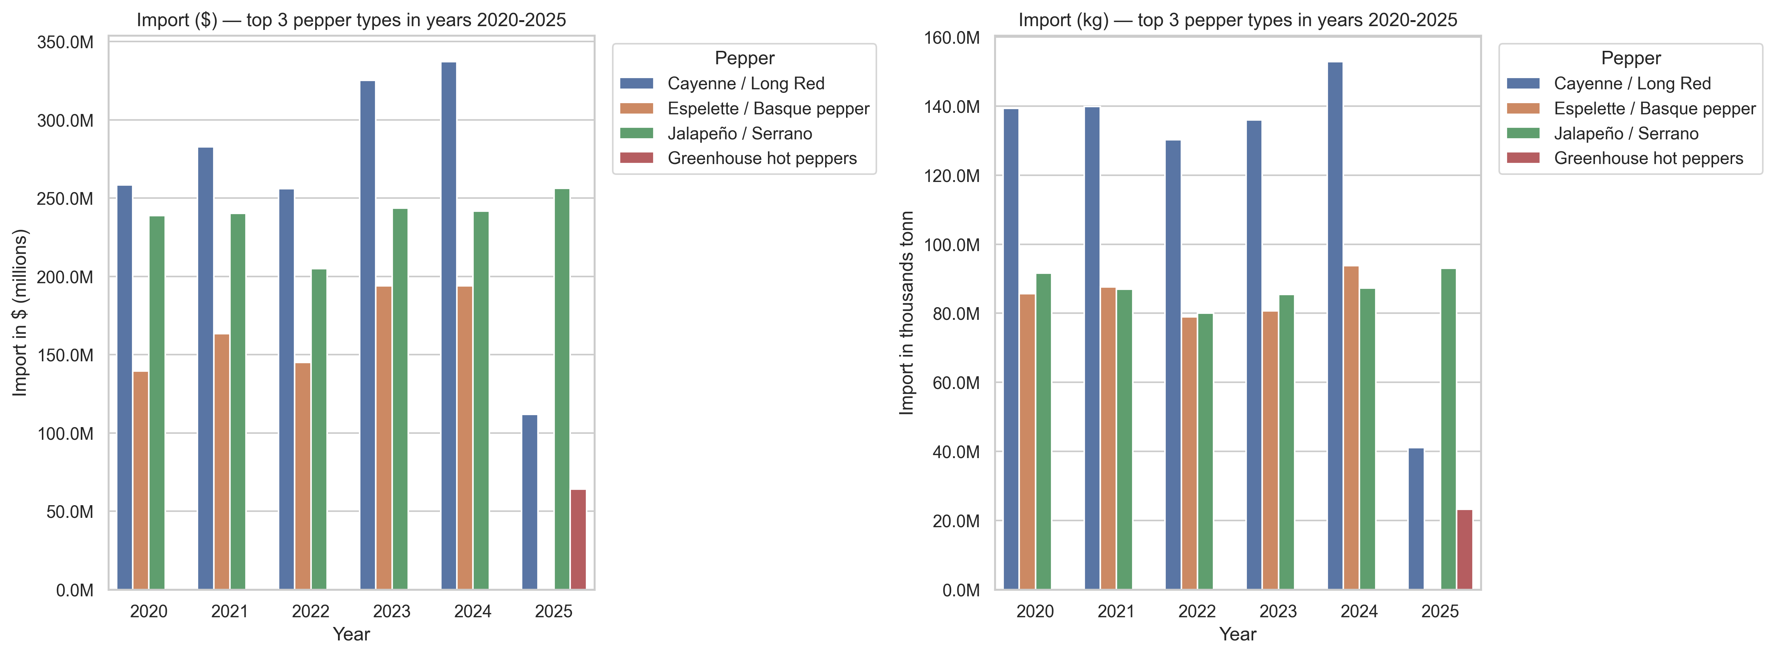
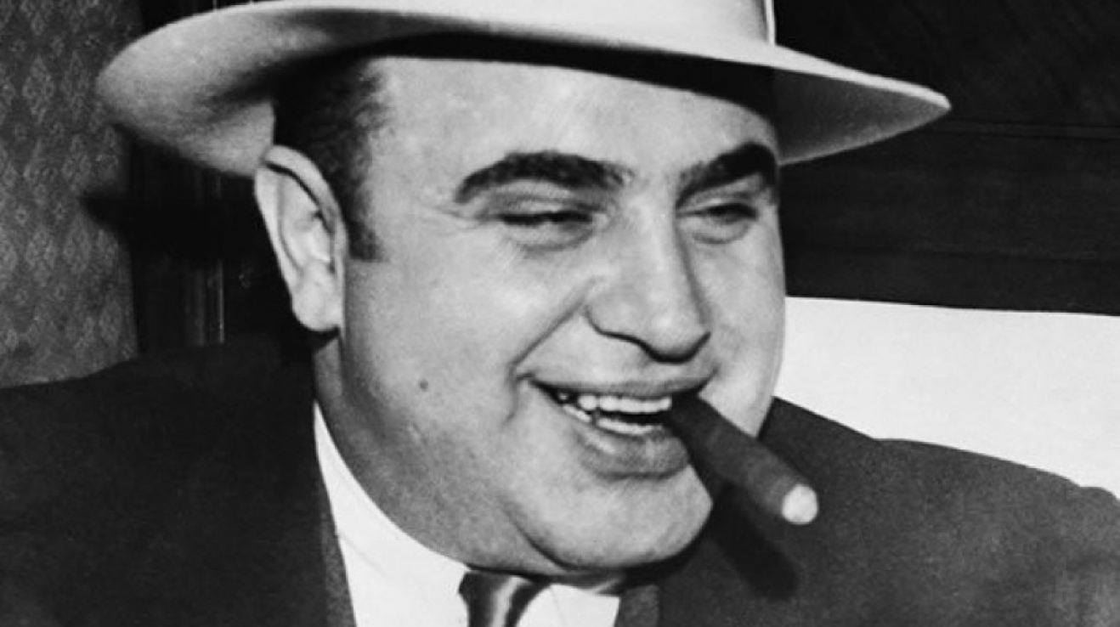
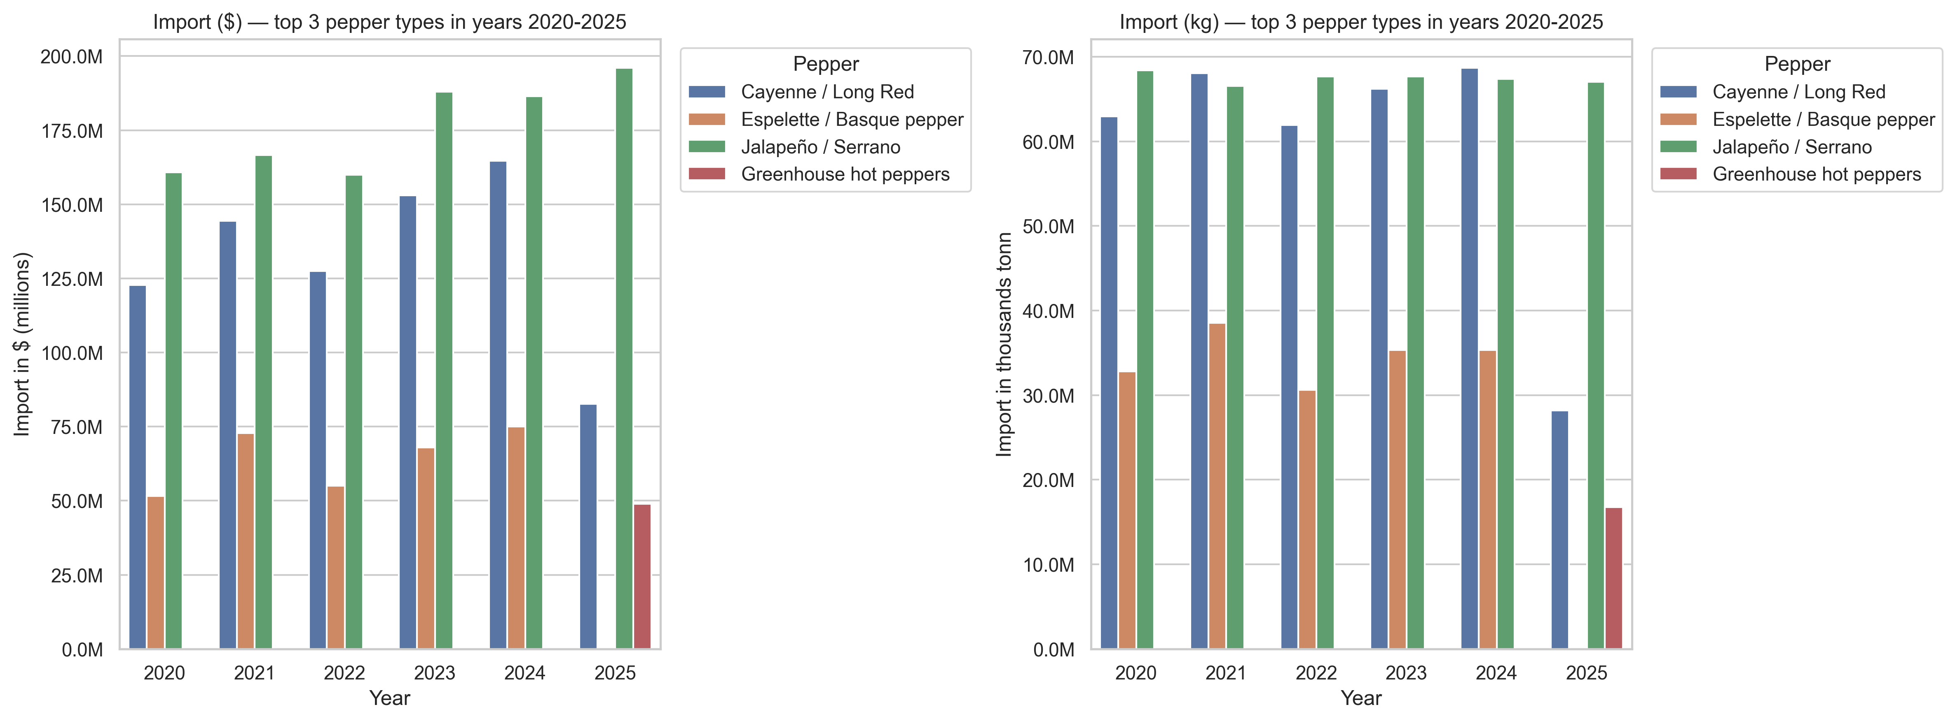

Interim data analysis regarding most common types of peppers
Corruption
Missing passport for country of Origin
Playing with EU regulations
Germany
Missing updated data for an accurate analysis
And how incorrect visualisation can put you in a „bad“ position
UK

Slide 3
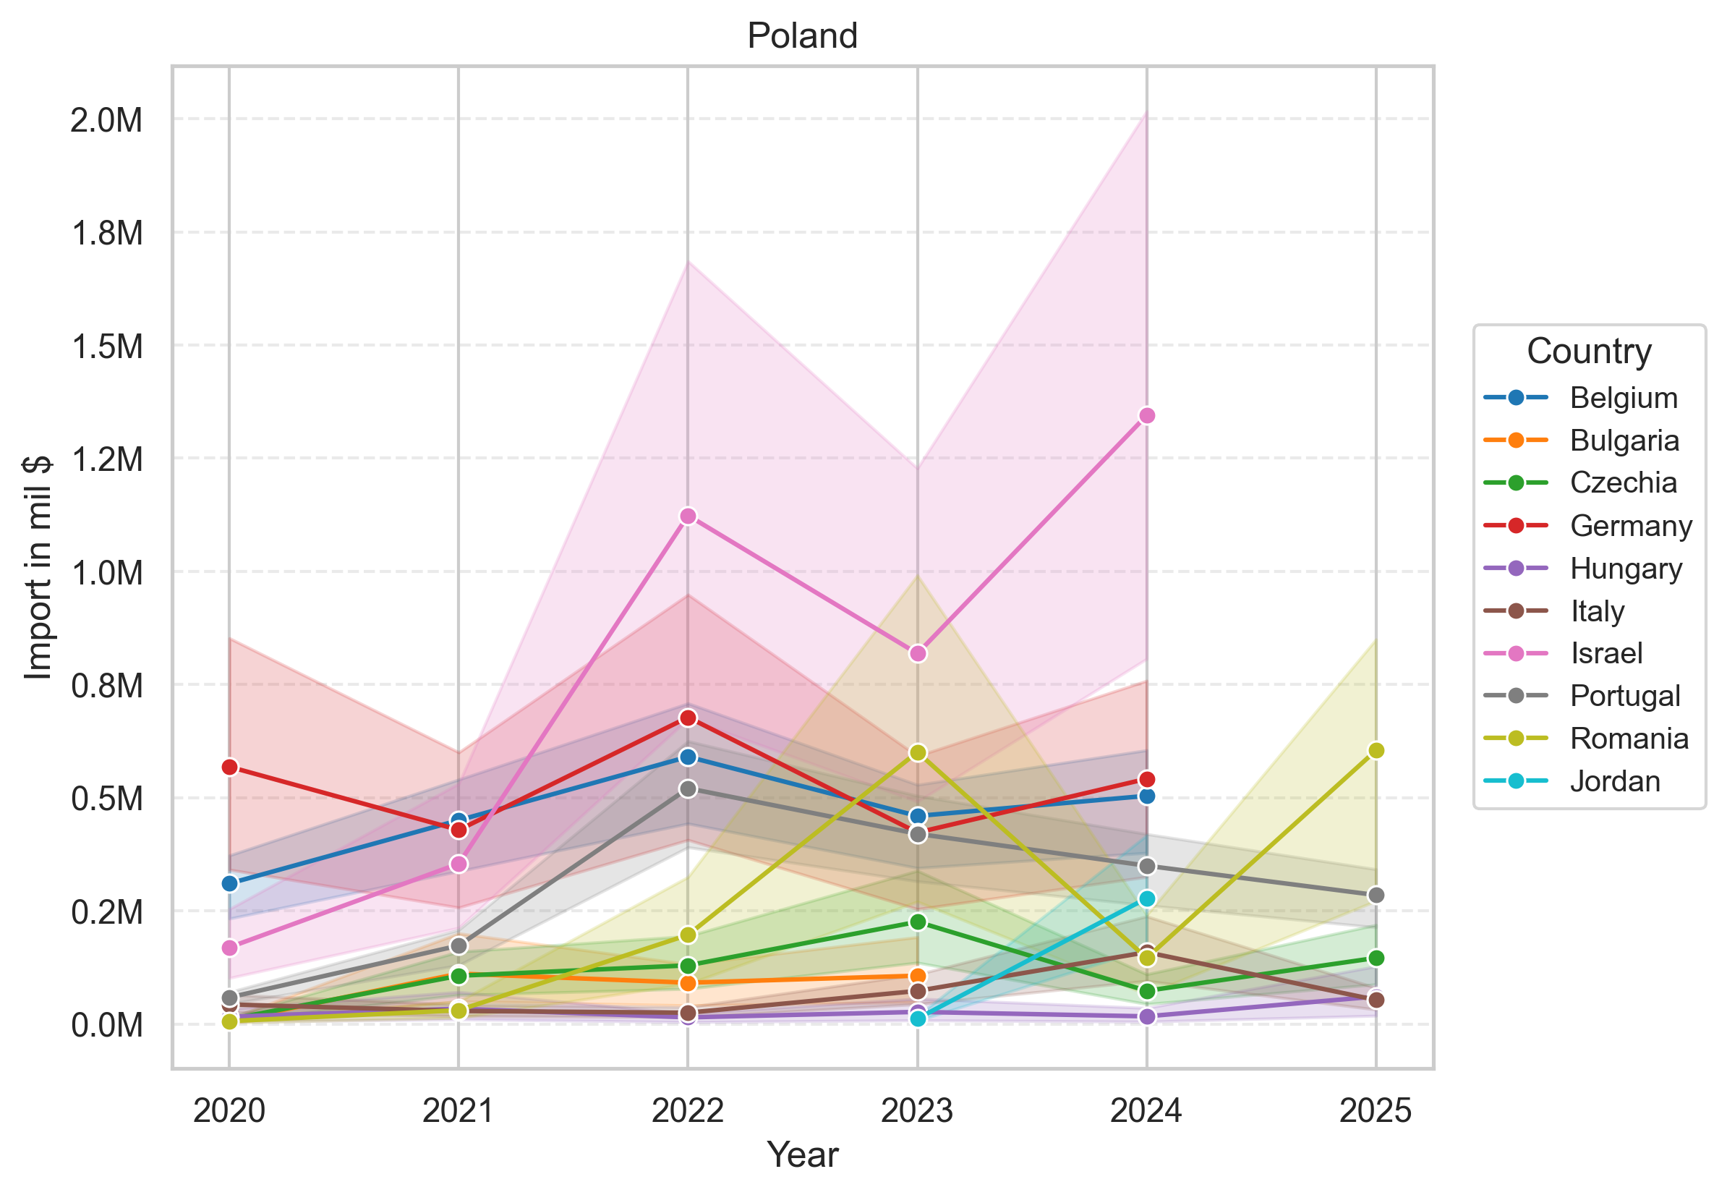
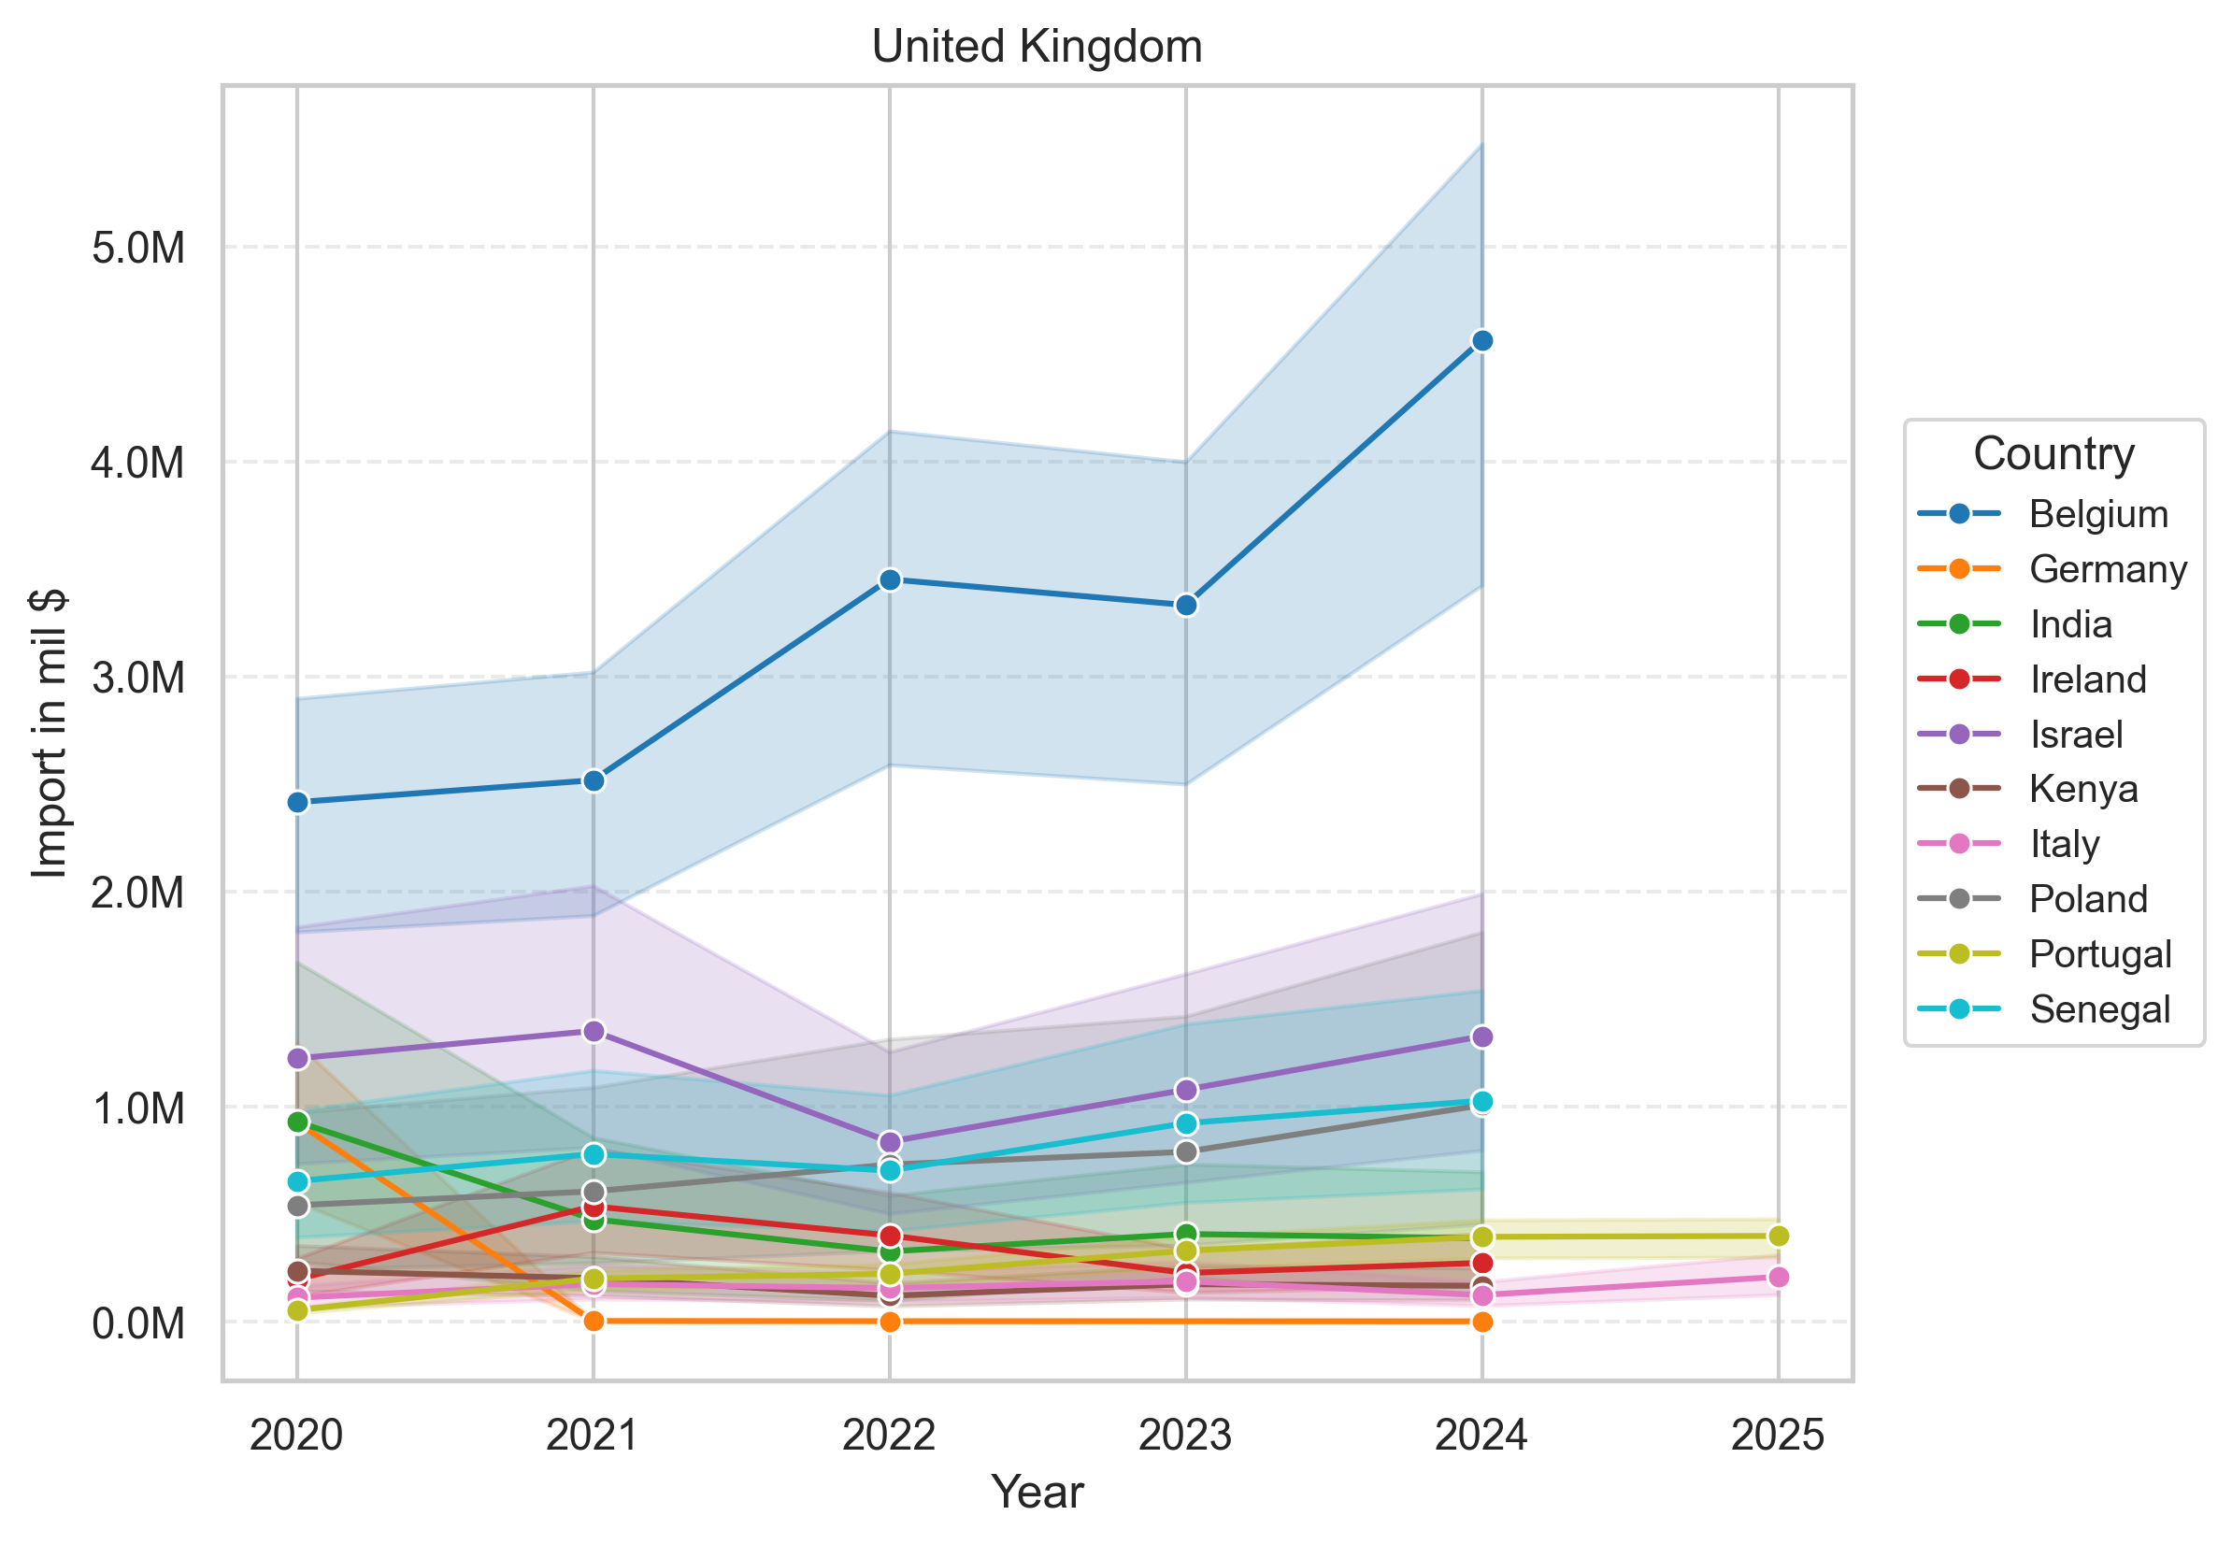
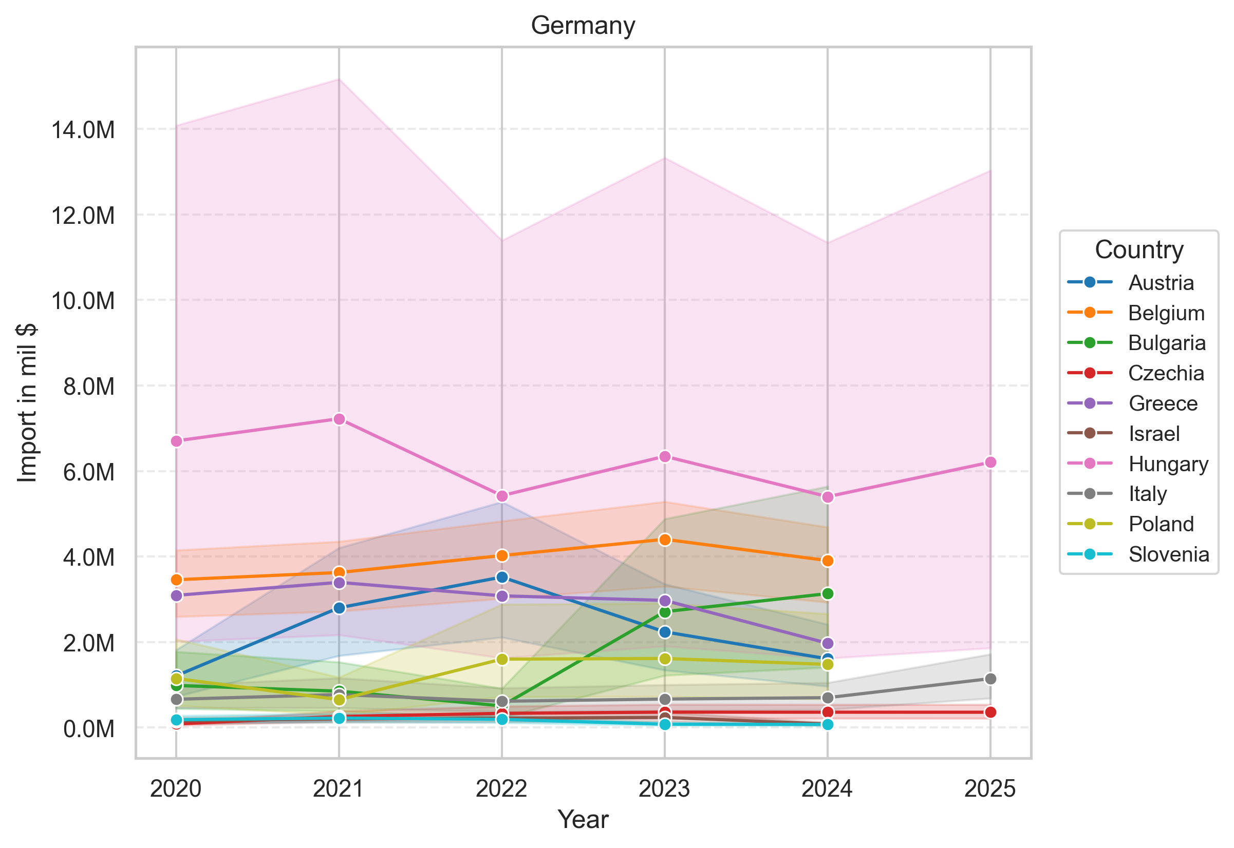
Checking specific market players tendency and “ai Scraped” data
Excluded main reexport players like Holland, Spain and France
Excluded Turkey and Marocco as a big producers
Bell peppers from Belgium ✅
Habanero from Israel ❌
„Gulash pepper“ for Germany ✅

Slide 4
Problems that we reached, lessons that we learned
“Trouble” list:
Pretty hard to find specific accurate data in limited time frames
Forming “monetizing” model is pretty hard, we went with informative one
Lesson list:
Some statistic and results after analysis can be interpreted in a wrong way “speculation”
Incorrect data visualization can cause wrong conclusions
You can implement “data-check” or “self-check” using some open source thesis

