Slide 1

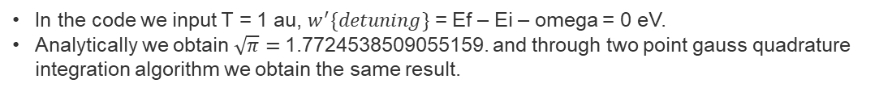
Time-dependent perturbation theory and integration
- Mitul Akbari Homework Problem set: 6
- Prof. Dr. Daria Gorelova
We verify the two point gauss quadrature algorithm by using analythical solution for the function
In the code we input T = 1 au, $w^{′}\{detuning\}$ = Ef – Ei – omega = 0 eV.
Analytically we obtain $\sqrt{π}=$1.7724538509055159. and through two point gauss quadrature integration algorithm we obtain the same result.

Slide 2
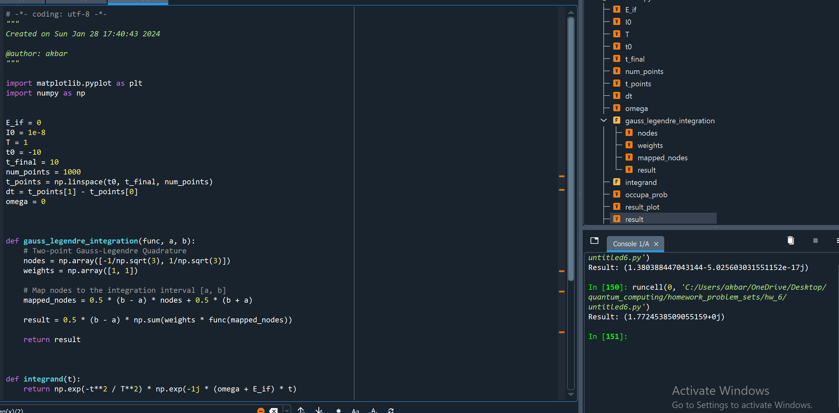
Time-dependent perturbation theory and integration

Slide 3
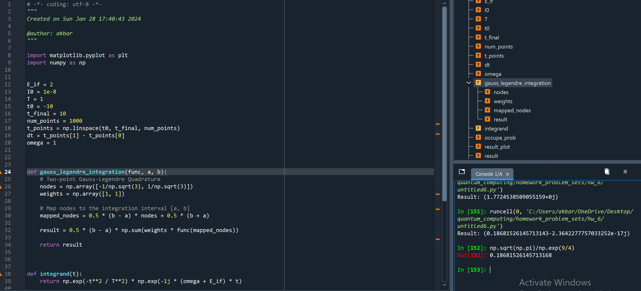
Time-dependent perturbation theory and integration
One more varifivation example of the code implemenation when T = 1 au, $w^{′}\{detuning\}$ = Ef – Ei – omega = 3 eV.

Slide 4
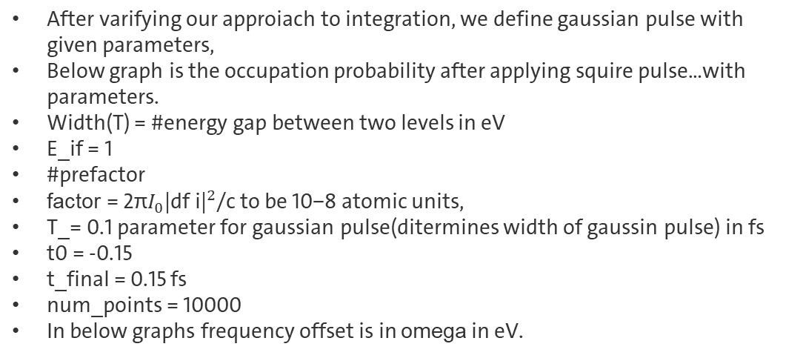
Time-dependent perturbation theory and integration
After varifying our approiach to integration, we define gaussian pulse with given parameters,
Below graph is the occupation probability after applying squire pulse…with parameters.
Width(T) = #energy gap between two levels in eV
E_if = 1
#prefactor
factor = 2π$I_{0}{\text{|}\text{df} \text{i}\text{|}}^{2}$/c to be 10−8 atomic units,
T_= 0.1 parameter for gaussian pulse(ditermines width of gaussin pulse) in fs
t0 = -0.15
t_final = 0.15 fs
num_points = 10000
In below graphs frequency offset is in omega in eV.

Slide 5
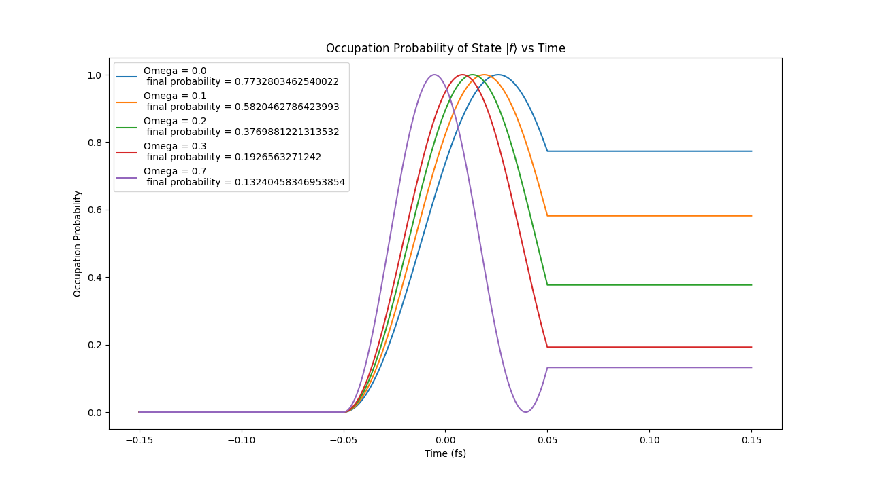
Time-dependent perturbation theory and integration

Slide 6
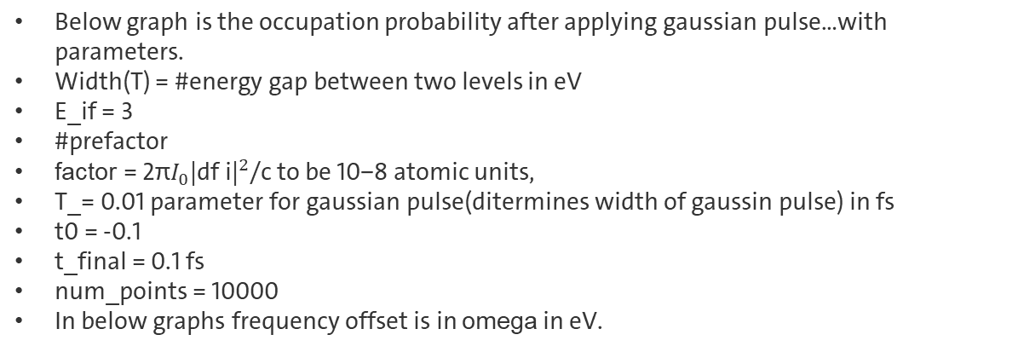
Time-dependent perturbation theory and integration
Below graph is the occupation probability after applying gaussian pulse…with parameters.
Width(T) = #energy gap between two levels in eV
E_if = 3
#prefactor
factor = 2π$I_{0}{\text{|}\text{df} \text{i}\text{|}}^{2}$/c to be 10−8 atomic units,
T_= 0.01 parameter for gaussian pulse(ditermines width of gaussin pulse) in fs
t0 = -0.1
t_final = 0.1 fs
num_points = 10000
In below graphs frequency offset is in omega in eV.

Slide 7
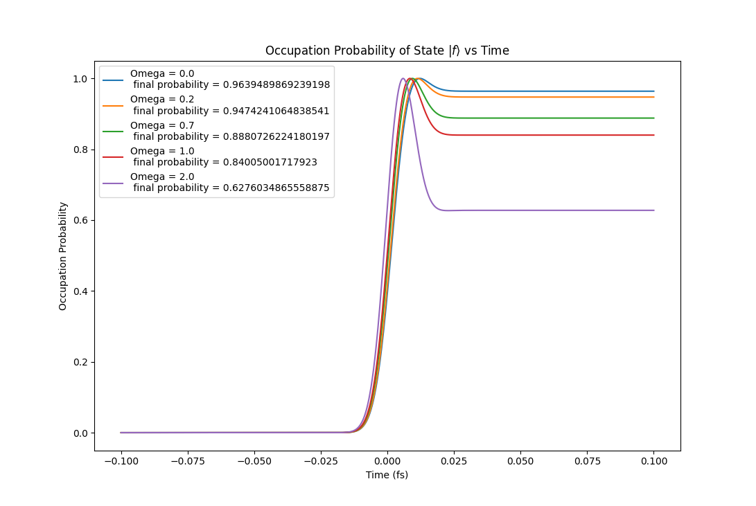
Time-dependent perturbation theory and integration

