Slide 1
Metropolis Monte Carlo method
- Mitul Akbari Homework Problem set: 8
- Prof. Dr. Daria Gorelova

Slide 2
Metropolis Monte Carlo method
#Parameters
N = 10
J = 1
B_lower = -2
B_higher = 2
T_lower = 0.1
T_higher = 5
num_steps = 1000
discard_steps = 500
fixed_B = 2
fixed_temperature = 4.0

Slide 3
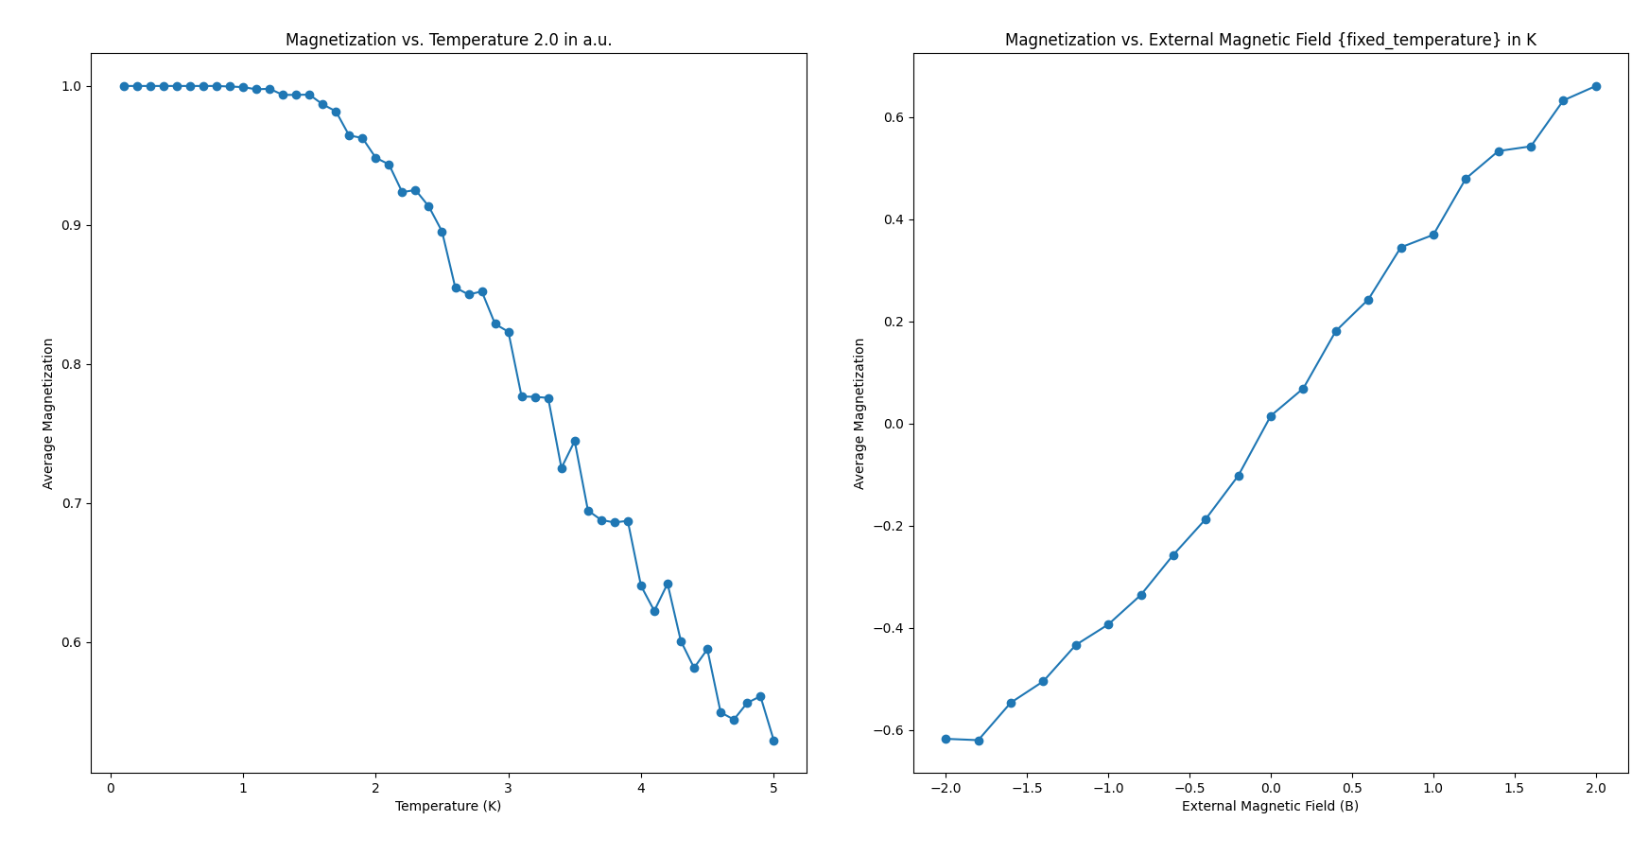
Metropolis Monte Carlo method

Slide 4
Metropolis Monte Carlo method
N = 10
J = 1
B_lower = -10
B_higher = 10
T_lower = 0.1
T_higher = 10
num_steps = 1000
discard_steps = 500
fixed_B = 10
fixed_temperature = 20

Slide 5
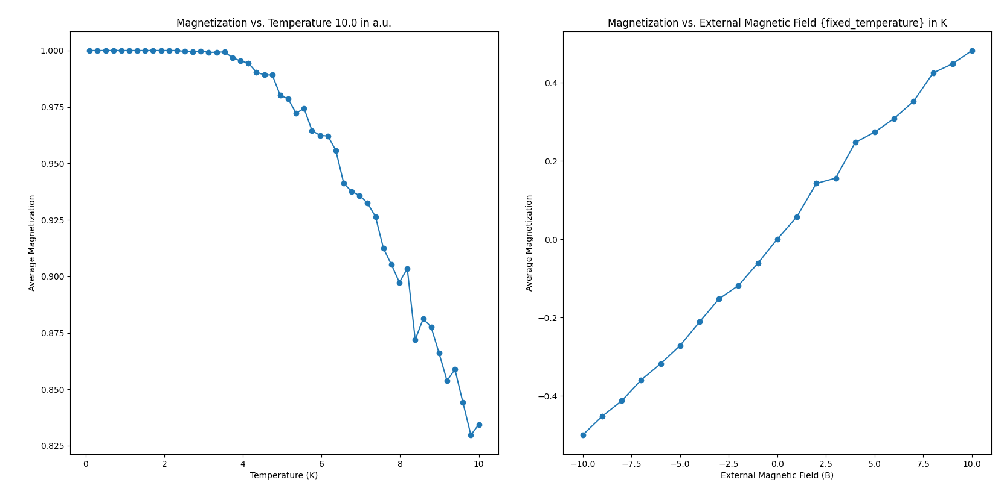
Split-operator method and fast Fourier transform

