Slide 1
Numerov’s method
- Mitul Akbari Homework Problem set: 5
- Prof. Dr. Daria Gorelova

Slide 2
Numerov’s method
#mass of the particle in atomic units
m = 1.0
#Potential coefficient
C = 1
# Potential coefficient
D = 0
# Potential coefficient
E = 0
# dimention of the simulation
x_min = -10.0
x_max = 10.0
# number of x steps
num_points = 500

Slide 3
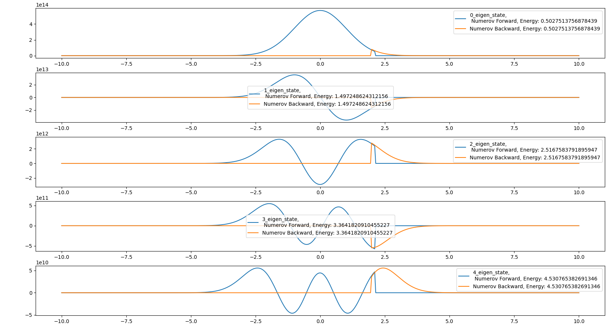
Numerov’s method

Slide 4
Numerov’s method
#mass of the particle in atomic units
m = 1.0
#Potential coefficient
C = 1
# Potential coefficient
D = 0
# Potential coefficient
E = 0
# dimention of the simulation
x_min = -10.0
x_max = 10.0
# number of x steps
num_points = 500

Slide 5
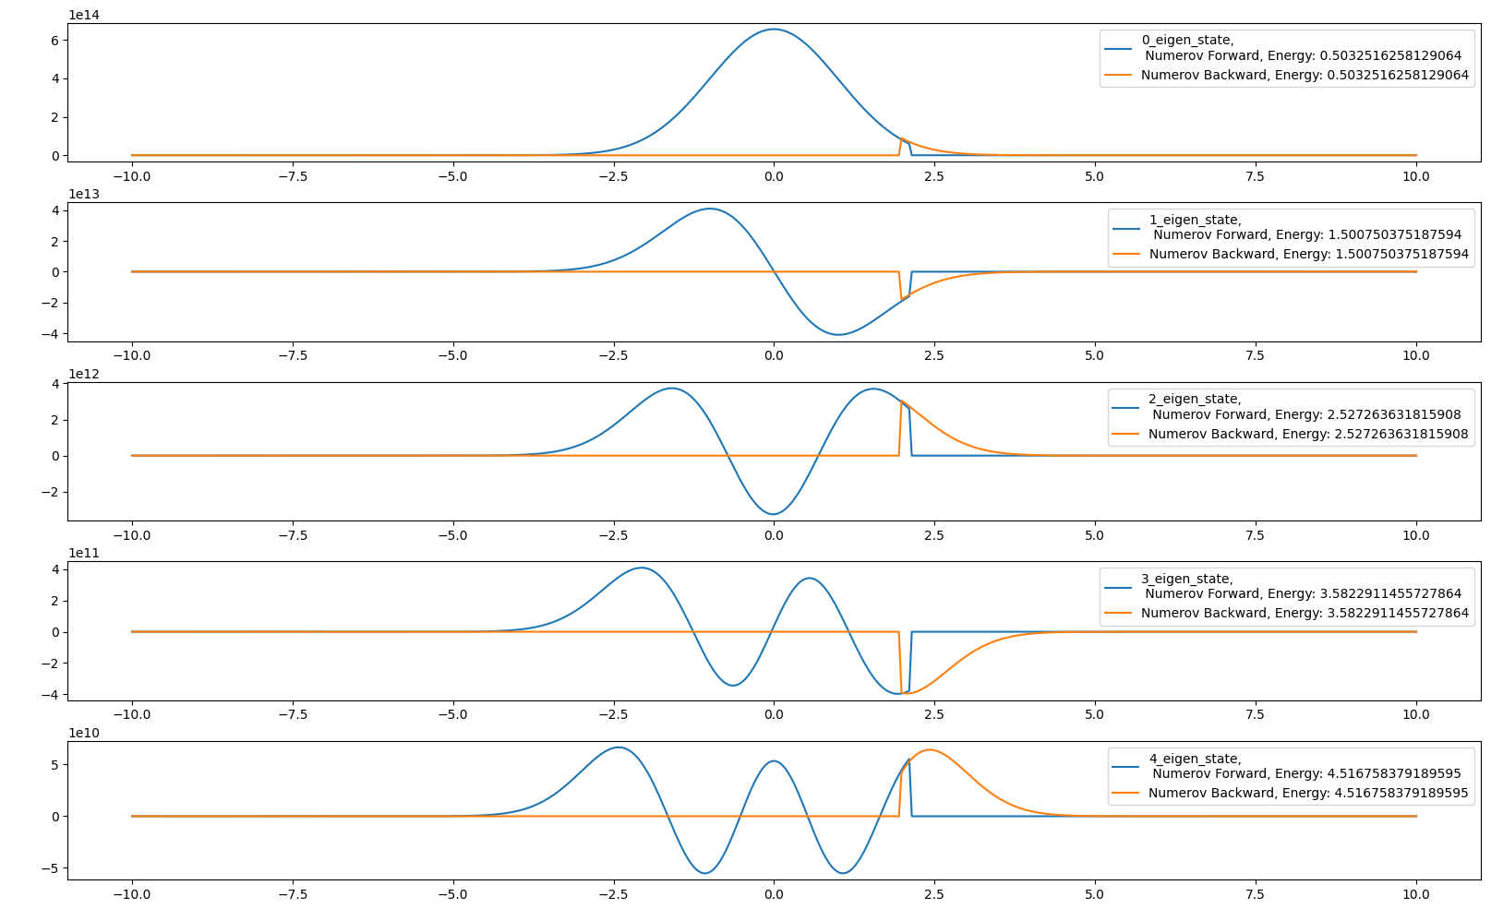
Numerov’s method

Slide 6
Numerov’s method
Eigen energies do not change much even in presence of anharmonic term

