Slide 1
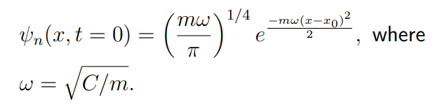
Split-operator method and fast Fourier transform
- Mitul Akbari Homework Problem set: 4
- Prof. Dr. Daria Gorelova
Solve computationally the 1D time-dependent Schrödinger equation for a particle in an infinite potential well using the split-operator algorithm.
The initial wave function is the Gaussian wave packet that is localized in the left side of the of the box.

Slide 2
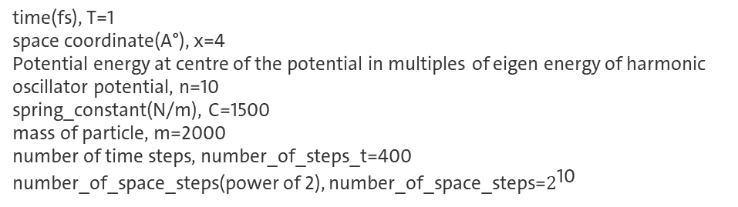
Split-operator method and fast Fourier transform
Here are some of the paraameters used for generating wavefunction propogation animation with double well potential. And it behaves as expected.
Here are parameters for generated animation below,
time(fs), T=1
space coordinate(A°), x=4
Potential energy at centre of the potential in multiples of eigen energy of harmonic oscillator potential, n=10
spring_constant(N/m), C=1500
mass of particle, m=2000
number of time steps, number_of_steps_t=400
number_of_space_steps(power of 2), number_of_space_steps=$2^{\text{10}}$

Slide 3
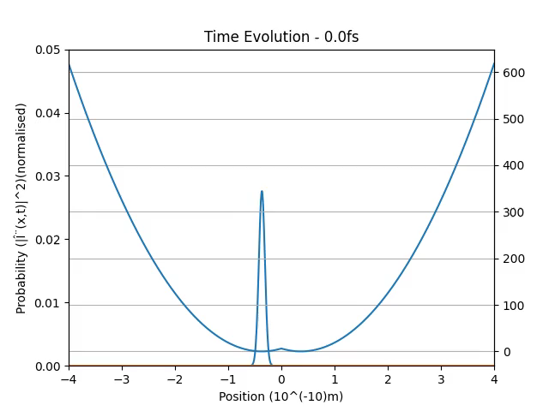
Split-operator method and fast Fourier transform
Potential_energy_in eV

Slide 4
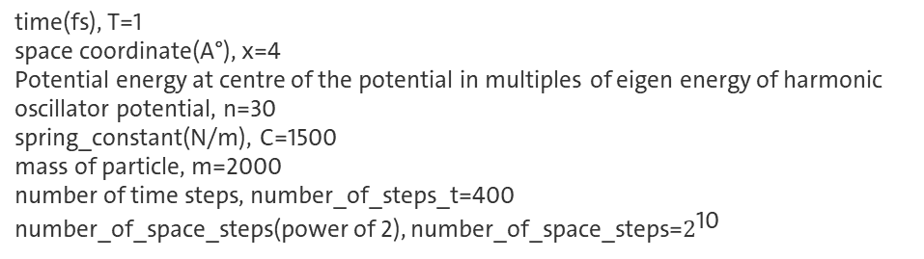
Split-operator method and fast Fourier transform
Here are parameters for generated animation below,
time(fs), T=1
space coordinate(A°), x=4
Potential energy at centre of the potential in multiples of eigen energy of harmonic oscillator potential, n=30
spring_constant(N/m), C=1500
mass of particle, m=2000
number of time steps, number_of_steps_t=400
number_of_space_steps(power of 2), number_of_space_steps=$2^{\text{10}}$

Slide 5
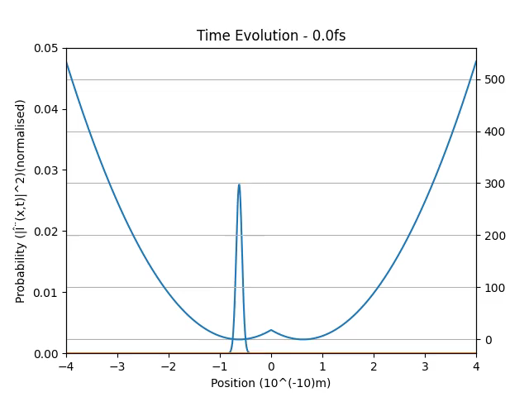
Split-operator method and fast Fourier transform
Potential_energy_in eV

Slide 6
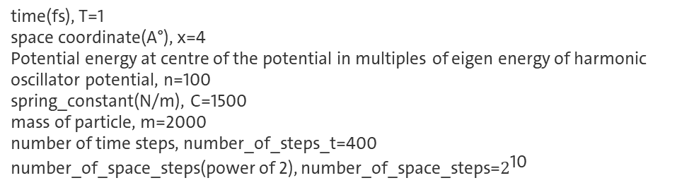
Split-operator method and fast Fourier transform
Here are parameters for generated animation below,
time(fs), T=1
space coordinate(A°), x=4
Potential energy at centre of the potential in multiples of eigen energy of harmonic oscillator potential, n=100
spring_constant(N/m), C=1500
mass of particle, m=2000
number of time steps, number_of_steps_t=400
number_of_space_steps(power of 2), number_of_space_steps=$2^{\text{10}}$

Slide 7
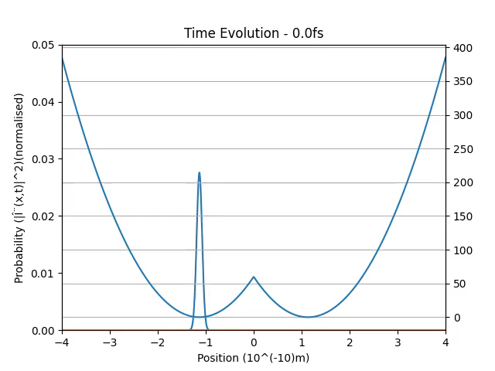
Split-operator method and fast Fourier transform
Potential_energy_in eV

Slide 8
Split-operator method and fast Fourier transform
Looking at the animation for potential energy equal to harmonic oscillator state n = 10, n = 30, n = 100 energies, we can see that the frequency of oscillation in increasing.

