Slide 1
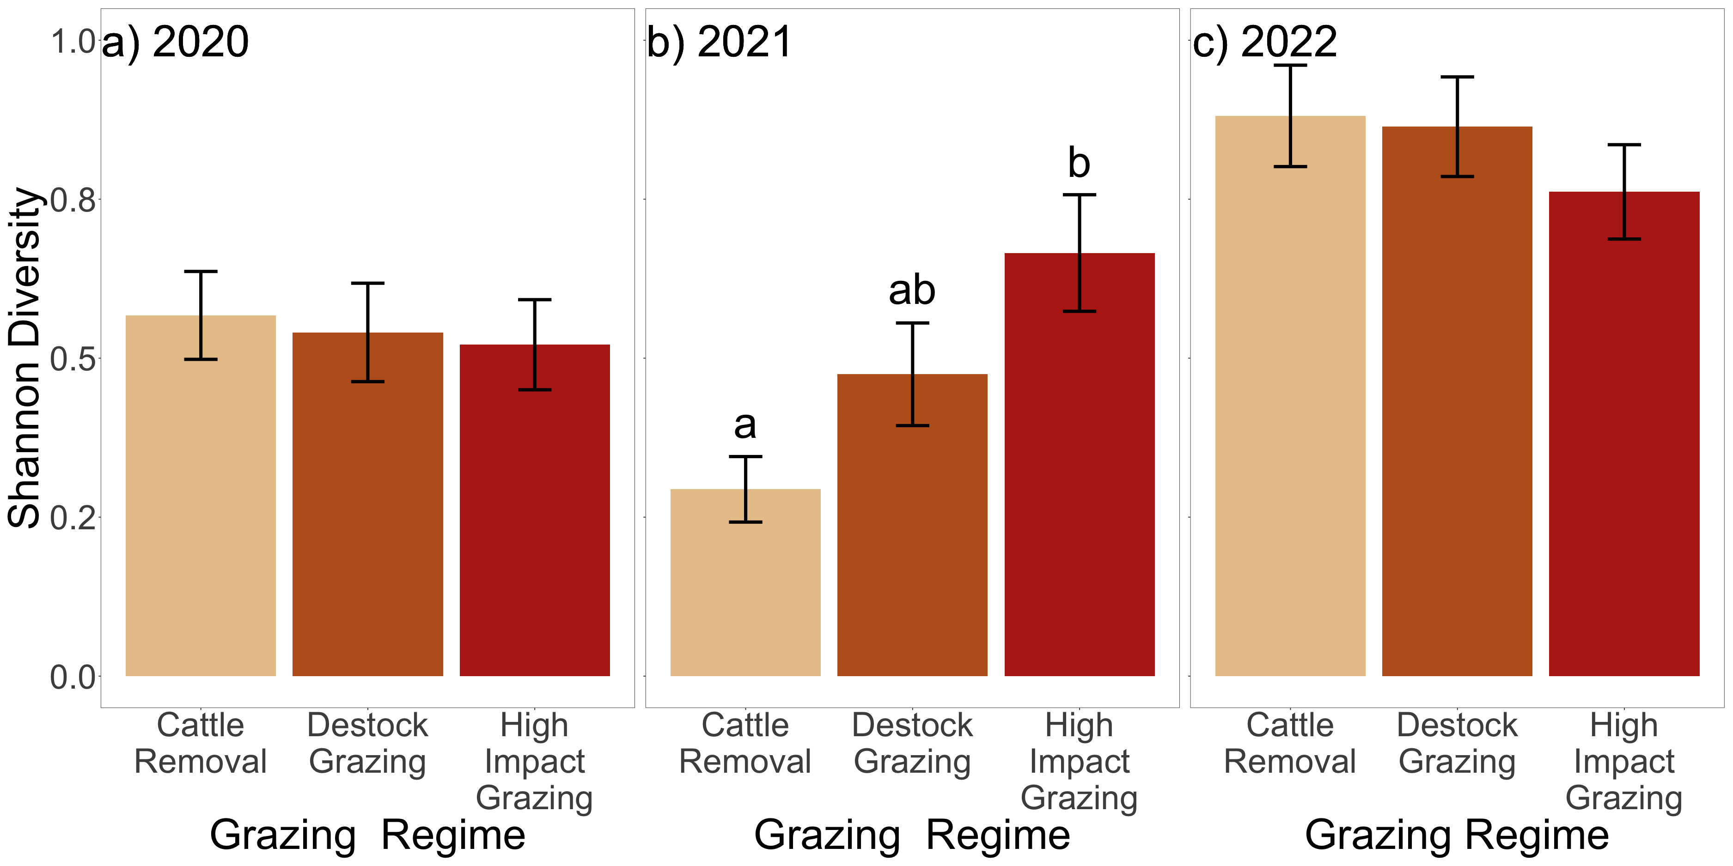
Figure 1
Updated stats, colors, labels
Thoughts
Not sure why I changed the grazing labels – someone must have said something?
I like “Rest from Grazing” better than cattle removal
Destock and light grazing I am fine either way

Slide 2
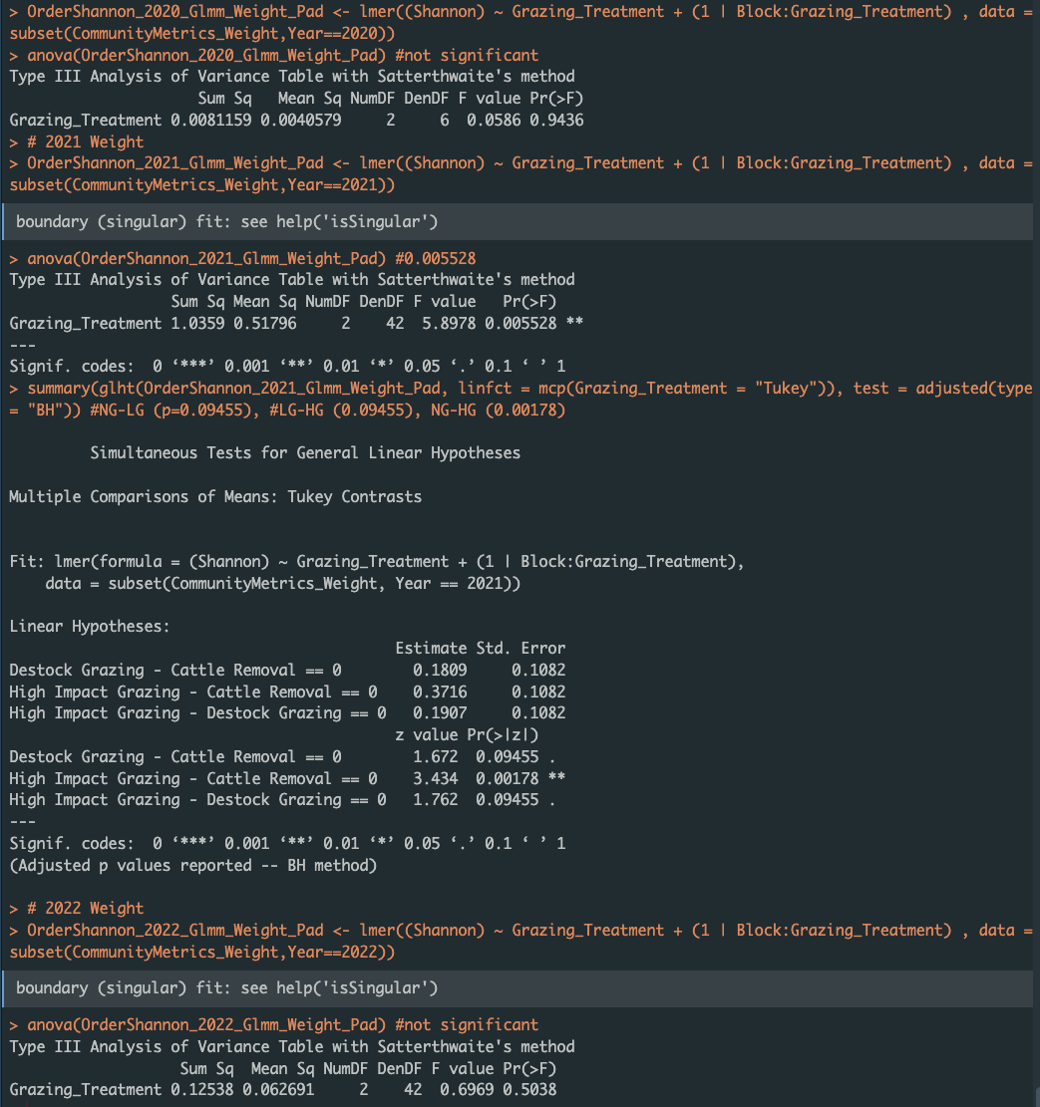
Figure 1
Updated stats, colors, labels
Block:Grazing_Treatment instead of just Block (before)

Slide 3
