Slide 1
R Workshop
Gruner Lab Meeting
October 4, 2024

Slide 2

Free UMD Workshops Coming Up
UMD Library offers data science workshops
Intro to ArcGIS
Wednesday Oct 9, 12:00-1:30
Data Mining with R
Tuesday Oct 15, 11:00-12:30
Intro to Spatial Statistics
Friday Oct 18, 12:00 – 1:30

Slide 3
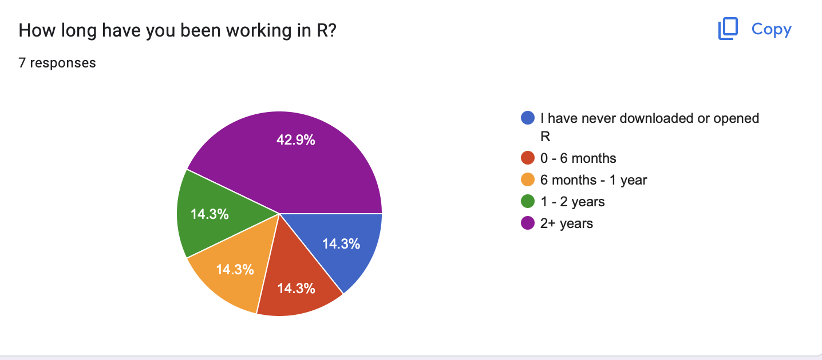
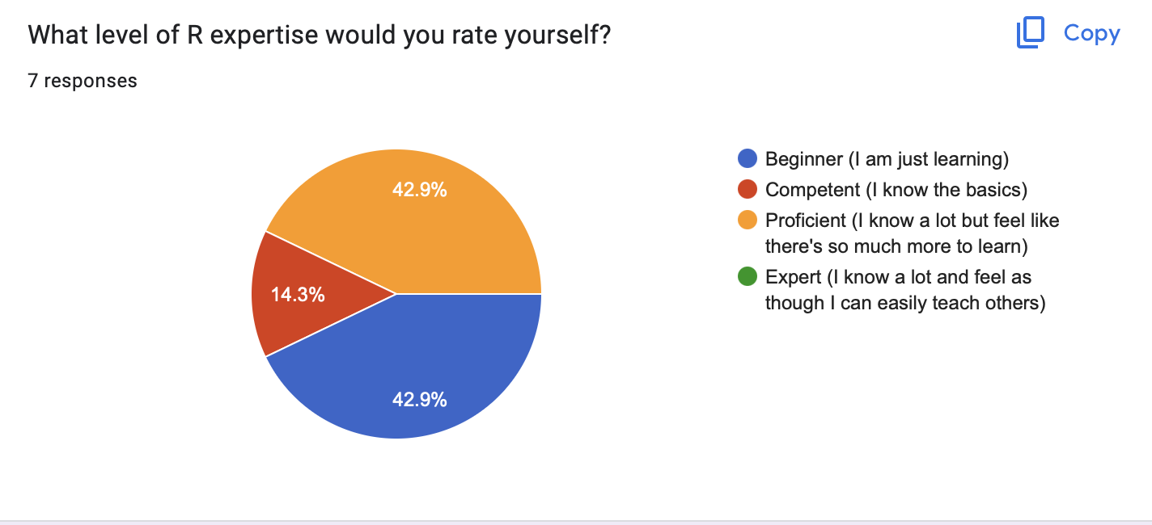
We’re all in different learning stages

Slide 4
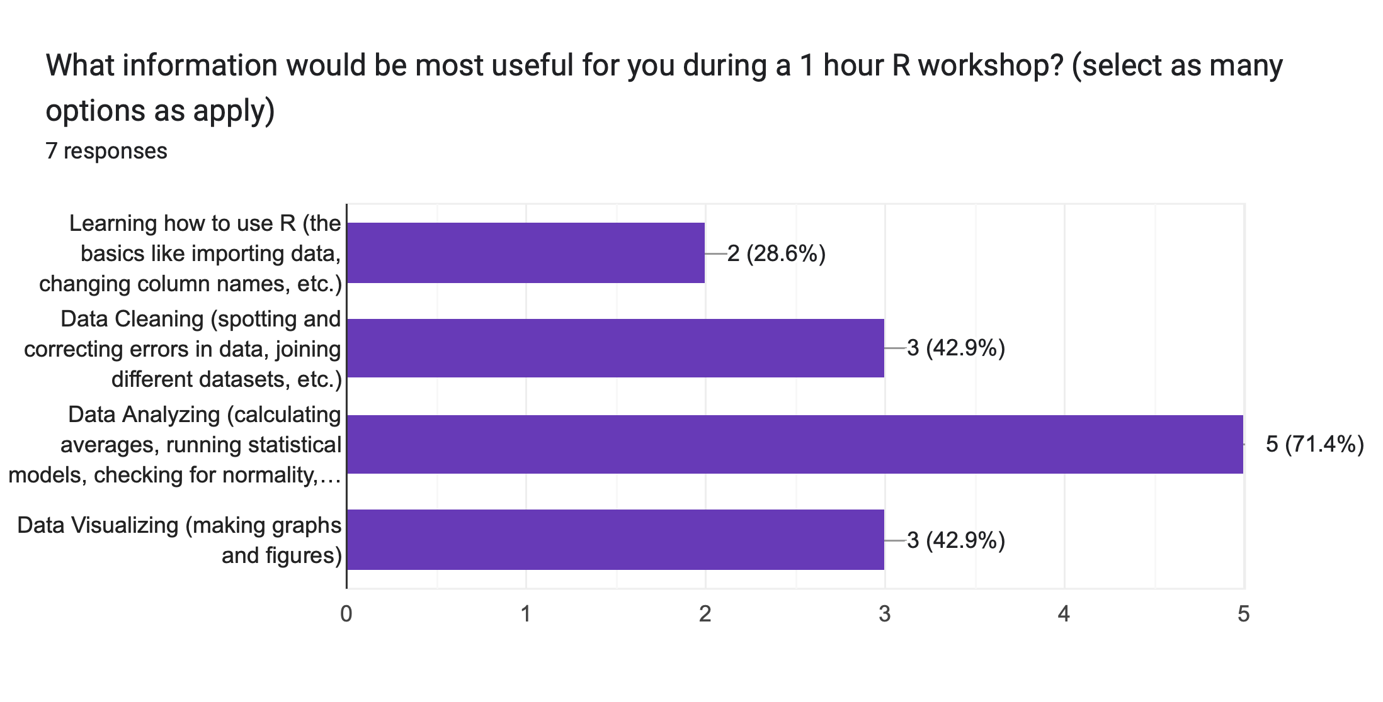
Today’s Workshop Inspiration

Slide 5
Today’s Workshop Inspiration
Notes:
We’ll have code for all of these steps, but I will focus a bit heavier on the data analyzing portion

Slide 6
Workshop Outline
Data Intro & Structure
Importing and cleaning data
Calculating Community Metrics
Modeling Changes in Community Metrics

Slide 7
Workshop Outline
Data Intro & Structure
Importing and cleaning data
Calculating Community Metrics
Modeling Changes in Community Metrics

Slide 8
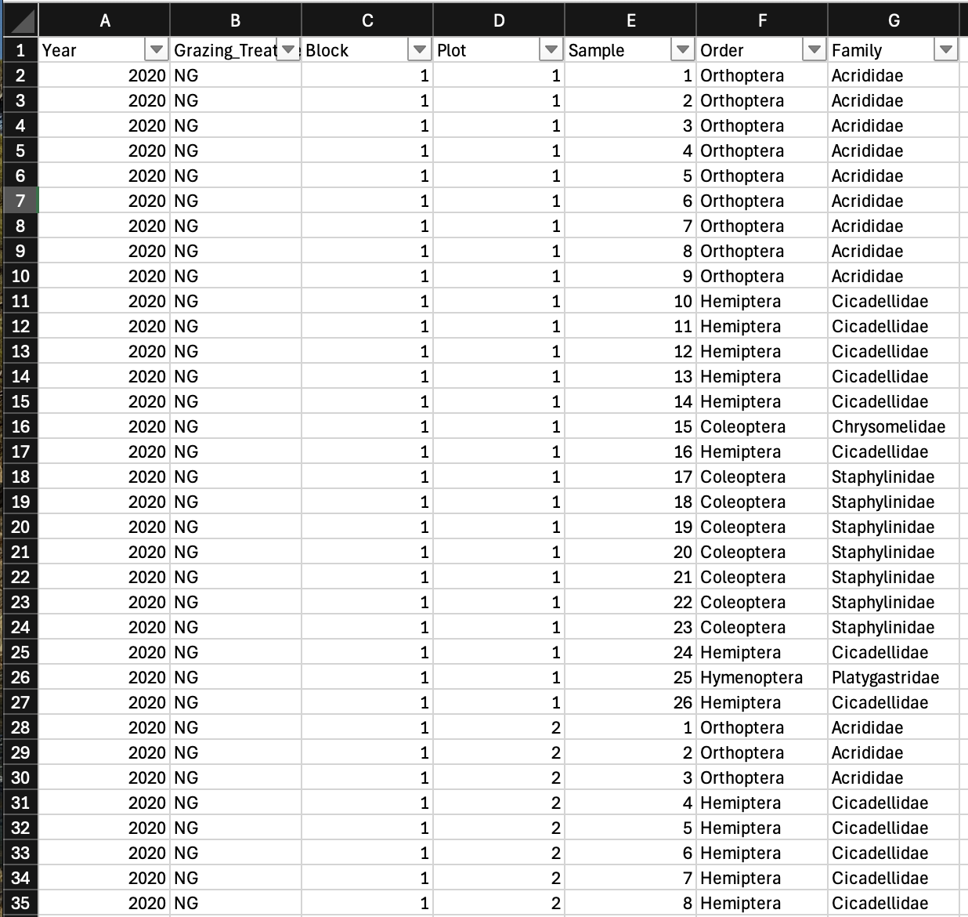
How does grazing affect arthropod communities?

Slide 9
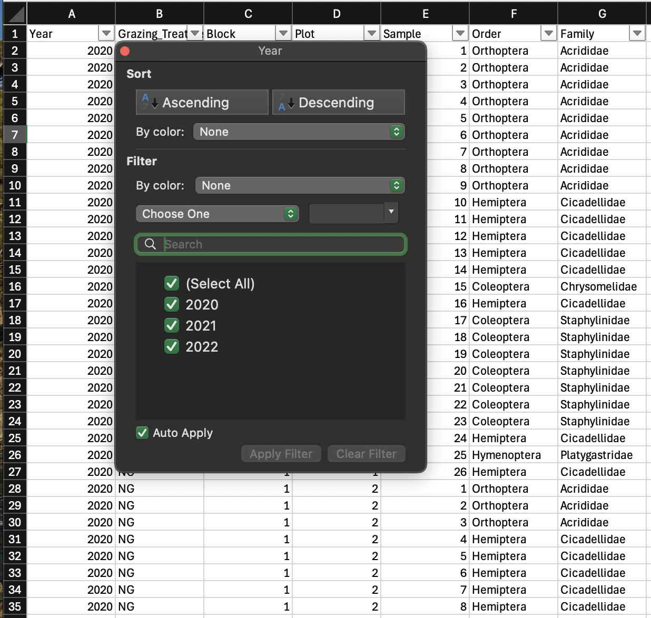
Data Structure
3 years of data

Slide 10
Data Structure
3 years of data
3 treatments in each year (High grazing, low grazing, and no grazing)
3 replicate blocks at each site
45 plots total
Cattle Removal
Destock Grazing
High Impact Grazing
1 m²
40 m
x3
30 m

Slide 11
Data Structure

Slide 12
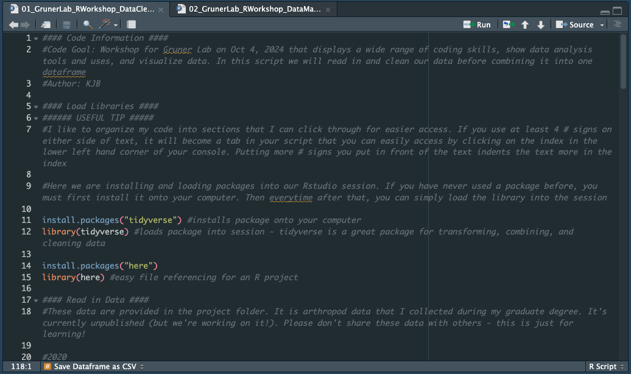
Workshop Outline
Data Intro & Structure
Importing and cleaning data
Not going through today but annotated code is available in Boxbox-group-grunerlab/ GRUNERLAB/ R Studio Workshop/ GrunerLab_RWorkshop/ 01_GrunerLab_RWorkshop_DataCleaning.R
Calculating Community Metrics
Modeling Changes in Community Metrics

Slide 13
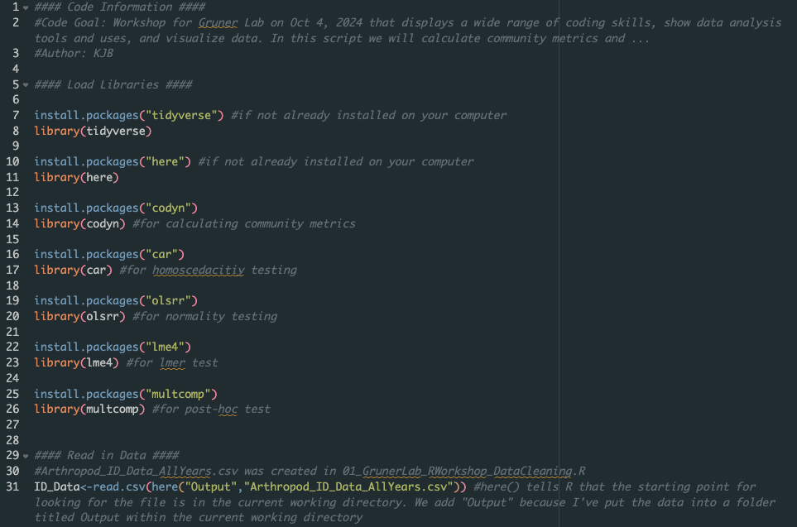
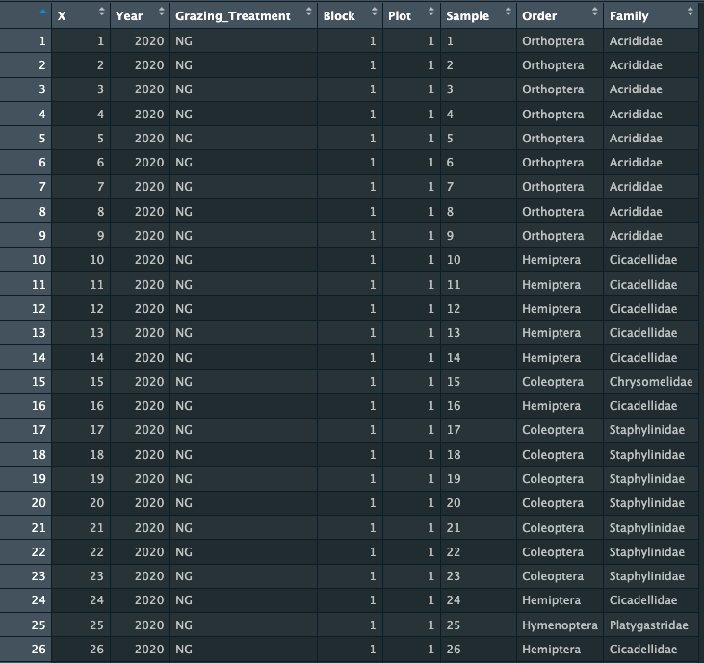
Install & load packages and read in data Lines 1-31

Slide 14
Workshop Outline
Data Intro & Structure
Importing and cleaning data
Calculating Community Metrics
Absolute Abundance
Relative Abundance
Richness
Evenness
Diversity
Modeling Changes in Community Metrics

Slide 15
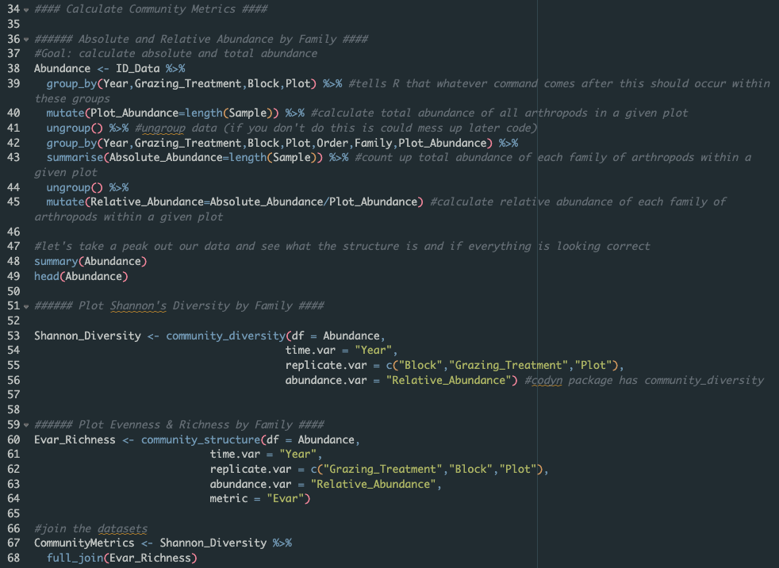
Calculate Community Metrics Lines 35 - 68

Slide 16
Workshop Outline
Data Intro & Structure
Importing and cleaning data
Calculating Community Metrics
Modeling Changes in Community Metrics
What model structure to choose? What test to run?
Checking for normality
Running the models & assessing model fit

Slide 17
Identifying what model to use…
Develop your question & hypotheses (ideally before collecting data…)
How does the arthropod community change with grazing intensity?
We hypothesized that as grazing intensified, arthropod richness and abundance would decrease because mixed-grass prairie has relatively low productivity, leading to higher competition for resources.
Notes:
You want your statistical methods to reflect your question and be a test of your hypothesis – not the other way around

Slide 18
Identifying what model to use…
Develop your question & hypotheses (ideally before collecting data…)
How does the arthropod community change with grazing intensity?
We hypothesized that as grazing intensified, arthropod richness and abundance would decrease because mixed-grass prairie has relatively low productivity, leading to higher competition for resources.
Does the arthropod community change from year to year with grazing intensity?
We hypothesized that this pattern would be most apparent in years where precipitation is lower due to a reduction in annual net primary productivity leading to higher competition between herbivore types
Notes:
You want your statistical methods to reflect your question and be a test of your hypothesis – not the other way around

Slide 19
Identifying what model to use…
Develop your question & hypotheses (ideally before collecting data…)
Assess your variable types (binary response variables vs. continuous vs. discrete etc.)
We have discrete and continuous variables depending on our question

Slide 20
Identifying what model to use…
Develop your question & hypotheses (ideally before collecting data…)
Assess your variable types (binary response variables vs. continuous vs. discrete etc.)
Decide if you can use parametric testing or if you need a non-parametric test (i.e. do your data abide by the assumptions of parametric testing)

Slide 21
Identifying what model to use…
Develop your question & hypotheses (ideally before collecting data…)
Assess your variable types (binary response variables vs. continuous vs. discrete etc.)
Decide if you can use parametric testing or if you need a non-parametric test (i.e. do your data abide by the assumptions of parametric testing)
Independence of Observations: is there a relationship between your observations or variables
Homogeneity of Variance (Homoscedasticity): is the variation among your different groups (treatments) relatively similar?
Normality of Data: do your data follow a normal distribution?

Slide 22
Identifying what model to use…
Develop your question & hypotheses (ideally before collecting data…)
Assess your variable types (binary response variables vs. continuous vs. discrete etc.)
Decide if you can use parametric testing or if you need a non-parametric test (i.e. do your data abide by the assumptions of parametric testing)
Independence of Observations: is there a relationship between your observations or variables
Homogeneity of Variance (Homoscedasticity): is the variation among your different groups (treatments) relatively similar?
Normality of Data: do your data follow a normal distribution?
If the answer to any of these 3 questions is yes, then you either need to correct for it, or use a non-parametric test

Slide 23
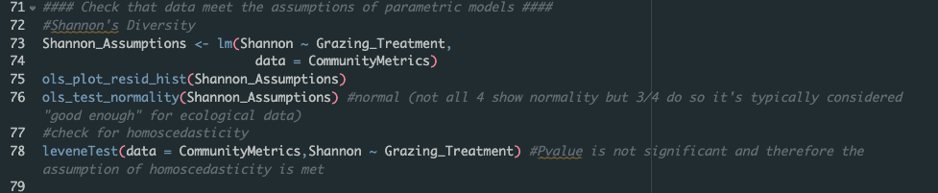
Checking Model Assumptions Lines 71-94

Slide 24
Identifying what model to use…
Develop your question & hypotheses (ideally before collecting data…)
Assess your variable types (binary response variables vs. continuous vs. discrete etc.)
Decide if you can use parametric testing or if you need a non-parametric test (i.e. do your data abide by the assumptions of parametric testing)
Independence of Observations: is there a relationship between your observations or variables
Homogeneity of Variance (Homoscedasticity): is the variation among your different groups (treatments) relatively similar?
Normality of Data: do your data follow a normal distribution?
If the answer to any of these 3 questions is yes, then you either need to correct for it, or use a non-parametric test

Slide 25
Identifying what model to use…
Develop your question & hypotheses (ideally before collecting data…)
Assess your variable types (binary response variables vs. continuous vs. discrete etc.)
Decide if you can use parametric testing or if you need a non-parametric test (i.e. do your data abide by the assumptions of parametric testing)
Choose a test that answers your questions and meets your needs

Slide 26
Common Ecological Stats Tests
T-tests
ANOVA or Linear Model
ANOVA (aov) is doing sequential sum of squares (Type I) – data are categorical
Linear Model (lm) is doing adjusted sum of squares (Type II) – data are continuous
Regression (a few types)
Ordination analyses (PCA, RDA, NMDS, CCA, etc…)
not going over this today but this is a good brief overview of the differences: https://www.davidzeleny.net/anadat-r/doku.php/en:ordination

Slide 27
Common Ecological Stats Tests
T-tests
ANOVA or Linear Model
ANOVA (aov) is doing sequential sum of squares (Type I) – data are categorical
Linear Model (lm) is doing adjusted sum of squares (Type II) – data are continuous
Regression (a few types)
Ordination analyses (PCA, RDA, NMDS, CCA, etc…)
not going over this today but this is a good brief overview of the differences: https://www.davidzeleny.net/anadat-r/doku.php/en:ordination

Slide 28
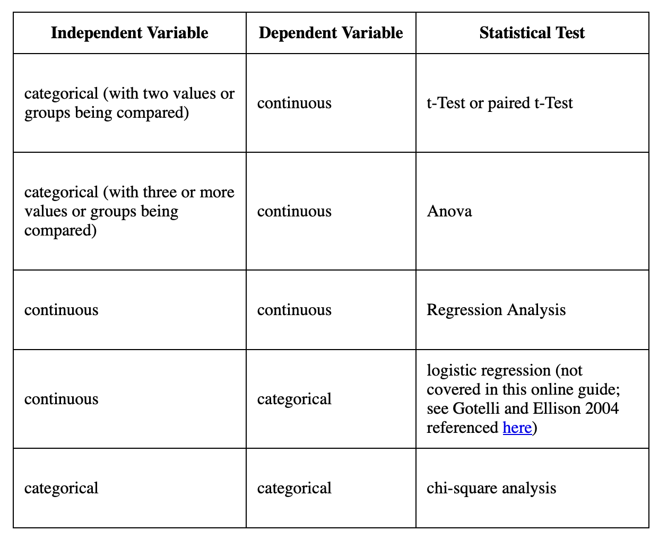
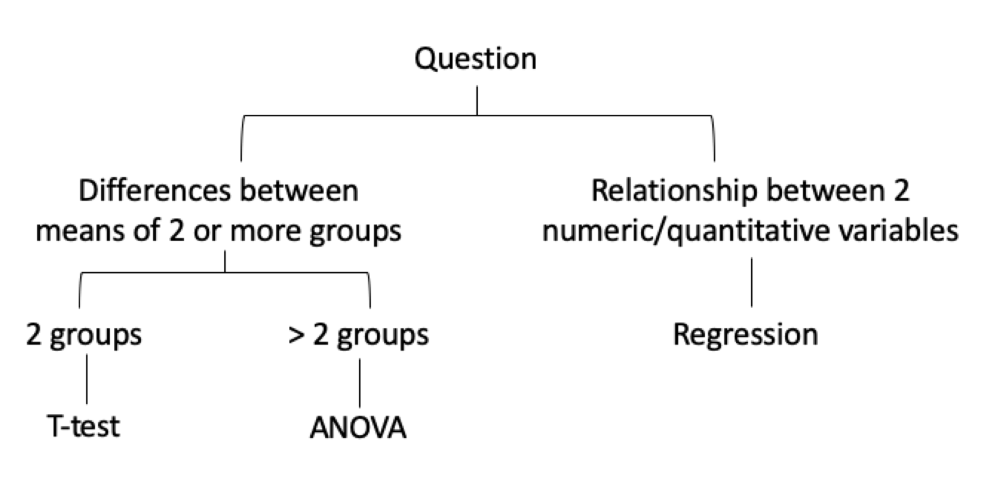
Apply this to our questions: Does the arthropod community change with grazing intensity?
(Binary)

Slide 29
Apply this to our questions: Does the arthropod community change with grazing intensity?
Our groups are:
high grazing, low grazing, and no grazing

Slide 30
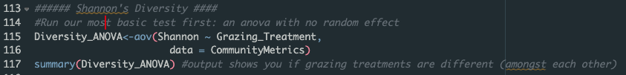
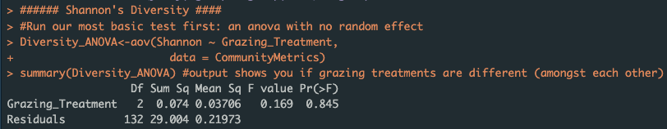
Basic ANOVA

Slide 31
Apply this to our questions: Does the arthropod community change with grazing intensity?
BUT if we want to add any random factors into our model then we need to run a more complicated regression
Our groups are:
high grazing, low grazing, and no grazing

Slide 32
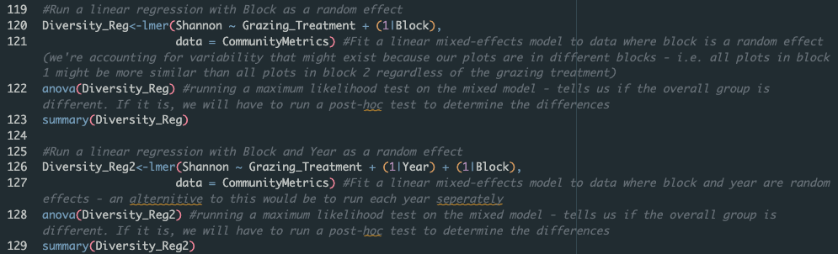
Linear Regression to include Random Factors

Slide 33
Apply this to our questions: Does the arthropod community change with grazing intensity?
After we run all of these models, we can choose the best model based on AIC scores
Our groups are:
high grazing, low grazing, and no grazing

Slide 34
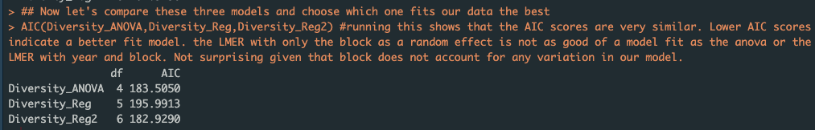
Compare AIC Scores of Models: Which is best?

Slide 35
Compare AIC Scores of Models: Which is best?
Do the same thing for Richness and evenness (Lines 135*176)

Slide 36
Apply this to our questions: Does the arthropod community change from year to year with grazing intensity?
Our groups are:
high grazing, low grazing, and no grazing
& year

Slide 37
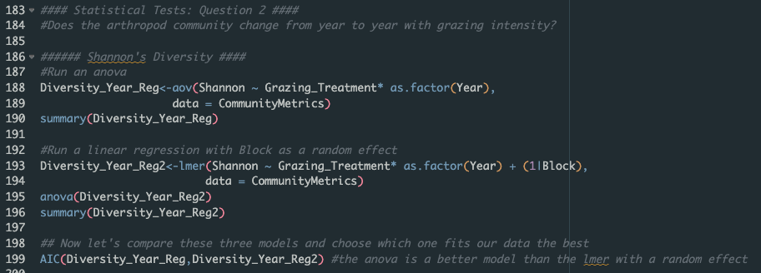
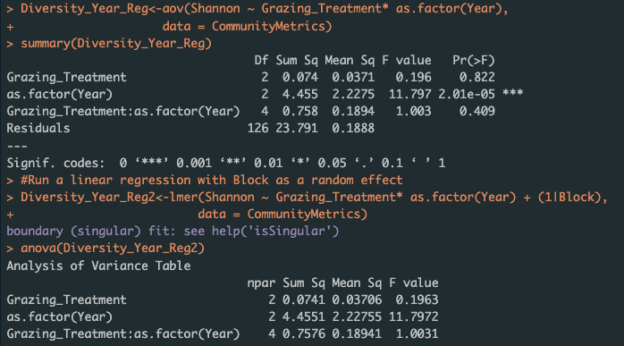
Apply this to our questions: Does the arthropod community change from year to year with grazing intensity?
Do the same thing for Richness and evenness (Lines 197*227)

Slide 38
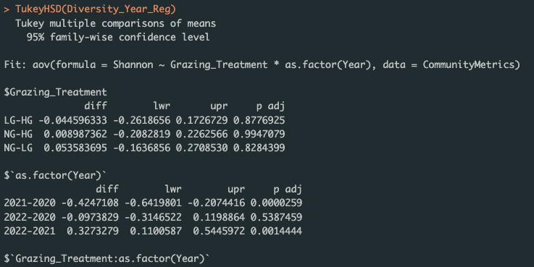
Apply this to our questions: Does the arthropod community change from year to year with grazing intensity?
Run a post-hoc test to see which years are different for diversity

Slide 39
RESULTS VISUALIZED!

Slide 40
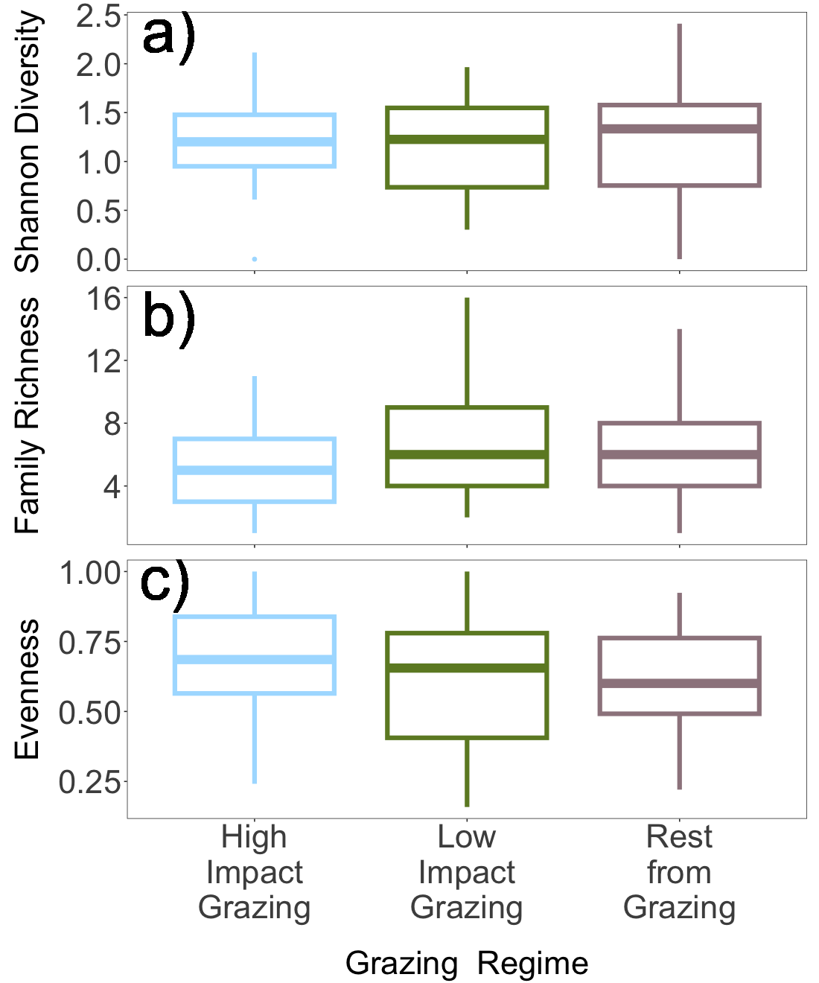
Does the arthropod community change with grazing intensity? NO!

Slide 41
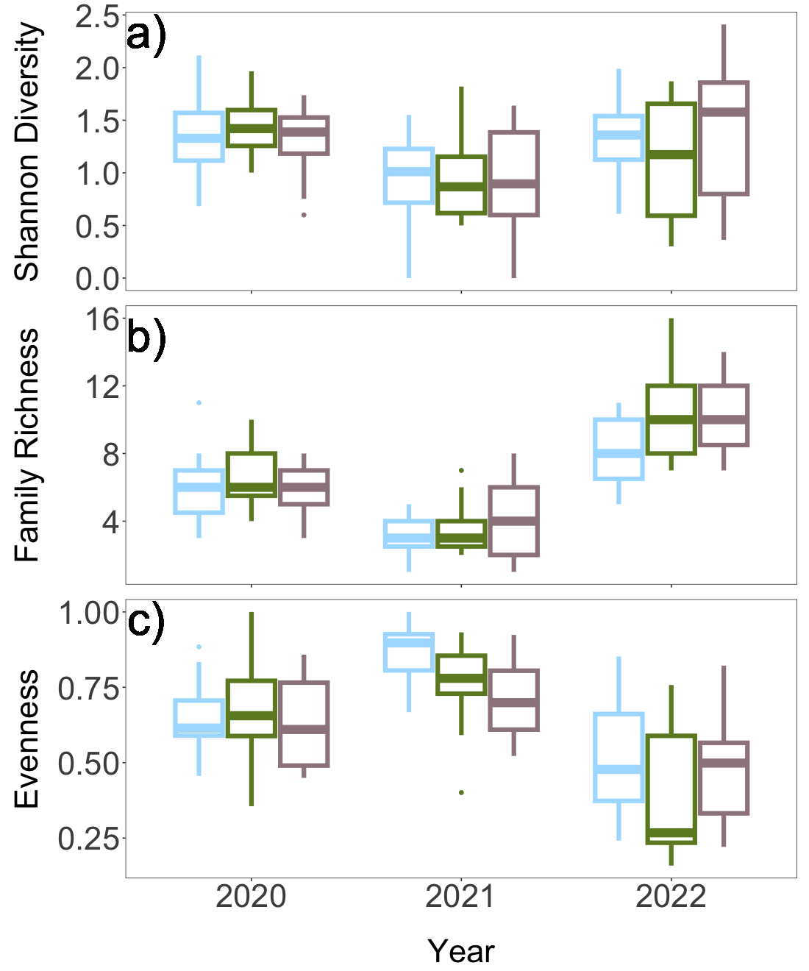
Does the arthropod community change from year to year with grazing intensity? YES - sometimes
Note: here you would want to decide whether to graph just year to year differences or year & grazing differences then put stats on the figure

