Slide 1
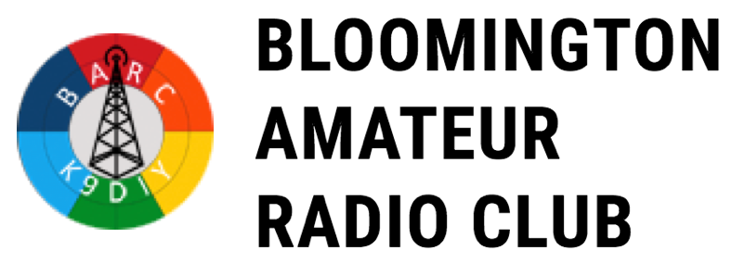
Presented on April 5, 2019 to:

Slide 2
BARC makes no recommendations on these petitions, but some of them have serious bearings on amateur radio operators.
Notice of Proposed Rule Making
‘
RM-11829 – New TYRO License Class *
RM-11828 – New Technician License Privileges *
RM-11831 – Would Enforce Digital Transmission Transparency
RM-11833 – Would Ban State “Distracted Driving” Laws For Amateurs
RM-11834 – Ban Vanity Call Sign Outside of One’s Call District
RM-11835 – Gives Vanity Call Preference To One’s District

Slide 3
Notice of Proposed Rule Making
RM-11829
Issued: 13 March 2019
Comments Due: 30 days from date of issuance
Amendment of the Commission’s Amateur Radio Rule …
Adding a Tyro License Class
Re-Structuring a Portion on the 70cm band
Establishment of Local Coordinating Committees
Insuring Amateur Radio as Primary User of 430 – 440 MHz
Adding Scientific Research to the Purpose of Amateur Radio

Slide 4
Who is the Author?
Mr. Gary A. Hampton, AD0WU, Longmont, CO

Slide 5
What is being proposed?
(a) A new license Class – Called the “Tyro”
How does a person obtain this license:
Be eleven (11) years or older.
Pass an On-line test (multiple choice questions) about radio etiquette and usage rules.
The proposed licensee finds a HAM Radio Operator with a Technician or higher class license to be his/her mentor.
The On-line test is proctored by a HAM Radio Operator with a Technician or higher class license (i.e., this can be the same person who is the mentor).
VECs and VE Teams are not involved in designing and/or administering this test.
Licensee limited to 20 Watts output power.
(b) The TyroSubBand will fall in the Amateur Television (ATV) – RX on 426 – 432 MHz, and TX on 438 – 444 MHz portions of the 70cm band plan.
Specifically: 430.0125 to 430.9875 MHz and 438.7625 to 438.9875 MHz using Narrow Band FM.
64 pairs of TX/RX frequencies would be coordinated and 15 pairs of TX/RX frequencies would not be subject to coordination.
20 simplex frequencies would be in the 439.0000 – 438.7625 MHz.
70cm to 2m cross-band repeating would be allowed, as the 2m repeaters are controlled by Amateurs with higher class licenses.
CTCSS would be allowed using only 67, 79.7 and 97.4 Hz

Slide 6
What is being proposed?
(b) continued:
An UrgentCall tone sequence meant to activate muted monitoring receivers, using DTMF characters “*#*”
(c) Change these frequencies to primary use by Amateur Radio Operators.
Currently, Amateur Radio Operators use these frequencies as a secondary user on a non-interference basis.
Benefit of this change is to protect a nationwide build-out of CERT/ARES systems.
The TYRO license is exceptionally important to FEMA’s CERT program.
Ask Congress to insure Amateur Radio’s access to interstate (highway) medians.
(d) Public Domain Scientific Research is explicitly added to Amateur Radio’s purpose.
(e) Local committee(s) are formed for – regional spectrum management and appropriate local repeater usage rules.

Slide 7
Issues
(a) Tyro License Class
Who will generate the test questions?
FCC – ?
COMMENT #1: Why would the FCC, who divorced themselves from developing and giving the examinations for all license classes when they signed the Memorandum of Understanding with the Volunteer Examiners Councils back in 1984, with continued budget reductions, the FCC will not have the staff necessary to devote to developing the question pool and setting up and maintaining the “On-line” examination.
COMMENT #2: Why would the FCC entertain the granting of a new license class (i.e., similar to the NOVICE Class License) when they deleted the NOVICE Class License in WT 98-143 “…on the theory that the Technician Class license was the preferred entry level license class”.
COMMENT #3: The TYRO class license leaves this class licensee in a similar “isolated” position with respect to: (1) narrow band FM, (2) a very limited frequency portion of the 70cm band and (3) limitation of transmitter power of 20 watts, with no discussion of wither or not this 20 watts includes antenna gain.
VECs – The proposed rule indicates that the test is outside the purview of the VECs / VE Teams.
How many questions will be on the Tyro examination and how many questions will be required to correctly answered for granting the TYRO License?
How long with the “mentor” tutor the Tyro applicant before the examination is given and how long will they mentor the licensee after the license is granted?
COMMENT #4: Will some ad hoc committee develop the question pool?
COMMENT #5: Will this committee be responsible for funding the “On-Line” examination website?
Why is there a minimum age requirement of 11 years old?
There have been instances of children younger than 11 years of age passing the NOVICE, TECHNICIAN, GENERAL, ADVANCED and EXTRA license examinations.
COMMENT #6: Admittedly these are rare, but they still occur, so conceivably, why couldn’t someone younger than 11 years old pass the TYRO license exam?

Slide 8
Issues
(b) Re-structuring the 70cm band (referring to the ARRL 70cm Band Plan):
Why is this proposal taking part of the ATV simplex portion of the 70cm band and converting it to a repeater receive frequency band (430.0125 to 430.9875 MHz)?
Why is this proposal taking part of the ATV repeater input portion of the 70cm band and making a portion of this segment simplex only (439.0000 to 438.7625 MHz)?

Slide 9
Issues – (b) 70cm TX / RX Coordinated Frequencies
See attached spreadsheet.

Slide 10
Issues – (b) 70cm TX / RX Uncoordinated Frequencies

Slide 11
Issues – (b) 70cm TX Simplex Frequencies

Slide 12
Issues
(c) Change these frequencies to primary use by Amateur Radio Operators.
This would require coordination with other Executive branches of the Federal Government (i.e., Department of Defense, National Oceanographic Organization, etc.)
Benefit of this change is to protect a nationwide build-out of CERT/ARES systems.
Who is requesting this buildout of repeater / simplex frequencies in the 70cm band for National Emergencies?
ARRL.
Department of Homeland Security, including individual state Emergency Management Agencies.
Is this a “pipe dream” for some business to generate a requirement for their repeaters to fill an non-existent requirement.
Why would you want to set-up repeaters in the medians of the Interstate Highway System where they would be subject to destruction by motor vehicle accidents?

Slide 13
Issues
(d) Public Domain Scientific Research is explicitly added to Amateur Radio’s purpose.
§97.1 Basis and purpose.
The rules and regulations in this part are designed to provide an amateur radio service having a fundamental purpose as expressed in the following principles:
(a) Recognition and enhancement of the value of the amateur service to the public as a voluntary noncommercial communication service, particularly with respect to providing emergency communications.
(b) Continuation and extension of the amateur's proven ability to contribute to the advancement of the radio art.
(c) Encouragement and improvement of the amateur service through rules which provide for advancing skills in both the communication and technical phases of the art.
(d) Expansion of the existing reservoir within the amateur radio service of trained operators, technicians, and electronics experts.
(e) Continuation and extension of the amateur's unique ability to enhance international goodwill.

Slide 14
Issue
(e) Local committee(s) are formed for – regional spectrum management and appropriate local repeater usage rules.
Why are new committees needed to coordinate repeaters when there are currently coordinating committees which address this issue?
(e)(1) {paragraph 4.81 of Notice of Proposed Rule Making}While the commission (FCC) will not adopt a “type acceptance” procedure for radios used on the TyroSubBand, Amateur licensees may form committees to review radio technical compliance to these rules.
Why would the FCC give up this function and allow companies with financial interests to perform tests to assure any radios used in the Amateur Radio Spectrum meets certain spurious emission tests.
(e)(2) {paragraph 4.82 of Notice of Proposed Rule Making} Such a committee may test both commercial and Amateur constructed or modified radios … issuing a recommendation, an approval or disapproval, as the Committee sees fit.
Who is going to pay for the committee to develop the necessary test equipment, test procedures, and actual tests, write the technical report? All the test equipment will require traceability back to the National Institute of Science and Technology (NIST). The test laboratory will require certification to the NIST standards.

Slide 15
Issue
(e)(3) {paragraph 4.83 of Notice of Proposed Rule Making} While not required, constructor or modifiers may supply radio for approval.
This leave a hole big enough to allow anything to be marketed as meeting the non-interference of the Amateur Radio service.
(e)(4) {paragraph 4.84 of Notice of Proposed Rule Making} Committees may obtain test radios using other free-market alternatives.
Again, this goes to how these committees will be funded.
(e)(5) {paragraph 4.85 of Notice of Proposed Rule Making} Committees may publish their finding.
Why shouldn’t they publish all their test results?
(e)(6) {paragraph 4.86 of Notice of Proposed Rule Making} Committees may involve the Commission (FCC) when they deem it appropriate.
Why shouldn’t the Commission be involved from the start?
(e)(7) {paragraph 4.87 of Notice of Proposed Rule Making} These Committees may be paid for their efforts.
Are the current repeater coordinating committees compensated for their work in coordinating existing repeater form interference with other repeaters in their region?

Slide 16
FCC RM-11828 Proposal for Increased Technician Licensee Privileges
Applies to all Technician Licensees but none to Novices
Increases transmission privileges to more HF bands (with a 200W limit):
Phone privileges 80M 3900-4000KHz, 40M 7225-7300KHz, 21350-21450KHz
Also adds RTTY and digital privileges in current allocation on 80, 40, 15, and 10M
According to the ARRL, “It will attract more newcomers to Amateur Radio, it will result in increased retention of licensees who hold Technician Class licenses, and it will provide an improved incentive for entry-level licensees to increase technical self-training and pursue higher license class achievement and development of communications skills”
ARRL data suggests that ham radio licensee uptick is only 1% per year
The ARRL finishes with, “The Entry-Level License Committee determined that the current Technician class question pool already covers far more material than necessary for an entry-level exam to validate expanded privileges. ARRL told the FCC that it would continue to refine examination preparation and training materials aimed at STEM topics, increase outreach and recruitment, work with Amateur Radio clubs, and encourage educational institutions to utilize Amateur Radio in STEM and other experiential learning programs.”

Slide 17
FCC RM-11828 Proposal for Increased Technician Licensee Privileges
Pros:
Makes entry into ham radio more attractive
Gives digital mode privileges, with an international reach
Cons:
Feeds the equipment vendors, who exert a great deal of control over the ARRL finances
Lets unexperienced operators into crowded bans (the CB argument)
FCC enforcement has been strangled by Congress and only makes emblematic gestures at control; the ARRL OO program has yet to have proven its worth and is at least a year away from active participation, and is arguably powerless.
SEE ENHANCED HF PRIVILEGES MAP, next slide.

Slide 18
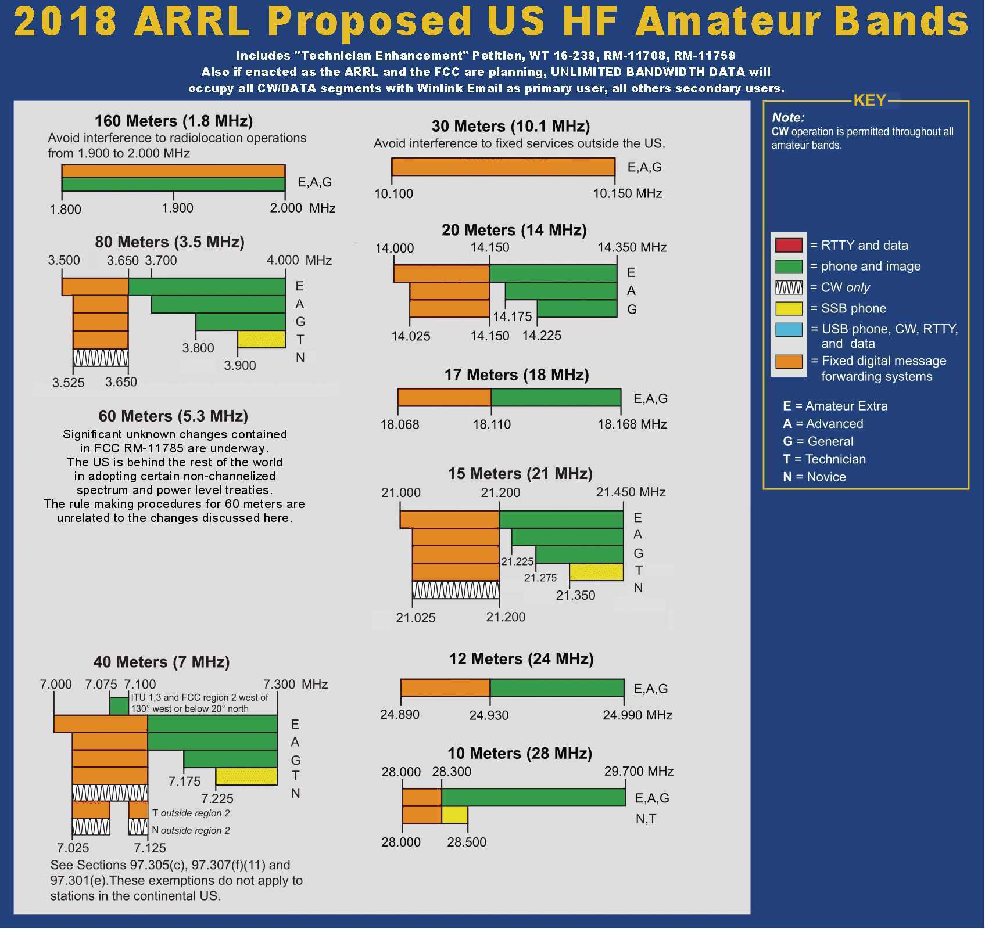

Slide 19
FCC RM-11831 Petition Would Enforce Digital Transparency
Pros:
Would require digital modes to be “whose technical characteristics have been documented publicly.”
“asks the FCC to require all digital codes to use protocols that “can be monitored in [their] entirety by third parties with freely available, open-source software,” per §97.113(a)(4).”
Prevents spectrum abuse by both primary, secondary, and “who knows???” operators
Cons:
Robs those poor vendors of proprietary codec revenues
Would require an “open source” approach to codec publishing, and the ability to reproduce codecs specific to different operating systems and operating environments
May also be superceded by other ARRL/FCC rule making poised towards increasing digital bandwidth in HF, and perhaps UHF/VHF/uWave/mmWave
Might be even crazier enforcement problems later (expanded cellular modes/frequencies)

Slide 20
FCC RM-11833 Proposal Asking FCC To Exert Amateur Radio Exemption to “Distracted Driving”
Pros:
Makes us legal when using a hand mic
Permits us to fiddle with our radios & gear (safely, of course)
Continues to exert control over state regulations for FEDERAL jurisdictions
Cons:
A stick up the hornet’s next of federal vs state rights to govern
Distracted driving, even ham driving, is horrifically dangerous
Creates classes of drivers, already seen in states banning radar detectors and scanners in cars; public safety officials must know and respect such an exemption
Anecdotally, an insurance actuary said that ham driver insurance rates could rise if an exemption is given to hams

Slide 21
FCC RM-11834 Petition Would Ban Requesting a Call Sign Outside of One’s District of Residency
Pros:
Makes callsigns easier to identify by region
Exemption for “family-inherited” callsigns
Keeps “foreign” operators from stealing “valuable callsigns” in desirable formats
Cons:
Lots of callsigns are used for life, through moves, etc. and few individuals complain about the “incorrect” area designation in the call
The callsign districts are somewhat artificial, and could be changed at any time (although with lots of objections)
Areas of high population have lots of competition for desirable calls, and the FCC’s process is currently by lottery when callsign weights are the same (submission date is tops)

Slide 22
FCC RM-11835 Petition Would Create Preference for Vanity Call Sign Inside of One’s District of Residency
Pros:
Makes callsigns easier to identify by region
Exemption for “family-inherited” callsigns
Keeps “foreign” operators from stealing “valuable callsigns” in desirable formats
Cons:
Lots of callsigns are used for life, through moves, etc. and few individuals complain about the “incorrect” area designation in the call
The callsign districts are somewhat artificial, and could be changed at any time (although with lots of objections)
Areas of high population have lots of competition for desirable calls, and the FCC’s process is currently by lottery when callsign weights are the same (submission date is tops)
Requires the FCC to think and use a more rigorous lottery process for awarding vanity calls

