Slide 1
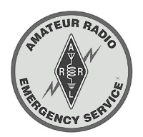

Emergency Communications
Monroe County
ARES – RACES Group
Monroe County
ARES-RACES Group

Slide 2
Why Ham Radio …
What we do and How we do it …
  Mitigation
    Who we are, where we come from
  Preparedness
    Training
    Equipment
    Modes
  Response
    NIMS and the Communications Plan
    Disaster Communications
    Repeater Operations
    Amateur Radio Nets and Operations
  Recovery
    Shelter Operations
    Health and Welfare
    Property Damage Surveys / Assessments
  Indiana Department of Homeland Security
Monroe County
ARES-RACES Group

Slide 3
Emergency Communications developed by: ARES-RACES Group
ARES Emergency Coordinator / RACES Officer
  Carl Zager, KB9RVB
Assistant ECs and ROs
  Maynard Raggio, N9PTG, simplex operations
  Rob Hamros, KB9RNB, membership
  Bobby Bristoe, KB9UVW, net manager
  Kevin Pauley, KB9WVI, public information
Monroe County
ARES-RACES Group

Slide 4
Additional Members
Emergency Committee
Radio Amateurs
    Tom Busch, WB8WOR
    Richard Landgrebe, WB9HXP
    John Maassen, K9FK
    Murl McRae, WA9CWT
  Dan Miller, KQ9I
  Tom Myers, KC9IRG
  Bob Poortinga, K9SQL
  Bill Wootton, KC9ACL
Monroe County EMA Director
  John Hooker
Red Cross Director of Disaster Services
  Maria Carrasquillo
Monroe County
ARES-RACES Group

Slide 5
Amateur
… for the 'love of' ….
The FCC– Title 47, Part 97
  Basis and Purpose:
    'Recognition and enhancement of the value of the amateur service to the public as a voluntary, non-commercial communication service, particularly with respect to providing emergency communications.'
Monroe County
ARES-RACES Group

Slide 6
Bibliography
Online:
  Monroe County ARES-RACES at
    http://bloomingtonradio.org/
  Monroe County EMA / RACES at
    http://www.co.monroe.in.us/emergencymanagement/index.htm
    http://www.co.monroe.in.us/emergencymanagement/RACES.html
  Volunteer Emergency Communications Plan
    http://www.co.monroe.in.us/emergencymanagement/documents/05VECM.pdf
  FEMA Civil Preparedness Guide
    http://www.fema.gov/library/civilpg.shtm
Monroe County
ARES-RACES Group

Slide 7
Bibliography²
Printed:
  Volunteer Emergency Communications
  in Monroe County, Indiana
ARRL Publications:
  Emergency Coordinator’s Manual
  Public Service Communications Manual
  Special Events Communications Manual
  Operating Manual
Monroe County
ARES-RACES Group

Slide 8
Why Ham Radio?
CB, MURS, GMRS, FRS are short-range, low-power radio services available to any citizen.
Internet connectivity becoming more common but requires comparatively expensive and reliable wired or wireless resources – for all participants.
Telephone requires wired connections and cell connectivity is not always reliable.
But that only addresses the equipment …
Monroe County
ARES-RACES Group

Slide 9
Why Ham Radio²
FCC encourages amateur radio 'to provide essential communications…when normal…not available.'
When common communications modes become overloaded or inoperable because of traffic or power, effective, accurate and timely communications can be provided by licensed hams.
Monroe County
ARES-RACES Group

Slide 10
Why Ham Radio³
Amateur radio is the only communication 'system' that utilizes multi-band, multi-mode, wide-area networks independent of the 'infrastructure' or commercial power sources.
A trained amateur operator can be on the air in minutes using only a battery and a wire a few feet off the ground to connect to stations a few miles away or around the world.
However, it takes training, skill, coordination and discipline to effectively merge the technology with the service.
Monroe County
ARES-RACES Group

Slide 11
Amateur Radio
Is private, non-government, non-profit.
Does not fight fires, find or rescue lost people, direct traffic, or perform other law enforcement services.
Does not open or staff shelters or missions, provide food, water or clothing, offer medical or counselling services.
Does not predict the weather.
Hams may volunteer to provide those services with or through an agency that does and may use amateur radio to support that effort.
Monroe County
ARES-RACES Group

Slide 12
Mitigation
Identify resources
Organize, associate
Monroe County
ARES-RACES Group

Slide 13
MITIGATION
Monroe County
ARES-RACES Group
Independent, unaffiliated hams,
Operators from Bloomington, Indiana University, Hoosier Hills, Owen County, BHS South amateur radio clubs,
Members of Monroe County Repeater Association, W9WIN, EARS,
Volunteers with Monroe County Red Cross, Salvation Army, Argus K9 SAR, IKCC S-R, Citizens Corps, CAP, MARS,
Trained NWS-Skywarn weather spotters.
Monroe County
ARES-RACES Group

Slide 14
MITIGATION
ARES
Amateur Radio Emergency Service
is an organized pool of hams who volunteer themselves and their equipment to local non-profit agencies, as well as to local, county and state government, to provide primary or backup communications links.
Any licensed amateur is eligible to volunteer him/herself and her/his equipment to community service with ARES. The ARES Emergency Coordinator is a ham appointed by the ARRL District EC.
In Monroe County, that is Carl Zager, KB9RVB.
In Owen County, that is John Sullivan, WD9BKA
Monroe County
ARES-RACES Group

Slide 15
MITIGATION
RACES
Radio Amateur Civil Emergency Service
is a special phase of amateur radio, sponsored by FEMA (Federal Emergency Management Agency), an arm of the Department of Homeland Security (DHS), that provides radio communications for civil-preparedness purposes only. These emergencies are no longer limited to war-related activities, but can include natural disasters such as fires, floods and earthquakes.
RACES hams must be enrolled in a local EMA/DHS civil preparedness group. The RACES Officer is a ham (Carl Zager, KB9RVB) appointed by the local EMA/DHS (John Hooker), Monroe County.
Monroe County
ARES-RACES Group

Slide 16
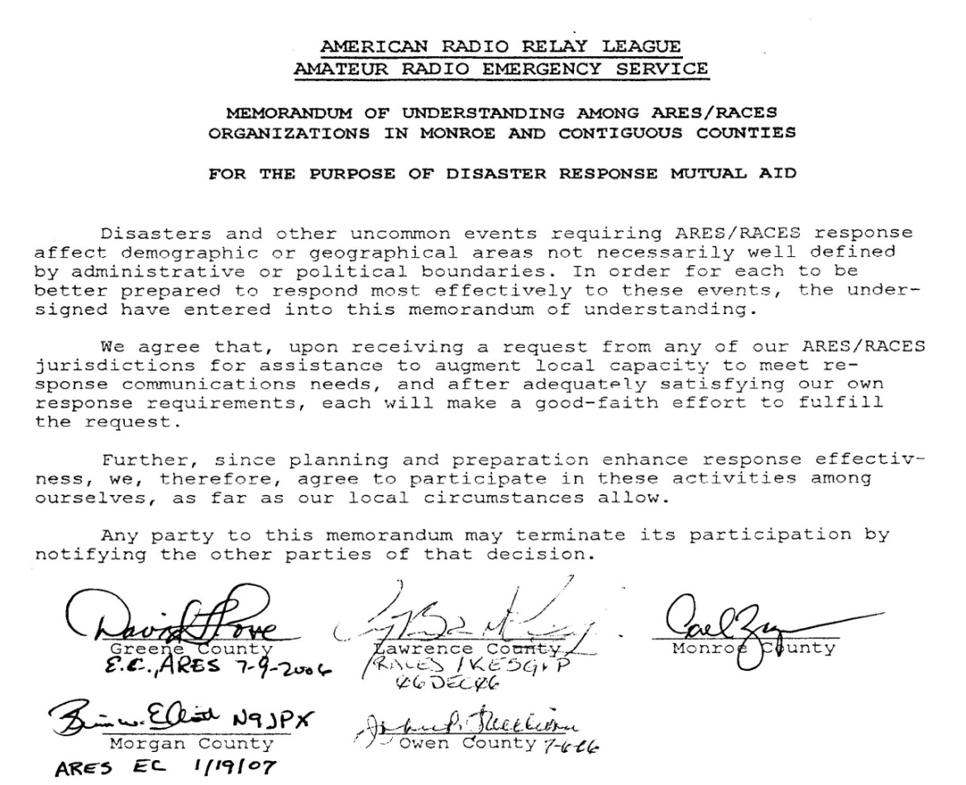
MITIGATION
ARES and RACES
Partnerships
Monroe County
ARES-RACES Group

Slide 17
MITIGATION
ARES and RACES
Mutual Aid/MOUs
Contiguous –
Signed Mutual Aid Agreements:
D5 -- Morgan [ARES EC: Brian Elliott, N9JPX]
[RO: Delbert Davis, K9DEL]
Morgan leadership has initiated mutual support activities, assisting and accepting assistance from Monroe in many public service training activities.
D7 -- Greene [RO/ARES EC: David Love, W9XTZ]
RACES leadership in Greene County assisted Monroe County with forming the RACES component. Greene County is now ARES-RACES.
D7 -- Owen [ARES EC: John Sullivan, WD9BKA]
ARES leadership in Owen County developed the 'mutual aid' agreements between Owen, Green, Monroe, Lawrence and Morgan counties, participates in Owen-Monroe Skywarn.
D8 – Jackson [no signed MOU]
D8 -- Lawrence [RO: Rick Nicholson, N9UMJ]
Lawrence County RACES leadership has stepped to the fore in state and District 8. N9UMJ is Coordinator of District 8 Technical Advisory Team and a member of the Overhead Team.
D8 -- Monroe [RO/EC: Carl Zager, KB9RVB]
Indiana District 8 –
MOUs To be secured:
Brown [EC: Robert Bowers, KB9TCN]
KB9TCN is member of D8 Overhead Team. Rick Woehlecke K9VM is member of D8 Technical Advisory Committee. Don’t know if this is joint ARES-RACES organization.
Bartholomew [EC: Wayne Brooks, N9MUS]
EMA sponsors RACES group. Jim Anderson N9VXW is member of D8 Overhead and Technical Advisory teams
Jackson
Hershel Zhand N9KPA is member of D8 Overhead and Technical Advisory teams
Lawrence [RO: Rick Nicholson, N9UMJ]
Monroe [RO/EC: Carl Zager, KB9RVB
Orange [EC: Larry Jones WB9HFP]
KB9TMP is member of D8 Technical Advisory Team. William Warren KB9TMP is member of D8 Overhead Team
Washington
Tim Peace, N9TP is member of D8 Technical Advisory Team
Monroe County
ARES-RACES Group

Slide 18
Preparedness
Training
Equipment
Operating Modes
Warnings
Monroe County
ARES-RACES Group

Slide 19
PREPAREDNESS
Training Activities
ARRL Field Day [with BARC, IUARC and BHSS ARC] June
Monday Night ARES nets [weekly]
  7:30 (1930 UTC -5) 146.640 repeater
  8:00 (2000 UTC -5) 146.580 simplex
State Tornado Test [with EMA/sirens] March
Statewide RACES Tests January + July
SET with National Traffic System September
Local Tabletops and Exercises [arranged]
Monroe County
ARES-RACES Group

Slide 20
PREPAREDNESS
Training Activities²
Community Events
  Indiana State Science Olympiad K9IU March
  and in 2006, National Science Olympiad June
  Red Eye Relay Race WB9VPG July
  Hoosier Hills Bicycle Ride KB9RVB September
  Hilly Hundred Bicycle Tour KC9IRG October
Monroe County
ARES-RACES Group

Slide 21
PREPAREDNESS
Formal Training
ARRL Activities:
  EC-001 – Emergency Communications
  EC-002 – EC Level II
  EC-003 – EC Level III
Amateurs wishing to volunteer for specialized Search and Rescue should seek training with the specific activity:
  National Cave Rescue Commission
  Indiana Karst Cave Conservancy
  http://www.caves.org/io/ncrc-cr/ocr.htm
  Argus K9 SARS http://www.argusk9.org/
Monroe County
ARES-RACES Group

Slide 22
PREPAREDNESS
Formal Training²
FEMA Online Courses [IS – Independent Study]
  Senior leaders, emergency management practitioners, disaster workers, and first responders, including ARES volunteers and RACES enrollees are required to demonstrate a working knowledge of ICS, NIMS and NRF because of the emphasis on inter-agency cooperation.
ARRL-ARES leadership and local
EMA RACES leadership are requiring
  IS-00100 Introduction to ICS [Incident Command System]
  IS-00200 ICS for Single Resources and Initial Action
  IS-00700 NIMS - National Incident Management System: An Introduction
  IS-00800b NRF – Introduction [National Response Framework
all of which are available from the FEMA Training web address http://training.fema.gov/EMIWeb/IS/crslist.asp
Those who completed either IS-800 or IS-800a do not need to complete IS-800b.
Monroe County
ARES-RACES Group

Slide 23
PREPAREDNESS
Formal Training²
Other appropriate FEMA IS offerings
[Certificates held by Monroe County ARES-RACES Officers]
IS-271 Hazardous Weather & Risk
IS-275 Role of EOC in Community
IS-288 Role of Volunteer Agencies
IS-292 Disaster Basics
IS-362 Multi-haz Em for Schools
IS-701 Multi Agency Coordination
IS-1 Emergency Manager
IS-7 Hazardous Materials
IS-15 Special Events Planning
IS-120 Community Disaster Exs
IS-139 Exercise Design
IS-195 Basic IC System
Monroe County
ARES-RACES Group

Slide 24
PREPAREDNESS
Formal Training³
Red Cross:
Disaster Services
Sheltering
Feeding
Transportation
Disaster Assessment
Volunteer Staffing
Health Services
Client Casework
Facilities
Supply
Community Disaster Education
Monroe County
ARES-RACES Group

Slide 25
PREPAREDNESS
Formal Training⁴
Skywarn – National Weather Service:
Weather Safety
  Watch v. Warning
  Flash Floods
  Lightning
Spotter Training
  Thunderstorms and Tornadoes
  Winter Storms
Monroe County
ARES-RACES Group

Slide 26
PREPAREDNESS
The Ready Kit
The ARRL Operating Manual contains the seminal Go Kit, Ready Kit information.
Monroe County Volunteer Emergency Communications Plan has short-term and extended service packages.
RACES -- www.races.org/gokit.htm (5pgs)
ARES-RACES Newsletter has local survey information and suggestions …
Monroe County
ARES-RACES Group

Slide 27
PREPAREDNESS
Our Version
Basic Deployment Go Kit:
  What you need to be self-sufficient during a 12-hour or 72-hour emergency communications response.
  A 12-hour Go Kit: Most local responses will not exceed 12 hours without a personnel change. Try to use a single bag, such as a back pack or a large gym bag for easy, hands-free carrying. The fewer items to carry, the better.
Monroe County
ARES-RACES Group

Slide 28
PREPAREDNESS
Radio Gear
2 meter radio / HT (if multiband, 2m/440)
Power
  Extra AA replacement pack if available for your HT
  Quick recharger(s) for battery type(s)
  Wall plug adapter
  Vehicle accessory (i.e., cigarette lighter) adapter
  Appropriate power supply, extension cord, grounding plugs, extra fuses if using mobile as ‘base’ station
  Adequate ventilation if using automotive batteries
Speaker Mic/Ear bud for noisy locations
Appropriate portable/mobile antenna connections and adapters
Ground plane (pizza pan/cookie sheet) to increase gain w/ mag mount
SWR meter and Extra Coax
Operator manual or instruction card for the radio(s)’ programmable functions – frequency memory, offset, PL settings, using reverse and simplex
Monroe County
ARES-RACES Group

Slide 29
PREPAREDNESS
Other Gear
Identification
  ARES or ARES/RACES Photo I.D., Agency IDs
  Copy of your FCC License
  Drivers License
Other Equipment
  Pens and/or pencils & paper
  Map(s) of the area
  Flashlight(s) and extra batteries
  Credit card or some cash for fuel, snacks and phones
  List of important phone numbers
Food – Water - Clothing
  Appropriate dress for the weather and outside the vehicle, base or shelter: i.e., Sun screen, insect repellent (DEET), rain gear (pocket poncho), cold weather gear, hand warmer
  Complete change of clothing, escpecially cocks. Keep it dry in plastic. Sleeping bag, pillow
  Bottle(s) of water and some munchies.
  Hand cleanser/disinfectant, dry towel.
  Personal prescription drugs with instructions and 1st aid kit.
Monroe County
ARES-RACES Group

Slide 30
PREPAREDNESS
Emergency Gear
  Blanket.
  You may have an occasion to use it to treat an injury victim for shock, or folded to make a splint.
  You can even move an injured person using it to make a litter (however, don’t ever move an injured person unless they are in danger of further injury by staying where they are!) In winter weather, a blanket can have more immediate personal importance.
  Hypothermia is a dangerous situation.
Monroe County
ARES-RACES Group

Slide 31
PREPAREDNESS
Equipment Evolution
2-meter handi-talkie [HT] with OES ‘rubber duckie’ $150-250
Entry-level radio for new operators. 1-5 watts power.
  Replace rubber duckie with a ‘gain’ antenna $50
  Increase Tx output by 3-4 DBls
  Switch to a ‘mag mount’ $35-100
  Additional range operating mobile or using ‘pie tin’ ground on base.
Upgrade to 2m/440 dual band HT $250-600
Possibly w/ TNC for APRS, Upgrade antennas to add UHF capabilities
Upgrade to 2-meter mobile $200-300
Higher power (10-25-50 watts), upgrade antenna $75-100
Upgrade to 2m/440 dual band mobile $300-750
Add HF capabilities to mobile operation $450-1000
Monroe County
ARES-RACES Group

Slide 32
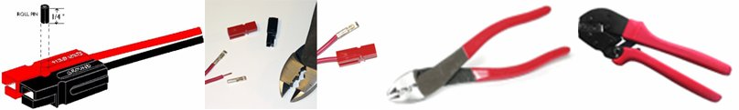
PREPAREDNESS
Preparedness Checklist
Check that family and property are safe and secure.
Be prepared to operate.
Check all equipment and connections.
Be prepared to deploy to an assignment/location with Ready-Kit.
Leave the house dressed for the weather expected in the next few hours (especially if you deploy to ‘spot’ severe weather in fair conditions before it’s onset. Most of our severe weather events are cold front driven and are followed by considerably cooler weather.
Monitor assigned frequency and follow check-in instructions.
Enter assigned frequency(s) on log sheet.
If you plan to use a mobile radio as a base station; be sure to include appropriate power supply, some extension cord with a third grounding plug, extra automotive fuses for your power cords. If carrying an automotive battery, be sure it is clean and will not spill battery acids, and use it in well ventilated areas!
Label your equipment (you may loan equipment or leave a station you’ve set up for use and work somewhere else, or you may even leave stuff in vehicles accidentally)
Monroe County
ARES-RACES Group

Slide 33
PREPAREDNESS
Alternative Modes for EmComm
  Why 'Alternative Modes'?
    Efficiency (use 'Right Tool' for the job)
    Provide both short haul and long haul data communications in event of Internet failure
    Provide 'situational awareness'
    Provide reliability and redundancy
Monroe County
ARES-RACES Group

Slide 34
PREPAREDNESS
Which Alternative Modes?
Automatic Packet Report System (APRS)
Winlink 2000
Digital SSTV (WinDRM, EasyPal)
Others
  PSK31, PSKmail
  Pactor
  WinDRM voice, FDMDV
  Olivia, Hellscheiber, MFSK
Monroe County
ARES-RACES Group

Slide 35
PREPAREDNESS
APRS
Developed by Bob Bruninga, WB4APR, as a method of broadcasting (connection-less) data using Packet Radio.
Uses both RF and Internet to carry data.
Most common use is vehicle tracking.
Also provides messaging and 'object data'
Monroe County
ARES-RACES Group

Slide 36
PREPAREDNESS
APRS²
Most APRS clients provide mapping capabilities which, when used with APRS 'objects', can provide real-time 'situational awareness' (Location and status of assets, weather, disaster areas, etc.)
APRS specification also defines a common bulletin which could be useful for EmComm, although most clients do not provide support for it.
Monroe County
ARES-RACES Group

Slide 37
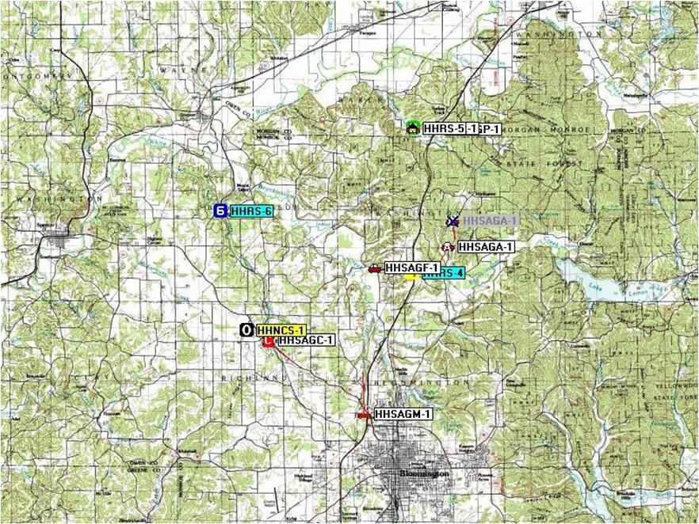
PREPAREDNESS
APRS use at Hilly 100 NCS
Monroe County
ARES-RACES Group

Slide 38
PREPAREDNESS
Accessing APRS
Radios: Kenwood TM-D700, TM-D710,
and TH-D7A provide built-in APRS functions.
APRS Client software (used with TNC, or soundcard interface and AGWPE / sound modem):
  UI-View32
  WinAPRS
  AGWTracker
  Xastir (Linux)
  Others (APRS-SA, APRSdos, APRSkml, etc)
APRS Trackers:
  Opentracker
  TinyTrak
Monroe County
ARES-RACES Group

Slide 39
PREPAREDNESS
Winlink 2000
What?
  Protocol, software and modes which implement a global email system over RF and the Internet.
  Uses Pactor over HF, AX.25 packet over VHF/UHF
Why?
  Ad Hoc Committee on ARES Communications (ARESCOM) July 2004 Final Progress Report & Recommendations
  'It is recommended that the Board endorse the use of Winlink 2000 in the ARRL Field Organization…'
Monroe County
ARES-RACES Group

Slide 40
PREPAREDNESS
Winlink 2000²
How?
  Must be a registered user!
  Use client software: Airmail (HF) and Paclink (VHF/UHF)
Potential:
  Will facilitate messaging during either RESPONSE or RECOVERY activities.
Monroe County
ARES-RACES Group

Slide 41
PREPAREDNESS
Digital SSTV
Provides a method of transmitting any digital file (not just images) using error detecting and correcting protocols.
Used in a simplex (station-to-station) or multi-station (net) operation over HF/VHF/UHF to exchange.
Provides reasonable data bandwidth over a 2.5KHz channel using either SSB or FM (about 2400 bps throughput).
Monroe County
ARES-RACES Group

Slide 42
PREPAREDNESS
Digital SSTV²
Software clients (Windows only):
  EasyPal
  WinDRM
  Others in development (DM780)
Potential:
  Transmission of information from sites to EOCs
Monroe County
ARES-RACES Group

Slide 43
PREPAREDNESS
Digital Voice Modes
Both hardware and software based modes:
  Hardware: AOR Voice Modem, Icom DSTAR
  Software: WinDRM, FDMDV
Why?
  Provide hi-quality noise-free audio.
  Provides some confidentiality to communications and immunity to intercept.
  FDMDV requires only 1100 Hz bandwidth.
Monroe County
ARES-RACES Group

Slide 44
PREPAREDNESS
Alternate Modes:
What needs to done?
Develop local expertise and experience in using these modes.
Have software downloaded and installed on laptops and home PCs.
Provide local infrastructure for APRS and Winlink 2000.
Monroe County
ARES-RACES Group

Slide 45
Response
Initial response
Tactical Traffic
Health & Welfare Traffic
Monroe County
ARES-RACES Group

Slide 46
RESPONSE
Initial Response Checklist
Deploy to assignment/location.
Get tactical call sign or confirm tactical call with NCO.
Log all traffic sent or received, and initiate personal event log of dates and times of other various and significant events performed while activated.
Use a formal ARRL Message Form when a precise record is required.Obtain tactical call sign for location/assignment (if appropriate).
Use tactical call sign, while observing FCC’s ten-minute ID rule.
Monitor your assigned frequency at all times. Request permission from NCS before changing frequency. Notify (and/or request permission from) NCS if you have to leave frequency or location.
Monroe County
ARES-RACES Group

Slide 47
RESPONSE
Emergencies!
Blackouts
Chemical Emergencies
Drought
Earthquakes
Fires
Floods
Heat Waves
Mudslides
Terrorism
Thunderstorms
Tornadoes
Wildfires
Winter Storms
The area is likely to be a destination for evacuees from other locations, so local communications volunteers may be activated for hurricanes and volcanic eruptions, as well as other distant emergency events.
Monroe County
ARES-RACES Group

Slide 48
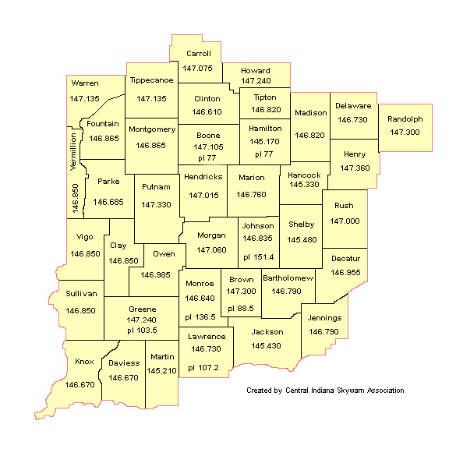
RESPONSE
Emergency Responses
Central Indiana Skywarn
Severe weather
  Tornado
  Funnel cloud
  Thunderstorm
  Flash Flood
  Lightning
  Blizzards
Monroe County
ARES-RACES Group

Slide 49
RESPONSE
Other Responses
Hazardous Materials
Search and Rescue
  Fox hunts are a sub-set of S+R activity
  Assist Law Enforcement track signals
Shelter Operations
Heath and Welfare
Disaster Assessment
Monroe County
ARES-RACES Group

Slide 50
RESPONSE
NIMS
The National Incident Command System promotes interagency collaboration on domestic incidents.
Incident Command System (ICS) is a component of NIMS.
  Clear text
  Unified command
  Flexibility
  Concise ‘span of control’
Monroe County
ARES-RACES Group

Slide 51
RESPONSE
1. Clear Text
NIMS and ICS principles require that all transmissions be in clear text.
No ’10’ codes.
This assures that all cooperating agencies understand each other’s communications.
Monroe County
ARES-RACES Group

Slide 52
RESPONSE
2. Unified Command
NIMS requires that all agencies come under the authority of a single Incident Commander.
The ICS command is determined by the nature of the event and the size of the response and may be changed during the event.
Monroe County
ARES-RACES Group

Slide 53
RESPONSE
3. Flexibility
Emergency events are seldom stable.
NIMS/ICS recognizes the need to be able to adjust components of the response to the nature of the event.
Monroe County
ARES-RACES Group

Slide 54
RESPONSE
4. Concise ‘span of control’
Emergency response operations will always include
  Planning
  Logistics [amateur radio support]
  Operations
  Finance
components
Small numbers in operational groups mean more effective coordination.
Monroe County
ARES-RACES Group

Slide 55
RESPONSE
Amateur Radio Operations
Events usually begin as ARES and migrate,
if necessary, to EMA/DHS-RACES.
Command of any event falls to the appropriate authority:
  Public Service: the sponsoring agency
  Skywarn: National Weather Service
  Emergency:
    Civil preparedness: EMA
    Other events: Red Cross
Ham volunteers are communicators.
Monroe County
ARES-RACES Group

Slide 56
RESPONSE
Amateur Radio Operations²
During an ARES response, any ham may participate and pass traffic.
  The purpose of enrolling in ARES is to register equipment and volunteer for service.
  It is NOT exclusionary.
Even if an event comes under the command of EMA/DHS, ARES may be used by all agencies.
But, if a RACES emergency is declared by EMA/DHS, only RACES operators may use the frequencies.
  While RACES has the authority to commandeer a wide range of frequencies, only those necessary will be used for an event.
Monroe County
ARES-RACES Group

Slide 57
RESPONSE
Amateur Radio Operations³
As much as possible, the operational nets shall be on 2 meters (VHF), which has an historic role in emergency communications.
More operators, currently, have VHF capability.
The WB9TLH repeater has excellent coverage in and around Monroe County.
Growing numbers are adding 70cm (UHF) capabilities, and this area has an two excellent 440 systems, covering nearly all of southern Indiana.
Monroe County
ARES-RACES Group

Slide 58
RESPONSE
Amateur Radio Operations⁴
146.640 (-) [136.5] – Primary Strategy net frequency
  ‘Strategy’ is the ‘Big Picture’ of the event; overall command and review, general tactics and tactical/resource traffic.
146.940 (-) [136.5] – 1st Strategy Backup, Tactical sub-net
147.180 (+) [136.5] -- 2nd backup, Tactical sub-net
443.775 (+5) [136.5] – Primary Tactical sub-net frequency
capable of linking Monroe, Brown, Lawrence, Greene, Putnam, Washington, and Marion counties, and with EARS link, can be stretched to Evansville and Illinois or possibly, state-wide.
146.580 /simplex/ Primary simplex Tactical frequency
short-range tactical nets but, for some operators and equipment, capable of county-wide coverage
Monroe County
ARES-RACES Group

Slide 59
RESPONSE
Amateur Radio Operations⁵
The net control station and/or officials on the designated emergency net will provide additional instructions, including information on frequencies used or other resource and tactical nets.
Tactical/Resource nets [sub-nets] may be created to serve communications groups and subjects on any of the associated repeaters or simplex.
Liaison and liaison nets may be established with operators and repeaters in other locations on other frequencies.
Monroe County
ARES-RACES Group

Slide 60
RESPONSE
10 EmComm Rules
Monitor and remain on assigned frequency.
Use mode/band selected by leadership or cooperating agency.
Remain silent until you have traffic or are called by the NCS/NCO.
Report first-hand knowledge. Messages being relayed must be authenticated.
Avoid initiating disaster or emergency reports or traffic. ARS communicates; agencies supply the content.
Monroe County
ARES-RACES Group

Slide 61
RESPONSE
10 EmComm Rules²
Strive for efficiency. Share shifts, responsibilities with other operators.
Be courteous and cooperate with other communications services.
Use all communications channels intelligently. Know and follow FCC regulations.
Clear text caveat: do not transmit names without prior administrative approval.
Don’t broadcast. Hams support agencies during event; do not provide information to public.
Monroe County
ARES-RACES Group

Slide 62
RESPONSE
Amateur Radio Nets
Any ham may institute a net, but no amateur operator has independent authority to declare an emergency.
Open Net – declared, but usually normal use of the repeater continues while operators rag chew, or share information or concerns prior to an event. May have an NCO.
Directed Net – public service and practice nets. Normal use of the frequency is allowed. Will have an NCO.
Monroe County
ARES-RACES Group

Slide 63
RESPONSE
Amateur Radio Nets²
Formal Directed Net:
specific nets for specific purposes.
  May be activated at the request of:
    National Weather Service [Skywarn - ARES]
    Red Cross (or other agency) [ARES]
    MoCo EMA will often use ARES for civil response emergencies.
  Usually, normal use of the frequency is curtailed or limited by NCO.
Only a RACES operator may activate a RACES net at the request of EMA. Access may be limited to RACES operators.
Cave Rescue may only be activated by the Indiana Karst Conservancy or the Indiana State Police.
Monroe County
ARES-RACES Group

Slide 64
RESPONSE
A Weather Example
A fictional scenario to demonstrate net operations …
Severe weather is possible.
  Hams begin to plan a
  response by finding out who
  will be available for strategic
  assignments:
    Net Control Operator, Alternate
    or Back-up NCOs
    Liaison station with Indianapolis
    NWS on 146.97 or 442.65
    system
    Liaison station with inter-county
    443.775 system
    Liaison station(s) with adjacent county nets and operators [147.24, 146.73, 146.03, 146.79]
Monroe County
ARES-RACES Group

Slide 65
RESPONSE
A Weather Example²
A fictional scenario to demonstrate net operations
Severe weather is eminent.
  Reports from counties along the typical storm path indicate NWS Warnings and Watches.
  Operators may continue to plan and organize or may decide to declare an Open Net*, allowing normal use of the repeater while operators share information or concerns and formalize event assignments.
*- This protocol eliminates past confusion between the terms
'informal net' and 'in formal net’ to describe net status.
‘Informal’ will not be used to describe ‘open’ or practice net activity.
Monroe County
ARES-RACES Group

Slide 66
RESPONSE
A Weather Example³
A fictional scenario to demonstrate net operations
A severe weather Warning is posted for adjacent counties, with a Watch block for Monroe.
  NWS may request Monroe 'bring up' a Formal* Directed Net for the specific purpose of observing hail, high winds, tornadoes, funnel clouds, and tornado-spawning conditions – or specific conditions needed to clarify NWS radar images.
  At this time, NCO will request that normal use of the frequency be curtailed.
*- This protocol eliminates past confusion between the terms
'informal net' and 'in formal net’ to describe net status.
‘Informal’ will not be used to describe ‘open’ or practice net activity.
Monroe County
ARES-RACES Group

Slide 67
RESPONSE
A Weather Example⁴
A fictional scenario to demonstrate net operations
Spotter stations:
  While NCOs and liaison assignments often fall to experienced operators with better connectivity, the KEY to an effective Skywarn operation are the 'eyes on the ground.‘
  NWS needs trained weather spotters watching the sky to confirm NWS radar images.
  The reports from these operators are what will be relayed to Indianapolis.
Monroe County
ARES-RACES Group

Slide 68
RESPONSE
A Weather Example⁴
A fictional scenario to demonstrate net operations
Liaison stations:
  An effective liaison between communication stations should understand the operation of both organizations.
    Monitoring the ‘partner’ station for relay requests
    Monitoring the Primary station for direction
    Contacting and relaying between stations
  An information liaison tasked with gathering one-way information (such as radar data or location of agency personnel) needs to clearly identify the source of information for the net.
Monroe County
ARES-RACES Group

Slide 69
RESPONSE
Principles of Net Operation
Listen to NCS [the Net Control Station]
The NCO [Net Control Operator] will be
  Building an asset list of operators, equipment, and locations,
  Announcing criteria for check-in,
  Establishing content of traffic.
Monroe County
ARES-RACES Group

Slide 70
RESPONSE
Principles of Net Operation²
Building an asset list of operators, equipment, and locations :
  Who is available?
  Where are they located?
  Are they mobile or base?
  What can their equipment do?
  How long are they available?
Monroe County
ARES-RACES Group

Slide 71
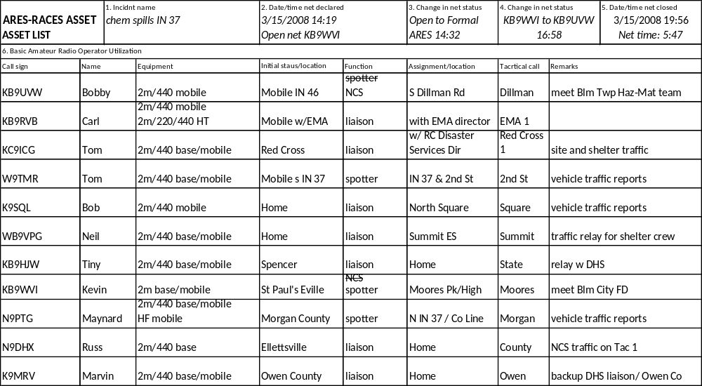
RESPONSE
Asset List
Monroe County
ARES-RACES Group

Slide 72
RESPONSE
Principles of Net Operation²
Announcing criteria for check-in :
  Any amateur operator / Specific operators:
    Reporting specific information
      'check in if reporting 1” hail....'
    In a particular location
      '...need spotters in SE quadrant of county....'
    With specific equipment
      '...need operator able to reach 146.97....'
    With special knowledge or skills
      '...any operator with variable DF equipment.'
Listen
Monroe County
ARES-RACES Group

Slide 73
RESPONSE
Principles of Net Operation³
Establishing content of traffic :
  Any traffic / Specific traffic:
    Requested reports of observed events
      i.e., hail, high winds, downed trees, etc.
    From a particular location
      i.e., '...operator at Williams Dam....'
    To/from a specific cooperating agency
      i.e., 'NWS liaison... Red Cross liaison'
Listen
Monroe County
ARES-RACES Group

Slide 74
RESPONSE
Principles of Net Operation⁴
The Directed Net:
  All traffic flows through the NCS.
  NCO sets the tone with instructions and information.
  NCO may allow
    Third-party traffic – to permit non-hams to pass traffic directly
    ‘Direct traffic’ – to permit hams to communicate without going through NCS.
    These practices reduce the possibility of error in traffic
  Check-out: If you check in to a net, please check out. NCOs will periodically make health and welfare checks of amateur operators.
  NCO may close net with a roll-call of active check-ins.
Monroe County
ARES-RACES Group

Slide 75
RESPONSE
Amateur Radio Traffic
Tactical traffic
  The first response communication in an emergency situation.
  Instructions or inquiries: ‘Send ambulance.’ ‘Where are water supplies?’
  Tactical traffic is generally unformatted and seldom written, but all traffic should be logged to protect both the radio amateur and the cooperating agency.
Formal traffic
  Generally long-term communications, often cast in ARRL message format and handled on NTS nets.
  Health and welfare traffic is usually formal.
Monroe County
ARES-RACES Group

Slide 76
RESPONSE
Amateur Radio Traffic²
Routine
  The expected traffic and operational communications. On a Formal Directed Net, the flow is controlled by the NCO who may allow ‘third-party’ traffic and ‘direct traffic’ to facilitate information exchange.
Break
  The normal, polite request for an opportunity to interrupt an ongoing contact is the lowest priority of interruption. Break is also often recognized during any Directed Net. The NCS can break back with a higher priority should events warrant a change in net status.
Monroe County
ARES-RACES Group

Slide 77
RESPONSE
Amateur Radio Traffic³
NCS/NCO, or an operator on any contact, will always stop everything and answer the following interruption priority calls immediately:
Priority [or Time Value]
The second highest level of interruption, Priority, means the traffic concerns an immediate safety issue regarding human life or injury, or impending property damage.
Emergency
The highest level of priority, Emergency, is reserved for only danger-of-death or serious-injury-if-message-is-not-heard-immediately messages.
Monroe County
ARES-RACES Group

Slide 78
RESPONSE
Repeater Operation
Using a repeater during an emergency:
  Power – Reduce power to avoid over-powering and conserve batteries. If tones are off, lower power avoids keying near-by, same frequency repeaters.
  Pause – Allow 2-3 second break after each transmission to permit potential Emergency or Priority traffic...
  Pause – On linked systems, hold key 2-3 seconds before transmitting to allow all repeaters to come online.
  Articulate. Speak across, not into, the mic. Talk low, slow, calm.
  Think. Stick to the facts. Control emotions. Write out what you need to transmit.
  Listen much. Transmit little.
Monroe County
ARES-RACES Group

Slide 79
RESPONSE
Liaison Activities
The Operational frequencies include both local and wide-area nets, both Strategy [Big Picture] and Tactical/Resource nets.
Strategy [146.64 (-)]
Tactical [443.775 (+5)]
2m Tactical [146.94 (-),
147.18 (+), 146.58 /s/ ]
NWS [146.97 (-), 442.65 (+5) ]
Area NOAA frequencies
Indiana Traffic Net [3.910]
Locations identified by EMA, Red Cross or other agency:
  Staging areas
  EMA / EOC
  Red Cross Chapter House
  Shelter locations
  Hospitals
  Law enforcement
  Fire response
  Service centers
Monroe County
ARES-RACES Group

Slide 80
Recovery
Health & Welfare Traffic
Damage Assessment
Monroe County
ARES-RACES Group

Slide 81
RESPONSE
RECOVERY
Shelter Operations
Shelter operations may occur during the RESPONSE phase and during the RECOVERY stages of an event.
Support may be provided by both ARES and RACES operations.
Shelter during RESPONSE could be service at the site – i.e., a stranded motorist.
Shelter during RECOVERY could mean serving families displaced by weather.
Monroe County
ARES-RACES Group

Slide 82
RESPONSE
RECOVERY
Shelter Operations²
Initial communications will probably involve inter/intra-agency logistics to open the facility.
ARS will support shelter activities
  Equipment logistics
  Victim location and identification
  Emergency food and water information
  Medical equipment
  Material distribution
  Life-and-death communication [Emergency / Priority]
Monroe County
ARES-RACES Group

Slide 83
RESPONSE
RECOVERY
Shelter Operations³
Shelter clients need to be able to inform, advise, and reassure friends and relatives of their status.
Hams will pass Health and Welfare traffic from the shelter to cooperating agencies and to HF traffic nets through a liaison.
Incoming Health and Welfare will be handled after all outgoing traffic is passed.
Monroe County
ARES-RACES Group

Slide 84
RECOVERY
Property and Damage Assessment
Both ARES and RACES may support Property and Damage Assessment teams.
EMA may request surveys to ascertain the amount of outside assistance needed in an area.
Red Cross uses DA to calculate initial impact estimates to aid recovery.
Hams can train to survey or may ride-along to provide instantaneous contact with Chapter or headquarters.
Monroe County
ARES-RACES Group

Slide 85
Indiana Department of Homeland Security
What’s Next?
10 Homeland Security Districts
  District 8
    Bartholomew, Brown, Jackson, Lawrence,
    Monroe, Orange and Washington counties
District Planning Council Program
  DP Oversight Committee (DPOC)
    President of County Commissioners of each County
    Mayor/Town Board President most populous city/town
    in each district County
  DPC
    Local emergency responders
    Emergency managers
    Other key agencies
    District Overhead Team representative
Monroe County
ARES-RACES Group

Slide 86
Indiana Department of Homeland Security
What’s Next?²
Oversight Planning Committee
  Appoint members of the DPC
  Provide executive oversight, support, guidance
DPC
  Conduct a District Homeland Security and Preparedness Assessment
  Develop and implement a District HS Strategy
  Develop a Crisis Communications and Public Information Plan
  Develop and implement a District Training and Exercise Program
  Sponsor and support District Grant and Resource Coordination
Monroe County
ARES-RACES Group

Slide 87
Indiana Department of Homeland Security
What’s Next?³
Benefits of DPC to local emergency responders and officials:
  Maintains control and direction of emergency services
  and disaster response at the local level
  Promotes formal district-wide mutual aid agreements and cooperation with non-jurisdictional partners
  Improves the ability of local governments to respond to large scale emergencies
Monroe County
ARES-RACES Group

Slide 88
Indiana Department of Homeland Security
What’s Next?⁴
District 8 Subcommittee Tasks & Objectives:
  Overhead Team
    Chair, county representatives (co-chairs)
    Representative is member of the DPC
  District Amateur Radio Response Team
    Ready response team to assist with normal and back-up emergency communications
    Deploy with District Emergency Planning and Response Team to local, regional, state events
Monroe County
ARES-RACES Group

Slide 89
Indiana Department of Homeland Security
D8 Overhead Team
Bartholomew
Brown
Jackson
Lawrence
Monroe
Orange
Washington
Jim Anderson N9VXW
Robert Bowers KB9TCN
Herschel Zhand N9KPA
Rick Nicholson N9UMJ
Carl Zager KB9RVB*
William Warren KB9TMP
Tim Peace N9TP
* Chair
Monroe County
ARES-RACES Group

Slide 90
Indiana Department of Homeland Security
What’s Next?⁵
Parallel and simultaneous planning and implementation of Amateur Radio response strategies:
  District 8 Subcommittee
    Pre-planning operational/tactical communications
    Training procedures
    Protocols and training
  State-wide RACES Standards & Protocol Council
    Technical Coordinator
    Technical advisory team
    to develop systems standards and protocols to be used state-wide and in each region
Monroe County
ARES-RACES Group

Slide 91
Indiana Department of Homeland Security
D8 Technical Advisory Committee
  Coordinator
  Bartholomew
  Brown
  Jackson
  Lawrence
  Monroe
  Orange
  Washington
Rick Nicholson, N9UMJ
TBD (interim, Jim Anderson, N9VXW)
Rick Woehlecke, K9VM
Hershel Zhand, N9KPA
Rick Nicholson, N9UMJ
Tim Miller, K9US
Rick Davis, WD8JJA
Dave Jones, KB4YZ
Mike Poe, KB9SGN
Neil Rapp, WB9VPG
Dwight Hazen, WB9TLH
Larry Jones, WB9HFP
Tim Peace, N9TP
Monroe County
ARES-RACES Group

Slide 92
Indiana Department of Homeland Security
D8 Support Service Advisors
Chris Gilbert KB9LTH American Red Cross
Dr Allen Smith K9APK D8 Public Health Coordinator
Monroe County
ARES-RACES Group

Slide 93
Indiana Department of Homeland Security
What’s Next?⁶
Details of the system should be a mutual decision by the Technical Council and the District Subcommittee
Communications inter-operability must be a priority to comply with NIMS
District Subcommittee will be responsible for getting support, approval and funding from the DPC, local RACES, ARES, community partners and served agencies to accomplish plans and projects
Monroe County
ARES-RACES Group

Slide 94
Indiana Department of Homeland Security
What’s Next?⁷
Team Planning Considerations:
  Develop a training standard
  Plan to provide training for DARRT personnel
  Standardize equipment, procedures and protocols
  Establish an equipment cache and training that a DARRT unit would need to provide communications
  Incorporate existing training options:
    ICS/NIMS/NRF (IS-100, 200, 700, 800b)
    ARRL EmComm (EC I, II, III)
Monroe County
ARES-RACES Group

Slide 95
Indiana Department of Homeland Security
What’s Next?⁸
Districts 8, 9 and 10 1st in Line:
  Complete and return membership survey
  Update volunteer equipment/training lists
  Get MOUs signed by all district counties
  Share communications and frequency plan for use by the D8 Technical Advisory Team
Monroe County
ARES-RACES Group

