Slide 1
Detection and Counting of On-Tree Citrus Fruit for Crop Yield Estimation
Student: Zavaczki Peter-Tibor
Group: 30433

Slide 2
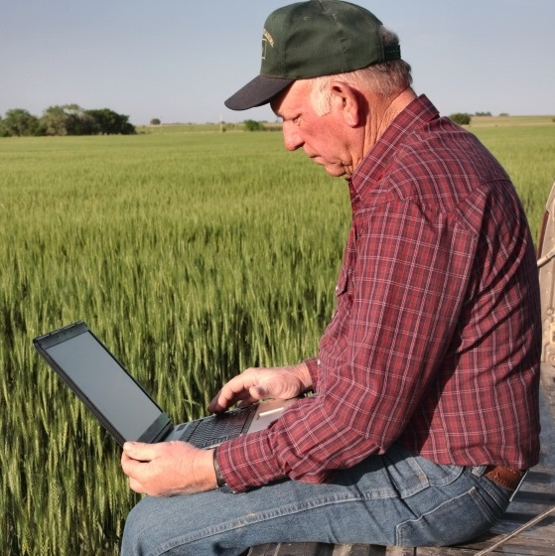
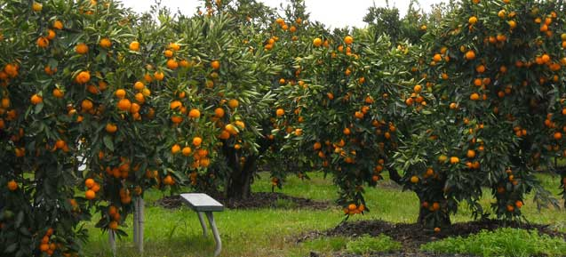
Domain of usefulness
The industry revolving around oranges (orange juice,
orange ice-cream, orange cars) all depend on the orange
farmers’ crop yield. The factories need to know precisely
how many oranges can a farm produce so that they can buy
the adequate amount to maximize production and profit.

Slide 3
The steps
Load an image from a dataset
Preprocessing by smoothing
Shadow reduction
Another level of smoothing using convolution
Selecting the relevant area
K-means segmentation
The final step is blob detection and object counting

Slide 4
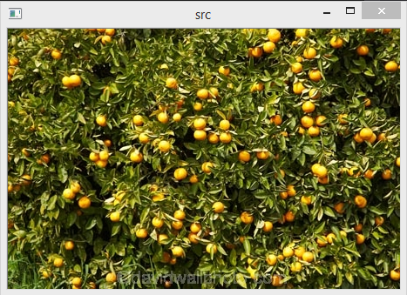
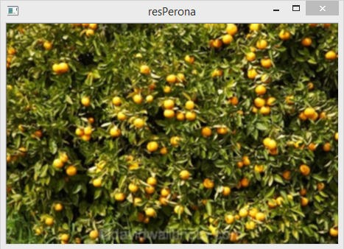
Preprocessing by smoothing
This step is accomplished by applying the Perona-Malik algorithm on the original image.
The Perona-Malik algorithm is basically a smoothing, applied to each of the three channels of
the original image. This algorithm relies on the following equation:
where the diffusivity is given by

Slide 5
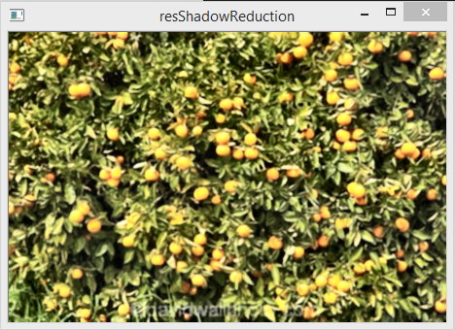
Shadow Reduction
This step is achieved by converting the image resulting from the previous step from its original
RGB color space to Lab (or CIELAB) color space, which stands for (Commission internationale
de l'éclairage / International Commission on Illumination) and the color space’s composition:
L – lightness, a – green–red color components and b – blue–yellow color components. The Lab
channels are then split, a CLAHE (contrast limited adaptive histogram equalization) algorithm
is applied to the lightness channel and the channels are merged and converted back to RGB.

Slide 6
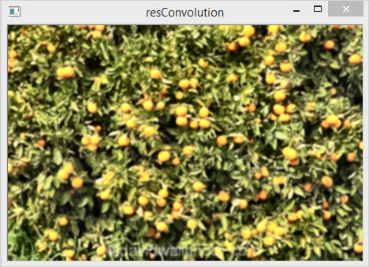
Convolution
In this step a simple Gaussian convolution blur is applied to the image. This means that the pixel
matrix is processed by multiplying and summing up some pixels based on a kernel, this applied
on every pixel and the results stored in the final image. The used kernel for the Gaussian blur is
{ {0.0625, 0.125, 0.0625}, {0.125, 0.25, 0.125}, {0.0625, 0.125, 0.0625} }.

Slide 7
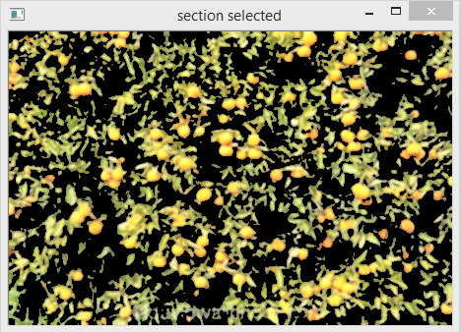
Section Selection
This step is performed by applying an autothresholding algorithm on the input image. The
autothresholding algorithm converts the input RGB image to grayscale by taking the mean of
the three channels, then finds the average of these values and creates an image where the
pixels can be white (if they are above the calculated threshold) or black (if they are below said
threshold). After that those pixels are selected from the original image, which are white, they are
put on the resulting image and the rest remain black.

Slide 8
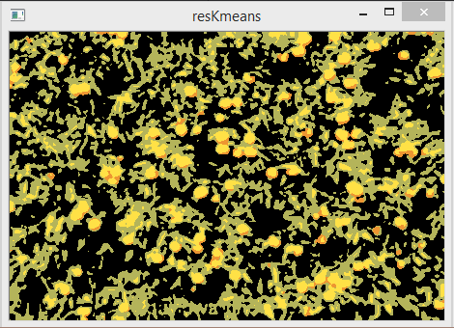
K-Means segmentation
In this step a K-means selection machine learning algorithm is applied. This algorithm takes a
value K, representing the number of sections it should split the input image into, then takes K
colors and marks every original pixel based on which color it is closer to. It then makes an average
of every color that is marked one way and makes an average of them, this being the new color by
which the image gets reprocessed until the computed colors don’t change anymore. The final
image is created by going through the labeled matrix and putting each computed color into their
respective label’s positions.

Slide 9
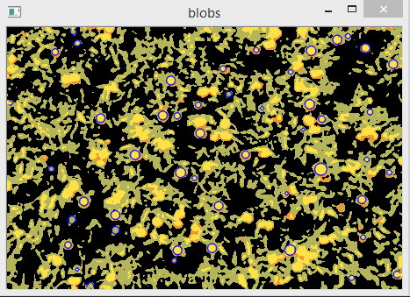
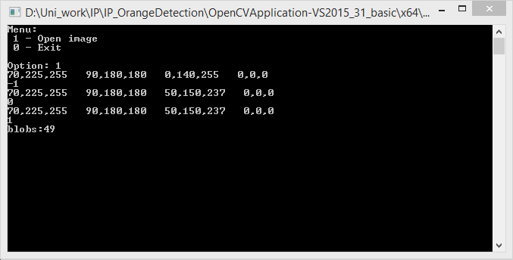
Blob detection
In the final step of this program, the number of blobs on the final image are counted. The blobs
are supposed to have a minimal amount of area, circularity, convexity, inertia and lightness.

Slide 10
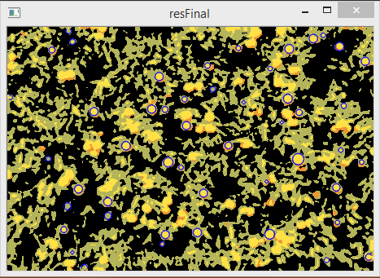
Blob detection
Thus, going through all those steps, we get from a simple image with oranges to a valuable
Industrial information!

Slide 11
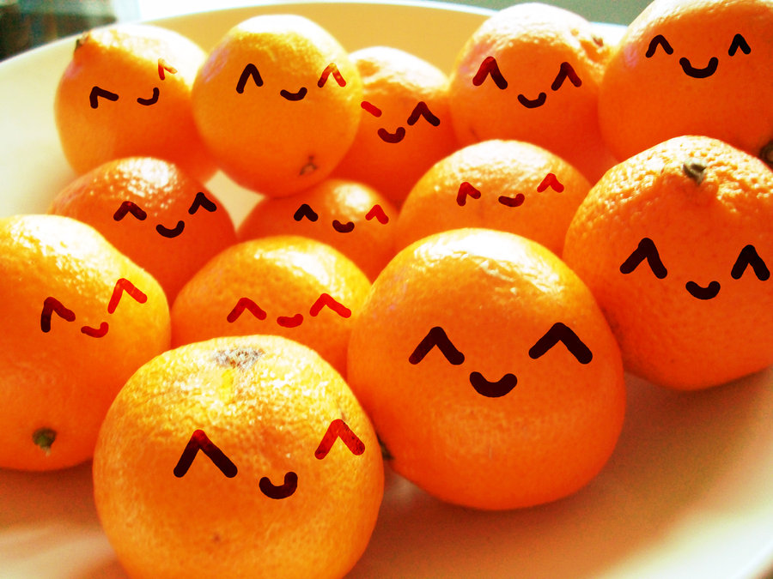
Thank you for your attention!

