Slide 1

Detection, Segmentation and Calibration of Rubber Strips
Computer Vision
Jaime Alvarado Fernández
David Morán Gorgojo
Pablo Ruíz Morán
Miguel Sánchez Rodríguez
15/03/2026

Slide 2
Contents
Introduction
Literature review
Selected method
Datasets
Performance metrics
Conclusions
References

Slide 3
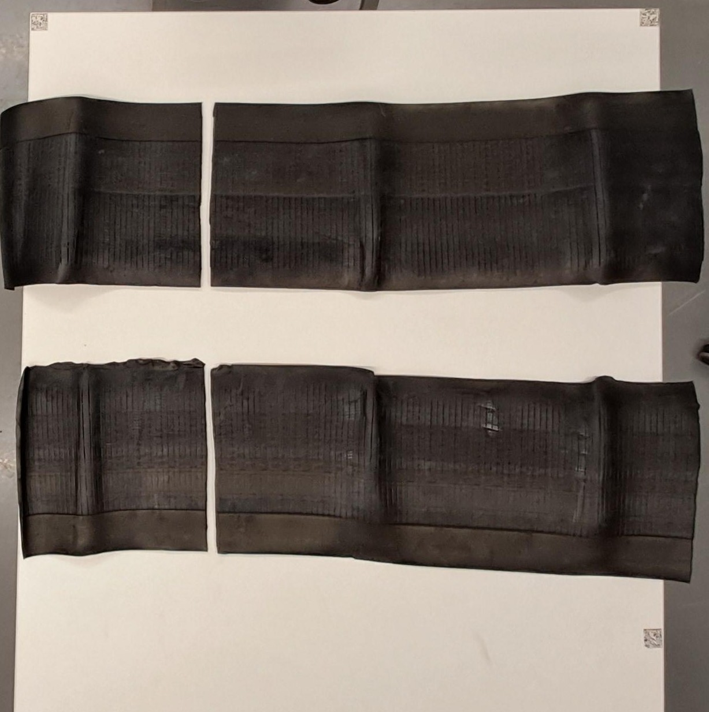
1. Introduction
What is the problem?
Detection, segmentation and distance estimation of rubber strips from smartphone images
What is it challenging?
Real-world smartphone images
Precise distance estimation
Perspective, noise, variability
Solution: Classical vs Deep Learning

Slide 4
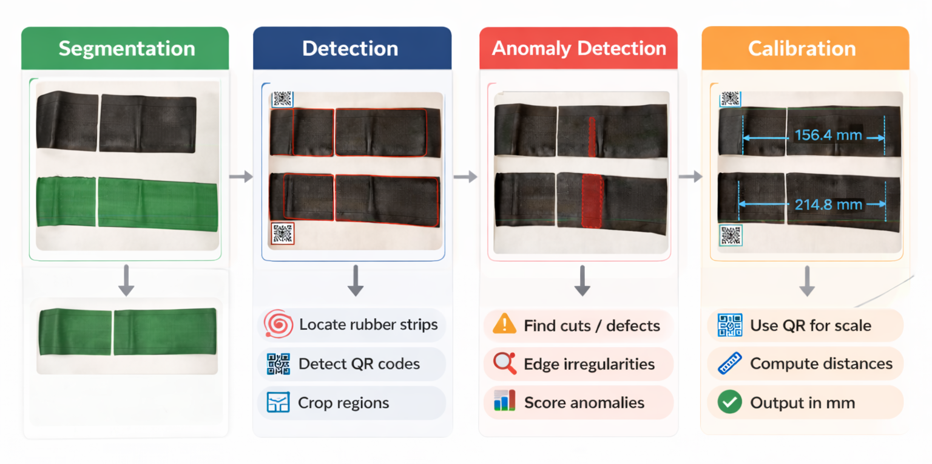
1. Introduction: State of the art
Main approaches
🟢 Segmentation
🔵 Detection
🔴 Anomaly Detection
🟠 Calibration

Slide 5
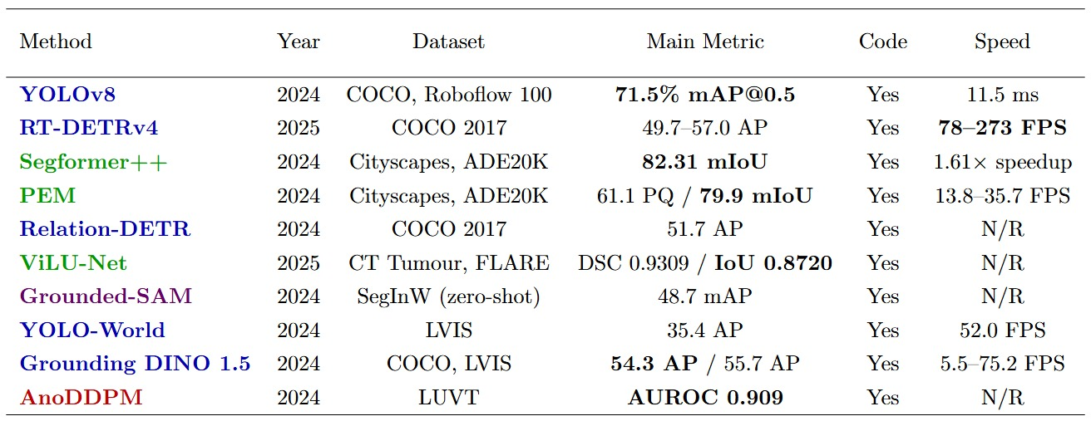
2. Literature review – Deep Learning
Main method categories: Segmentation, Detection and Anomaly Detection

Slide 6
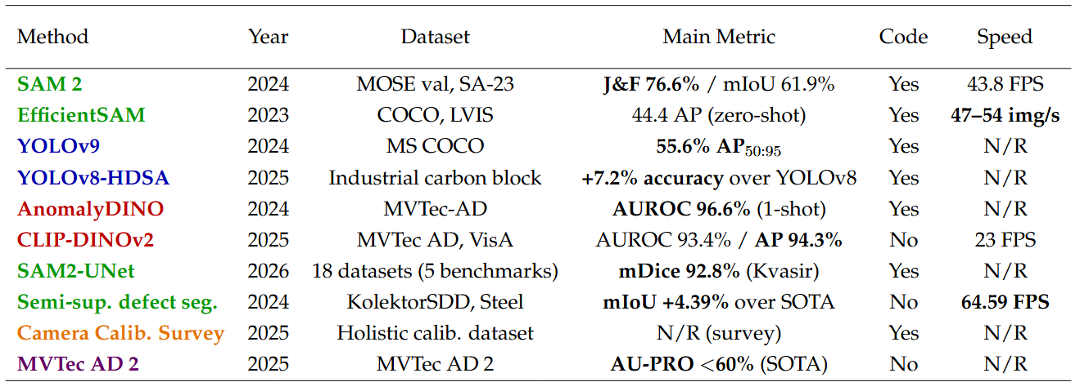
2. Literature review – Deep Learning
Main method categories: Segmentation, Detection and Anomaly Detection

Slide 7
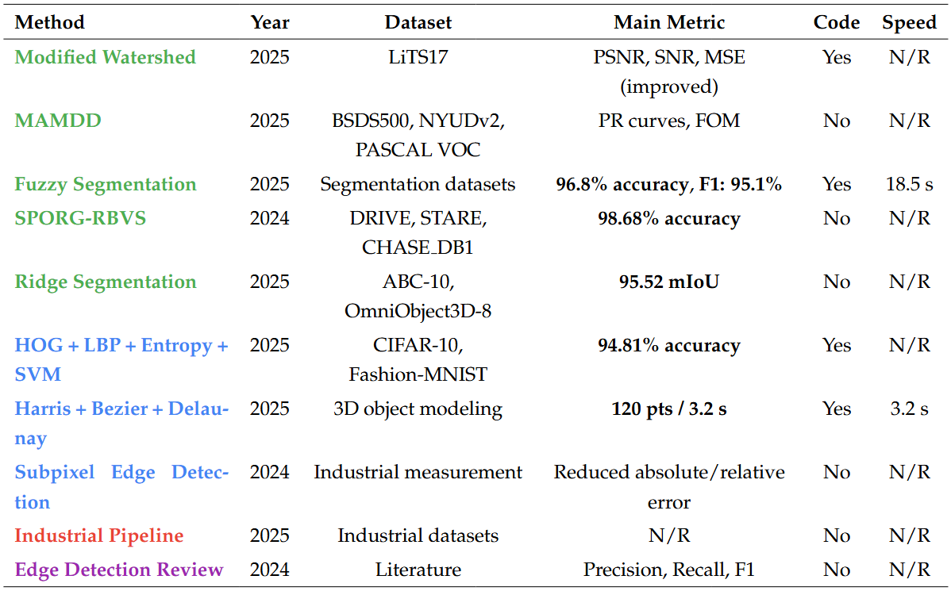
2. Literature review – Classical
Main method categories: Segmentation, Detection and Anomaly Detection

Slide 8
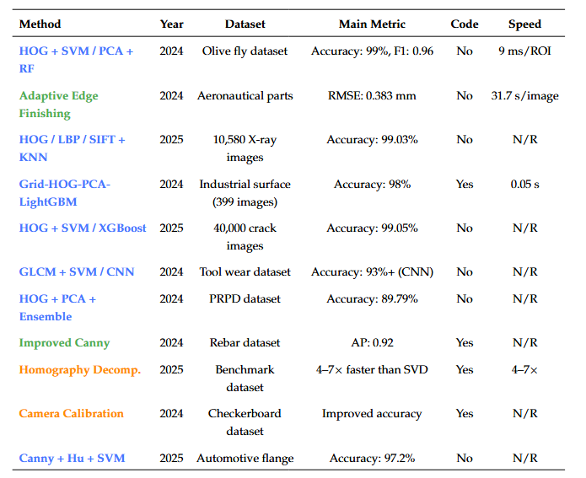
2. Literature review – Classical
Main method categories: Segmentation, Detection and Calibracion

Slide 9
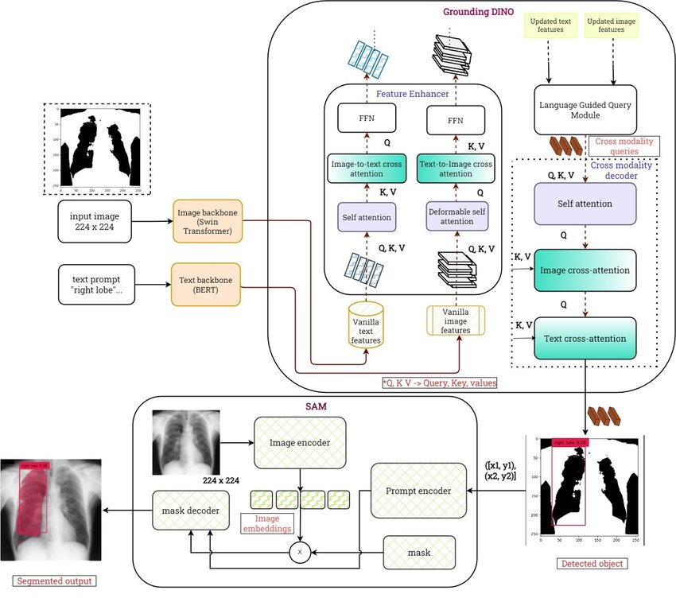
3. Selected method (Deep 1): Grounded-SAM
Detection + segmentation pipeline (2-stage)
Open-vocabulary
Object detection
Precise segmentation masks
Zero-shot
Notes:
Grounding DINO -> Object Detection
SAM -> precise segmentation masks

Slide 10
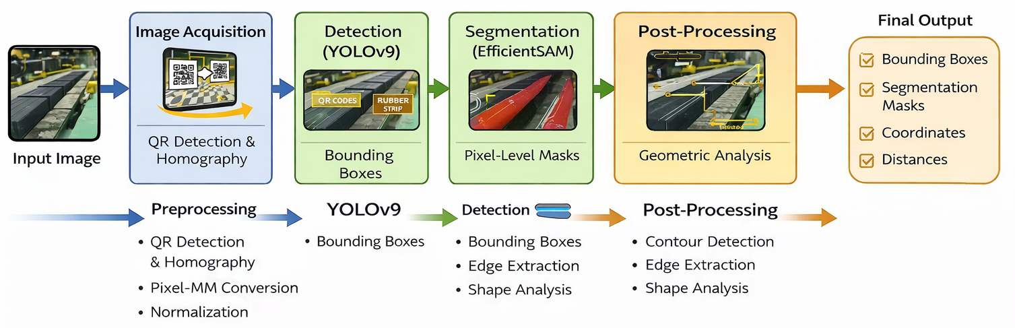
3. Selected method (Deep 2): YOLOv9 + EfficientSAM
Detection + segmentation pipeline (2-stage)
Real-time object detection (YOLOv9)
Lightweight segmentation (EfficientSAM)
QR-based calibration + homography
Precise Edge localization and measurement
Robust to real-world conditions

Slide 11
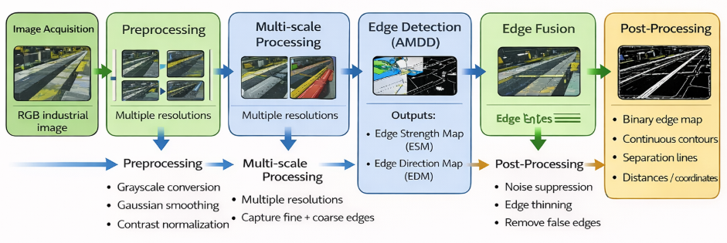
3. Selected method (Classical 1): AAMD
Multi-scale edge detection pipeline (classical)
Noise-robust edge extraction (AMDD)
Anisotropic morphological filtering
Directional edge analysis (ESM + EDM)
Edge fusion for continuity and accuracy
Robust to low contrast and industrial noise

Slide 12
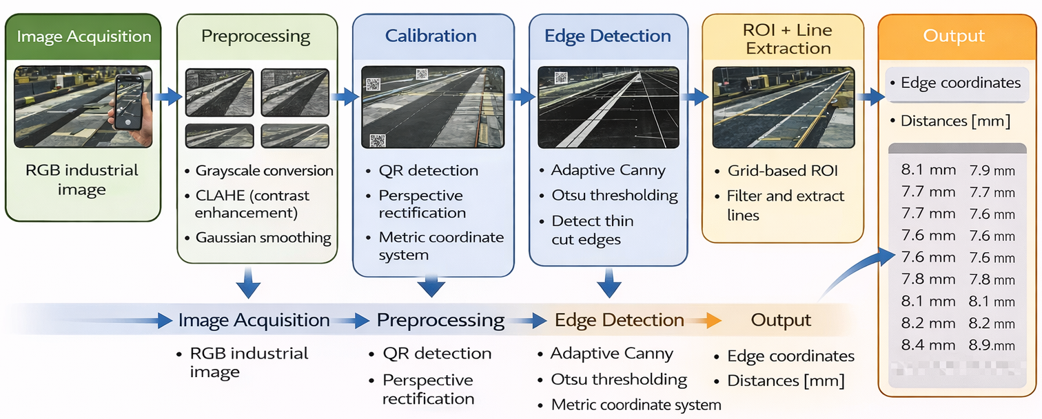
3. Selected method (Classical 2): Adaptative Canny
• Adaptive Canny edge detection (Otsu-based)
• QR-based homography calibration (mm estimation)
• Perspective correction + lens distortion removal
• ROI filtering + Hough line extraction
• Geometric filtering and line merging
• Robust to illumination, perspective and noise
• No training required (CPU-based deployment)

Slide 13
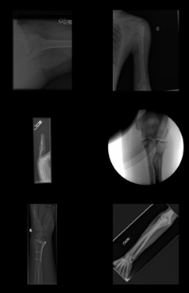
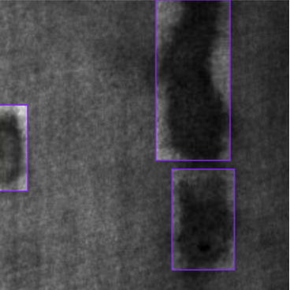
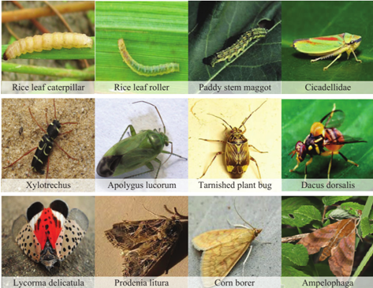
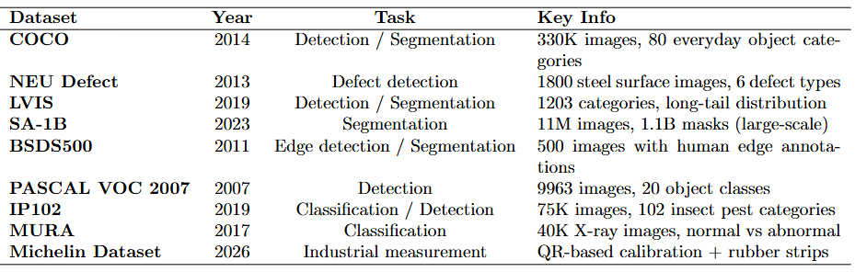
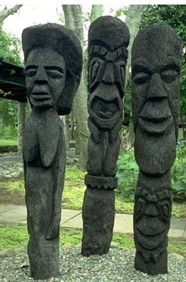
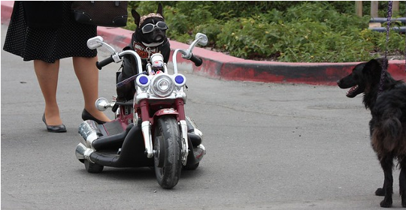
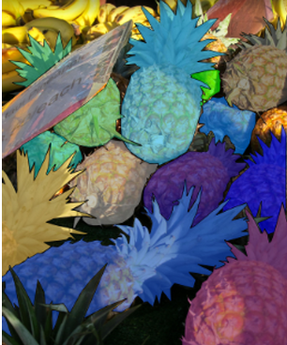
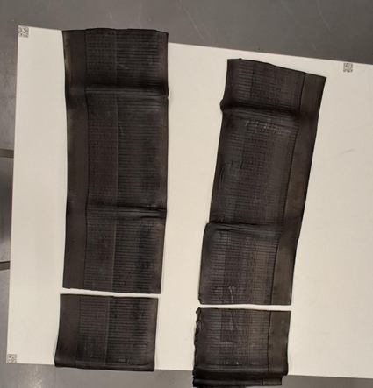
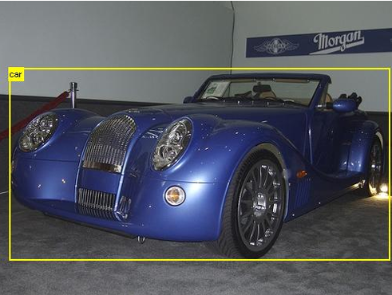
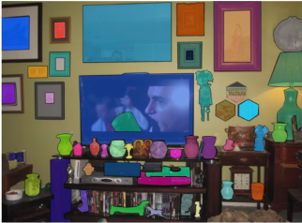
4. Datasets

Slide 14
5. Performance Metrics
🔹 Detection & Segmentation - Precision / Recall / F1-Score
- IoU (overlap quality)
- AP / mAP (overall detection performance)
🔹 Edge Detection - Precison-Recall Curve
- FOM (Edge accuracy)
🔹 Measurement - RMSE / MAE
- Distance Error

Slide 15
6. Conclusions
Deep learning highest accuracy, but requires data + GPU.
Classical methods efficient and no data needde, but less robust to real conditions.
Grounded-SAM is the most flexible approach, enabling zero-shot detection and segmentation, making it suitable when labeled data is unavailable.
YOLOv9 + EfficientsSAM provides the best accuracy-speed trade-off, but depends on fine-tunning and training data.
MAMDD enhances classical edge detection with robustness to noise and low contrast, although it still relies on handcrafted processing.
Adaptive Canny pipeline is the most practical and deployable solution, requiring no training and only CPU, but with lower robustness.

Slide 16
Thank you for your attention

Slide 17
7. References
[1] Jocher, G.; Chaurasia, A.; Qiu, J. Ultralytics YOLOv8. 2023. Available online: https://github.com/ultralytics/ultralytics
[2] Liao, Z. et al. RT-DETRv4: Painlessly furthering real-time object detection with vision foundation models. 2025.
[3] Ren, T.; Liu, S.; Zeng, A.; Lin, J.; Li, K.; Cao, H.; Chen, J.; Huang, X.; Chen, Y.; Yan, F.; et al. Grounded SAM: Assembling open-world models for diverse visual tasks. 2024.
[4] Kirillov, A.; Mintun, E.; Ravi, N.; Mao, H.; Rolland, C.; Gustafson, L.; Xiao, T.; Whitehead, S.; Berg, A.C.; Lo, W.-Y.; et al. Segment Anything. 2023.
[5] Damm, S.; Laszkiewicz, M.; Lederer, J.; Fischer, A. Anomaly DINO: Boosting patch-based few-shot anomaly detection with DINOv2. 2024.
[6] Kienzle, D.; Kantarelis, K.; Barthel, K. Segformer++: Efficient token-merging strategies for high-resolution semantic segmentation. 2024.
[7] Cavagnero, N.; Rosi, G.; Averta, G.; Lamberti, F.; Tommasi, T. PEM: Prototype-based efficient MaskFormer for image segmentation. 2024.
[8] Hou, X.; Ma, M.; Fan, B.; Luo, P.; Wan, Y. Relation-DETR: Exploring explicit position relation prior for object detection. 2024.
[9] Heidari, M. et al. A study on the performance of U-Net modifications in retroperitoneal tumor segmentation. 2025.

Slide 18
7. References
[10] Cheng, T.; Song, L.; Ge, Y.; Liu, W.; Wang, X.; Shan, Y. YOLO-World: Real-time open-vocabulary object detection. In Proceedings of CVPR 2024; pp. 16901–16911.
[11] Wyatt, J.; Leach, A.; Schmon, S.M.; Willcocks, C.G. AnoDDPM: Anomaly detection with denoising diffusion probabilistic models. In Proceedings of CVPR Workshops 2022; pp. 650–656.
[12] Ren, T. et al. Grounding DINO 1.5: Advance the edge of open-set object detection. 2024.
[13] Ravi, N.; Gabeur, V.; Hu, Y.-T.; Hu, R.; Ryali, C.; Ma, T.; Khedr, H.; Rädle, R.; Rolland, C.; Gustafson, L.; et al. SAM 2: Segment anything in images and videos. arXiv preprint, 2024.
[14] Xiong, Y.; Varadarajan, B.; Wu, L.; Xiang, X.; Xiao, F.; Zhu, C.; Dai, X.; Wang, D.; Sun, F.; Iandola, F.; et al. EfficientSAM: Leveraged masked image pretraining for efficient segment anything. 2023.
[15] Wang, C.-Y.; Yeh, I.-H.; Liao, H.-Y.M. YOLOv9: Learning what you want to learn using programmable gradient information. 2024.
[16] Shi, R.; Li, Z.; Wu, Z.; Zhang, W.; Xu, Y.; Luo, G.; Ma, P.; Zhang, Z. An industrial carbon block instance segmentation algorithm based on improved YOLOv8. Scientific Reports, 2025.
[17] Jiang, J.; He, Z.; Wan, A.; AL-Bukhaiti, K.; Wang, K.; Zhu, P.; Cheng, X. Zero-shot industrial anomaly detection via CLIP-DINOv2 multimodal fusion. Electronics, 2025.
[18] Xiong, X.; Wu, Z.; Tan, S.; Li, W.; Tang, F.; Chen, Y.; Li, S.; Ma, J.; Li, G. SAM2-UNet: Segment anything 2 as a strong encoder. 2026.

Slide 19
7. References
[19] Shi, C.; Wang, K.; Zhang, G.; Li, Z.; Zhu, C. Semi-supervised semantic segmentation for industrial surface defects. Scientific Reports, 2024. [20] Liao, K.; Nie, L.; Huang, S.; Lin, C.; Zhang, J.; Zhao, Y.; Gabbouj, M.; Tao, D. Deep learning for camera calibration and beyond: A survey. 2025. [21] Heckler-Kram, L.; Neudeck, J.-H.; Scheler, U.; König, R.; Steger, C. The MVTec AD 2 dataset: Advanced scenarios for anomaly detection . 2025.
[22] Kang Liao, Lang Nie, Shujuan Huang, Chunyu Lin, Jing Zhang, Yao Zhao, Moncef Gabbouj, and Dacheng Tao. Deep learning for camera calibration and beyond: A survey, 2025. [23] Lars Heckler-Kram, Jan-Hendrik Neudeck, Ulla Scheler, Rebecca König, and Carsten Steger. The MVTec AD 2 dataset: Advanced scenarios for unsupervised anomaly detection, 2025. [24] S. Yesmin et al. Detection segmentation and noise removal process of cancerous image cell of liver through modified marker-controlled watershed approach. Springer, 2025. [25] A. Sen et al. Feature engineering is not dead: Reviving classical machine learning with entropy, HOG, and LBP feature fusion for image classification. arXiv preprint, 2025. [26] X. Xu. The application of automated image processing technology in industrial inspection. Journal of the corresponding venue, 2025. [27] Hua Song and Ziqiao Wen. Interactive design modeling of 3D styling combining Bezier curve and Harris corner point detection algorithm. PLOS ONE, 2025.

Slide 20
7. References
[28] Ibrar Hussain. A stable region-based image segmentation model integrating fuzzy logic and geometric principles. Acadlore Transactions on AI and Machine Learning, 2025. [29] Ibrahim Almohimeed et al. Sandpiper optimization algorithm with region growing based robust retinal blood vessel segmentation approach. IEEE Access, 2024. [30] Ran Jia et al. Robust ridge-patterned instance segmentation for high-resolution point cloud measurement. IEEE Transactions on Instrumentation and Measurement, 2025. [31] Jun Guo, Yang Yang, and Yuxin Chen. Research on sub-pixel accuracy flange disk dimension measurement based on machine vision. Signal, Image and Video Processing, 2024. [32] Hewa Majeed Zangana, Ayaz Khalid Mohammed, and Firas Mahmood Mustafa. Advancements in edge detection techniques for image enhancement: A comprehensive review. International Journal of Artificial Intelligence & Robotics, 2024. [33] José L. Mira et al. Benchmarking of computer vision methods for energy-efficient high-accuracy olive fly detection on edge devices. Multimedia Tools and Applications, 2024. [34] Mikel González et al. Adaptive edge finishing process on distorted features through robot-assisted computer vision. Journal of Manufacturing Systems, 2024. [35] Hasan Muzakki et al. Evaluating K-nearest neighbors for X-ray bone fracture detection using HOG, LBP, and SIFT feature extraction methods. IEEE Access, 2025. [36] Hengxu Liu et al. Surface defect detection based on machine learning and data augmentation. IEEE ICCASIT, 2024.

Slide 21
7. References
[37] Hafizh Eryadi. Comparative analysis of SVM and XGBoost classifiers with HOG features for concrete crack detection. IT Journal Research and Development, 2025. [38] Hung et al. Tool wear classification based on support vector machine and deep learning models. Sensors and Materials, 2024. [39] Priananda et al. Machine learning-based phase resolved partial discharge pattern classification using HOG and PCA. IEEE Conference, 2024. [40] Ding et al. Homography decomposition revisited. International Journal of Computer Vision, 2025. [41] Zhang et al. A high-quality and convenient camera calibration method using a single image. Electronics, 2024. [42] Ge et al. Research on surface defect classification model of automotive flange disks based on machine vision. Signal, Image and Video Processing, 2025. [43] Tsung-Yi Lin et al. Microsoft COCO: Common objects in context. ECCV, 2014. [44] Kechen Song and Yunhui Yan. A noise robust method based on completed local binary patterns for hot-rolled steel strip surface defects. Applied Surface Science, 2013. [45] David R. Martin et al. A database of human segmented natural images and its application to evaluating segmentation algorithms. ICCV, 2001.

Slide 22
7. References
[46] Pablo Arbeláez et al. Contour detection and hierarchical image segmentation. IEEE TPAMI, 2011. [47] Mark Everingham et al. The PASCAL visual object classes (VOC) challenge. IJCV, 2010. [48] Xiaoping Wu et al. IP102: A large-scale benchmark dataset for insect pest recognition. CVPR, 2019. [49] Pranav Rajpurkar et al. MURA: Large dataset for abnormality detection in musculoskeletal radiographs. arXiv, 2017. [50] John Canny. A computational approach to edge detection. IEEE TPAMI, 1986. [51] Rafael Grompone von Gioi et al. LSD: A line segment detector. Image Processing On Line, 2012. [52] Piotr Dollár and C. Lawrence Zitnick. Structured forests for fast edge detection. ICCV, 2013. [53] Luc Vincent and Pierre Soille. Watersheds in digital spaces: An efficient algorithm based on immersion simulations. IEEE TPAMI, 1991. [54] Alejandro F. Frangi et al. Multi-scale vessel enhancement filtering. MICCAI, 1998.

