Slide 1

Title - For example: Phishing detection using Phishing kits
Computer Vision
by Student Name
Presentation date

Slide 2
Contents
Introduction
Literature review
Selected method
Datasets
Performance metrics
Results and discussion
Conclusions
References

Slide 3
1. Introduction
For example: What is phishing?
Definition.
Why is important to detect phishing?
Explanation

Slide 4





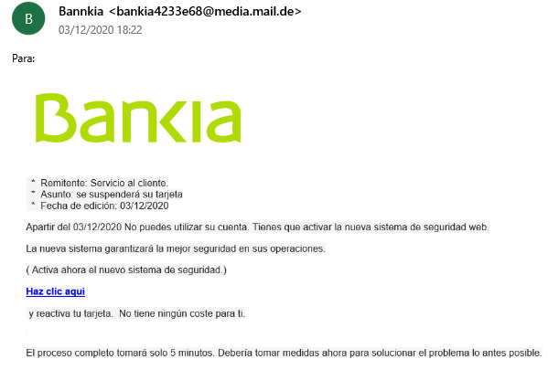
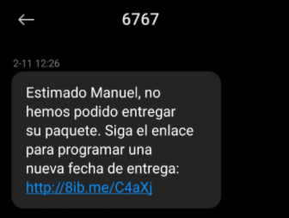
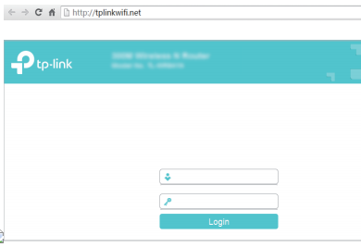
1. Introduction
Attack vectors
Email
Smishing
Instant
messaging
Vishing
Wi-Fi

Slide 5







2. Literature review
Typically it is the ”state-of-the-art”. Just one slide containing a summary of the state of the art in this problem. A table summarizing multiple papers/results would be OK
Software detection
Lists
Heuristics
Artificial Intelligence
Whitelist
URLs
Blacklist
Content
Visual
3rd party

Slide 6
3. Selected method 01: XXXX

Slide 7
3. Selected method 02: YYYY

Slide 8
3. …

Slide 9
7. Conclusions
The best method is … because…
The main drawback is…
The performance decreases when..
….
Using method XX may be better than method YY in … circumstances …
…..
The implementation evaluated requires a GPU for….

Slide 10
8. References
(Every paper cited in the previous slides needs to be referenced properly here)
[1] Wang, K.; Belongie, S. Word spotting in the wild. In Proceedings of the 11th European Conference on Computer Vision (ECCV 2010), Heraklion, Greece, 5–11 September 2010; pp. 591–604.
[2] Karatzas, D.; Shafait, F.; Uchida, S.; Iwamura, M.; I Bigorda, L.G.; Mestre, S.R.; Mas, J.; Mota, D.F.; Almazan, J.A.; De Las Heras, L.P. ICDAR 2013 robust reading competition. In Proceedings of the 2013 12th International Conference on Document Analysis and Recognition, Washington, DC, USA, 25–28 August 2013; pp. 1484–1493.
[3] Karatzas, D.; Gomez-Bigorda, L.; Nicolaou, A.; Ghosh, S.; Bagdanov, A.; Iwamura, M.; Matas, J.; Neumann, L.; Chandrasekhar, V.R.; Lu, S.; et al. ICDAR 2015 competition on robust reading. In Proceedings of the 2015 13th International Conference on Document Analysis and Recognition (ICDAR), Tunis, Tunisia, 23–26 August 2015; pp. 1156–1160.
[4] Mishra, A.; Alahari, K.; Jawahar, C. Scene text recognition using higher order language priors. In Proceedings of the BMVC-British Machine Vision Conference 2012, Surrey, UK, 3–7 September 2012.

Slide 11
Thank you for your attention

