Slide 1
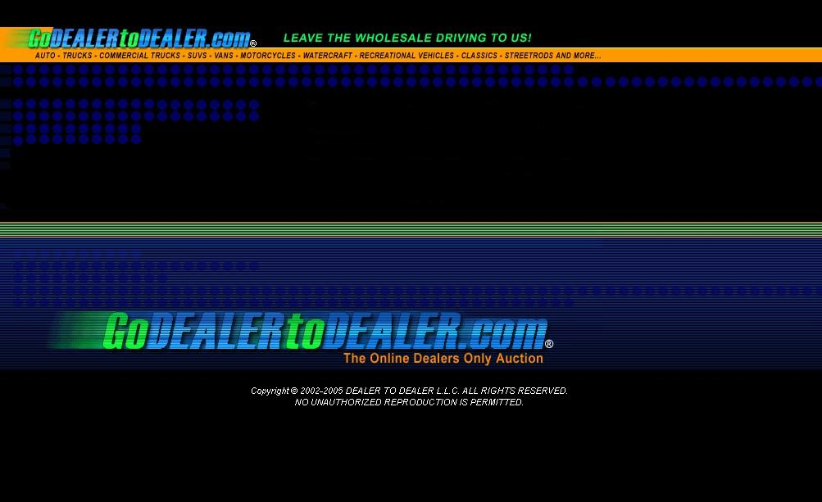

Slide 2
Motorcycle Industry
Sell
Buy
Search

Slide 3


Wholesale Challenges and Issues
Transportation Issues
  Traditional motorcycle auctions need the inventory transported to their locations. Each trip to these auctions cost more and more, not counting the amount of time spent for the return transportation should those units go unsold. This is unnecessary transportation costs.
Inventory Offsite
  While inventory is at the traditional auction, it is impossible for it to be available for retail. Never before was it possible for your item to be available on both the retail and wholesale markets at the same time.
Auction Frequency
  Motorcycle auctions are rare and difficult to travel to. Only a few auctions are conducted across the US. This causes great expense to dealers to attend before any purchasing is conducted. For this fact, the inventory is not ideal, thus resulting is low satisfaction and frustration.

Slide 4

Wholesale Challenges and Issues
Selling Hassles
  When selling wholesale:
    Your presence is required
    Only the people who are in your “lane” have the ability to bid on your items
    If you have a late number, your chances to have a good audience is reduced
    Weather Conditions
      Seasonal / Geographic Weather Conditions affect the audience attendance and price of the items
    Limited Inventory Selection

Slide 5

Who We Are
Go Dealer to Dealer is a dealers only online wholesale auction.
We offer a broad scope of unparalleled auction services for industries ranging from Motorcycle, Automotive, Marine, RV, Fleet, Rental, and Financial Companies.
We provide convenience in the wholesale market 24 hours a day / 365 days a year, while the inventory remains on your lot for the retail market at the same time.
We provide FAST, COST-EFFECTIVE electronic means of buying and selling wholesale.
We are looking to enhance your wholesaling experience by bringing you what has been missing, and the opportunity to further your wholesaling during physical auction “downtime”.
We can educate you and your dealership to significantly reduce the time required to control, buy, and sell inventory faster while saving TIME and MONEY.

Slide 6
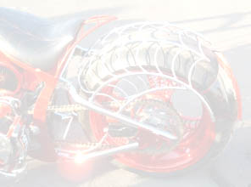
What We Offer
Auctions 24 hrs a day, 365 days a year
  Custom start and end times for all auctions with schedules from 1 to 30 day listings.
Unlimited Auction Listings
  Our through research has enabled us to provide an auction experience that is unparalleled. No listing fees and no sell fees to dealers provides the opportunity to have your Entire inventory on wholesale auctions.
Selling to a potential audience of Thousands
  We can train your dealership or financial company how to list your inventory to wholesale Faster and with Less Cost then ever before. Since your inventory is online, all Go Dealer to Dealer members from Coast to Coast are able to search, view, and bid on your items.
Streamlined Processes
  With powerful custom searching, proxy bidding, and fast listing, you can expand your WHOLESALE business faster and easier than ever before. Also increasing your RETAIL business due to immediate inventory access never before available.
Local, Regional, & National Exposure
  Every auction is visible to all other Go Dealer to Dealer members Nation Wide. You are no longer limited to dealers from your geographic area to view and bid on your auctions.
Unlimited Inventory
  You have the ability to list your entire inventory at No Cost with unlimited pictures. You also have the power to list, sell, and purchase items in ALL categories. This will open your business to accepting items that your dealership might not specialize in to close a deal, because you now have a venue to move that inventory.

Slide 7
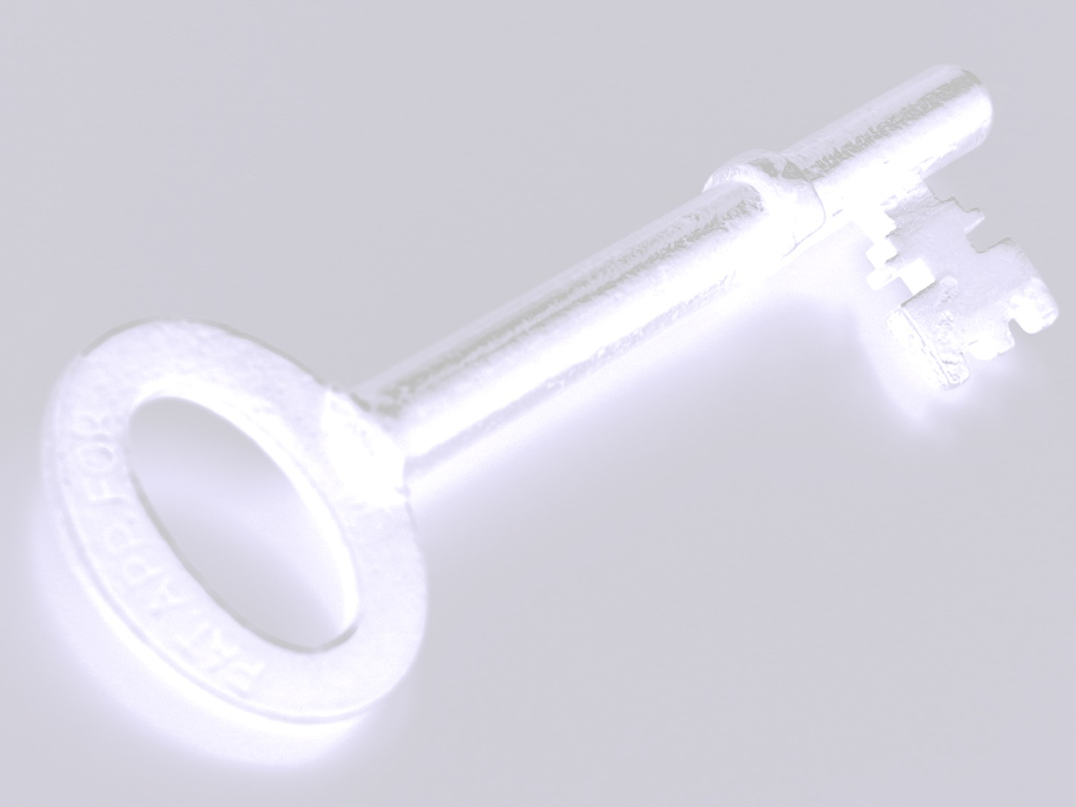
Key Features
Custom Listing
  The listing form is custom designed for each category. Depending on your listing, the criteria is specific to that exact item.
Custom Searching
  With instant access to the database, you have the power to search in detail for the item you are looking for. You can search by year, make, model, and miles (or hours). You can also search nationally, regionally, or by state. You may also conduct an advanced search by choosing detailed custom items about that particular category.
Proxy Bidding
  You may bid on numerous items at once by searching for the items, then placing bids with your maximum price you are willing to pay. The system will bid against other bidders for you until the auction ends or your maximum bid has been exceeded. You will be notified if you have been outbid or if you have won the auction.
Condition Reports
  The advanced graphical condition report allows a bidder to see topics of the interior, exterior, and mechanical condition of every auction. Since it is graphical and color coded, the process of viewing the item is quick and easy, and yet detailed at the same time. This reduces time when reading long paragraphs of text.

Slide 8
More Key Features
Buy Now Option
  With the Buy Now feature, you can instantly purchase items at the click of a button. This can extend to your showroom as a quick and easy selling tool. You can search for items, make the deal, and purchase the item to re-sell instantly.
Auction Request
  The robust search tool includes ALL items entered into the database. If an item is not in an active auction, you have the ability to send an Auction Request for the dealer to enter that item in an auction. Once the item is active, you will be notified immediately.
Auction Time Extension
  Our EXCLUSIVE Auction Time Extension allows bidders to place bids on items within the last seconds of an auction. If a bid is made within the last 5 minutes of the close time, an additional 5 minutes will be extended from the time of the bid. This allows all interested members the opportunity to bid before the auction ends, which allows the seller to get maximum price and exposure for all online auctions.
Make Offer Option
  If at the end of an auction, the reserve was not met, both the high bidder and the seller have the opportunity to Make an Offer to the other party. The other party will then have the opportunity to simply accept, deny, or counter the offer resulting in more sales and completed transactions than ever before.
Rating System
  The detailed rating system is an advanced system where the buyer rates the seller on every transaction. This system rates the seller on multiple topics regarding the auction. These values are averaged to create the numerical rating of the seller which is displayed on all auctions.

Slide 9

Who Can Participate
Any licensed Motorcycle, Marine, Power Sports, Automotive, or RV dealer as well as any Fleet, Rental or Financial Company may become a member.
For security purposes, each registering member must pass a background check with the assurance they are in good standings with their state requirements.
Every member will have a direct Account Executive assigned to them to help increase efficiency and improve your bottom line.

Slide 10

Cost and Savings
Our studies have shown that an average dealership going to traditional auctions costs hundreds of thousands of dollars each year. This includes transportation costs, auction fees, and…
We have designed our pricing structure to benefit you.
Buyers will pay a small transaction fee based on the end of auction price. As the auction amount goes up, the percentage goes down. The fee for typical $10,000 item will be 1.8% = $180.
Time!
No Listing Fees
No Sell Fees
No Re-Listing Fees

Slide 11

How To Contact Us
The fastest and easiest way to contact us and for you to get online and start saving valuable time and money is to simply fill out the online form.
The online form is located at the home page. Click on the “Sign Up Here” link.
Your submittal will be entered into the system and an Account Executive will be assigned to setup an appointment with you to go over more information and to complete your application.

Slide 12

THANK YOU
All of us at Go DEALER to DEALER are committed to helping your business succeed and grow in ways never before imaginable.
We look forward to servicing your account!!
LEAVE THE WHOLESALE DRIVING TO US!

