Slide 1

Assessing File Management Systems:
A Case Study on Apple File System
-By Mahima Gupta(T22055)
Notes:
Good morning everyone ! Myself Mahima Gupta. I’m pursuing MTech here from CSE Branch. My research topic is Assessing File Management Systems : A case study on Apple File System

Slide 2
The aim of the study is to explore the working and performance of Apple File Systems.
In this paper, we will be discussing the architecture, components, features and evolution of APFS. We have performed an experiment to analyze performance of APFS against NTFS.
Notes:
Apple File System is the current file management system for Apple devices. It was launched in 2017. Since Its a relatively new file system, there is a strong need of documentation to understand to understand how APFS is different from the previous file versions and its competitors in the market. In the midterm presentation, we had discussed the basic operations of a file system. Talked a little about APFS and its evolution. Literature review and a brief idea about the experiment. Today, we will be discussing features of APFS and the results of the performance analysis experiment. Before talking about the features of APFS. Few interesting anecdotes that I would like to share with everyone.

Slide 3
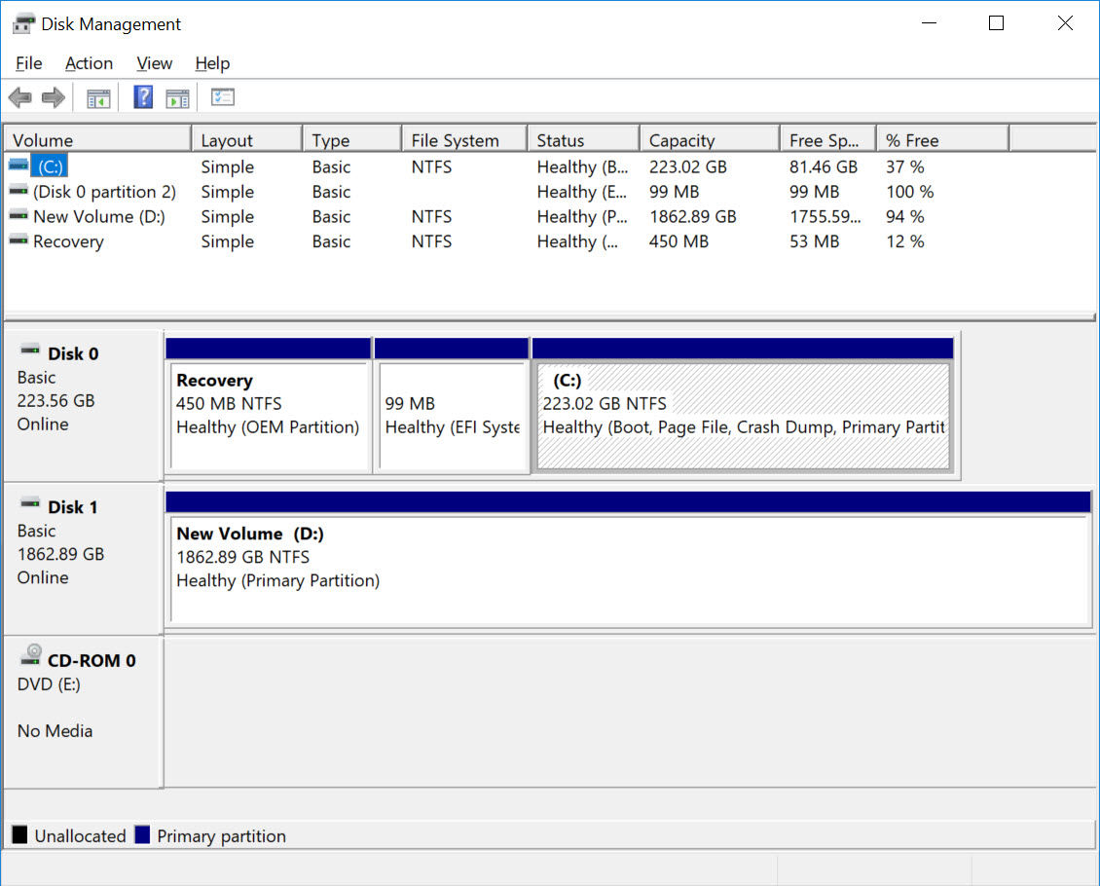
Figure 1 : Disk Management Utility in Windows referenced from https://www.online-tech-tips.com/software-reviews/5-hard-drive-formatting-and-partitioning-utilities/
Notes:
Windows device - C drive + D drive and more. Here, you partition the hard drive into volumes. NTFS. General practice, C - System data, D/ E - User data

Slide 4
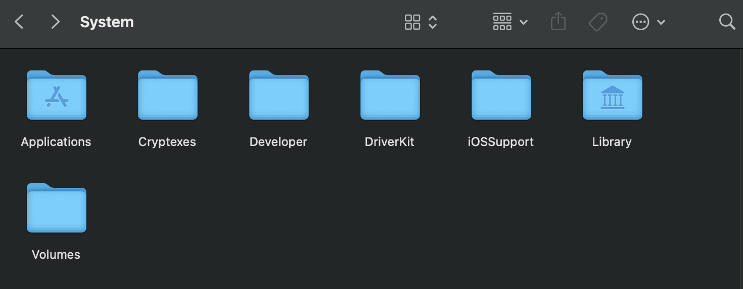
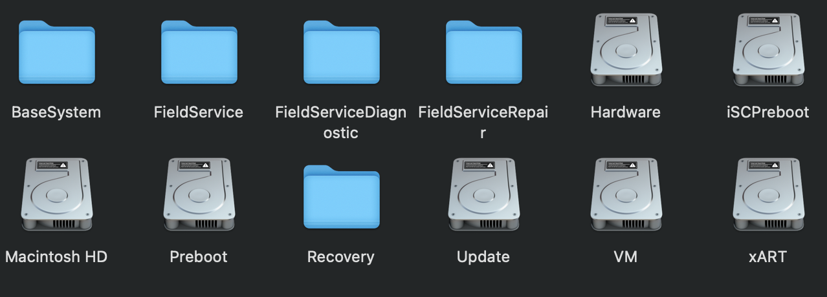
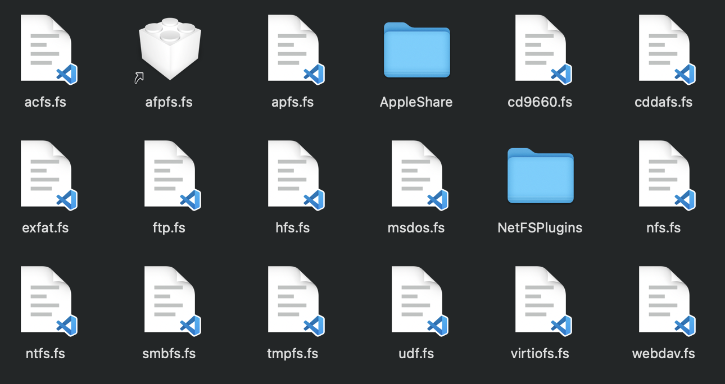
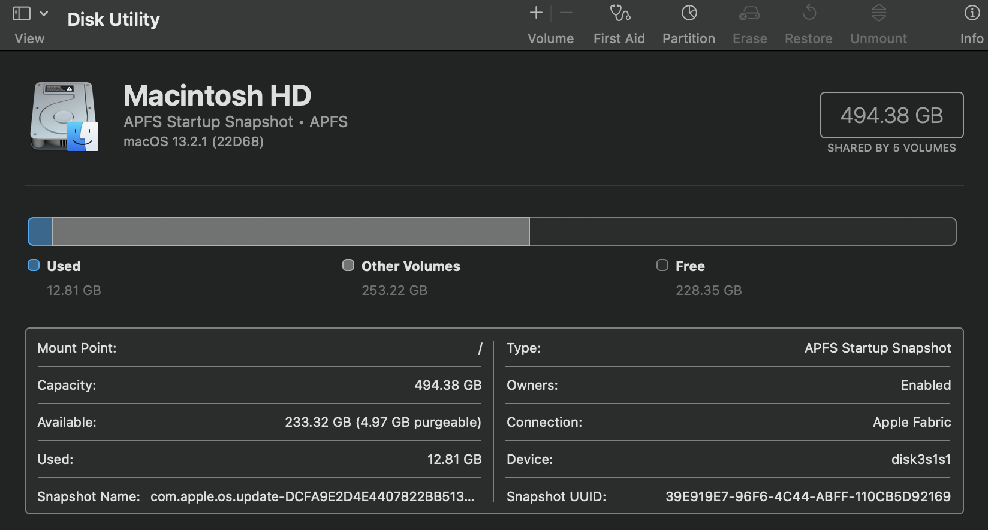
Figure 2 : Finder Window displaying System Directory
Figure 3 : Finder Window displaying volumes in the fiel system
Figure 4 : Finder Window displaying file systems supported
Figure 5 : Disk Utility Window in Apple Macbook Pro
Notes:
Apple Containers + volumes. System directory in finder . In the file systems directory, file systems supported by MAc. apfs. NTFS. exFAT. Disk Utility of Mac device. Moving on to the features of APFS. Starting with snapshots

Slide 5

Snapshots
Snapshots are user generated states. It is created when data is flushed in APFS. It created only for volumes, not containers.
Snapshots help rollback data in time. This implies that if a file is a part of snapshots, it cannot be completely deleted until snapshot is deleted. If you need, you can use the APFS snapshot to return your Mac to the state when the snapshot was taken.
Notes:
There are two things in APFS - Checkpoints & Snapshots. Checkpoints provide crash protection & maintain data integrity, captures data of Apple containers.
Snapshots capture state of file system in that frame of time. Its like screenshots in your mobile. You can create snapshots using terminal commands.

Slide 6
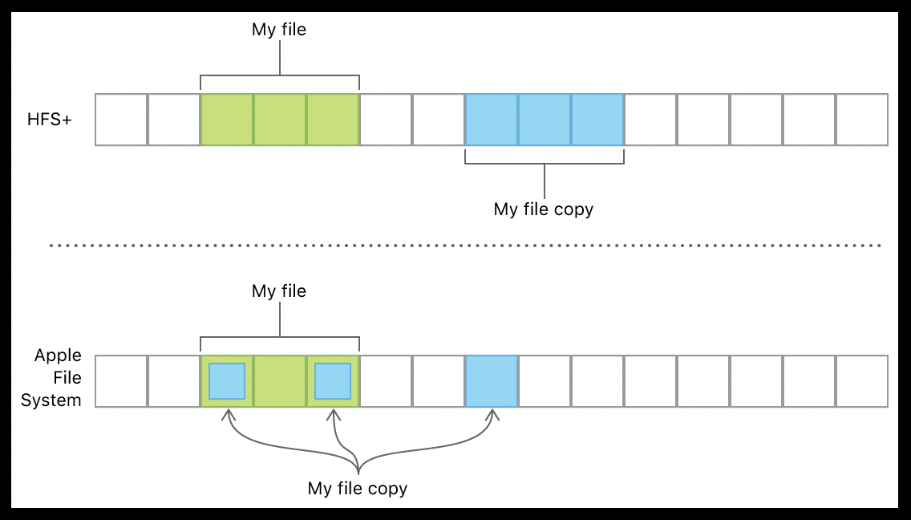
Cloning
A clone is a copy of file or directory that does not require additional space on disk. .
Figure 6 : Schematic Diagram of Snapshots in APFS (https://developer.apple.com/documentation/foundation/file_system/about_apple_file_system )
Notes:
Cloning makes power efficient file copies on the same volume.The figure below shows a file named “My file” and its copy “My file copy” that have two blocks in common and one block that varies between them. On file systems like HFS Plus, they’d each need three on-disk blocks, but on an Apple File System volume, the two common blocks are shared.

Slide 7
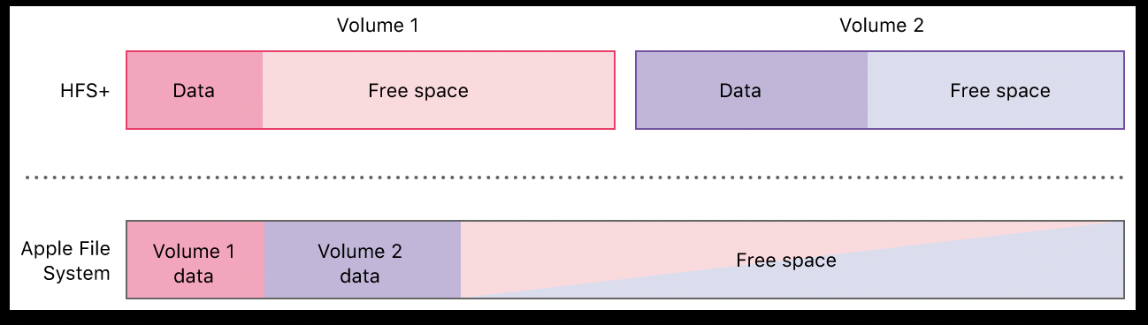
Space Sharing
APFS supports multiple volumes in a single partition, which allows all of those volumes to share free space in that containers.
Figure 7 : Schematic Diagram of Space Sharing in APFS (https://developer.apple.com/documentation/foundation/file_system/about_apple_file_system )
Notes:
Many files systems, including HFS Plus, support only a single volume per partition. Because free space can’t be shared across partitions, each volume’s size is set when partitioning the storage device, and each volume can only grow into its available free space. In contrast, Apple File System supports multiple volumes within a single partition, which allows all of those volumes to share their free space. All of the volumes in an Apple File System partition can grow and shrink independently; space that’s freed when one volume shrinks can be used when another volume grows.Each volume in the container can use the shared free space, so they all include that amount when reporting the available free space.

Slide 8
Encryption
Location of Volume KeyBag Wrapped Volume Encryption Key
Metadata Information
Hardware Encryption (AES-CBC) is used in iOS and macOS devices.
Keybags are encrypted using UUID of the volume/ container.
Key Encryption Keys
Metadata Information
Volume Keybag
Container Keybag
Figure 8 : Hierarchical Structure of Encryption Keys in APFS

Slide 9
Methodology
Performance Analysis
Metrics
Factors
Response
Time
Read
Throughput
Write
Throughput
CPU
Utilization
File Size
Type of Processor

Slide 10
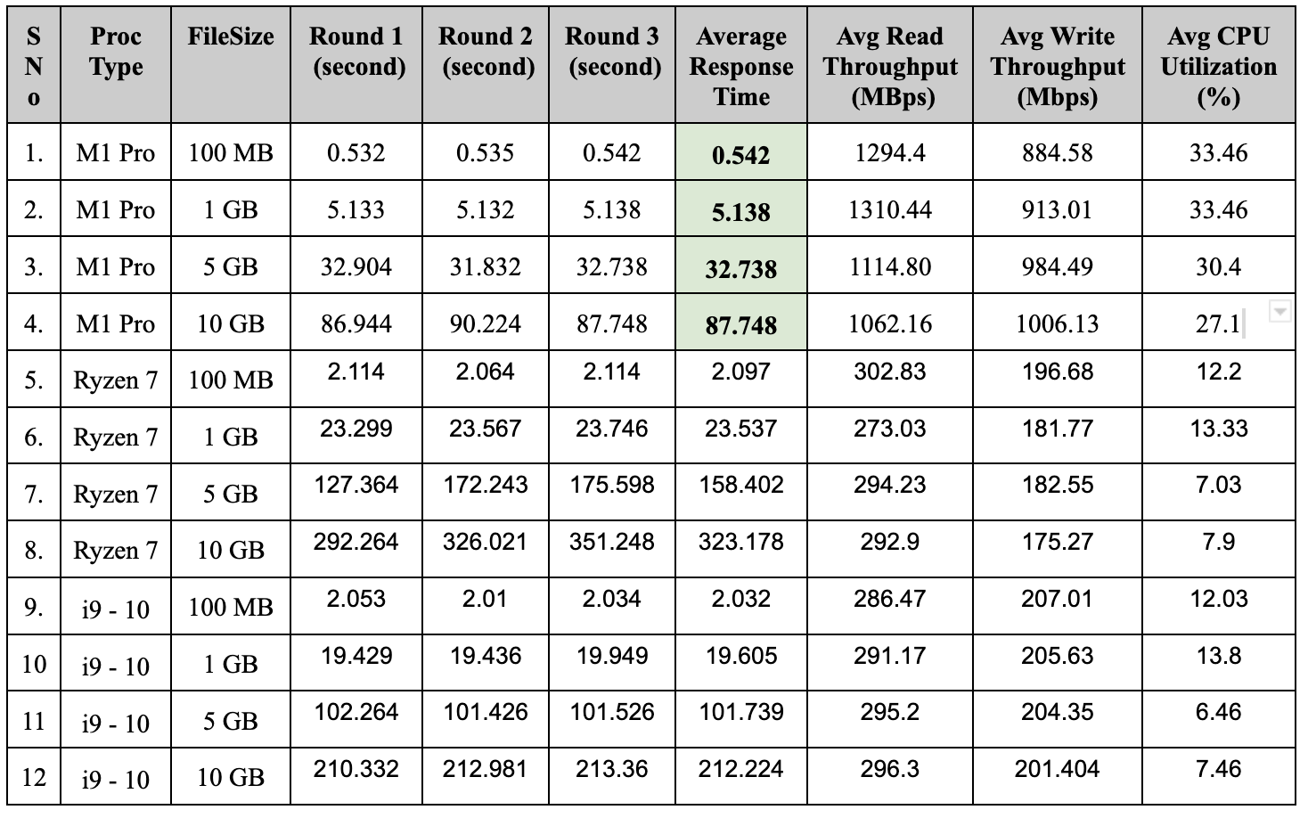

Slide 11
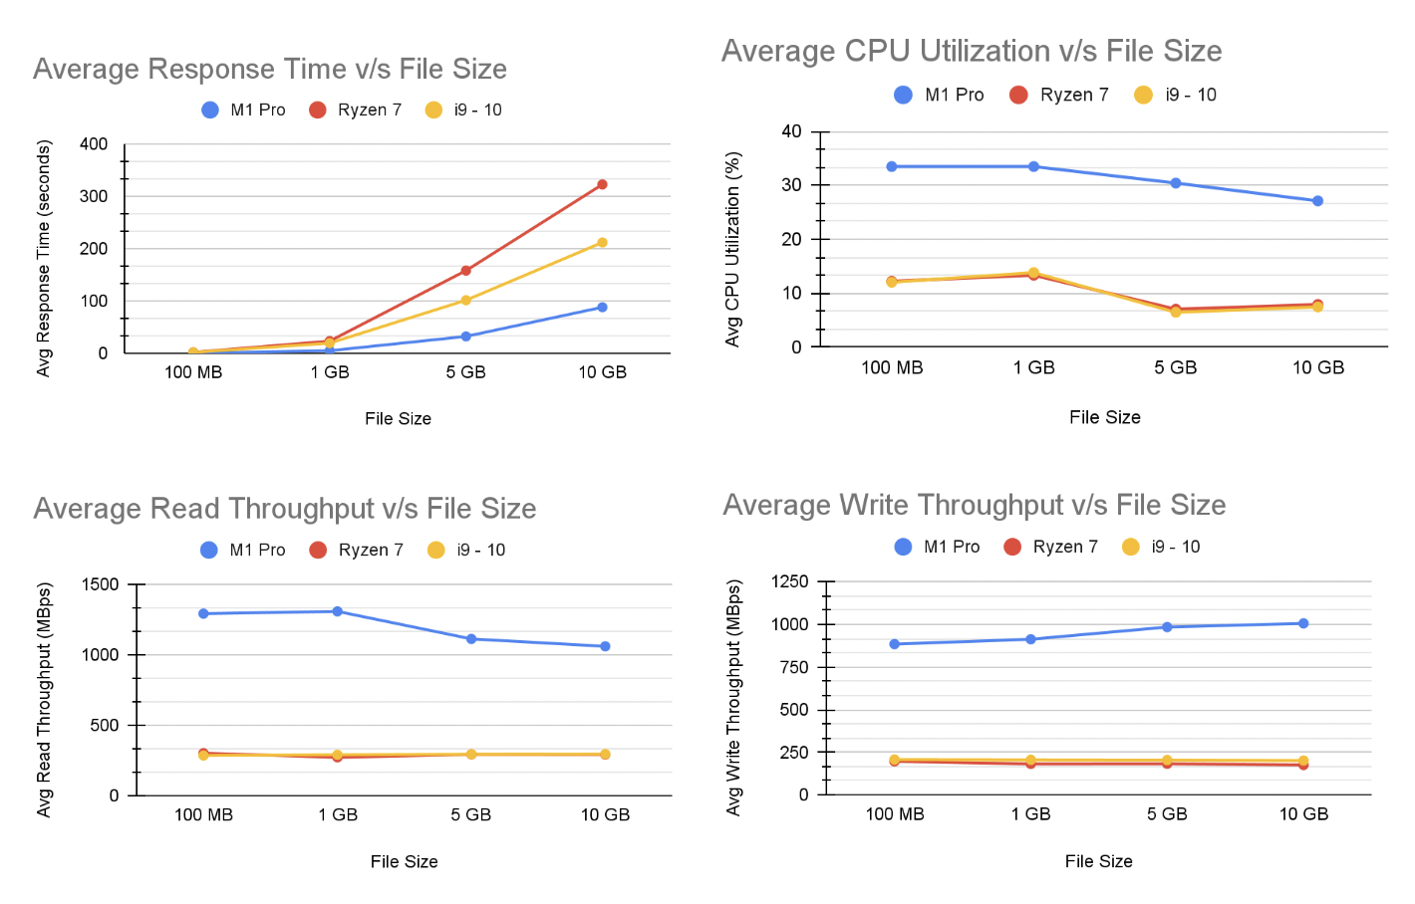

Slide 12
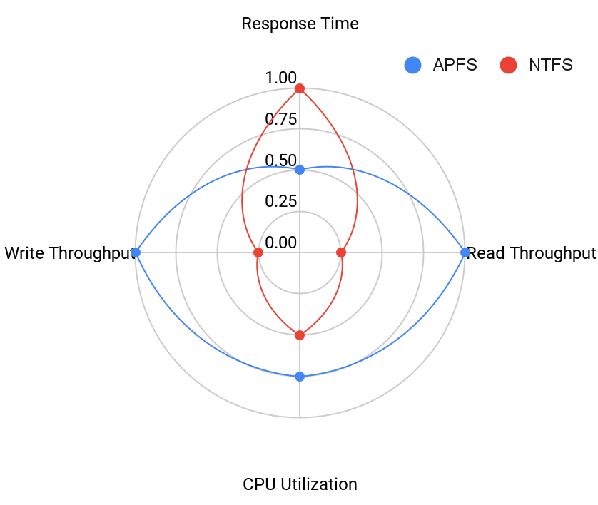
Lower Response Time
Higher Read Throughput
Lower CPU Utilization
Write Throughput
Using ANOVA,
Interaction due to File Size = 64.77 % Interaction due to Processor = 15.20 %

Slide 13
Questions ?

