Slide 1
End-to-End Geospatial Data Analysis of Urban Heat Island Dynamics in Uyo LGA
A Decadal Multi-Temporal Remote Sensing Framework (2016–2025)
Department: Department of Computer Science
Host Organization: Advanced Space Technology And Applications Laboratories, Uyo, Akwa Ibom State
Project Type: Industrial Training (IT) Defence Presentation

Slide 2
Abstract, Dedication & Acknowledgements
ACADEMIC PRELIMINARIES
Abstract
Rapid urbanization in Uyo Local Government Area has accelerated the replacement of natural vegetation with impervious surfaces. This framework utilizes Landsat 8/9 satellite remote sensing across a 9-year decadal window (2016–2025) to quantify the Surface Urban Heat Island (SUHI) effect. By computing NDVI, NDBI, MNDWI, and LST, this study models microclimate heating and cooling dynamics and delivers results via an interactive web dashboard.
Dedication
Dedicated to sustainable, data-driven urban planning in Nigeria and to every young analyst learning to turn satellite observations into actionable environmental protection decisions.
Acknowledgements
I appreciate my academic supervisors and the Department of Computer Science for guidance. Special thanks go to the board of management and staff of Advanced Space Technology And Applications Laboratories, Uyo, Akwa Ibom State, for the placement opportunity and mentorship.

Slide 3
Project Introduction & Research Framing
PROJECT FOUNDATION
Project Aim
To develop a reproducible Python-based geospatial analytics framework that quantifies Surface Urban Heat Island patterns in Uyo LGA using Landsat 8/9 Level-2 data, and delivers results through an interactive web application.
Research Questions
1. What is the spatial pattern and intensity of daytime land surface temperature across Uyo LGA?
2. How have vegetation canopy (NDVI) and built-up density (NDBI) signals shifted across epochs (2016–2025)?
3. How strongly do vegetation density and impervious surfaces explain microclimate temperature variation?
4. How can satellite data products be deployed into interactive tools for decision-makers?

Slide 4
Industrial Training & Computer Science Relevance
HOST ALIGNMENT
Host Organization Alignment
• Carried out at Advanced Space Technology And Applications Laboratories, Uyo, Akwa Ibom State.
• Aligns directly with operational Earth Observation (EO) and Geospatial Information Systems (GIS) workflows.
Computer Science & Software Engineering Contribution
• Automated Framework vs Manual GIS: Replaces non-reproducible manual software clicks with a 100% automated Python data framework.
• Open-Source Ecosystem: Built entirely with Python (Rasterio, GeoPandas, PySTAC, Plotly, Streamlit), eliminating expensive software licensing bottlenecks.
• Cloud Deployment: End-to-end integration from Google Colab cloud processing to VS Code local execution and 24/7 Streamlit Cloud hosting.

Slide 5
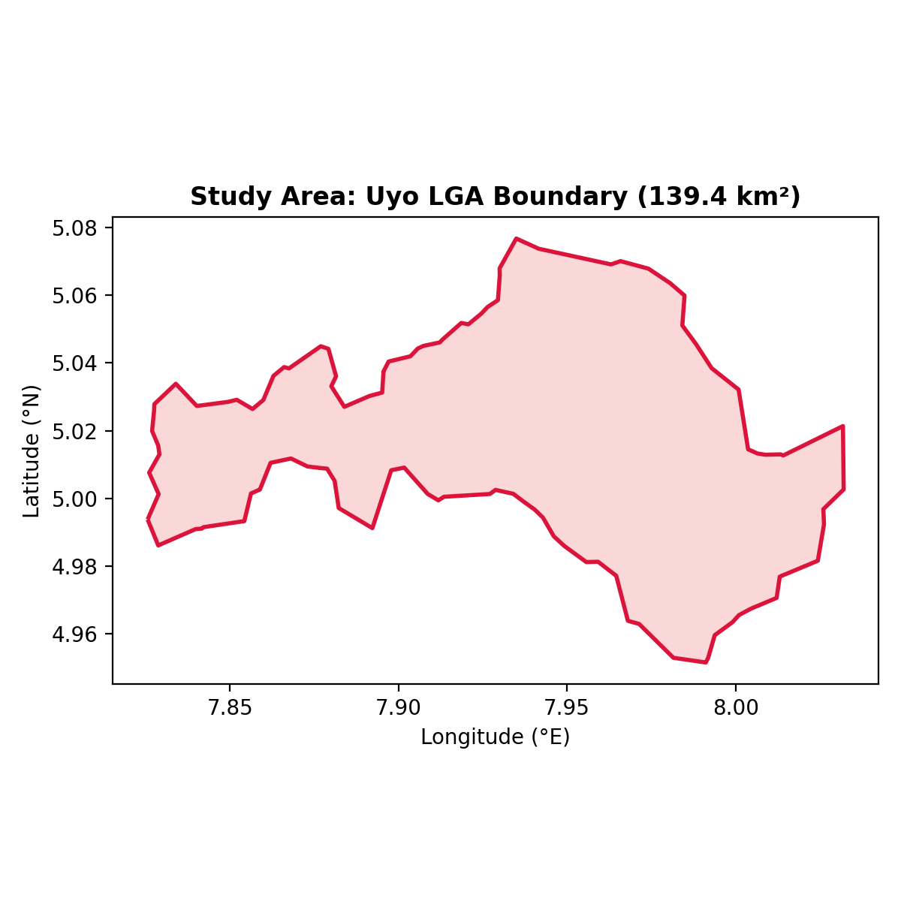
Study Area Boundary & Dataset Specifications
DATA FRAMEWORK
Study Area Specifications
• Location: Uyo Local Government Area (LGA), Akwa Ibom State (~139.41 km²).
• Spatial CRS: EPSG:4326 (Display), UTM Zone 32N / EPSG:32632 (Analysis).
Satellite Dataset & Quality Control
• Source: USGS Landsat 8/9 Collection 2 Level-2 Surface Reflectance + Thermal (ST_B10).
• 4 Dry-Season Epochs: Jan 04, 2016 | Jan 15, 2019 | Jan 24, 2022 | Jan 12, 2025.
• QA Bitmasking: Applied bitmask filtering on QA_PIXEL to mask cloud and shadow artifacts.

Slide 6
Geospatial Index Formulations & Scale Factors
METHODOLOGY
USGS Level-2 Radiometric Scaling
• Surface Reflectance: SR = DN × 0.0000275 - 0.2
• Land Surface Temperature (°C): LST = (DN × 0.00341802 + 149.0) - 273.15
Spectral Formulations
• Vegetation Index (NDVI): (NIR - Red) / (NIR + Red) --> Landsat B5 & B4
• Built-up Index (NDBI): (SWIR1 - NIR) / (SWIR1 + NIR) --> Landsat B6 & B5
• Water Index (MNDWI): (Green - SWIR1) / (Green + SWIR1) --> Landsat B3 & B6
• Thermal Variance (UTFVI): (LST - Mean_LST) / LST

Slide 7
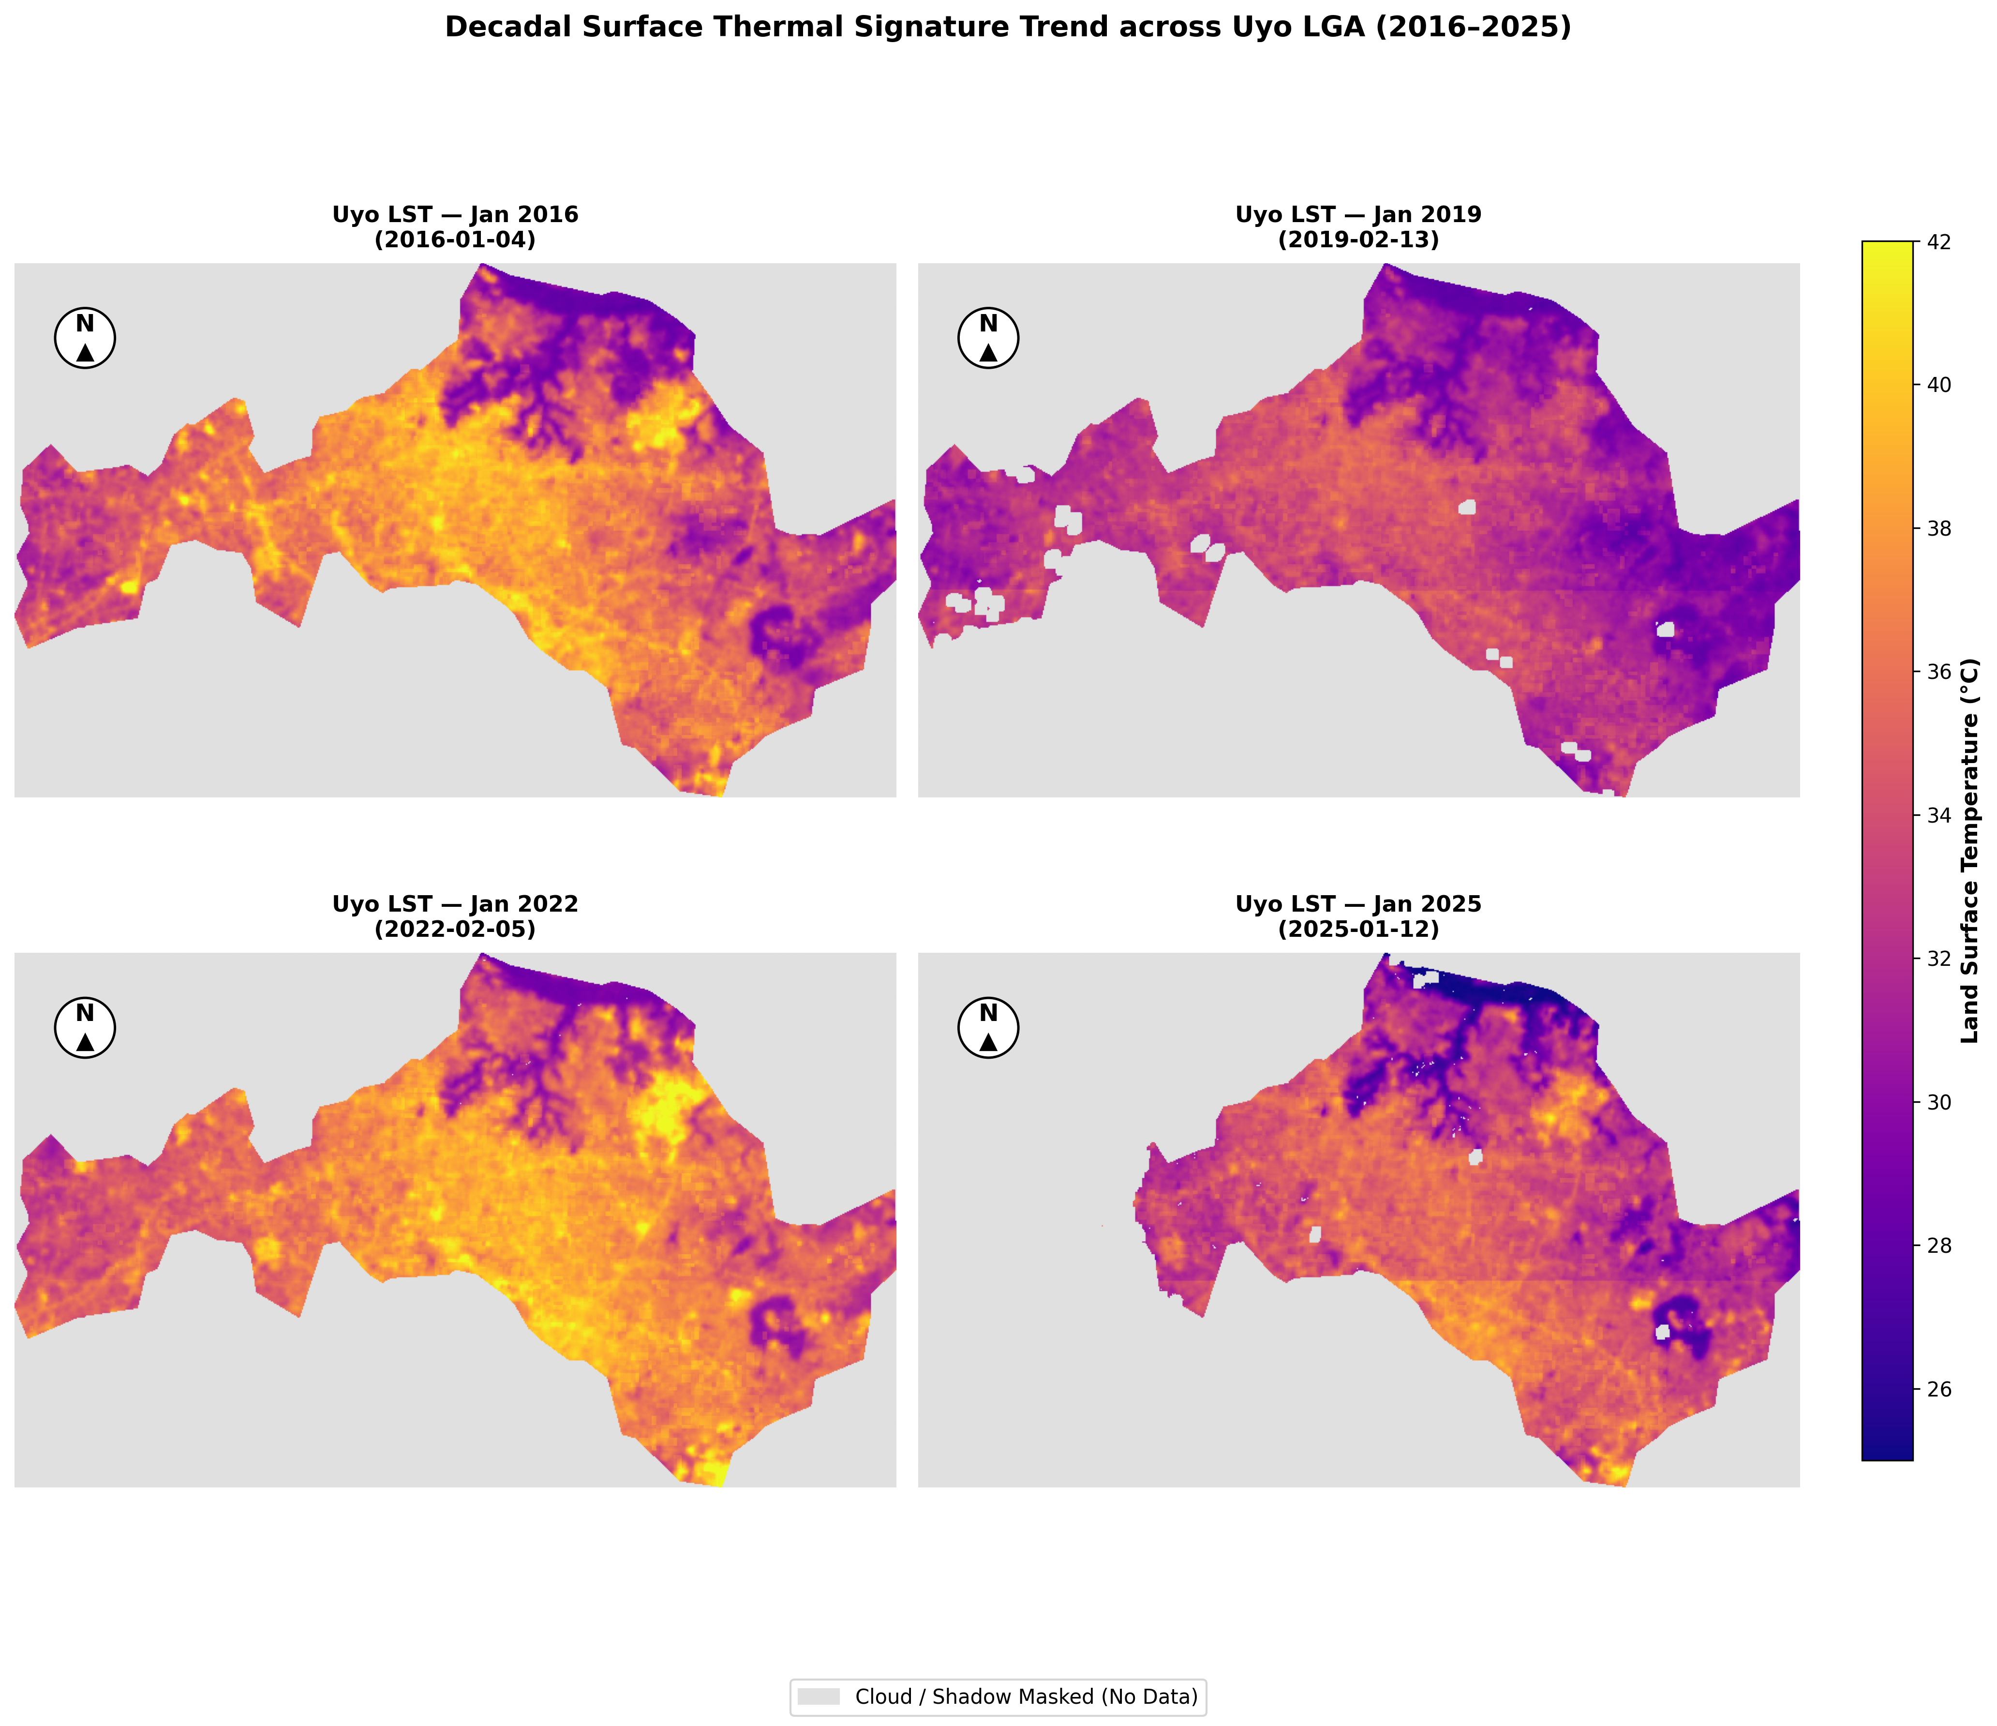
Decadal Spatial Thermal Signatures (2016, 2019, 2022, 2025)
SPATIAL MAPS
All 4 Epochs Included:
• 2x2 Composite Grid showing 2016, 2019, 2022, and 2025 side-by-side.
• Cartographic Elements: Titles, North Arrows (N ▲), Scale Bar (°C), Gray Cloud Mask Key.
Thermal Observations:
• Bright yellow/white-hot zones (>38°C) concentrate in urban cores.
• Vegetated peripheries stay cool (26–30°C).

Slide 8
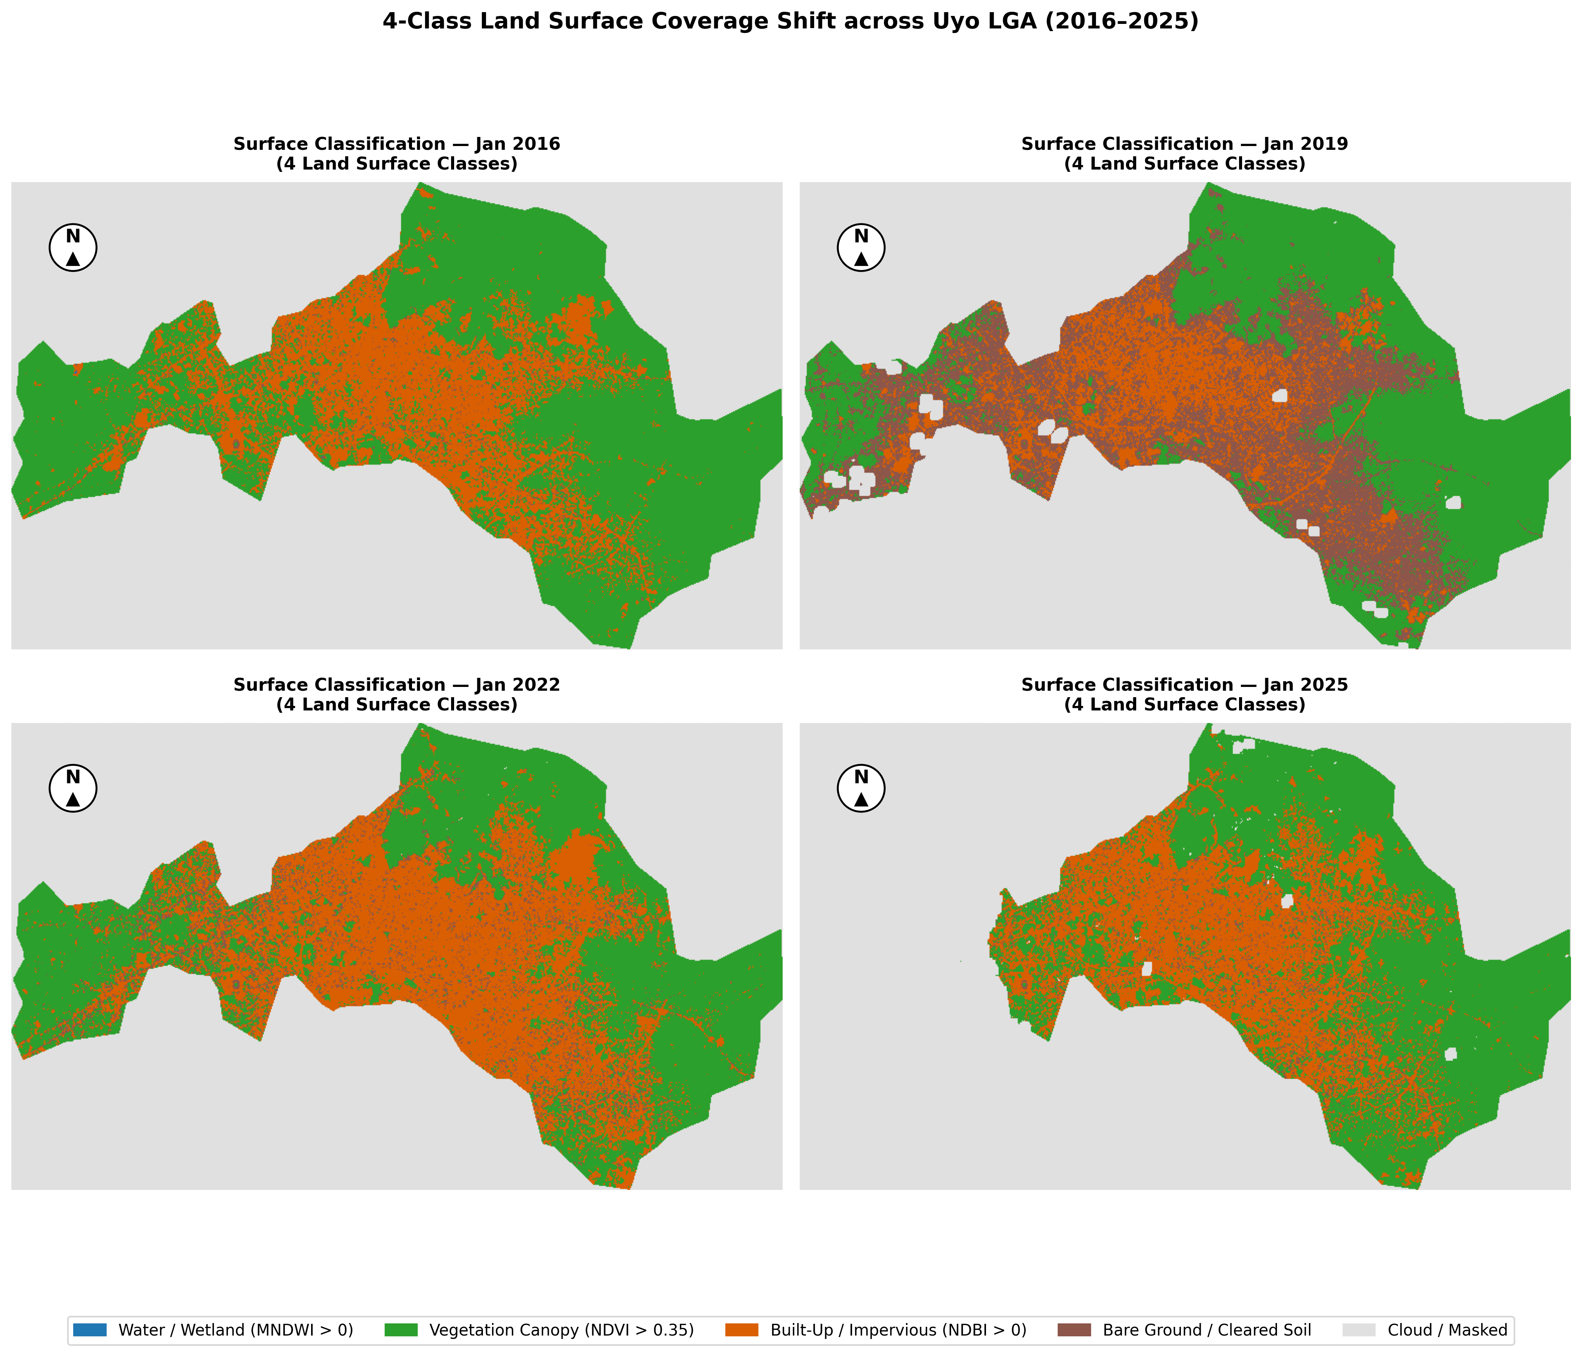
4-Class Land Surface Coverage (2016, 2019, 2022, 2025)
SURFACE CLASSIFICATION
4 Surface Categories:
• 🟩 Vegetation Canopy
• 🟧 Built-Up Infrastructure
• 🟫 Bare Soil / Cleared Land
• 🟦 Water Bodies / Wetland
Thermal Contrast:
• Built-up & Bare Soil record higher mean LST than Vegetation.
• Open water is modest due to sub-pixel mixing of narrow streams at 30 m resolution.

Slide 9
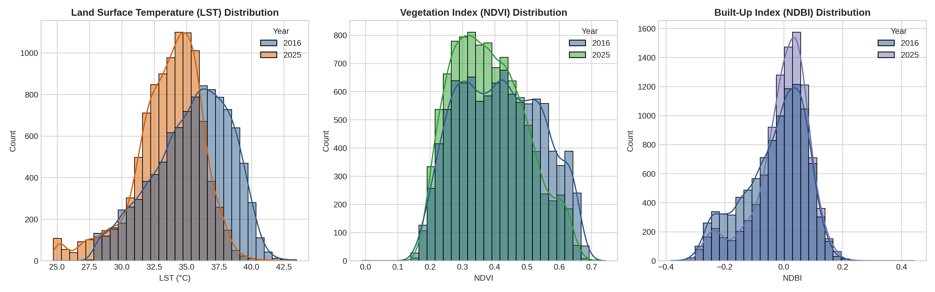
Decadal Trajectory: Built-Up Expansion vs Canopy Loss
RESULTS & TRENDS
Quantitative Metrics (2016 vs 2025):
• Built-up Growth: Mean NDBI increased from -0.031 (2016) to -0.005 (2025) [Δ = +0.026], confirming infrastructure expansion.
• Canopy Loss: Mean NDVI dropped from 0.418 (2016) to 0.382 (2025) [Δ = -0.036], reflecting forest clearing.
• Core Insight: Rising NDBI combined with falling NDVI demonstrates structural landscape shift driving microclimate warming.

Slide 10
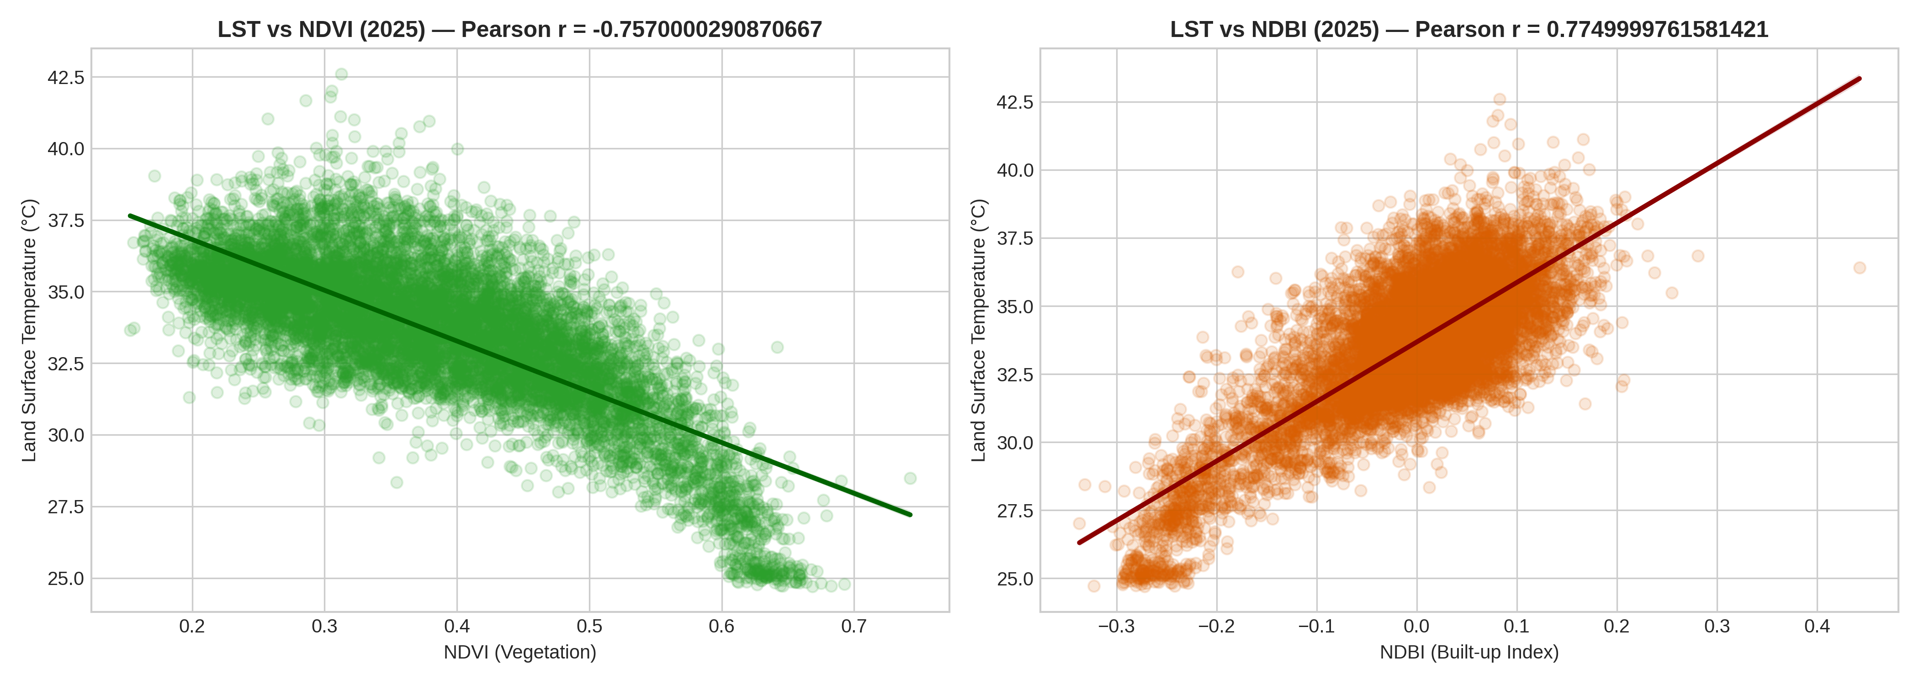
Microclimate Statistical Modeling (OLS Regression)
STATISTICAL EVIDENCE
Mathematical Proof of Behavior:
• 🟩 LST vs NDVI (Vegetation): Negative slope. Proves mathematically that as vegetation density increases, surface temperature decreases (Surface Cooling).
• 🟧 LST vs NDBI (Built-Up): Positive slope. Proves mathematically that as built-up density increases, surface temperature increases (Surface Heating).

Slide 11
Software Architecture & 24/7 Cloud Deployment
SYSTEM ARCHITECTURE
End-to-End System Framework:
1. Google Colab: High-speed cloud raster extraction via Planetary Computer STAC API.
2. Visual Studio Code (VS Code): Local modular software development & Git integration.
3. GitHub Repository: Public open-source repository (github.com/blossomsplendour-cpu/uyo_uhi).
4. Streamlit Community Cloud: 24/7 live web deployment.

Slide 12
Scientific Limitations & Urban Planning Recommendations
CONCLUSION
Stated Scientific Limitations:
• LST vs Air Temp: Satellites measure radiometric skin surface temperature (~10:30 AM overpass), not 2 m ambient air temperature.
• Snapshot Timing: Observations reflect mid-morning dry-season overpass conditions.
Planning Recommendations:
• Targeted Urban Greening: Mandate green buffers along expanding road corridors (e.g., Uyo Ring Roads).
• Framework Scalability: Operationalize this automated Python framework at Advanced Space Technology And Applications Laboratories for low-cost city monitoring.

Slide 13
Academic References & Standards
REFERENCES
Formal Literature Citations:
• United States Geological Survey (USGS). (2021). Landsat 8-9 Collection 2 Level-2 Science Products. USGS Earth Resources Observation and Science Center.
• Tucker, C. J. (1979). Red and photographic infrared linear combinations for monitoring vegetation. Remote Sensing of Environment, 8(2), 127-150.
• Zha, Y., Gao, J., & Ni, S. (2003). Use of normalized difference built-up index in automatically mapping urban areas from TM imagery. International Journal of Remote Sensing, 24(3), 583-594.
• Xu, H. (2006). Modification of normalised difference water index (NDWI) to enhance open water features in remotely sensed imagery. International Journal of Remote Sensing, 27(14), 3025-3033.
• Voogt, J. A., & Oke, T. R. (2003). Thermal remote sensing of urban climates. Remote Sensing of Environment, 86(3), 370-384.

Slide 14
Thank You!
Questions & Answers
🌐 CLICK HERE TO LAUNCH LIVE DASHBOARD
https://uyouhi-iayygetbmnholngdvqjmdv.streamlit.app/

