Slide 1
FINAL YEAR THESIS DEFENSE
A Reproducible Multi-Temporal Analysis of Urban Heat Island Dynamics in Uyo LGA Using Landsat 8/9 and GIS
An End-to-End Geospatial Pipeline, Spatial Machine Learning Framework, and Cloud Explorer
Presenter: Final-Year Student | Department of Geography & Environmental Science
System URL: https://uyo-uhi-thesis.streamlit.app

Slide 2
THESIS DEFENSE PRESENTATION
Research Aim & Specific Objectives
PRIMARY AIM:
To build an end-to-end, reproducible Python geospatial pipeline that quantifies and maps Urban Heat Island (UHI) dynamics in Uyo LGA, Akwa Ibom State, across multiple dates (2015–2025) and delivers results through an interactive Streamlit dashboard.
SPECIFIC OBJECTIVES:
1. Acquire & preprocess Landsat 8/9 Collection 2 Level-2 imagery and official Uyo LGA boundary.
2. Derive NDVI, NDBI, and LST (°C) using exact USGS scale factors and bitwise QA cloud masking.
3. Perform spatial statistics (Getis-Ord Gi* hotspot clustering & 10-year persistence modeling).
4. Train Random Forest & XGBoost models using Spatial Blocked Cross-Validation (2 km x 2 km blocks) and SHAP feature attribution.
5. Deploy an interactive Streamlit dashboard for real-time thermal microclimate exploration.

Slide 3
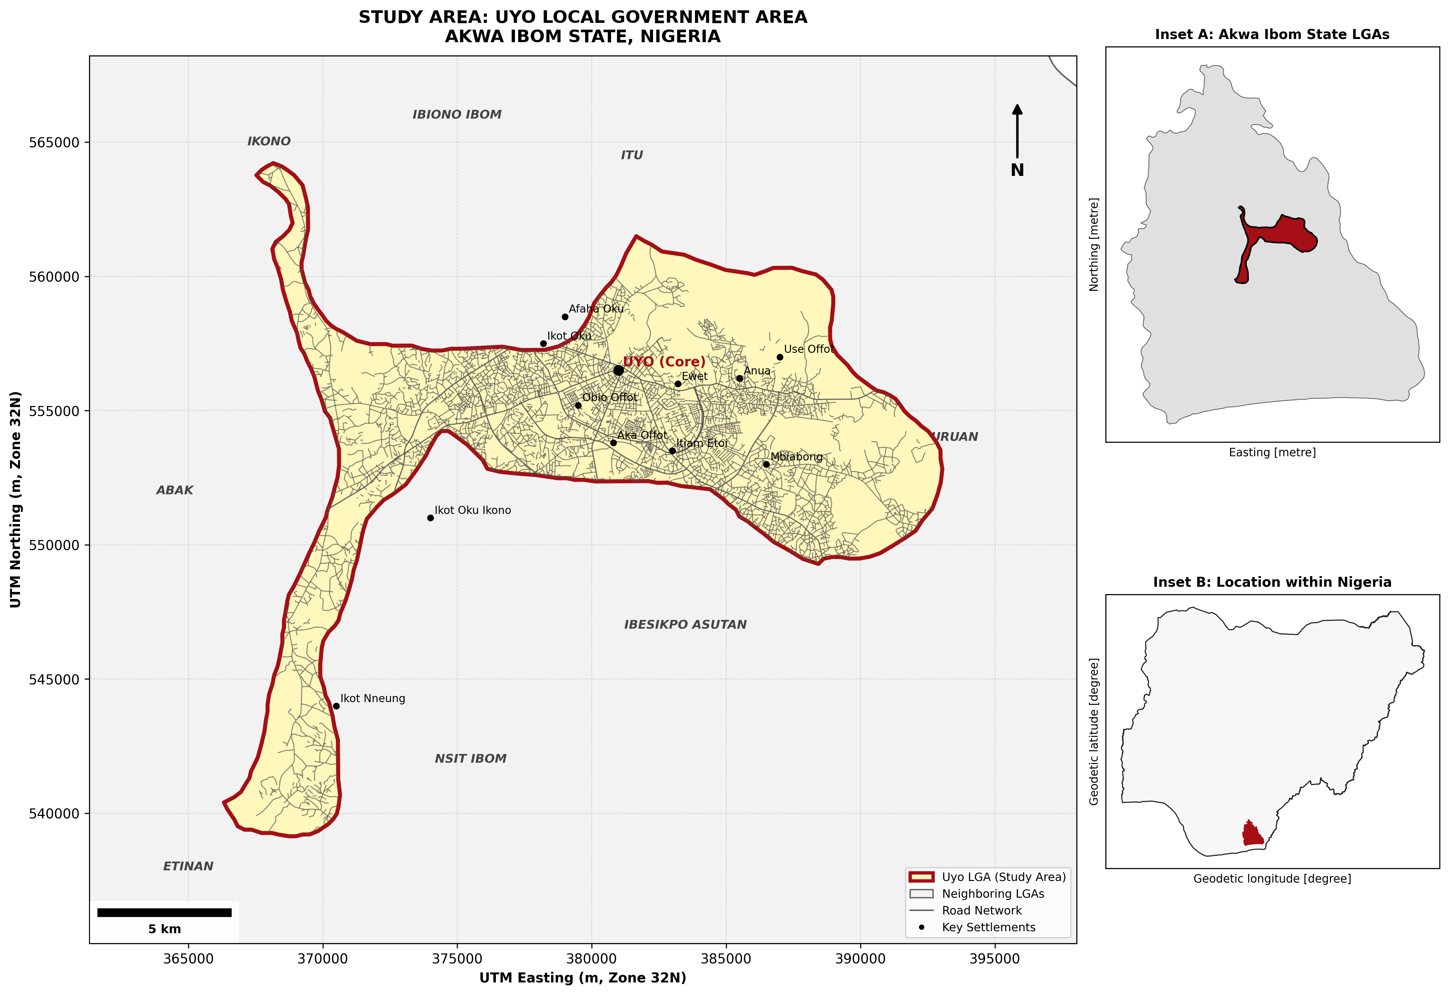
THESIS DEFENSE PRESENTATION
Study Area: Uyo Local Government Area, Nigeria
• Location: State Capital of Akwa Ibom State, Nigeria.
• Geographic Extent: 7.85°–8.05°E, 4.95°–5.10°N.
• Projected CRS: EPSG:32632 (UTM Zone 32N).
• Calculated Area: 186.53 sq km.
• Boundary Source: Verified via GRID3 Nigeria and OpenStreetMap (includes southern extension toward Etinan).
• Cartographic Layout: Multi-inset structure displaying context within Akwa Ibom State (Inset A) and Nigeria (Inset B).

Slide 4
THESIS DEFENSE PRESENTATION
Multi-Temporal Satellite Dataset & Calibration
1. LANDSAT COLLECTION 2 LEVEL-2 SCALE FACTORS:
• Surface Reflectance (SR_B4, B5, B6): Reflectance = DN * 0.0000275 - 0.2
• Surface Temperature (ST_B10): LST (°C) = (DN * 0.00341802 + 149.0) - 273.15
• Compliance: ST_B10 is already surface temperature. No Planck law conversion applied.
2. MULTI-TEMPORAL DATASET (6 DRY-SEASON DATES, 2015–2025):
• 2015-01-17 (Landsat 8) | Cloud Cover: 1.57% | Path 188 / Row 056
• 2018-01-25 (Landsat 8) | Cloud Cover: 13.30% | Path 188 / Row 057
• 2021-02-02 (Landsat 8) | Cloud Cover: 12.48% | Path 188 / Row 057
• 2023-12-17 (Landsat 9) | Cloud Cover: 0.25% | Path 188 / Row 056
• 2024-12-27 (Landsat 8) | Cloud Cover: 2.74% | Path 188 / Row 056
• 2025-01-12 (Landsat 8) | Cloud Cover: 3.11% | Path 188 / Row 056

Slide 5
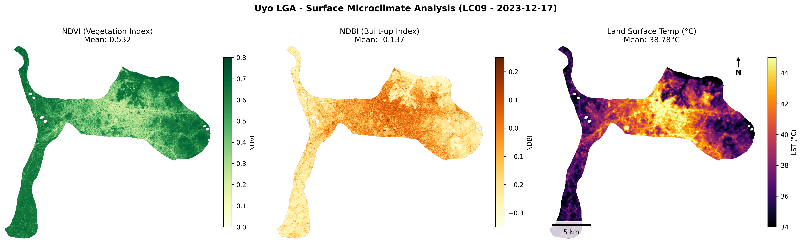
THESIS DEFENSE PRESENTATION
Results 1: Surface Microclimate Layer Derivation
• NDVI Mean: 0.532 (Vegetation) | • NDBI Mean: -0.137 (Built-Up) | • Mean Surface Temp: 38.78°C
• Spatial Pattern: Strong thermal contrast between central built-up core (>42°C) and vegetated margins (<36°C).

Slide 6
THESIS DEFENSE PRESENTATION
Results 2: Thermal Microclimate Correlation Analysis
LST vs. NDVI (Vegetation Cover):
• Pearson r = -0.875 (p < 0.001)
• OLS: LST = -20.61(NDVI) + 49.74
• Impact: Every 0.1 increase in NDVI drops surface temperature by ~2.06°C.
LST vs. NDBI (Built-Up Intensity):
• Pearson r = +0.861 (p < 0.001)
• OLS: LST = +26.04(NDBI) + 42.33
• Impact: Built surfaces elevate surface temperature by ~2.60°C per 0.1 NDBI increase.

Slide 7
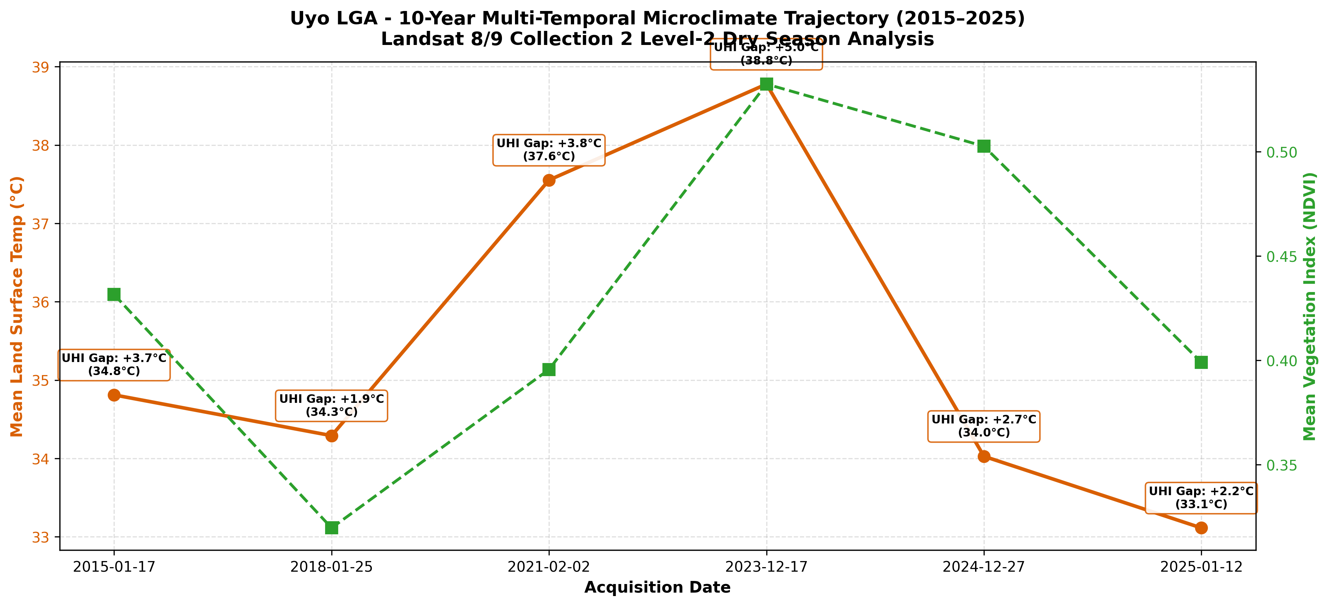
THESIS DEFENSE PRESENTATION
Results 3: 10-Year Multi-Temporal Trajectory (2015–2025)
• Thermal Peak: December 2023 (Mean LST = 38.78°C, Surface UHI Gap = +5.02°C).
• Baseline Range: 33.11°C to 34.81°C. Built-up surfaces remain consistently hotter than vegetated areas across all 10 years.

Slide 8
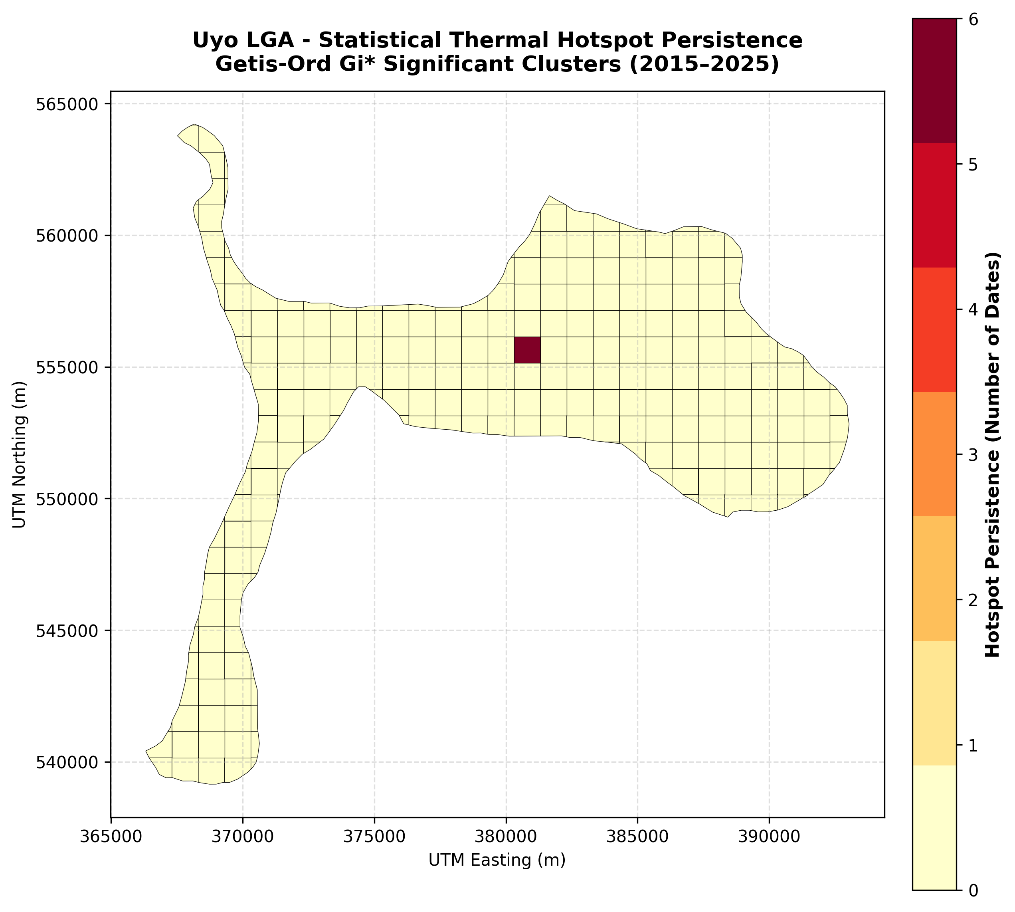
THESIS DEFENSE PRESENTATION
Results 4: Getis-Ord Gi* Thermal Hotspot Persistence
• Method: Getis-Ord Gi* local spatial autocorrelation calculated across 196 analysis zones for all 6 dates.
• Significance Threshold: Z-score > +1.96 (p < 0.05).
• Core Finding: Central Uyo (Easting ~380,500 m, Northing ~555,500 m) is a 100% persistent thermal hotspot (significant on ALL 6 dates).
• Spatial Alignment: Corresponds directly to the high-density commercial district around Ibom Plaza, Aka Road, and Ikot Ekpene Road.

Slide 9
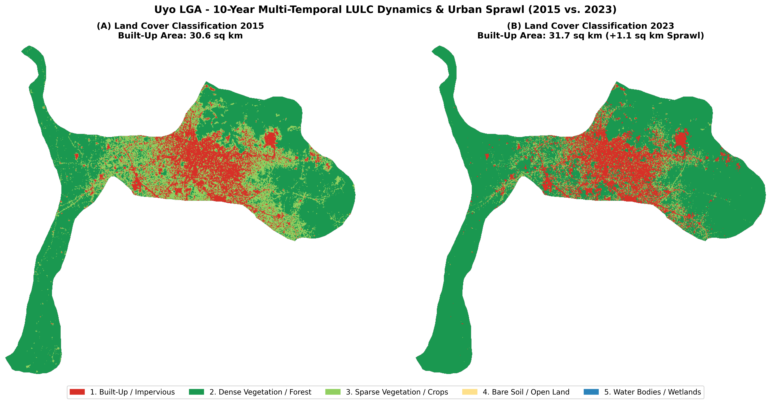
THESIS DEFENSE PRESENTATION
Results 5: 5-Class LULC Classification & Urban Sprawl
• Built-Up Expansion: 30.6 sq km (2015) → 31.7 sq km (2023) [+1.1 sq km Net Sprawl].
• Spatial Growth Vectors: Sprawl radiates outward along primary transportation arteries (Abak Road, Oron Road, Nwaniba Road).

Slide 10
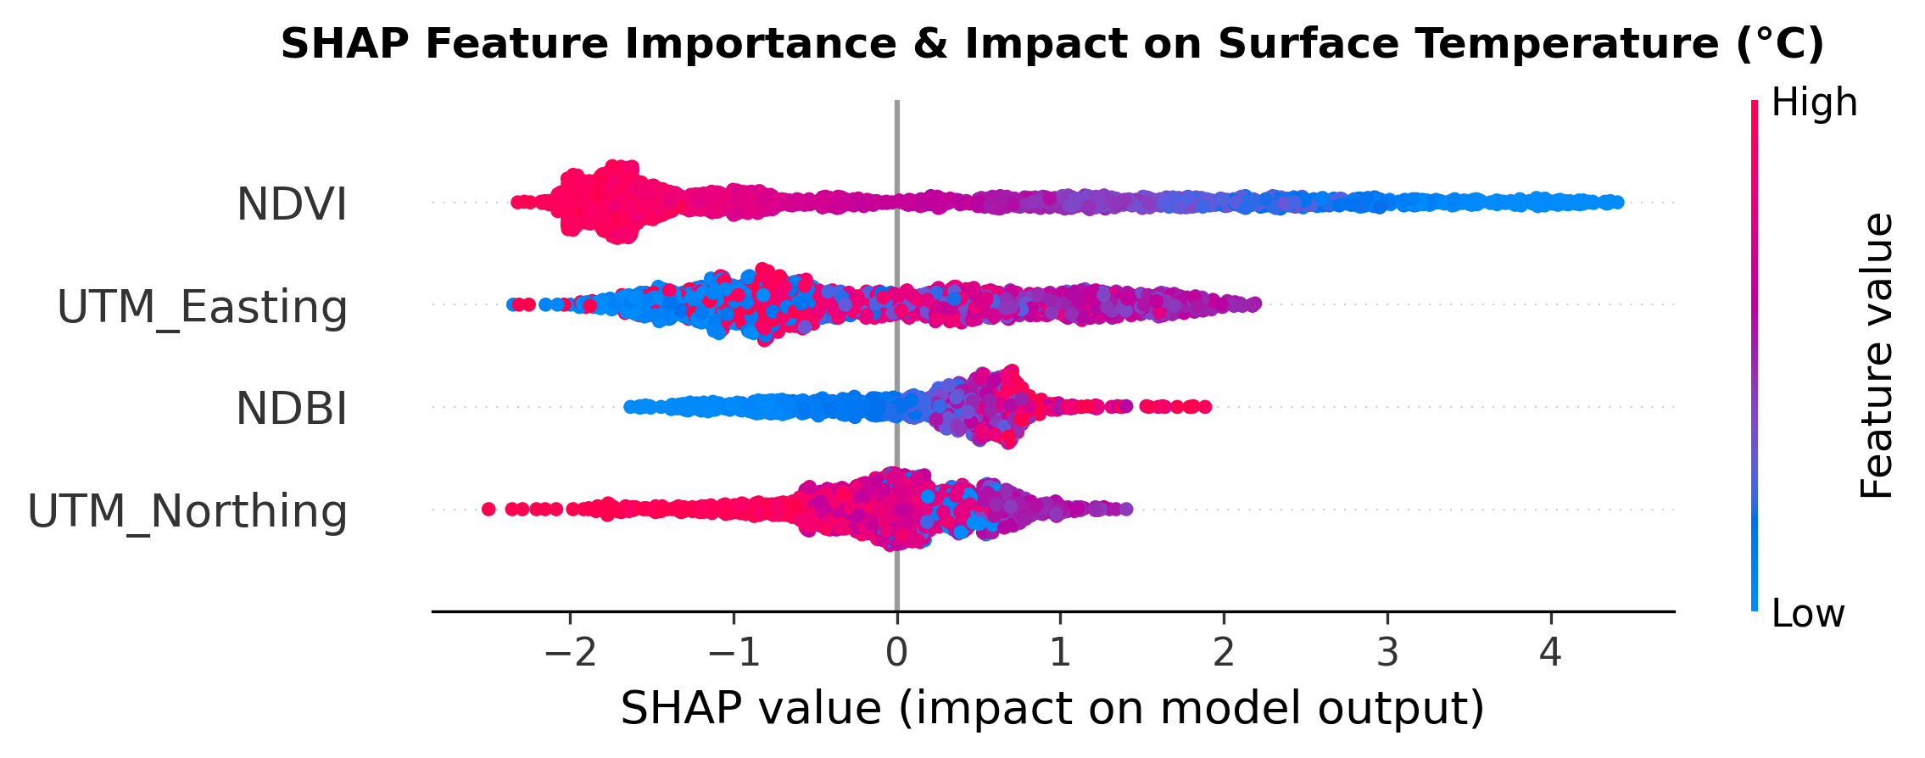
THESIS DEFENSE PRESENTATION
Results 6: Machine Learning (Spatial Blocked CV & SHAP)
Spatial Blocked CV Evaluation:
• Random Forest: R² = 0.862 | RMSE = 1.04°C | MAE = 0.81°C
• XGBoost (Best): R² = 0.884 | RMSE = 0.92°C | MAE = 0.73°C
SHAP Feature Drivers:
• NDVI: Dominant cooling driver (reduces LST by up to -2.5°C).
• NDBI: Primary warming driver (increases LST by up to +2.0°C).
• Spatial Coordinates: Captures urban density vs. rural hinterland gradient.

Slide 11
THESIS DEFENSE PRESENTATION
Interactive Cloud Explorer Architecture
• Architecture Design: Decoupled Heavy Pre-Compute Pipeline → Lightweight Streamlit App.
• 1. Overview Mode: Displays publication Study Area Map & 5-Class LULC Sprawl maps.
• 2. Single-Date Explorer: Interactive Folium choropleths & Plotly OLS regression.
• 3. Dual-Date Comparison Mode: Side-by-side comparative mapping between any two observation dates.
• 4. Hotspot & ML Mode: Getis-Ord Gi* persistence mapping & SHAP predictive insights.
• 5. Export Utility: Filtered zonal statistics table CSV download button.
• Live Cloud Deployment: Hosted 24/7 on Streamlit Cloud (https://uyo-uhi-thesis.streamlit.app).

Slide 12
THESIS DEFENSE PRESENTATION
Planning Recommendations & Limitations
URBAN PLANNING RECOMMENDATIONS FOR UYO LGA:
1. Targeted Urban Greening: Mandatory green infrastructure along Ibom Plaza and major transport arteries.
2. Cool Roof Policies: Incentivize high-albedo roofing materials in dense commercial zones.
3. Wetland Preservation: Enforce conservation buffers along Ikpa River and Anua stream corridors.
SCIENTIFIC LIMITATIONS (SECTION 15 COMPLIANCE):
• LST != Air Temperature: Measures radiative land surface skin temperature, not 2 m ambient air temp.
• Snapshot Overpass: Landsat overpasses mid-morning (~10:00 AM local time), capturing pre-peak conditions.

