Slide 1
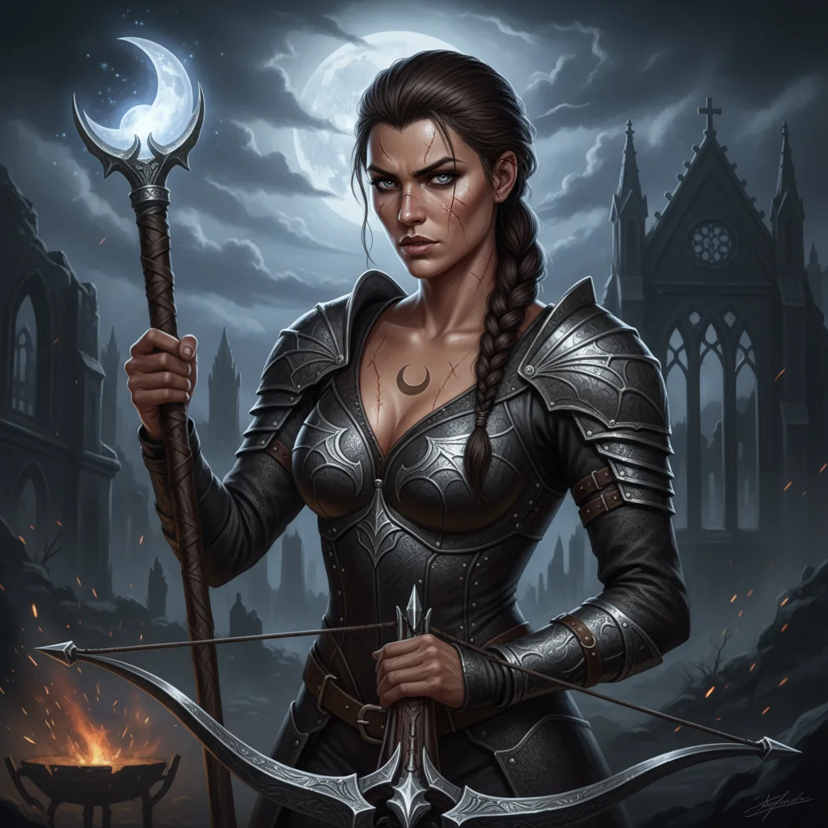
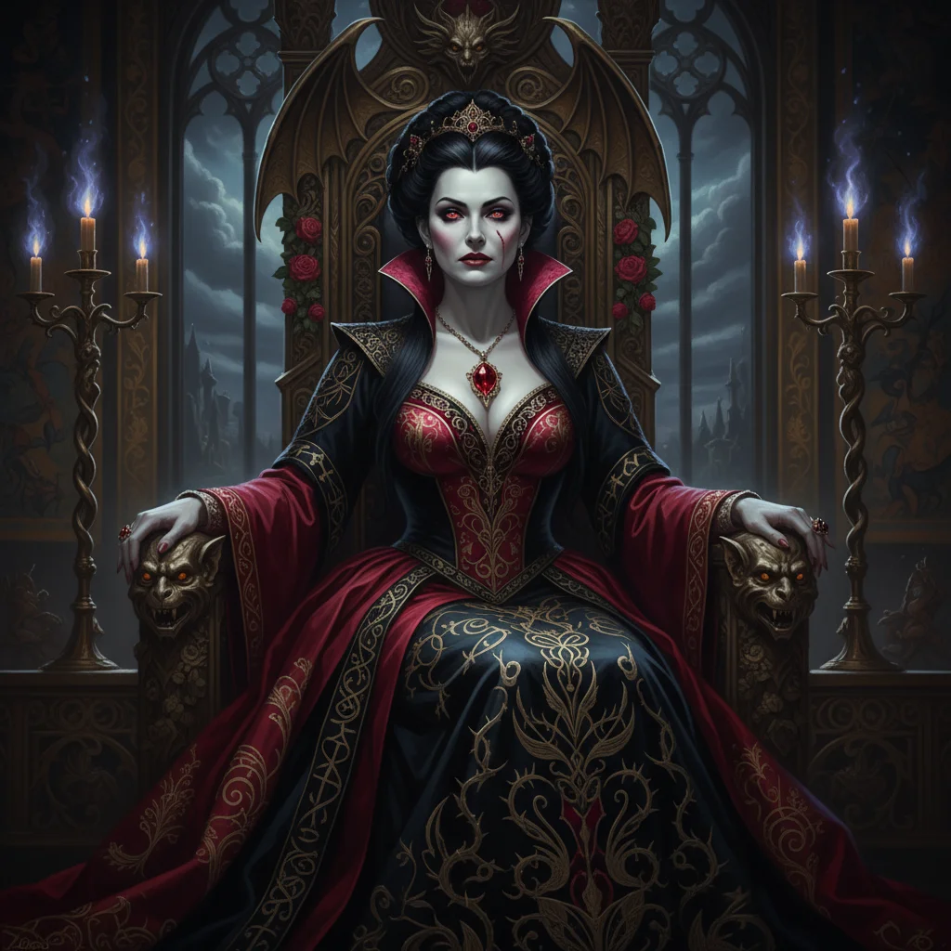
BLOOD ASSASSIN
A Dark Fantasy Novel
When prophecy and blood collide, even monsters must choose their humanity

Slide 2
A WORLD DIVIDED BY BLOOD
THE CRIMSON COURT
Vampire aristocracy ruling from shadows • Centuries of dominance • Queen Lysandria's iron grip
THE ORDER OF THE DAGGER
Elite vampire hunters • Sworn to protect humanity • Harbor dangerous secrets
THE MORTAL REBELLION
Fighting for freedom • Led by pragmatic warriors • The cost of resistance
THE BLOODBOUND PROPHECY
"One of mixed blood shall bridge the divide or bring eternal night"

Slide 3
UNFORGETTABLE CHARACTERS
ELARA NIGHTSHADE
The Chosen Hunter
• Raised by vampire hunters • Discovers her mixed bloodline • Must master both sides of her nature • Torn between duty and destiny
QUEEN LYSANDRIA
The Paranoid Tyrant
• Rules through fear • Obsessed with control • Sees Elara as ultimate threat • Her paranoia becomes prophecy
SUPPORTING CAST
SERAPHIEL - Fallen celestial guide • VALERIA - Double agent spy • CAELUM - Betraying mentor
MARA - Exiled vampire rebel • LYS - Pragmatic rebel leader • ARDYN - The quiet anchor

Slide 4
EVERYTHING IS AT STAKE
PERSONAL STAKES
• Identity shattered by bloodline revelation
• Betrayal by trusted mentor
• Fight to retain humanity
• Love threatened by prophecy
WORLD STAKES
• The Nightbringer threatens eternal stasis
• War between vampires and mortals
• Collapse of the fragile Twilight Accord
• The fate of two species

Slide 5
THEMES THAT RESONATE
IDENTITY & DUALITY
Who are we beyond our blood and birthright?
POWER & PARANOIA
How fear of losing control becomes self-fulfilling prophecy
TRUST & VULNERABILITY
The courage required to let others in
REDEMPTION
Everyone deserves the chance to rewrite their story
CHOICE VS DESTINY
Can we escape prophecy through free will?

Slide 6
PERFECT FOR TODAY'S MARKET
TARGET READERS
Adults 25-45
Dark fantasy enthusiasts
Vampire fiction fans
Readers who love:
• Morally gray protagonists
• Political intrigue
• Prophecy narratives
• Found family dynamics
COMPARABLE TITLES
For fans of:
• Sarah J. Maas
• Holly Black
• Leigh Bardugo
Meets the mood of:
• Castlevania
• The Witcher
• Underworld

Slide 7
A TRILOGY WITH FRANCHISE POTENTIAL
BOOK ONE: BLOOD ASSASSIN
Elara discovers her heritage • Confronts the Nightbringer • Shatters the status quo
BOOK TWO: CRIMSON PROPHECY
New alliances form • Ancient secrets revealed • The true enemy emerges
BOOK THREE: TWILIGHT THRONE
Unite or perish • Elara's ultimate choice • Redefine both worlds
SPIN-OFF OPPORTUNITIES
• Seraphiel's celestial fall • Mara's rebellion origin • The Order's dark history • Lysandria's rise to power

Slide 8
THE HUNT BEGINS
BLOOD ASSASSIN
A story where monsters and heroes are often the same person

