Slide 1

Web Based Stall Management System for Center Point
Alegado, Winly John B.
Balbastro, Danislyn G.
Ramos, John Lloyd B.
Jumuad, Arjie C.
Researchers
Waien G. Watamama
Adviser

Slide 2
GENERAL OBJECTIVE
To design and develop a web-based stall management system for Center Point, using Laravel 12 and Livewire 3, that improves efficiency, transparency, security, and access through automated billing, online payments, real-time communication, analytics, and tenant self-service.

Slide 3
BACKGROUND OF THE STUDY
• Center Point managed stalls with logbooks, paper receipts, and physical folders
• Payments were tracked by hand, causing errors and slow verification
• Tenants had no access to their own balances, receipts, or contracts
• No online way to apply for a stall, and no alerts for expiring leases
• Administrator accounts had no extra layer of security

Slide 4
SCOPE
• Users: Administrator, Tenant, and visitors who are not signed in
• Stall, floor, lease, and tenant account management
• Automated billing, PayMongo payments, receipts, statements of account
• Support tickets with chat, announcements, notifications by email and SMS
• Reports, calendar, global search, audit logs, and encrypted backups

Slide 5
LIMITATION
• Needs a stable internet connection for payments, email, and SMS
• No electricity/water billing, late-payment penalties, or partial payments
• Grid-based floor map; very irregular layouts may not fit exactly
• Two-Factor Authentication is for administrator accounts only
• Backups are stored on the same server unless copied elsewhere

Slide 6
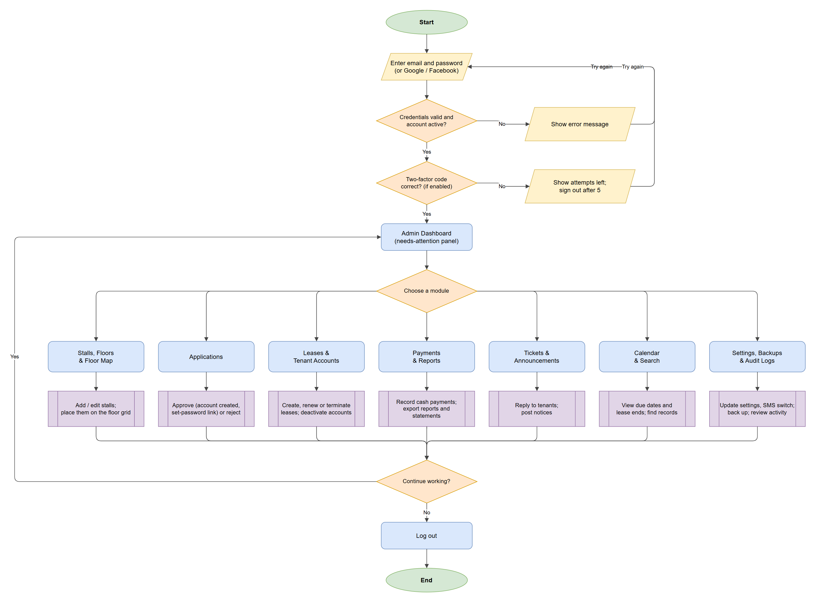
RESULTS AND DISCUSSION
• 340 automated tests — all passing
• Zero security-policy violations in the browser
• Code review findings fixed and tested
• One web platform replaced the logbooks

Slide 7
CONCLUSION
• The system replaced manual stall management with a centralized platform
• Automated invoicing, reminders, and online payments reduced errors and delays
• Tenants and applicants gained self-service access and clear communication
• Layered security and encrypted backups protect tenant and financial data
• All general and specific objectives were achieved

Slide 8
RECOMMENDATION
• Develop a mobile app for tenants
• Support multiple branches or locations
• Copy backups to off-site storage automatically
• Upgrade to Livewire 4 for a stricter security policy
• Offer Two-Factor Authentication to tenants

Slide 9
Thank you!

