Slide 1

Web Based Stall Management System for Center Point
Angcap, Crisandra Mae B.
Malongo, Alvin A.
Pasiol, Jasper R.
Sagga, Mark G.
Else, Jhack L.
Fiel, Jay-ar T.
Researchers
[Adviser’s Name]
Adviser

Slide 2
BACKGROUND & OBJECTIVE
• Center Point tracked stalls, leases, and payments in logbooks and paper folders
• Manual records led to payment errors, slow checking, and missed lease expirations
• Tenants could not see their own balances, receipts, or contracts
• Objective: a Laravel 12 and Livewire 3 web system with automated billing, online payments, and tenant self-service

Slide 3
SCOPE & LIMITATIONS
• Users: the administrator, tenants, and visitors who are not signed in
• Covers stalls, the floor map, leases, billing, payments, tickets, reports, and backups
• Needs a stable internet connection for payments, email, and SMS
• No utility billing, late-payment penalties, or partial payments
• Two-factor authentication covers administrator accounts only

Slide 4
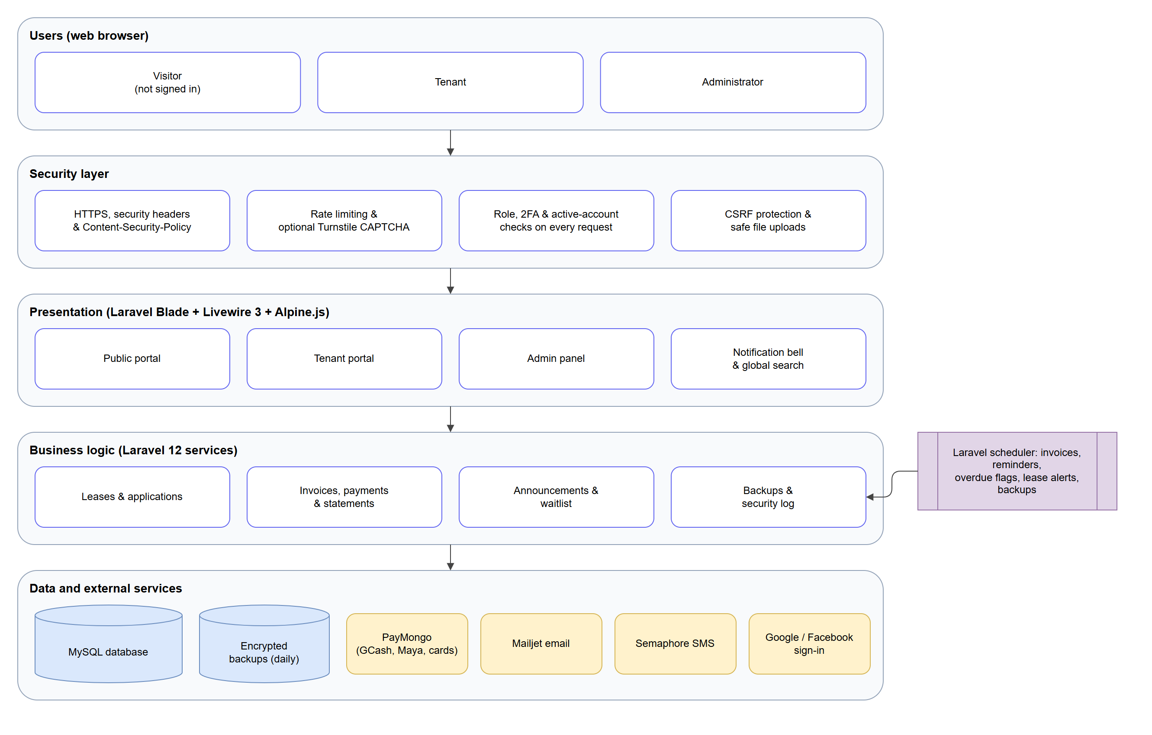
SYSTEM ARCHITECTURE
• Every request passes the security layer first
• Livewire 3 pages run on Laravel 12 services
• MySQL database with encrypted daily backups
• PayMongo, Mailjet, Semaphore, Google and Facebook

Slide 5
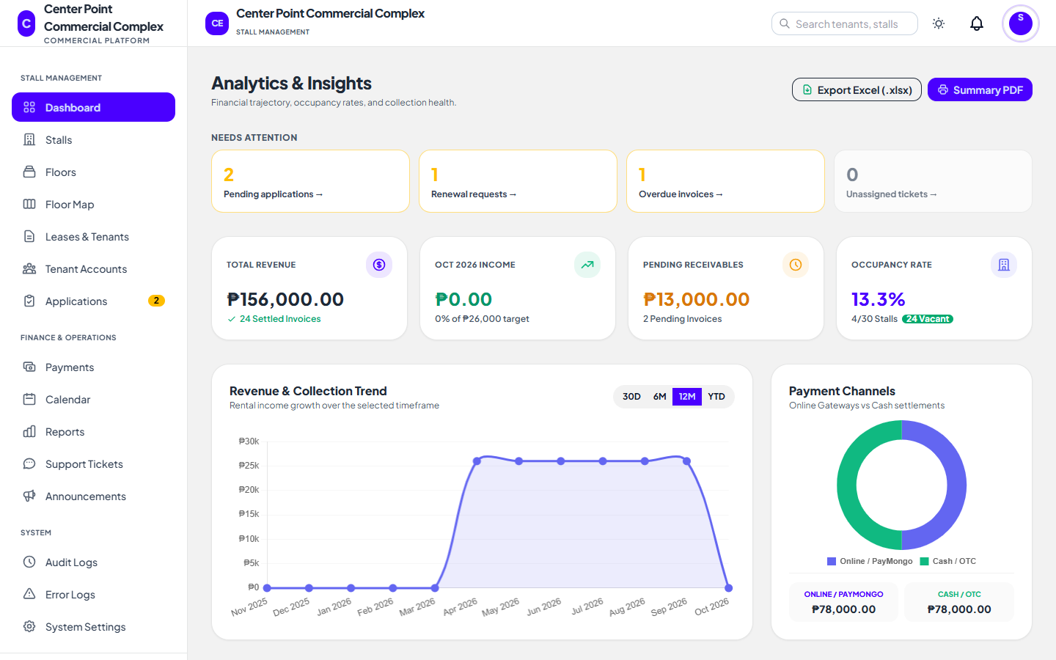
KEY FEATURES
• Public: browse stalls, apply online, track the application
• Admin: floor map, leases, renewals, calendar, reports
• Billing: monthly invoices, PayMongo, QR-verified receipts
• Tenant: invoices, documents, support tickets

Slide 6
SECURITY & RESULTS
• SMS code two-factor authentication for administrators
• Role and account checks on every action
• Content Security Policy, rate limits, and safe file uploads
• Encrypted backups and an audit log of key actions
• 340 automated tests, all passing

Slide 7
CONCLUSION & RECOMMENDATION
• One web platform replaced the logbooks and paper receipts
• Automated invoices, reminders, and online payments reduced errors and delays
• All general and specific objectives were achieved
• Next steps: a tenant mobile app, more branches, off-site backups, and 2FA for tenants

Slide 8
Thank you!

