Slide 1
Implementing a Model to Predict Hospital Readmission from Diabetes Diagnosis
Final Project
Jianna J. Estevez, Julianna M. Lomonte & Brianna L. Palmisano
St. John’s University, The Peter J. Tobin College of Business
BUA 611/3311: Machine Learning for Business
Spring 2024

Slide 2
Summary
Introduction to the data set and motivation to create machine learning models
Overview of data including its source and descriptions of the variables
Pre-processing/munging plan
Some preliminary results and initial visualizations

Slide 3
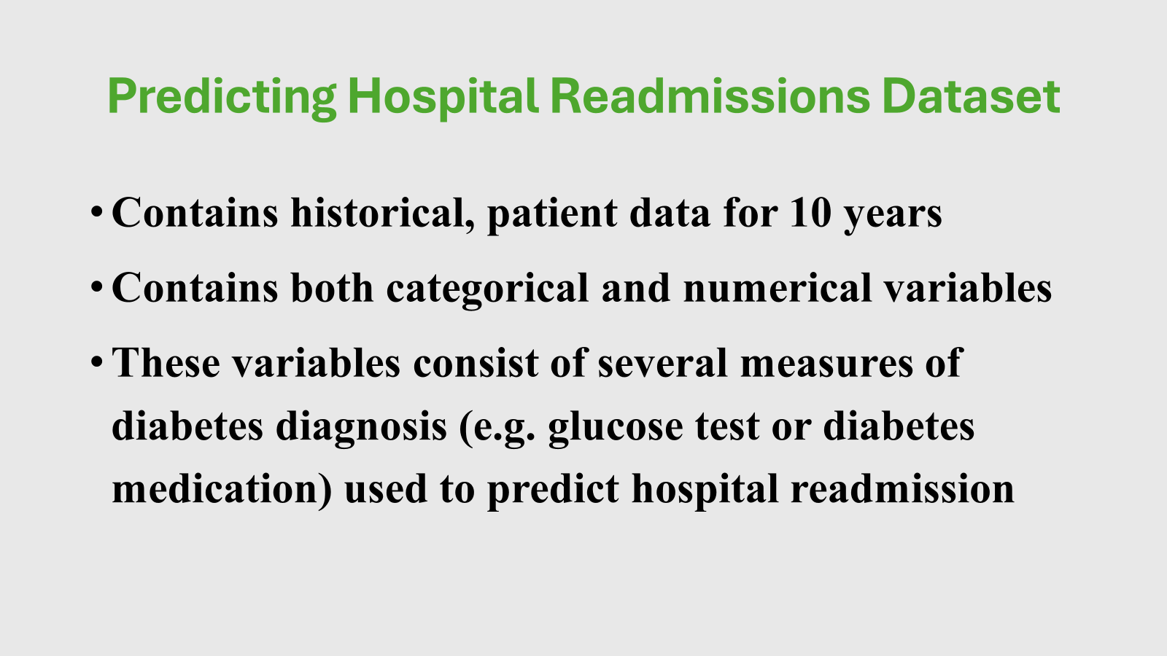
Introduction describing your data, motivation and objectives. Data…
Data set itself

Slide 4
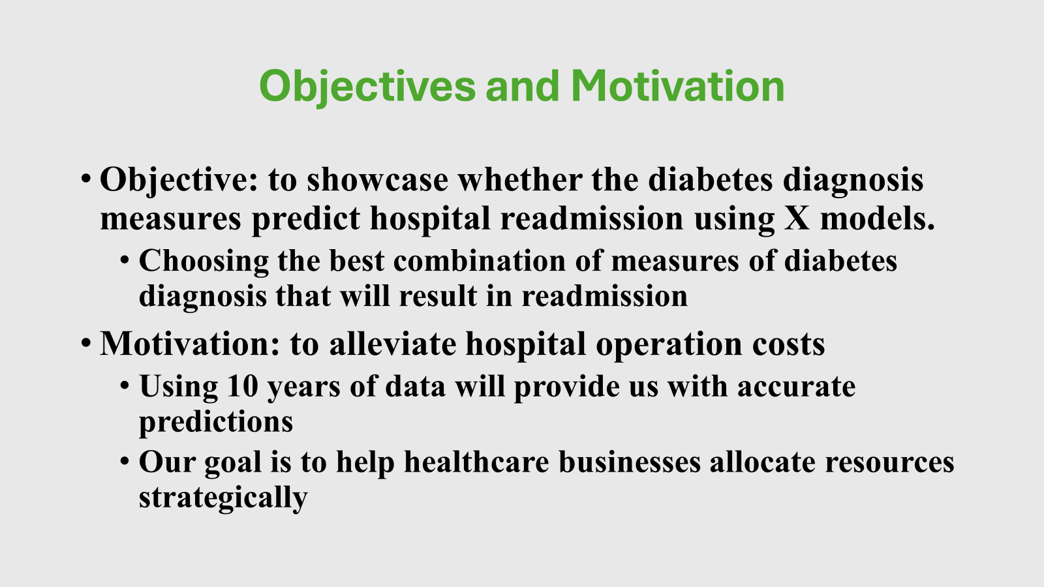
Motivation & Objectives…

Slide 5
Descriptions of variables
This data consists of both categorical and numerical variables. The categorical variables were encoded using both regular and one-hot into binary vectors to be included as input features in the model.
The variables encoded using regular encoding require that their data is given a hierarchy in terms of how important that result is to the objective of our model.
In one-hot encoding, each categorical variable is given a column, and the data elements are either hot or cold (0 or 1), a binary vector. One variable is 1 and the rest are 0. This helps us avoid imposing ordinal relationships on categorical variables. Rather, where the categorical variables don't have a meaningful numerical relationship, they are given one.

Slide 6
Categorical variables
"medical_specialty" - the specialty of the admitting physician
"age" - age bracket of the patient
"diag_1" - primary diagnosis (Circulatory, Respiratory, Digestive, etc.)
"diag_2" - secondary diagnosis
"diag_3" - additional secondary diagnosis
"glucose_test" - whether the glucose serum came out as high (> 200), normal, or not performed (ordered in importance)
"change" - whether there was a change in the diabetes medication ('yes' or 'no')
"diabetes_med" - whether a diabetes medication was prescribed ('yes' or 'no')
"A1Ctest" - whether the A1C level of the patient came out as high (> 7%), normal, or not performed (ordered in importance)
"readmitted" - if the patient was readmitted at the hospital ('yes' or 'no')

Slide 7
Numerical variables
"time_in_hospital" - days (from 1 to 14)
"n_procedures" - number of procedures performed during the hospital stay
"n_lab_procedures" - number of laboratory procedures performed during the hospital stay
"n_medications" - number of medications administered during the hospital stay
"n_outpatient" - number of outpatient visits in the year before a hospital stay
"n_inpatient" - number of inpatient visits in the year before the hospital stay
"n_emergency" - number of visits to the emergency room in the year before the hospital stay

Slide 8
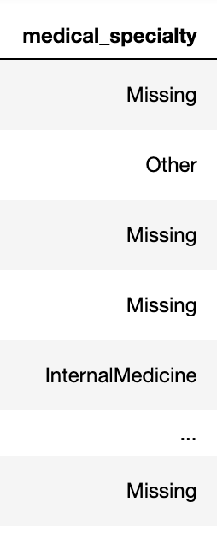
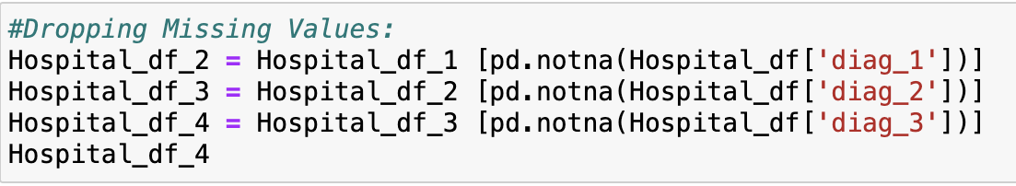
Preprocessing and Data Munging

Slide 9
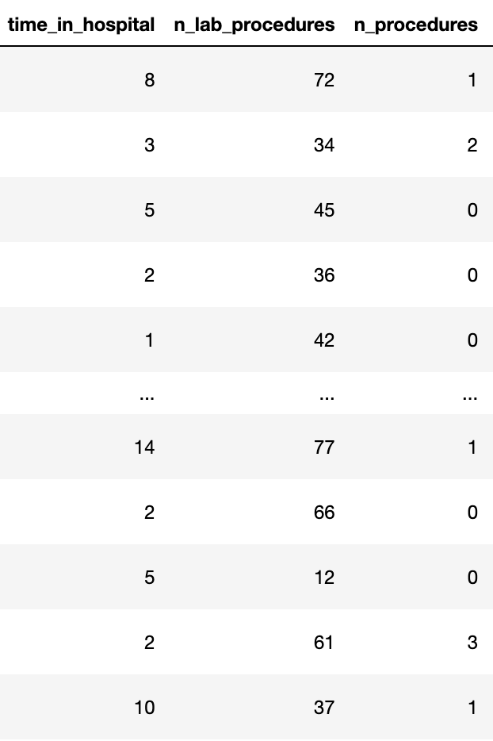
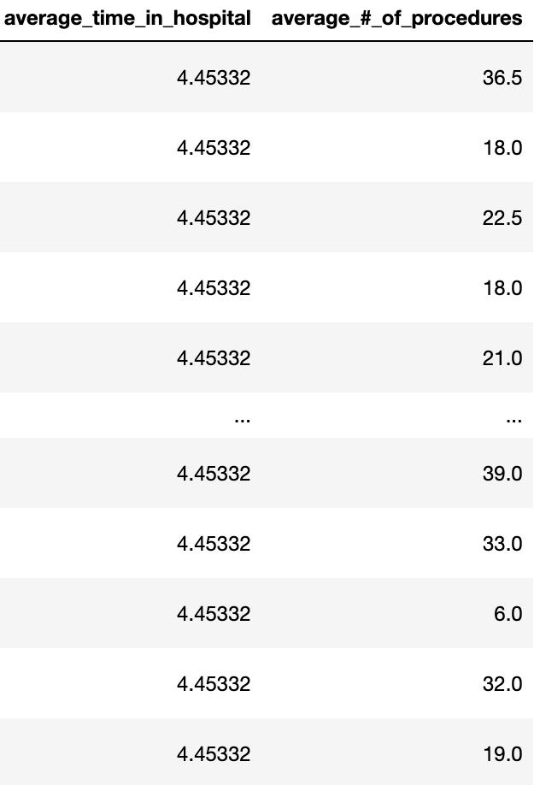
Preprocessing and Data Munging cont.

Slide 10
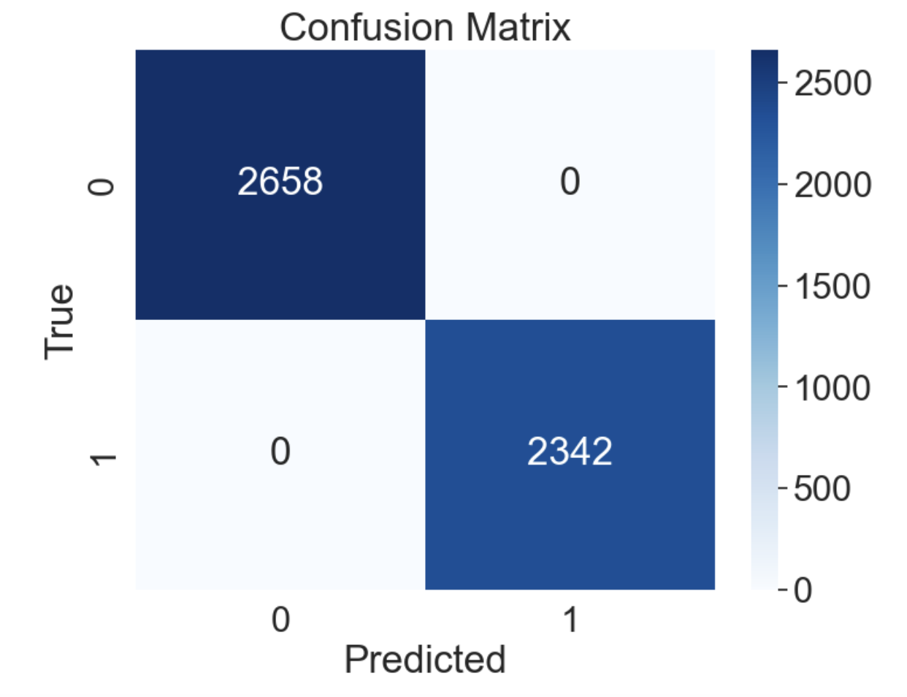
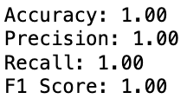
Preliminary results & initial visualizations
Regression 1: Initial Results lead to overfitting

Slide 11
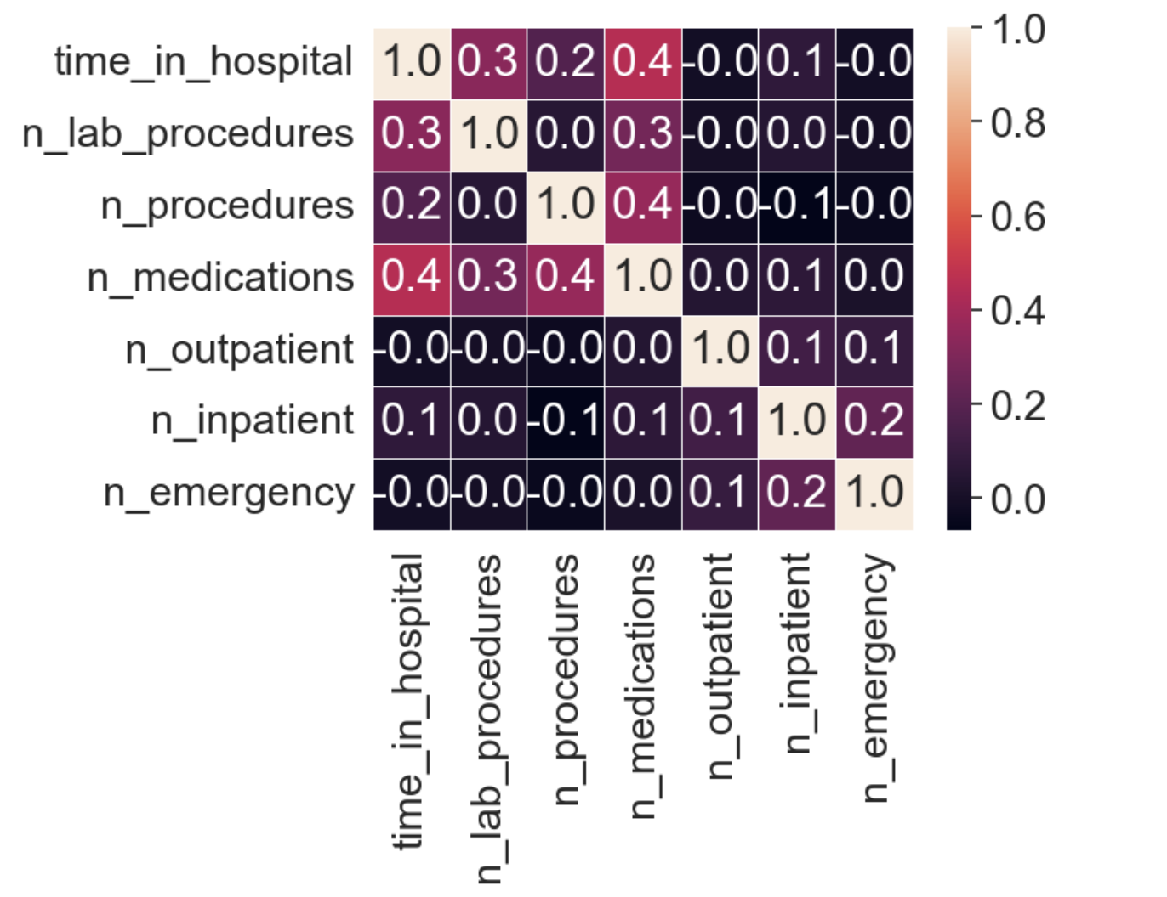
Preliminary results & initial visualizations
Correlation Matrix of numerical values

Slide 12
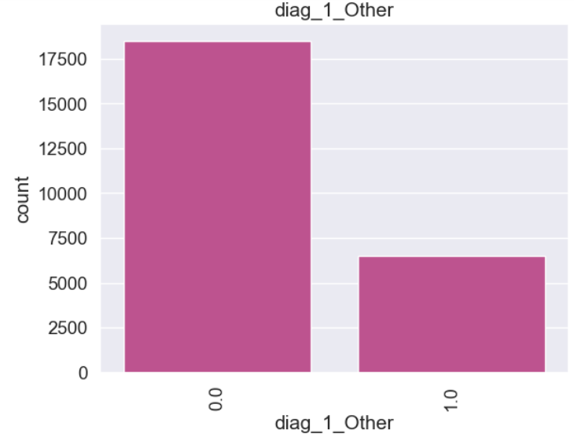
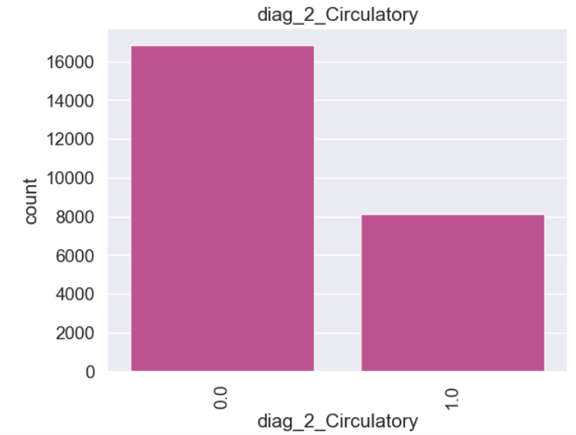
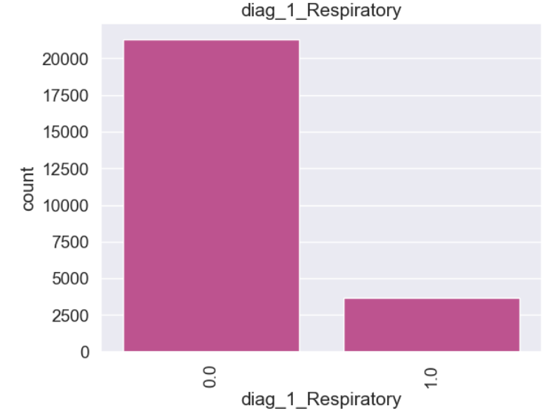
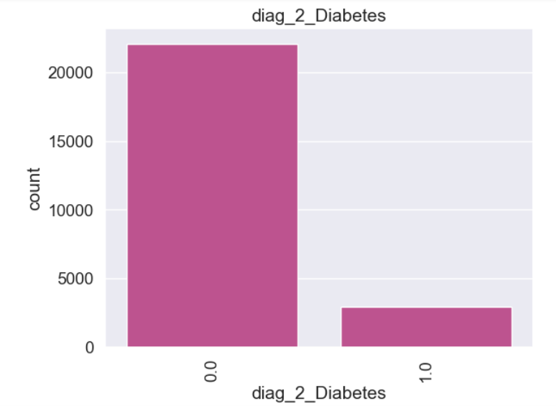
Top Categorical Features

Slide 13
Preliminary results & initial visualizations
When looking at the time patients stay in the hospital (days) compared to other features of importance, more people are leaving after about a 3-day stay than the latter.
This data leads us to predict that the number of days you spend in the hospital has an impact or relationship with readmission rate. The other independent variables also increase in correlation overall, due to this relationship.
As the time variable increases, our other features of importance such as number procedures, lab procedures and medications objectively increases as well.

Slide 14
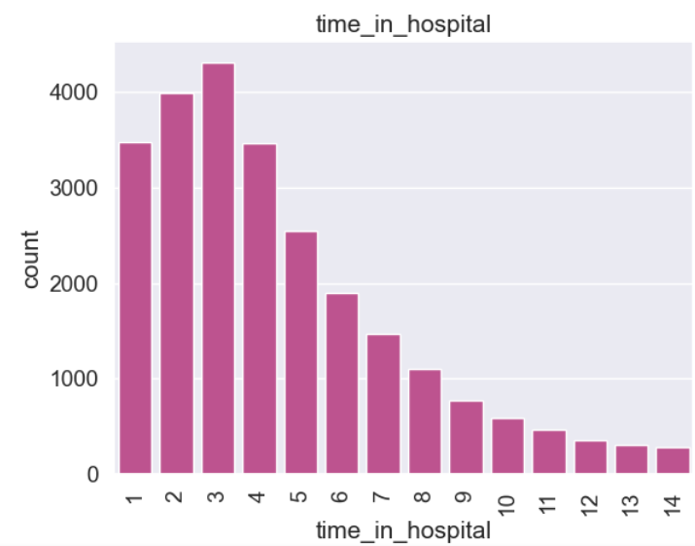
Top Numerical Feature

Slide 15
Thank you!

