Slide 1
A Statistical Model to Identify Factors Effecting Equity Price in the… Electric Utilities Industry
Brianna L. Palmisano (X03625986)​
St. John’s University, The Peter J. Tobin College of Business​
Summer 2024

Slide 2
Introduction
This evaluation uses the stock prices of the companies within the Electric Utilities (EU) industry of the Energy sector of the S&P1500 and the indicators within that industry, to examine the linear relationship between these variables.
This includes the earnings per share (EPS), book value per share (BVPS), debt to total assets (DTA) and current ratio (CR) for each company within the EU industry.
Information regarding the stock prices of companies within this industry could be valuable for not only our research within the climate change or sustainability literature, but for investors in energy technology or innovation, or stock traders following the Energy sector of investing as well.

Slide 3
Methodology
The input data here has been collected from the Electric Utilities (EU) industry, within the Energy sector of the S&P1500. The S&P1500 is a stock market index of the top unique companies included in the S&P LargeCap 500, S&P MidCap 400, and S&P SmallCap 600 indices (“Cap” refers to market capitalization or equity).
The S&P1500 is inclusive of 11 sectors and 73 industries, with about 1507 publicly traded United States companies. This is secondary data, as these observations have been adjusted for the integrity of the data. Here we have cross-section data, with a total of 23 observations, all taken on the last day of the year, 2021.
The dependent variable here is the price per share (Stock Price), and the independent variables are the EPS, BVPS, DTA, and CR. Companies Constellation Energy Corporation (CEG) and American Electric Power Company, Inc. (AEP) have been removed from the data, due to signs of outliers in these observations, as well as missing or ‘NA’ values.

Slide 4
Methodology, continued…
Listed below are the equations defining the functional specification equation (Eqn. 1), population regression equation (Eqn. 2) and sample regression equation (Eqn. 3).
+ + + +
Eqn. 1 Price = f(EPS, BVPS, DTA, CR)
Eqn. 2 Price = a + ßeps EPS + ßbvps BVPS + ßdta DTA + ßcr CR
Eqn. 3 Price = a + beps EPS + bbvps BVPS + bdta DTA+ bcr CR
The objective of this model is to evaluate the association or lack thereof that the stock prices of the companies within Electrical Utilities industry have with EPS, BVPS, DTA, and CR.
Graphical techniques including both histograms and scatterplots are used in this analysis. This data has been analyzed using descriptive statistics (for scalable variables), as well as correlation and regression statistical analysis, via both Microsoft Excel and R-Script.

Slide 5
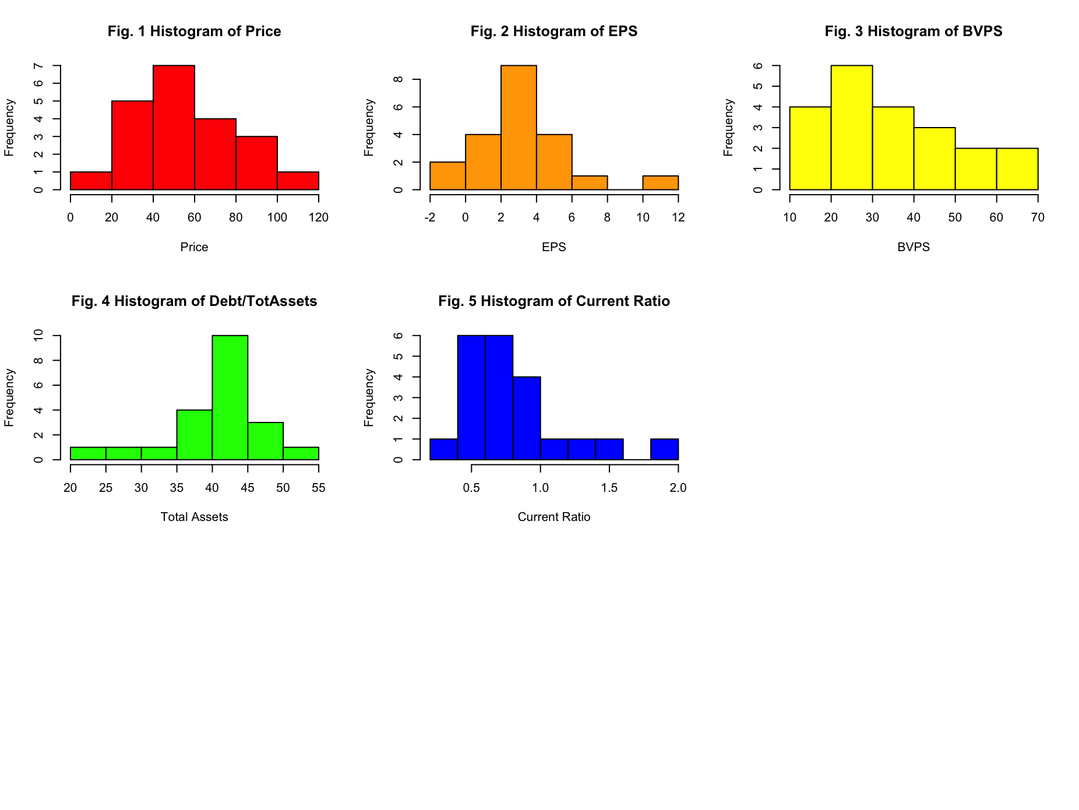
Histograms
Fig. 1 through Fig. 5 show the histograms of each variable being analyzed. All histograms are roughly negative and skewed right, excluding DTA. The histogram of DTA is positive and skewed left. There is less of a recognizable or weak pattern in Fig. 5, the graph of CR, having more peaks and irregular symmetry.

Slide 6
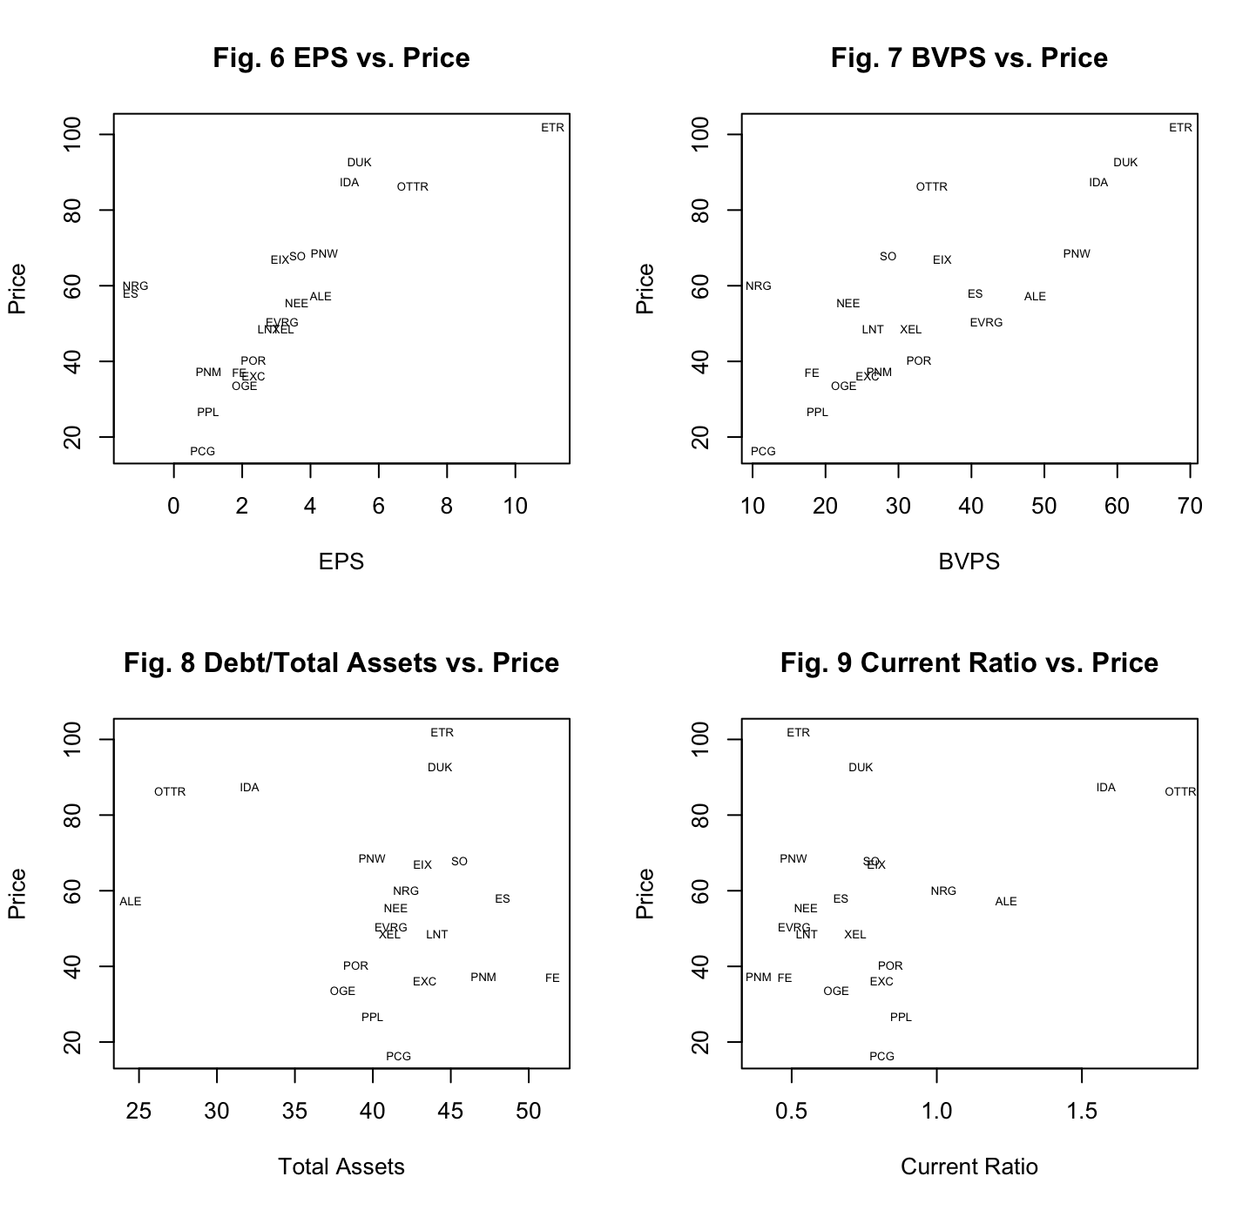
Scatterplots
The relationships visible via the scatterplots in Fig. 6 through Fig. 9 are the independent variables, each relative to the dependent variable.
The relationships seen in Fig. 6 and Fig. 7 are stronger or more positively correlated, non-heteroscedastic, nonlinear and with few outliers. The stock prices of the companies within the EU industry are most correlated with EPS and BVPS, compared the other variables (bjectively).
In Fig. 8 and Fig. 9, the data is even more nonlinear, with less of a visible pattern, as well as very congested and clustered. The DTA data is clustered higher, whereas the clustered CR data is lower.
The contrasting clustering in Fig. 8 -9 insists that these companies holding more debt and risk than they are assets. This also tells us that regardless of debt and/or liability levels relative to assets, the influence that these variables hold on stock prices varies across the companies within this industry.

Slide 7
Table 1: Descriptive Statistics
In Table 1, are the descriptive statistics for all variables that are non-categorical, here, that is all variables. The standard deviation for each variable is about half (or less than half) of the mean for all variables, except EPS. The data around EPS is the least disbursed from the mean.
The measure of skewness and kurtosis is asymmetric across all variables in this model, though Price and BVPS are the closest variables to displaying normal distribution, yet still far from. The measure of kurtosis is higher or more peaked than normal distribution in all variables, especially high in EPS, DTA and CR. The higher kurtosis seen in all variables indicates that the data has sharper peaks around the center of the dispersion, with heavier tails. We can also conclude that there is a higher chance of outliers or extreme values.

Slide 8
Table 2: Correlation Matrix
Via the correlation matrix in Table 2, it can be observed that the Price has a strong positive correlation with the EPS (at 0.732) and BVPS (at 0.785). There is also a high correlation between EPS and BVPS (at 0.723.
It should also be noted that the DTA has a strong correlation with CR (at -0.791), although this correlation is negative. These variables are moving in opposing directions, though there is still a relationship between these variables, one that is greater than all other correlations in this model.
Due to high correlation coefficients, we can assume that there are signs of multicollinearity in this model, or a high correlation in our independent variables than that with our dependent.

Slide 9
Regression Equation
Equation for Sample Regression Line.
+ + + +
Eqn. 4 Price = f(EPS, BVPS, DTA, CR)
t-stat (-2.44)*** (2.16)** (3.73)*** (2.81)*** (3.44) ***
p-value (0.026)* (0.046)* (0.002)** (0.013)* (0.003)**
r (corr) (2.91) (0.82) (1.82) (38.23)
n = 20 r-sq. = 0.812 F = 17.31*** F-Prob = SE =
Confidence Intervals.
* Significant at the 0% level of significance (90% Sure, or “are below”) (1.28)
** Significant at the 5% level of significance (95% Sure, or “are below”) (1.65)
*** Significant at the 1% level of significance (99% Sure, or “are below”) (2.33)
Results of an F-test for the entire model.
Ho: beps = bbvps = bbdta = bcr = 0 (Null Hypothesis) * 1% Ha: at least 1 bi not equal to 0 (17.31 > 4.99) (Alternate Hypothesis)
The above F-test includes the null (Ho) and alternative hypothesis (Ha) for the entire model.

Slide 10
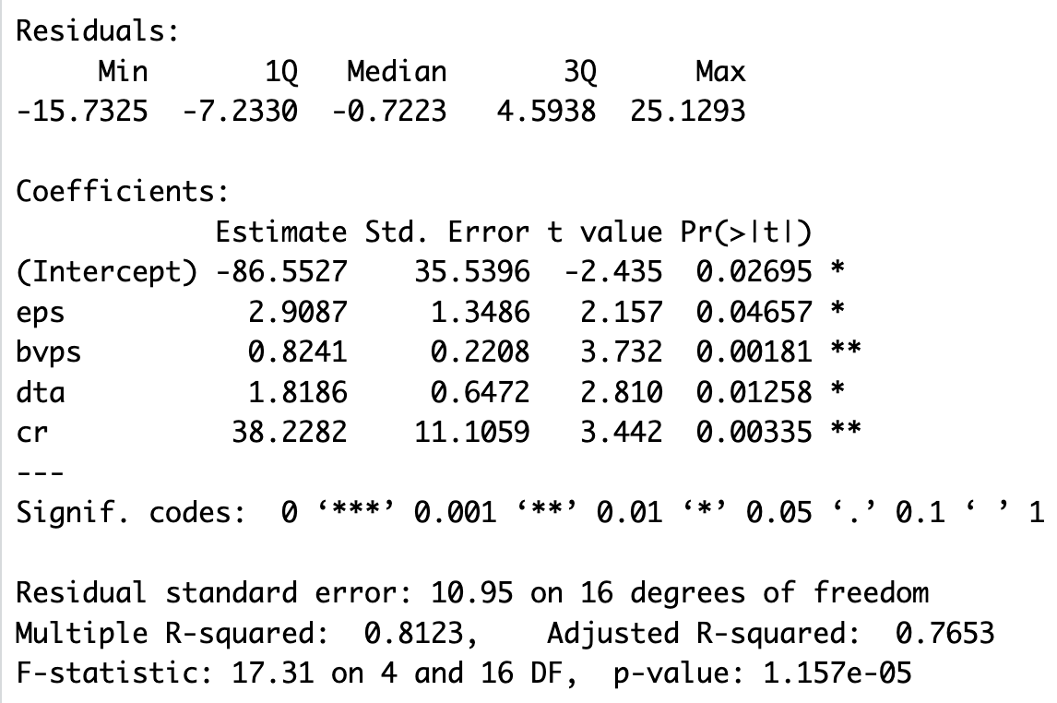
Table 3: Regression Statistics
To further interpret the regression statistics in Table 3, this F-test includes the null (Ho) and alternative hypothesis (Ha) for the entire model. The results for the F-Statistic (17.31) indicate that the regression model is statistically significant, as it is above the cutoff (>4.99).
All variables here were statistically significant. The null hypothesis should be rejected, while the alternate hypothesis should be accepted. Rather, the higher value insists that the model explains a significant amount of the variation in the dependent variable with the predictor variables, than without.
The results for the t-statistics show that though EPS is only significant at the 95% confidence interval, all other variables were statistically significant at the 99% confidence level. This inclines us to reject the null hypothesis at the 99% confidence interval.

Slide 11
Regression Results, continued…
Similarly, the results for our p-value show that all variables were statistically significant and support our t-statistic results in the context of probability. The BVPS (at 0.002) and CR (at 0.003) were the most significant, having the most effect on the dependent variable, Price.
When looking at the results for the coefficient of determination, it can be concluded that that statistical model predicts an association between the dependent and independent variables that is strong. There is 81.2% of variation in the dependent variable can be explained by variations in the independent variables.
The standard error is considerably high around the intercept and the variable CR, indicating that there is a lot of room for uncertainty in the analysis of both variables. The high standard error value around the independent variable CR (11.11) tells us that the CR falls much further from the regression line than the other variables, especially BVPS (at 0.22) with the lowest standard error. The greater standard error value seen in the intercept determines that the dependent variable is being affected by other independent variables, ones not included in this model.
To discuss the statistically significant regression coefficients, the dependent variable is most impacted by the CR (at 38.23) and the EPS (at 2.91). That is to say that for every unit increase in the independent variable CR, there is a $38.23 increase in the dependent variable (Price), as well as that there is a $2.91 increase in Price for every unit increase in EPS, holding all other variables constant.

Slide 12
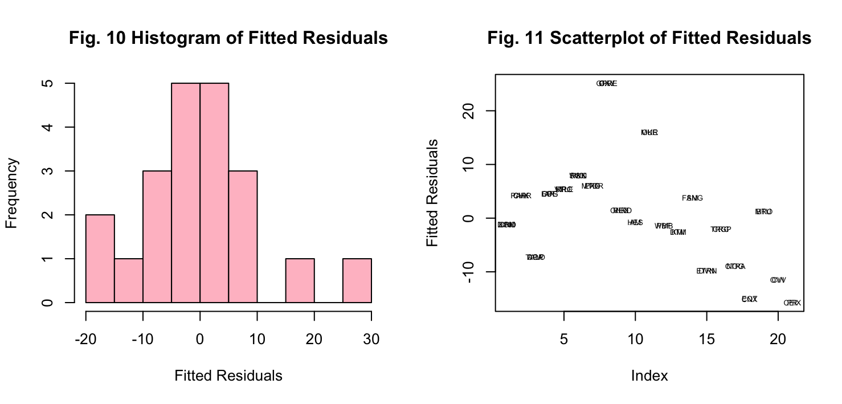
Residual Analysis
Fig. 10 and Fig. 11 show the graphed fitted residuals. These graphs give us insight as to the integrity of the assumptions made in this analysis. The histogram is not entirely, but approximately normally distributed, due to a lack of symmetry on either end of the some-what visible bell-curve.
The plotted residuals in Fig. 11 are fairly negative and non-linear, possibly due to outliers, insisting that because of there lack of both symmetry and linear pattern in the fitted residual output, our model is possibly lacking statistical significance as a whole.

Slide 13
Conclusions
For this model, the null hypothesis is rejected, and the alternate hypothesis is accepted. The research presented here can be considered successful, as 81.2% of variation in the dependent variable can be explained by the independent variables. It can be determined true that the dependent variable is better supported by the independent variables, than if it were not. This model was not entirely predictive, as the variables here do not influence one-another enough, but it was somewhat predictive when looking at EPS and CR.
This model can be improved on by increasing the number of observations, as there were just enough observations to create a valuable model after removing outliers and the model is still lacking significance. Should there be a need to break down the moments of closer associations, breaking this model up by time periods may add to the findings that this model is capable of. The highly correlated independent variables or multicollinearity seen in this model can be adjusted by switching those variables out and taking the first difference for those variables to reanalyze the trends in those variables.

Slide 14
Public Policy Implications
Public policy does not entirely pertain to driving a relationship between these variables but could be influential in the context of regulating the terms of trade, changes in regulations that compromise operations within the Energy industry, as well as climate change efforts (including “green” incentives relative to electricity production or consumption). This model or an expanded version of this model could be beneficial to investors who require more insight on the variables that influence the stock price of the companies within this industry.

Slide 15
Appendix I: Bibliography
Data Source.
“S&P Composite 1500®.” S&P Dow Jones Indices, 2024. https://www.spglobal.com/spdji/en/indices/equity/sp-composite-1500/#data.

Slide 16
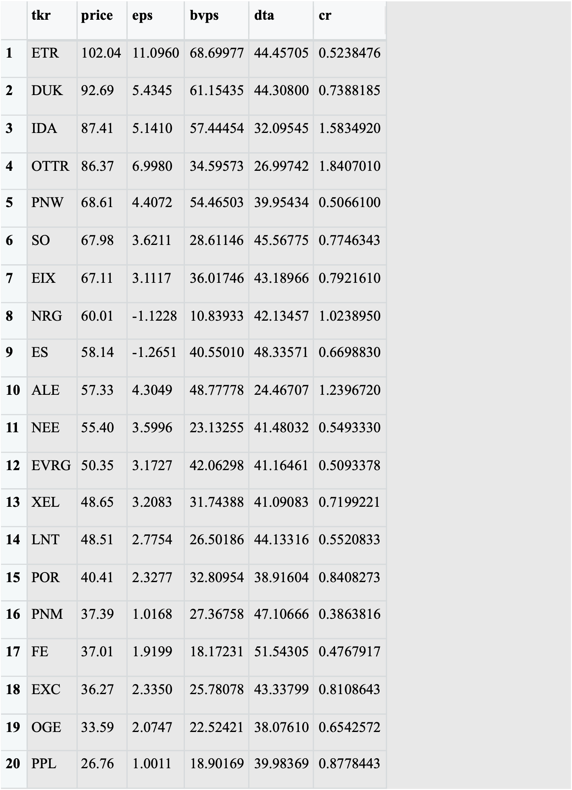
Appendix II: Input Data
Via R-Script.

Slide 17
Appendix III: R-Script
# REGRESSION ANALYSIS...
# SECTOR: Energy
# INDUSTRY: Electric Utilities
# IMPORT LIBRARIES...
library(YRmisc)
library(readxl)
# Read SP1500 data file
sp1500 <- read_excel("Downloads/sp1500.xlsx", sheet = "Tab1")
View(sp1500)
dim(sp1500)
names(sp1500)
# View sector & industry.
data.frame(unique(sp1500$sector))
data.frame(unique(sp1500$industry))
# Choose a sector.
idf<-sp1500[sp1500$industry=="Electric Utilities",c("tkr","price","eps","bvps","dta","cr")]
dim(idf) #Confirm that the dimensions have decreased.
View(idf)
# Drop CEG & AEP (Outliers/NA Values).
drop_CEG <- "CEG"
idf <- idf[idf$tkr != drop_CEG,]
drop_AEP <- "AEP"
idf <- idf[idf$tkr != drop_AEP,]
View(idf)
# FIGURES 1-5: HISTOGRAMS
par(mfrow=c(3,3)
hist(idf$price, col="red", xlab="Price", ylab="Frequency", main="Fig. 1 Histogram of Price")
hist(idf$eps, col="orange", xlab="EPS", ylab="Frequency", main="Fig. 2 Histogram of EPS")
hist(idf$bvps, col="yellow", xlab="BVPS", ylab="Frequency", main="Fig. 3 Histogram of BVPS")
hist(idf$dta, col="green", xlab="Total Assets", ylab="Frequency", main="Fig. 4 Histogram of Debt/TotAssets")
hist(idf$cr, col="blue", xlab="Current Ratio", ylab="Frequency", main="Fig. 5 Histogram of Current Ratio")
# FIGURES 6-9: SCATTERPLOTS
par(mfrow=c(2,2))
plot(idf$eps, idf$price, xlab="EPS", ylab="Price", main="Fig. 6 EPS vs. Price", type="n")
text(idf$eps, idf$price, as.character(idf$tkr), cex=0.5)
plot(idf$bvps, idf$price, xlab="BVPS", ylab="Price", main="Fig. 7 BVPS vs. Price", type="n")
text(idf$bvps, idf$price, as.character(idf$tkr), cex=0.5)
plot(idf$dta, idf$price, xlab="Total Assets", ylab="Price", main="Fig. 8 Debt/Total Assets vs. Price", type="n")
text(idf$dta, idf$price, as.character(idf$tkr), cex=0.5)
plot(idf$cr, idf$price, xlab="Current Ratio", ylab="Price", main="Fig. 9 Current Ratio vs. Price", type="n")
text(idf$cr, idf$price, as.character(idf$tkr), cex=0.5)
# DESCRIPTIVE STATISTICS
des_stats<-ds.summ(idf[,c("price","eps","bvps","dta","cr")],3)[,-c(7,8)]
View(des_stats)
# CORRELATION MATRIX
cor_matrix<-round(cor(na.omit(idf[,c("price","eps","bvps","dta","cr")])),3)
View(cor_matrix)
# REGRESSION ANALYSIS
idf1<-na.omit(idf)
fit<-lm(price~eps+bvps+dta+cr,na.action=na.omit, data=idf1)
summary(fit)
# FIGURES 10 & 11: FITTED RESIDUALS
idf$price
fit$fitted.values
fit$residuals
par(mfrow=c(2,2))
hist(fit$residuals,col="pink",xlab="Fitted Residuals",ylab="Frequency",main="Fig. 10 Histogram of Fitted Residuals")
plot(fit$residuals,xlab="Index",ylab="Fitted Residuals",main="Fig. 11 Scatterplot of Fitted Residuals",type="n")
text(fit$residuals,as.character(idf$tkr),cex=.5)

Slide 18
Copyright Notice
© 2024 Brianna L. Palmisano. All rights reserved.
This presentation, including all content, graphics, and design elements, is the intellectual property of Brianna L. Palmisano. Unauthorized copying, distribution, display, or use of any part of this presentation without express written permission is strictly prohibited. For permissions, please contact brianna.palmisano21@my.stjohns.edu.

Slide 19
Thank you! Questions & Correspondence Brianna Palmisano brianna.palmisano21@my.stjohns.edu

