Slide 1
A Statistical Model to Identify Social Issues Effecting the United States Homicide Rate
Brianna L. Palmisano (X03625986)​
St. John’s University, The Peter J. Tobin College of Business​
Summer 2024

Slide 2
Table of Variables
Variable Abbr. R-Script
Homicide Rate HR homcideRate
Unemployment Rate UR unempRate
Income Level IL income
Bachelor’s Degree BD bachDegree
High School Degree HSD hsDegree
Obesity Rate OR obesityRate
Robbery Rate RR robberyRate
Suicide Rate SR suicideRate
Teenage Pregnancy Rate TPR teenPregRate

Slide 3
Introduction
A “homicide” is defined by Oxford Languages as “the killing of one person by another” and is considered one of the most heinous levels of crime committable. This evaluation uses the United States homicide rate against other social issues or indicators to examine the linear relationship between these variables. This includes the unemployment rate, level of income, obesity rate, robbery rate, suicide rate, teen pregnancy rate, as well as the completion of a high school and/or bachelor’s degree.
Information regarding the homicide rate across the US could not only be valuable for analyzing the the social issues and economic factors that go into our understanding of predicting regional homicide rates, but for research within legal studies and other crime related fields as well.

Slide 4
Methodology
[SENTENCE ABOUT DATA SOUCRE HERE] This is secondary data, as these observations have been adjusted for the integrity of the data. Here we have cross-section data, including 48 states. All observations were taken on the last day of the year, 2021.
The variables used in this model can be considered social issues, as well as economic indicators in some context. The dependent variable here is the homicide rate (HR), and the independent variables are the unemployment rate (UR), level of income (IL), obesity rate (OR), robbery rate (RR), suicide rate (SR), teen pregnancy rate (TPR), as well as the completion of a high school (HSD) and/or bachelor’s degree (BD), for each of those specified 48 states.
Graphical techniques including both histograms and scatterplots are used in this analysis. This data has been analyzed using descriptive statistics (for scalable variables), as well as correlation and regression statistical analysis, via both Microsoft Excel and R-Script.

Slide 5
Methodology, continued…
Listed below are the equations defining the functional specification (Eqn. 1), population regression equation (Eqn. 2) and sample regression equation (Eqn. 3).
Eqn. 1 Homicide Rate = f(UR, IL, BD, HSD, OR, RR, SR, TPR )
Eqn. 2 Homicide Rate = a + ßur UR + ßil IL + ßbd BD + ßhsd HSD + ßor OR + ßrr RR + ßsr SR + ßtpr TPR
Eqn. 3 Homicide Rate = a + bur UR + bil IL + bbd BD + bhsd HSD + bor OR + brr RR + bsr SR + btpr TPR
The objective of this model is to evaluate the association or lack thereof between these independent variables and the dependent variable.

Slide 6
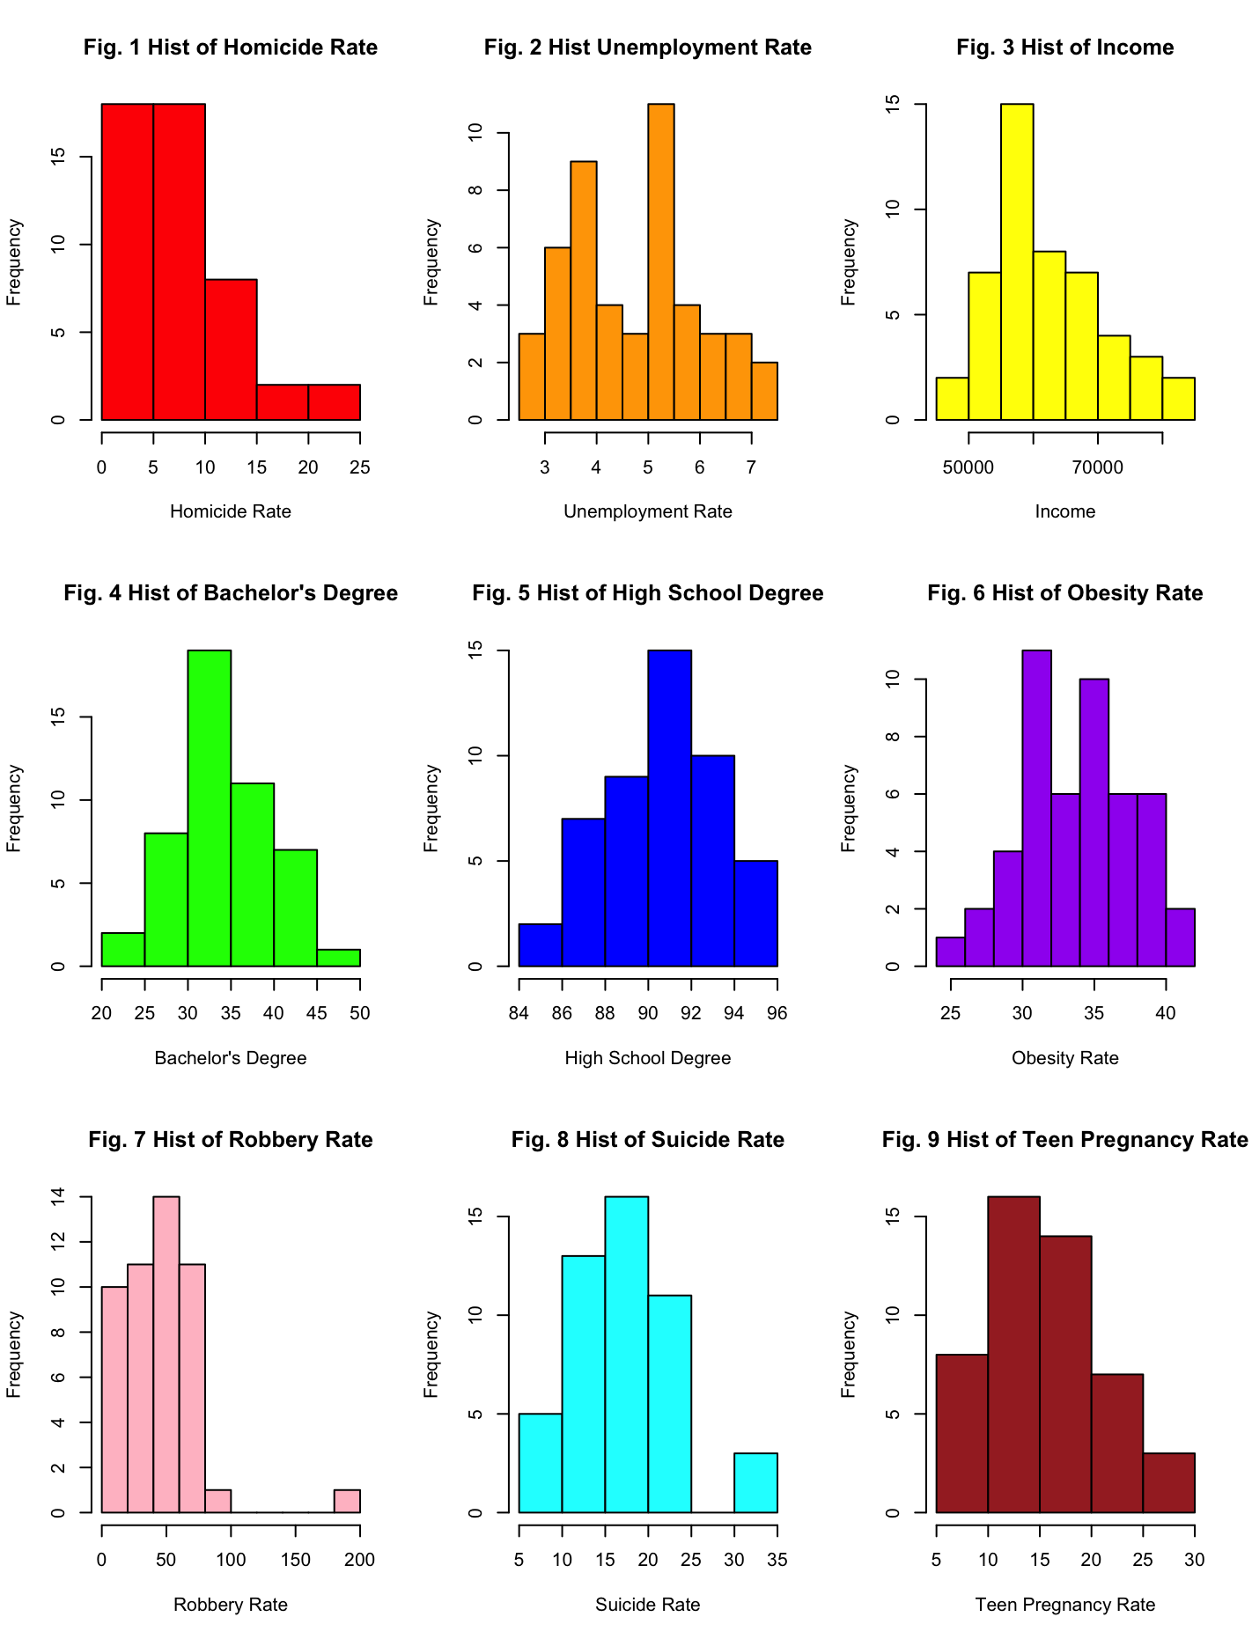
Histograms
Fig. 1 through Fig. 9 show the histograms of each variable being analyzed.
All histograms are roughly normally distributed, excluding the graphs of HR (the dependent variable), UR, OR and RR.
Fig. 1 and Fig. 7 (graphs of of HR and RR) are both negative and skewed right.
There is less of a recognizable, weak pattern in Fig. 2 and Fig. 6 (graphs of UR and OR), having more peaks and irregular symmetry.

Slide 7
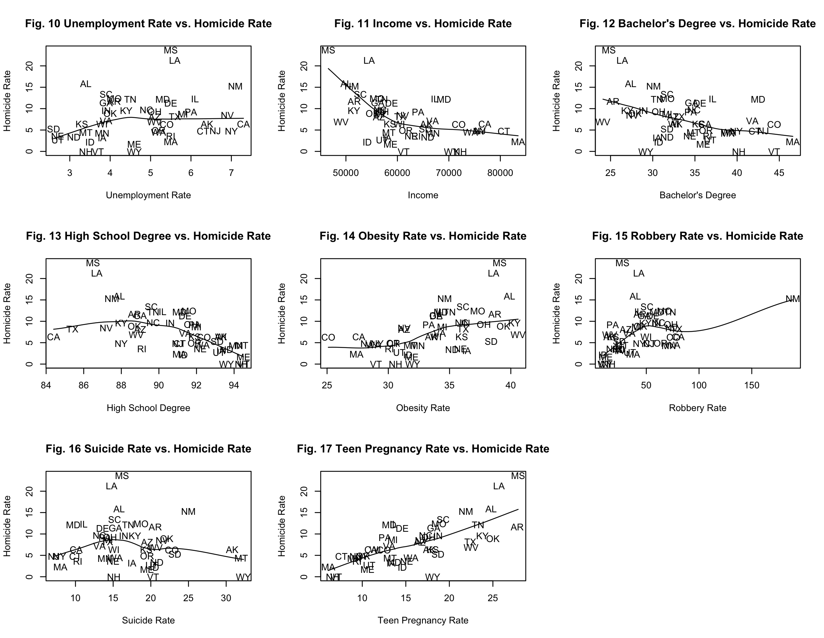

Scatterplots
The relationships visible via the scatterplots in Fig. 10 through Fig. 17 are the independent variables, each relative to the dependent variable.
All graphs are nonlinear, lack a clear positive or negative pattern, and thus hold a weak relationship. A lack of trend across all variables could be due to outliers.
The relationships seen in Fig. 11 – 12 are more negative, although they are weak. Whereas in Fig. 14 – 15 and 17, the pattern is positive and weak. There are fewer outliers as well.
The graphs with the strongest and most linear relationships here are Fig. 11 - 12 (IL and BD) and Fig. 17 (TPR) when plotted against the HR. The graphs of IL and BD were negatively correlated, while the graph of TPR was positive.

Slide 8
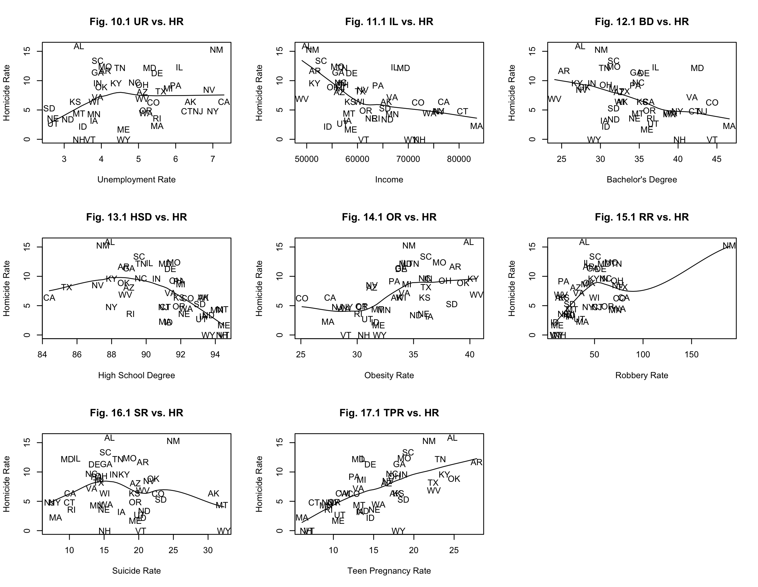
Post-Removal of Outliers
A lack of trend across all variables could be due to outliers in the data for states including Mississippi and Louisiana. These states could have less economic activity in general, and for many reasons (low population levels, consumer norms, etc.), resulting in extreme data in either direction. Fig. 10.1 through 17.1 are the same scatterplots as earlier, following the removal of these states.
The data in Fig. 15.1 (RR) is congested and clustered at the beginning of the graph and only stretches out because of the data for New Mexico. This state was not removed, as it is only an outlier when looking at the RR and is not an outlier when looking at our other crime related independent variables.
Removing outliers was not impactful of the results in this part of the model. The outliers in question have been included in the following statistical analysis because they may not be outliers, as well as to avoid compromising the number of observations included here or the integrity of this model.

Slide 9
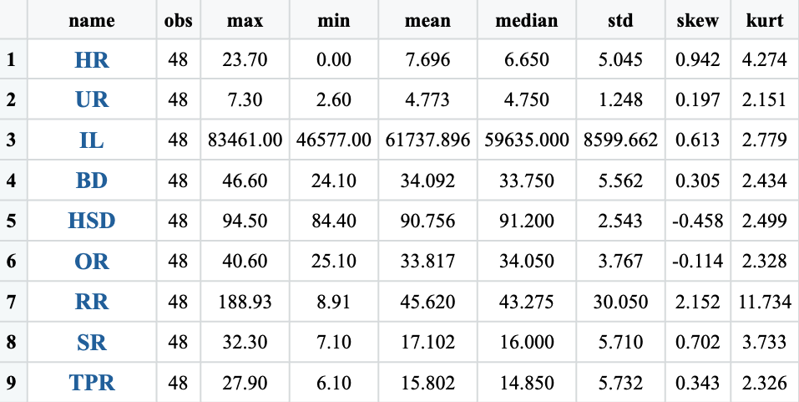
Table 1: Descriptive Statistics
In Table 1, are the descriptive statistics for all variables that are non-categorical, here, that is all variables. The standard deviation for HR, UR, IL and RR is disbursed relatively close to that variables mean, indicating that they all have moderate to low variability. The standard deviation is higher than the mean for IL, meaning this data deviates in the opposing direction.
The measure of kurtosis is positive and slightly higher or more peaked than normal distribution in all variables. This is higher around our dependent variable, and especially high in RR (indicating that this data is the most dispersed). The higher kurtosis seen indicates sharper peaks, with a higher chance of outliers.
The measure of skewness is asymmetric across all variables in this model. Both HSD and OR are skewed negatively, whereas all other variables were positive. UR and OR are the closest to being normally distributed (in opposing directions), whereas HR, RR and SR were the least (stretching further right from center than the other variables).

Slide 10
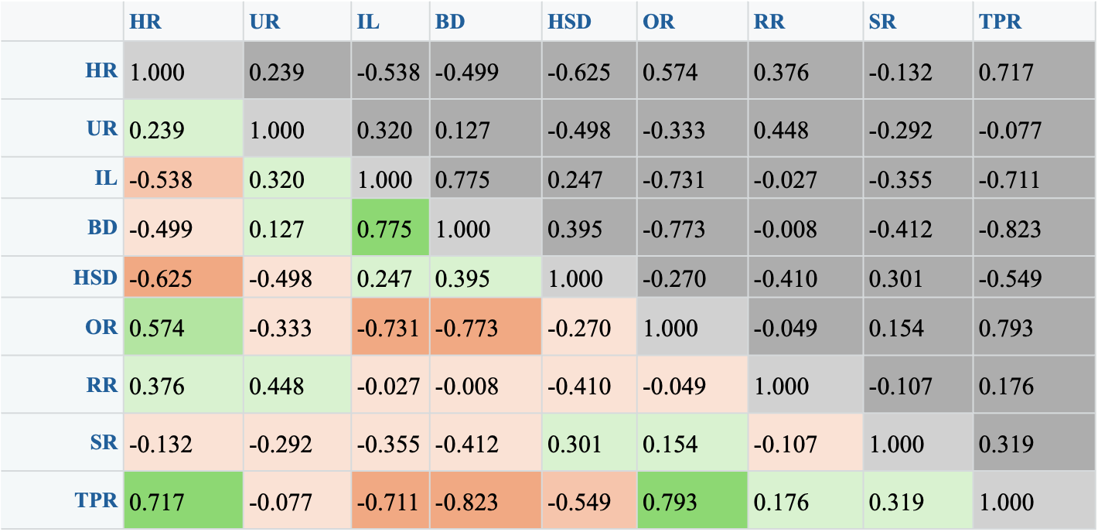
Table 2: Correlation Matrix
Via the correlation matrix in Table 2, it can be observed that the homicide rate is most positively correlated with the TPR (at 0.717) and most negatively correlated with HSD (at -0.625). The highest is positive correlations between independent variables are between OR and TPR (at 0.793) and between IL and BD (at 0.775). The highest negative correlations are between BD and TPR (at -0.823) (the strongest correlation here) and between BD and OR (at -0.773). These correlations are worth noting because although they are moving in opposing directions, there is still a relationship between these variables greater than others in this model.
Due to high correlation coefficients, we can assume that there are signs of multicollinearity in this model, or a high correlation in our independent variables.

Slide 11
Regression Equation
Equation for Sample Regression Line.
+ + + + + + + +
Eqn. 4 Homicide Rate = f(UR, IL, BD, HSD, OR, RR, SR, TPR)
t-stat (-1.05) (2.94)*** (-2.94)***(1.63)** (0.9) (0.34) (1.01) (-2.7)***(3.86)***
p-value (0.3) (0.01) (0.1) (0.11) (0.37) (0.74) (0.32) (0.01) (0.00)
r (corr) () () () () () () () ()
n = 48 r-sq. = 0.773 F = 16.62*** F-Prob = SE =
Confidence Intervals.
* Significant at the 0% level of significance (90% Sure, or “are below”) (1.28)
** Significant at the 5% level of significance (95% Sure, or “are below”) (1.65)
*** Significant at the 1% level of significance (99% Sure, or “are below”) (2.33)
Results of an F-test for the entire model.
Ho: bur = bil = bbd = bhsd = bor = bsr = brr = btpr = 0 (Null Hypothesis) * 1% Ha: at least 1 bi not equal to 0 (16.62 > 4.99) (Alternate Hypothesis)
The above F-test includes the null (Ho) and alternative hypothesis (Ha) for the entire model.

Slide 12
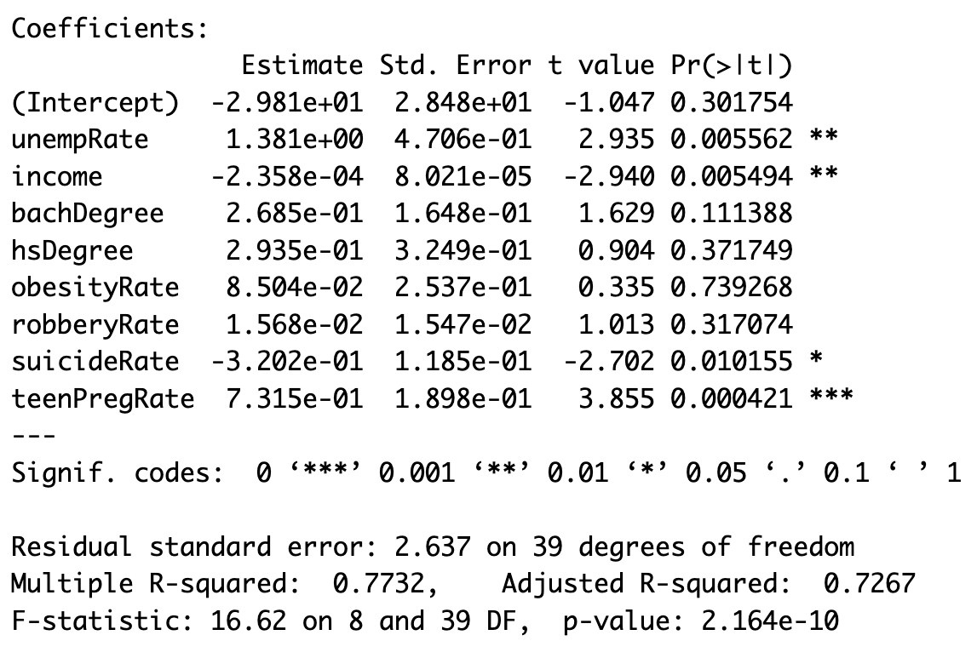
Table 3: Regression Statistics
To further interpret the regression statistics in Table 3, the F-Statistic (equal to 16.62) indicates that the regression model is statistically significant, as it is above the cutoff (>4.99) for this measure. This inclines us to determine that the null hypothesis should be rejected.
Rather, the higher value insists that the model explains a significant amount of the variation in the dependent variable with the predictor variables, than without.
The results for our p-value show that the variables with the association that is the most significant are TPR (at 0.000), UR (at 0.006), IL (at 0.005) and SR (at0.01), with TPR being the strongest. These variables all having high significance, inclines us to reject the null hypothesis at the 99% confidence level (all confidence levels were above 99% confidence level interval).

Slide 13
Regression Results, continued…
The results for the t-Statistic indicate are inline with the levels of significance expressed in these p-values. When looking at the results for the coefficient of determination, it can be concluded that that statistical model predicts an association between the dependent and independent variables that is strong. There is 77.3% of variation in the dependent variable can be explained by variations in the independent variables.
There is a lot of room for uncertainty in this analysis which could be due to initial assumptions of multicollinearity; too much correlation between our independent variables. The greater standard error value seen in the intercept (HR) determines that the dependent variable is being affected by other independent variables, ones not included in this model.
To discuss the statistically significant regression coefficients, the dependent variable (HR) is most impacted by the UR (at 1.381), TPR (at 0.732) and the SR (at -0.320). That is to say that for every unit increase in the independent variable UR, there is a 1.381 unit increase in the dependent variable (HR) (similar logic can be applied to TPR), and that there is a 0.320 unit decrease in HR for every unit increase in the SR, holding all other variables constant.

Slide 14
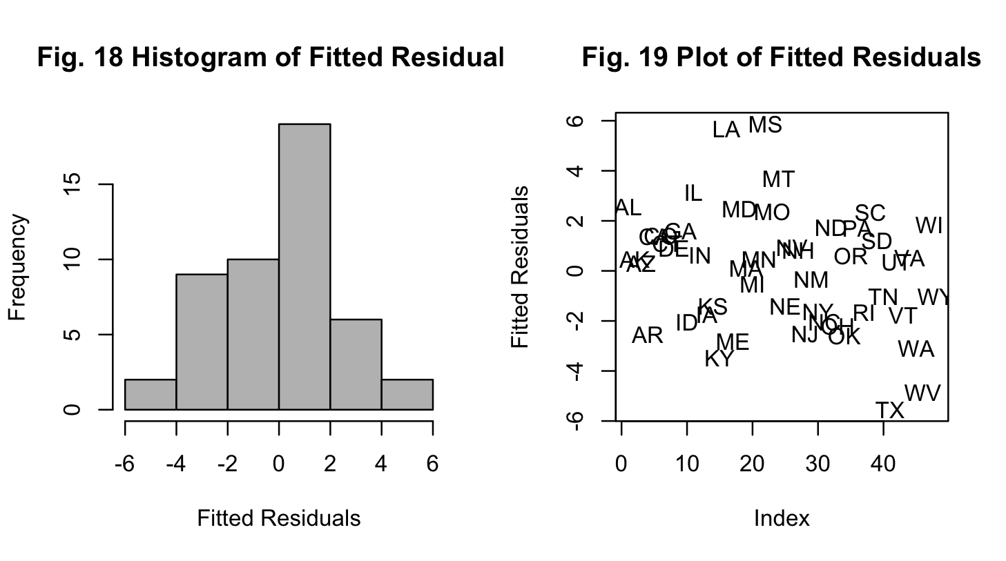
Residuals Analysis
The results from the above fitted residuals were are approximately normally distributed in Fig. 18 , though there is a lack of clear positive and negative pattern or visible linear trendline in Fig 19. The accuracy of this model is debatable.

Slide 15
Conclusions
For this model, the null hypothesis is rejected, and the alternate hypothesis is accepted. The research presented here can be considered successful, as 77.3% of variation in the dependent variable can be explained by the independent variables. It can be determined true that the dependent variable is better supported by the independent variables, than if it were not. This model was not entirely predictive, as the variables here do not influence one-another enough, but it was somewhat predictive when looking at TPR, UR, IL, RR, and SR.
This model can be improved on by increasing the number of observations, as there were missing states and missing values under some states that were included in this input data. Missing or “NA” values were omitted from this model. More observations would increase the validity of any model, but it can be assumed that this would not change our overall results in this analysis.
Should there be a need to break down the moments of closer associations, breaking this model up by time periods may add to the findings that this model is capable of. The highly correlated independent variables or multicollinearity seen in this model can be adjusted by switching those variables out and taking the first difference for those variables to reanalyze the trends in those variables.

Slide 16
Public Policy Implications
Public policy does not entirely pertain to driving a relationship between these variables but could be influential in the context of analyzing the social and economic factors that play into changes in regional homicide rate, as well as in research fields including law, criminology or even sociology. This model or an expanded version of this model could be beneficial to professionals or investors who require more insight on the variables that influence the homicide rate or general social issue levels per region of America.

Slide 17
Appendix I: Bibliography
[CITED DATA SOURCE FOR SOCIAL VARIABLES GOES HERE]

Slide 18
Appendix II: Input Data
Via Microsoft Excel file.

Slide 19
Appendix III: R-Script
# REGRESSION ANALYSIS...
# DEPENDENT: Homicide Rate
# INDEPENDENT: Unemployment, Income, Bachelor's Degree, High School Degree, Obesity, Robbery, Suicide, Teen Pregnancy
# IMPORT LIBRARIES & FILE...
library(YRmisc)
library(readxl)
SocialData_1_ <- read_excel("Documents/SocialData (1).xlsx",
sheet = "data1")
sddf<- SocialData_1_[,c("stateShort","homcideRate","unempRate","income","bachDegree","hsDegree","obesityRate","robberyRate","suicideRate","teenPregRate")]
thesis<-sddf
View(thesis)
# GRAPHICAL ANALYSIS BEGINS HERE...
# FIGURES 1 - 9: Histograms
par(mfrow=c(3,3))
hist(thesis$homcideRate, col="red", xlab="Homicide Rate", ylab="Frequency", main="Fig. 1 Hist of Homicide Rate")
hist(thesis$unempRate, col="orange", xlab="Unemployment Rate", ylab="Frequency", main="Fig. 2 Hist Unemployment Rate")
hist(thesis$income, col="yellow", xlab="Income", ylab="Frequency", main="Fig. 3 Hist of Income")
hist(thesis$bachDegree, col="green", xlab="Bachelor's Degree", ylab="Frequency", main="Fig. 4 Hist of Bachelor's Degree")
hist(thesis$hsDegree, col="blue", xlab="High School Degree", ylab="Frequency", main="Fig. 5 Hist of High School Degree")
hist(thesis$obesityRate, col="purple", xlab="Obesity Rate", ylab="Frequency", main="Fig. 6 Hist of Obesity Rate")
hist(thesis$robberyRate, col="pink", xlab="Robbery Rate", ylab="Frequency", main="Fig. 7 Hist of Robbery Rate")
hist(thesis$suicideRate, col="cyan", xlab="Suicide Rate", ylab="Frequency", main="Fig. 8 Hist of Suicide Rate")
hist(thesis$teenPregRate, col="brown", xlab="Teen Pregnancy Rate", ylab="Frequency", main="Fig. 9 Hist of Teen Pregnancy Rate")
# FIGURES 10 - 17: Scatterplots
par(mfrow=c(3,3))
scatter.smooth(thesis$unempRate, thesis$homcideRate, xlab="Unemployment Rate", ylab="Homicide Rate", main="Fig. 10 Unemployment Rate vs. Homicide Rate", type="n")
text(thesis$unempRate, thesis$homcideRate, as.character(thesis$stateShort), cex=1)
scatter.smooth(thesis$income, thesis$homcideRate, xlab="Income", ylab="Homicide Rate", main="Fig. 11 Income vs. Homicide Rate", type="n")
text(thesis$income, thesis$homcideRate, as.character(thesis$stateShort), cex=1)
scatter.smooth(thesis$bachDegree, thesis$homcideRate, xlab="Bachelor's Degree", ylab="Homicide Rate", main="Fig. 12 Bachelor's Degree vs. Homicide Rate", type="n")
text(thesis$bachDegree, thesis$homcideRate, as.character(thesis$stateShort), cex=1)
scatter.smooth(thesis$hsDegree, thesis$homcideRate, xlab="High School Degree", ylab="Homicide Rate", main="Fig. 13 High School Degree vs. Homicide Rate", type="n")
text(thesis$hsDegree, thesis$homcideRate, as.character(thesis$stateShort), cex=1)
scatter.smooth(thesis$obesityRate, thesis$homcideRate, xlab="Obesity Rate", ylab="Homicide Rate", main="Fig. 14 Obesity Rate vs. Homicide Rate", type="n")
text(thesis$obesityRate, thesis$homcideRate, as.character(thesis$stateShort), cex=1)
scatter.smooth(thesis$robberyRate, thesis$homcideRate, xlab="Robbery Rate", ylab="Homicide Rate", main="Fig. 15 Robbery Rate vs. Homicide Rate", type="n")
text(thesis$robberyRate, thesis$homcideRate, as.character(thesis$stateShort), cex=1)
scatter.smooth(thesis$suicideRate, thesis$homcideRate, xlab="Suicide Rate", ylab="Homicide Rate", main="Fig. 16 Suicide Rate vs. Homicide Rate", type="n")
text(thesis$suicideRate, thesis$homcideRate, as.character(thesis$stateShort), cex=1)
scatter.smooth(thesis$teenPregRate, thesis$homcideRate, xlab="Teen Pregnancy Rate", ylab="Homicide Rate", main="Fig. 17 Teen Pregnancy Rate vs. Homicide Rate", type="n")
text(thesis$teenPregRate, thesis$homcideRate, as.character(thesis$stateShort), cex=1)
# FIGURES 10.1 - 17.1: Scatter plots - States with Outliers
# Drop states (outliers).
thesis_drop_outliers <- thesis
drop_MS <- "MS"
drop_LA <- "LA"
thesis_drop_outliers <- thesis[thesis$stateShort != drop_MS & thesis$stateShort != drop_LA,]
View(thesis_drop_outliers)
par(mfrow=c(3,3))
scatter.smooth(thesis_drop_outliers$unempRate, thesis_drop_outliers$homcideRate, xlab="Unemployment Rate", ylab="Homicide Rate", main="Fig. 10.1 UR vs. HR", type="n")
text(thesis_drop_outliers$unempRate, thesis_drop_outliers$homcideRate, as.character(thesis_drop_outliers$stateShort), cex=1)
scatter.smooth(thesis_drop_outliers$income, thesis_drop_outliers$homcideRate, xlab="Income", ylab="Homicide Rate", main="Fig. 11.1 IL vs. HR", type="n")
text(thesis_drop_outliers$income, thesis_drop_outliers$homcideRate, as.character(thesis_drop_outliers$stateShort), cex=1)
scatter.smooth(thesis_drop_outliers$bachDegree, thesis_drop_outliers$homcideRate, xlab="Bachelor's Degree", ylab="Homicide Rate", main="Fig. 12.1 BD vs. HR", type="n")
text(thesis_drop_outliers$bachDegree, thesis_drop_outliers$homcideRate, as.character(thesis_drop_outliers$stateShort), cex=1)
scatter.smooth(thesis_drop_outliers$hsDegree, thesis_drop_outliers$homcideRate, xlab="High School Degree", ylab="Homicide Rate", main="Fig. 13.1 HSD vs. HR", type="n")
text(thesis_drop_outliers$hsDegree, thesis_drop_outliers$homcideRate, as.character(thesis_drop_outliers$stateShort), cex=1)
scatter.smooth(thesis_drop_outliers$obesityRate, thesis_drop_outliers$homcideRate, xlab="Obesity Rate", ylab="Homicide Rate", main="Fig. 14.1 OR vs. HR", type="n")
text(thesis_drop_outliers$obesityRate, thesis_drop_outliers$homcideRate, as.character(thesis_drop_outliers$stateShort), cex=1)
scatter.smooth(thesis_drop_outliers$robberyRate, thesis_drop_outliers$homcideRate, xlab="Robbery Rate", ylab="Homicide Rate", main="Fig. 15.1 RR vs. HR", type="n")
text(thesis_drop_outliers$robberyRate, thesis_drop_outliers$homcideRate, as.character(thesis_drop_outliers$stateShort), cex=1)
scatter.smooth(thesis_drop_outliers$suicideRate, thesis_drop_outliers$homcideRate, xlab="Suicide Rate", ylab="Homicide Rate", main="Fig. 16.1 SR vs. HR", type="n")
text(thesis_drop_outliers$suicideRate, thesis_drop_outliers$homcideRate, as.character(thesis_drop_outliers$stateShort), cex=1)
scatter.smooth(thesis_drop_outliers$teenPregRate, thesis_drop_outliers$homcideRate, xlab="Teen Pregnancy Rate", ylab="Homicide Rate", main="Fig. 17.1 TPR vs. HR", type="n")
text(thesis_drop_outliers$teenPregRate, thesis_drop_outliers$homcideRate, as.character(thesis_drop_outliers$stateShort), cex=1)
# STATISTICAL ANALYSIS BEGINS HERE...
# TABLE 1: DESCRIPTIVE STATISTICS
des_stats<-ds.summ(thesis[,c("homcideRate","unempRate","income","bachDegree","hsDegree","obesityRate","robberyRate","suicideRate","teenPregRate")],3)[,-c(7,8)]
View(des_stats)
# TABLE 2: CORRELATION MATRIX
cor_matrix<-round(cor(thesis[,c("homcideRate","unempRate","income","bachDegree","hsDegree","obesityRate","robberyRate","suicideRate","teenPregRate")]),3)
View(cor_matrix)
# TABLE 3: REGRESSION ANALYSIS
thesis1<-na.omit(thesis)
fit<-lm(homcideRate~unempRate+income+bachDegree+hsDegree+obesityRate+robberyRate+suicideRate+teenPregRate,na.action=na.omit,data=thesis1)
summary(fit)
# FIGURES 18 & 19: Fitted Residuals
#Vector; how much the computer missed each time...
thesis1$homcideRate
fit$fitted.values
fit$residuals
par(mfrow=c(2,2))
hist(fit$residuals,col="grey",xlab="Fitted Residuals",ylab="Frequency",main="Fig. 18 Histogram of Fitted Residuals")
plot(fit$residuals,xlab="Index",ylab="Fitted Residuals",main="Fig. 19 Plot of Fitted Residuals",type="n")
text(fit$residuals,as.character(thesis1$stateShort),cex=1)

Slide 20
Copyright Notice
© 2024 Brianna L. Palmisano. All rights reserved.
This presentation, including all content, graphics, and design elements, is the intellectual property of Brianna L. Palmisano. Unauthorized copying, distribution, display, or use of any part of this presentation without express written permission is strictly prohibited. For permissions, please contact brianna.palmisano21@my.stjohns.edu.

Slide 21
Thank you! Questions & Correspondence Brianna Palmisano brianna.palmisano21@my.stjohns.edu

