Slide 1
Module 3
Data visualization

Slide 2
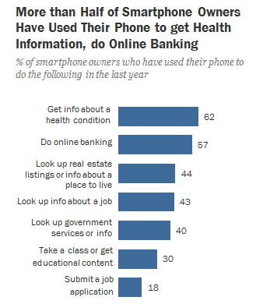
Discussion Question
Which of the following questions can be answered by this chart?
Among survey responders...
What proportion did not use their phone for online banking?
What proportion either used their phone for online banking or to look up real estate listings?
Did everyone use their phone for at least one of these activities?
Did anyone use their phone for both online banking and real estate?
Pew research center, 2014

Slide 3
Visualization – beyond tables
Tables are a powerful way of organizing and visualizing data.
However, large tables of numbers can be difficult to interpret, no matter how organized they are.
Sometimes it is much easier to interpret graphs than numbers.

Slide 4
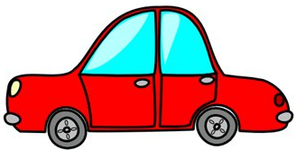
Area Principle
Areas should be proportional to the values they represent
In 2013,
30% of accidental deaths of males were due to automobile accidents
20% of accidental deaths of females were due to automobile accidents
0%
10%
20%
30%
Example from Tian Zheng

Slide 5
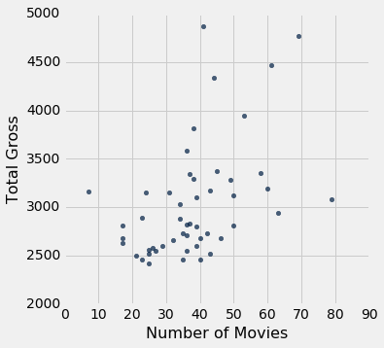
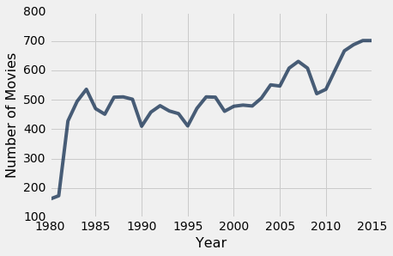
Examples of chart types
Scatter plots
Line graphs
(Demo) – notebook 3.1
Charts
Notes:
Emphasize that the type pf plot one makes will depend on the type of data under study. This is a good segue to the next slide.

Slide 6
Types of Data
All values in a column should be both the same type and be comparable to each other in some way
Numerical — Each value is from a numerical scale
Numerical measurements are ordered
Differences are meaningful
Categorical — Each value is from a fixed inventory
May or may not have an ordering
Categories are the same or different

Slide 7
“Numerical” Data
Just because the values are numbers, doesn’t mean the variable is numerical
Census example had numerical SEX code (0, 1, and 2)
It doesn’t make sense to perform arithmetic on these “numbers”, e.g. 1 - 0 or (0+1+2)/3 are nonsense here
The variable SEX is still categorical, even though numbers were used for the categories

Slide 8
Terminology
Individuals: those whose features are recorded
Variables: features; these vary across individuals
Variables have different values
Values can be numerical, or categorical, or of many other types
Distribution: For each different value of the variable, the frequency of individuals that have that value
Frequency is measured in counts. Later we will use proportions or percents.

Slide 9
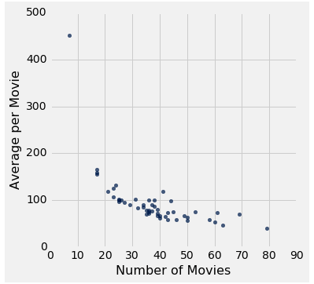
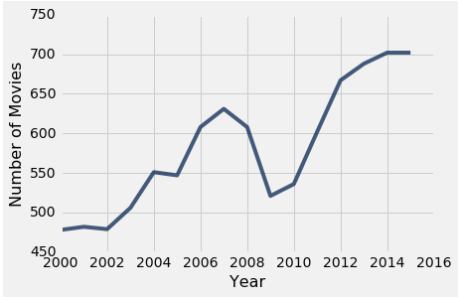
Plotting Two Numerical Variables
Scatter plot: scatter
Line graph: plot

Slide 10
Categorical Distribution

Slide 11
Bar Charts of Counts
Distributions:
The distribution of a variable (a column) describes the frequency of its different values
The group method counts the number of rows for each value in a column
Bar charts can display the distribution of categorical values
Ex. 1: Proportion of how many US residents are male or female
Ex. 2: Count of how many top movies were released by each studio
(Demo) – notebook 3.1
categorical distributions
Notes:
Another example/demo from the book - https://umass-data-science.github.io/190fwebsite/textbook/07/1/visualizing-categorical-distributions/

Slide 12
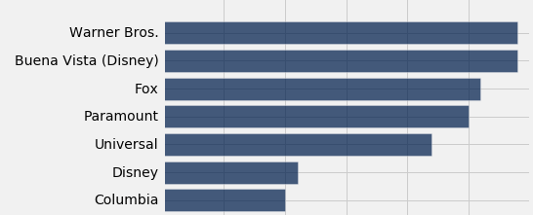
Categorical Distributions
bar chart: barh
Displays a categorical distribution
(But when the values of the variable have a rank ordering (e.g. year), or fixed sizes relative to each other, more care might be needed.)

Slide 13
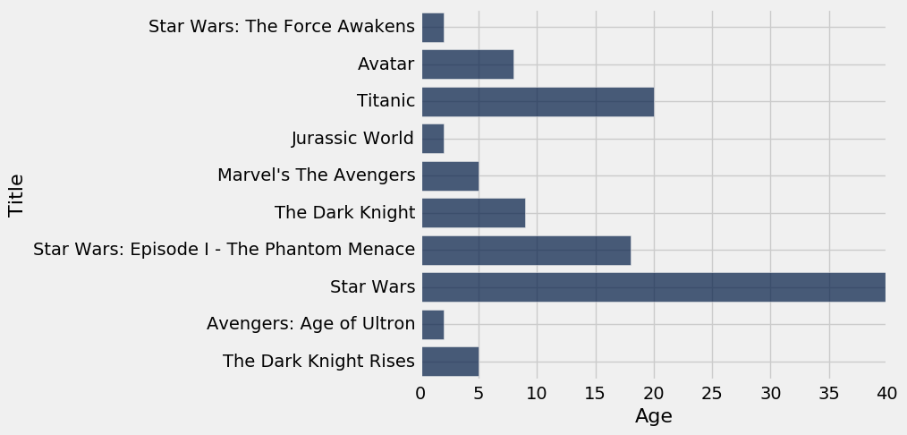
How Do You Generate This Chart?
Top 10 highest grossing movies
How long ago each one was released
Notes:
Student Can generate this chart using the “top” table from the .ipynb

Slide 14
numerical distribution

Slide 15
Binning

Slide 16
Binning Numerical Values
Binning is counting the number of numerical values that lie within ranges, called bins.
Bins are defined by their lower bounds (inclusive)
The upper bound is the lower bound of the next bin
188, 170, 189, 163, 183, 171, 185, 168, 173, ...
The [185,190) bin
160
165
170
175
180
185
190

Slide 17

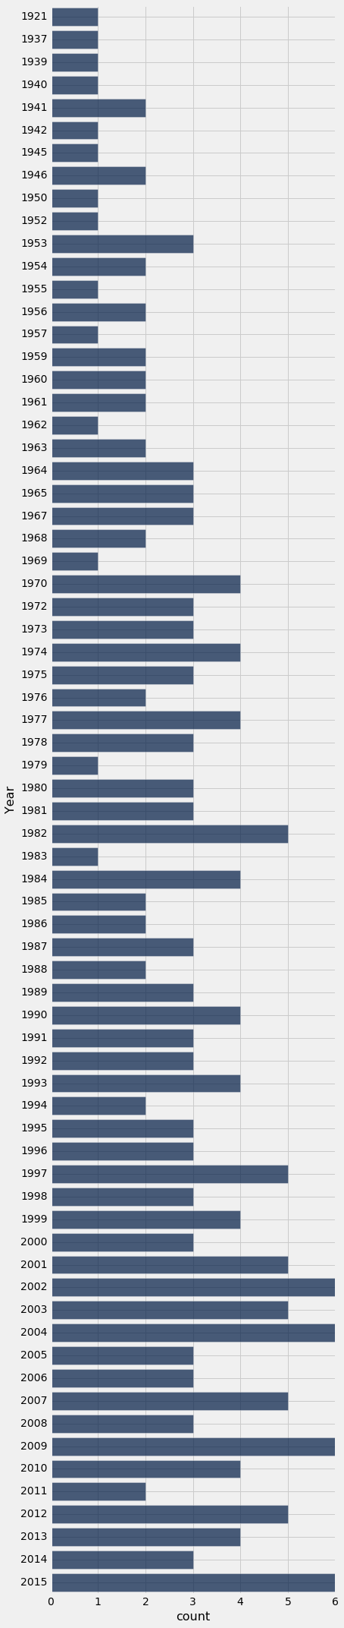
Why BiN?
The chart to the right has many issues:
The bars at 1921 and 1937 are just as far apart from each other as the bars at 1937 and 1939.
The bar chart doesn't show that none of the 200 movies were released in the years 1922 through 1936, nor in 1938.
Shows the bar chart is unsuitable for visualization such data (data that’s ordered some way/has some rank)
The individual bars are too many, we need to group them somehow (hence binning)
Notes:
First pic is the example from the book. We want to plot a bar chart of title counts per year
In case the pic on the right is not visible here correctly, load it from https://umass-data-science.github.io/190fwebsite/textbook/07/1/visualizing-categorical-distributions/
Because of points 1 and 2: Such inconsistencies and omissions make the distribution in the early years hard to understand based on this visualization.

Slide 18
Histogram
Chart to display the distribution of numerical values using bins
(Demo) – notebook 3.1
binning and histograms
Notes:
More demos here: first few visualizations at - https://umass-data-science.github.io/190fwebsite/textbook/07/2/visualizing-numerical-distributions/

Slide 19
The Density Scale

Slide 20
Histogram Axes
By default, hist uses a scale (normed=True) that ensures the area of the chart sums to 100%
The horizontal axis is a number line (e.g., years)
The vertical axis is a rate (e.g., percent per year)
The area of a bar is a percentage of the whole
(Demo) – notebook 3.1 the density scale
Notes:
More demos over here : https://umass-data-science.github.io/190fwebsite/textbook/07/2/visualizing-numerical-distributions/

Slide 21
How to Calculate Height
The [20, 40) bin contains 59 out of 200 movies
“59 out of 200” is 29.5%
The bin is 40 - 20 = 20 years wide
29.5 percent
Height of bar = --------------------------
20 years
= 1.475 percent per year

Slide 22
Height Measures Density
% in bin
Height = ---------------------
width of bin
The height measures the percent of data in the bin relative to the amount of space in the bin.
So height measures crowdedness, or density.

Slide 23
Area Measures Percent
Area = % in bin = Height x width of bin
“How many individuals in the bin?” Use area.
“How crowded is the bin?” Use height.
Notes:
At this point, do a review of the histogram at the end of the 3.1 notebook

Slide 24
Discussion Question
Name | 2016 Income (millions)
Jennifer Lawrence | 61.7
Scarlett Johansson | 57.5
Angelina Jolie | 40
Jennifer Aniston | 24.75
Anne Hathaway | 24
Melissa McCarthy | 24
Bingbing Fan | 20
Sandra Bullock | 20
Cara Delevingne | 15
Reese Witherspoon | 15
Amy Adams | 15
Kristen Stewart | 12
Amanda Seyfried | 10.5
Tina Fey | 10.5
Julia Roberts | 10
Emma Stone | 10
Natalie Portman | 8.5
Margot Robbie | 8
Meryl Streep | 6
Mila Kunis | 4.5
What's the height of each bar in these two histograms?
actress.hist(1, bins=[0,15,25,85])
actress.hist(1, bins=[0,15,35,85])
What are the vertical axis units?
Notes:
First - height = % in bin/width of bin – percentage = 9/20 * 100 = 45; 45/15 = 3
Second – height = % in bin/width of bin – percentage =
-- Vertical axis units = % per million dollars, horizontal axis units = adjusted gross (million dollars)

Slide 25
Chart Types

Slide 26
Bar Chart Versus Histogram
Bar Chart
1 categorical axis & 1 numerical axis
Bars have arbitrary (but equal) widths and spacings
For distributions: height (or length) of bars are proportional to the percent of individuals
Histogram
Horizontal axis is numerical, hence to scale with no gaps
Height measures density; areas are proportional to the percent of individuals
Notes:
Bar chart notes:
1 categorical axis (e.g., flavors), 1 numerical axis (e.g., count)
Bar widths don’t mean anything

Slide 27
Comparing Histograms

Slide 28
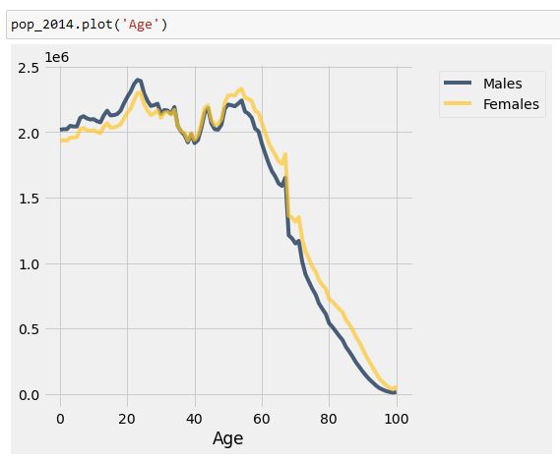
Overlaid Graphs
For visually comparing two populations

Slide 29
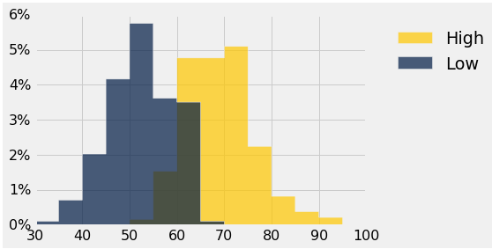
Discussion Question
This histogram describes a year of daily temperatures
Try to answer these questions:
What proportion of days had a high temp in the range 60-69?
What proportion had a low of 45 or more?
How many days had a difference of more than 20 degrees between their high & low temperatures?

Slide 30
Questions?

