Slide 1
Module 8
Why the mean matters
Notes:
- In this course we have studied several different statistics, including total variation distance, the maximum, the median, and also the mean.
Under clear assumptions about randomness, we have drawn empirical distributions of all of these statistics.
Some, like the maximum and the total variation distance, have distributions that are clearly skewed in one direction or the other.
But the empirical distribution of the sample mean has almost always turned out close to bell-shaped, regardless of the population being studied.
If a property of random samples is true regardless of the population, it becomes a powerful tool for inference because we rarely know much about the data in the entire population.
That is why random sample means are extensively used in data science.

Slide 2
Center and spread
Notes:
In studying the mean, we want to answer such questions as:
What exactly does the mean measure?
How close to the mean are most of the data?
How is the sample size related to the variability of the sample mean?
Why do empirical distributions of random sample means come out bell shaped?
How can we use sample means effectively for inference?

Slide 3
Questions
How can we quantify natural concepts like “center” and “variability”?
Why do many of the empirical distributions that we generate come out bell shaped?
How is sample size related to the accuracy of an estimate?

Slide 4
Average

Slide 5
The average or mean
Data: 2, 3, 3, 9 Average = (2+3+3+9)/4 = 4.25
Need not be a value in the collection
Need not be an integer even if the data are integers
Somewhere between min and max, but not necessarily halfway in between
Same units as the data
Smoothing operator: collect all the contributions in one big pot, then split evenly
(Demo – notebook 8.1,
Average(Mean))
Notes:
Mean as a smoother.
You can think of taking the mean as an "equalizing" or "smoothing" operation.
For example, imagine the entries in [2, 3, 3, 9] as the dollars in the pockets of four different people.
To get the mean, you first put all of the money into one big pot and then divide it evenly among the four people.

Slide 6
Proportions are Averages
Data: 0 1 0 0 1 0 1 1 0 0 (10 entries)
Sum = 4 = number of 1’s
Average = 4/10 = 0.4 = proportion of 1’s
If the population consists of 1’s and 0’s (yes/no answers to a question), then:
the population average is the proportion of 1’s in the population
the sample average is the proportion of 1’s in the sample
(Demo – notebook 8.1,
Average(Mean))
Notes:
If a collection consists only of ones and zeroes, then the sum of the collection is the number of ones in it, and the mean of the collection is the proportion of ones.

Slide 7
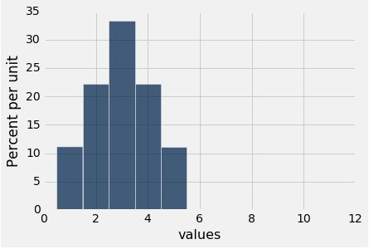
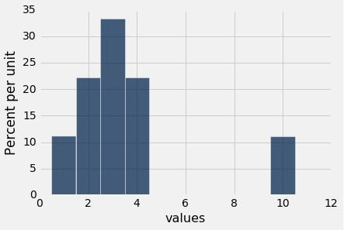
Discussion Question
Are the medians of these two distributions the same or different? Are the means the same or different? If you say “different,” then say which one is bigger.
Notes:
Medians are the same
Means are different.
Which is bigger? Mean B is bigger

Slide 8
Comparing Mean and Median
Mean: Balance point of the histogram
Median: Half-way point of data; half the area of histogram is on either side of median
If the distribution is symmetric about a value, then that value is both the average and the median.
If the histogram is skewed, then the mean is pulled away from the median in the direction of the tail.
Notes:
In general, if the histogram has a tail on one side (the formal term is "skewed"), then the mean is pulled away from the median in the direction of the tail.
For example; The table sf2015 contains salary and benefits data for San Francisco City employees in 2015.

Slide 9
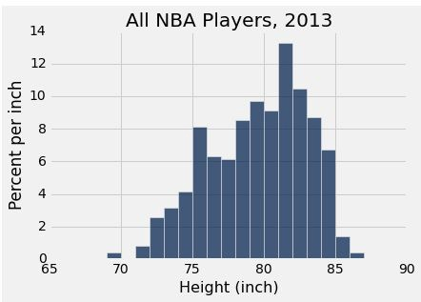
Discussion Question
Which is bigger?
mean
median
(Demo – Notebook 8.1, Discussion Question)

Slide 10
Standard deviation

Slide 11
Defining Variability
Plan A: “biggest value - smallest value”
Doesn’t tell us much about the shape of the distribution
Plan B:
Measure variability around the mean
Need to figure out a way to quantify this
(Demo – Notebook 8.1, Standard Deviation)
Notes:
The mean tells us where a histogram balances.
But in almost every histogram we have seen, the values spread out on both sides of the mean.
How far from the mean can they be?
To answer this question, we will develop a measure of variability about the mean.

Slide 12
How Far from the Average?
Standard deviation (SD) measures roughly how far the data are from their average
SD = root mean square of deviations from average
5 4 3 2 1
SD has the same units as the data

Slide 13
Why Use the SD?
There are two main reasons.
The first reason:
No matter what the shape of the distribution,
the bulk of the data are in the range “average ± a few SDs”
The second reason:
We can quantify how much data is represented within a few SDs, i.e., Chevyshev’s Bounds.

Slide 14
Chebyshev’s inequality

Slide 15
How Big are Most of the Values?
No matter what the shape of the distribution,
the bulk of the data are in the range “average ± a few SDs”
Chebyshev’s Inequality
No matter what the shape of the distribution,
the proportion of values in the range “average ± z SDs” is
at least 1 - 1/z²
Notes:
It is important to note that the result gives a bound, not an exact value or an approximation.
What makes the result powerful is that it is true for all lists – all distributions, no matter how irregular.

Slide 16
Chebyshev’s Bounds
Range | Proportion
average ± 2 SDs | at least 1 - 1/4 (75%)
average ± 3 SDs | at least 1 - 1/9 (88.888…%)
average ± 4 SDs | at least 1 - 1/16 (93.75%)
average ± 5 SDs | at least 1 - 1/25 (96%)
No matter what the distribution looks like
(Demo – Notebook 8.2, Chebyshev’s Bounds)
Notes:
Specifically, it says that for every list:
the proportion in the range "average ±± 2 SDs" is at least 1 - 1/4 = 0.75
the proportion in the range "average ±± 3 SDs" is at least 1 - 1/9 ≈≈ 0.89
the proportion in the range "average ±± 4.5 SDs" is at least 1 - 1/4.524.52 ≈≈ 0.95

Slide 17
Standard units

Slide 18
Standard Units
● How many SDs above average?
● z = (value - average)/SD
○ Negative z:
○ Positive z:
○ z = 0:
value below average value above average value equal to average
● When values are in standard units: average = 0, SD = 1
● Chebyshev: At least 96% of the values of z are between
-5 and 5
(Demo – Notebook 8.2, Standard Units)
Notes:
In the calculations above, the quantity z measures standard units, the number of standard deviations above average.
But no matter what the distribution of the list looks like, Chebychev's bounds imply that standard units will typically be in the (-5, 5) range.
To convert a value to standard units, first find how far it is from average, and then compare that deviation with the standard deviation.
Standard units are frequently used in data analysis.

Slide 19
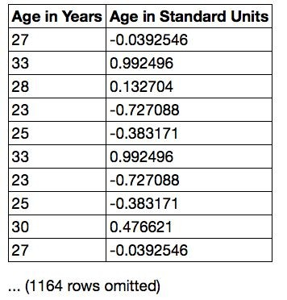
Discussion Question
Find whole numbers that are close to:
(a) the average age
(b) the SD of the ages
Notes:
Those close to the average age should have age in std units closer to 0?

Slide 20
The SD and the Histogram
● Usually, it's not easy to estimate the SD by looking at a histogram.
● But if the histogram has a bell shape, then you can.

Slide 21
The SD and Bell-Shaped Curves
If a histogram is bell-shaped, then
● the average is at the center
● the SD is the distance between the average and the points of inflection on either side
(Demo – Notebook 8.2, The SD and Bell-Shaped Curves)

Slide 22
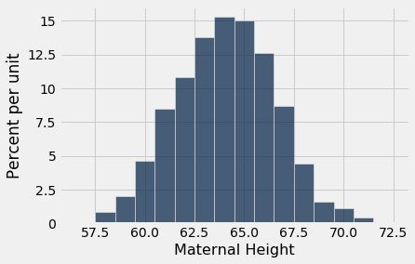
Point of Inflection

Slide 23
The normal distribution

Slide 24
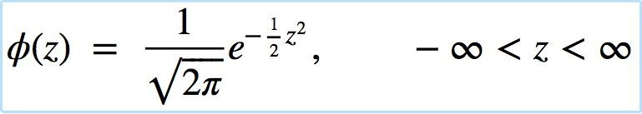
The Standard Normal Curve
A beautiful formula that we won’t use at all:
Notes:
All the bell-shaped histograms that we have seen look essentially the same apart from the labels on the axes. Indeed, there is really just one basic curve from which all of these curves can be drawn just by relabeling the axes appropriately.
To draw that basic curve, we will use the units into which we can convert every list: standard units. The resulting curve is therefore called the standard normal curve.
The standard normal curve has an impressive equation. But for now, it is best to think of it as a smoothed outline of a histogram of a variable that has been measured in standard units and has a bell-shaped distribution.

Slide 25
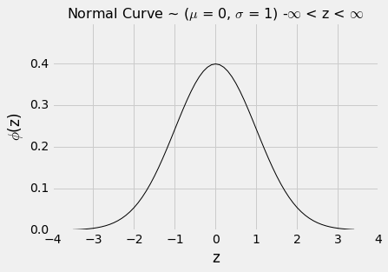
Bell Curve
Notes:
As always when you examine a new histogram, start by looking at the horizontal axis. On the horizontal axis of the standard normal curve, the values are standard units.
Here are some properties of the curve. Some are apparent by observation, and others require a considerable amount of mathematics to establish.
The total area under the curve is 1. So you can think of it as a histogram drawn to the density scale.
The curve is symmetric about 0. So if a variable has this distribution, its mean and median are both 0.
The points of inflection of the curve are at -1 and +1.
If a variable has this distribution, its SD is 1. The normal curve is one of the very few distributions that has an SD so clearly identifiable on the histogram.

Slide 26
normal proportions

Slide 27
How Big are Most of the Values?
No matter what the shape of the distribution,
the bulk of the data are in the range “average ± a few SDs”
If a histogram is bell-shaped, then
● Almost all of the data are in the range “average ± 3 SDs”
Notes:
Segue to the book here – re:cdfs
https://umass-data-science.github.io/190fwebsite/textbook/14/3/sd-and-the-normal-curve/

Slide 28
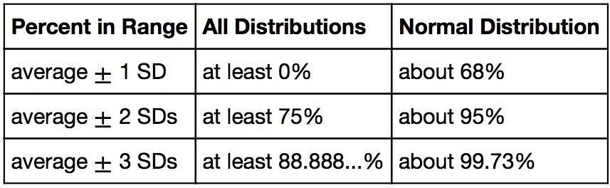
Bounds and Normal Approximations

Slide 29
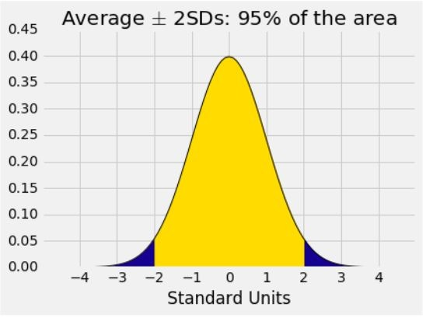
A “Central” Area

Slide 30
Central limit theorem

Slide 31
Sample Averages
● The Central Limit Theorem describes how the normal distribution (a bell-shaped curve) is connected to random sample averages.
● We care about sample averages because they estimate population averages.

Slide 32
Central Limit Theorem
If the sample is
● large, and
● drawn at random with replacement,
Then, regardless of the distribution of the population,
the probability distribution of the sample sum (or the sample average) is roughly normal
(Demo – Notebook 8.3, Central Limit Theorem)

Slide 33
Distribution of the sample average

Slide 34
Why is There a Distribution?
You have only one random sample, and it has only one average.
But the sample could have come out differently.
And then the sample average might have been different.
So there are many possible sample averages.

Slide 35
Distribution of the Sample Average
Imagine all possible random samples of the same size as yours. There are lots of them.
Each of these samples has an average.
The distribution of the sample average is the distribution of the averages of all the possible samples.
(Demo – Notebook 8.3, Distribution of the Sample Average)

Slide 36
Specifying the Distribution
Suppose the random sample is large.
We have seen that the distribution of the sample average is roughly bell shaped.
Important questions remain:
Where is the center of that bell curve?
How wide is that bell curve?

Slide 37
Center of the Distribution

Slide 38
The Population Average
The distribution of the sample average is roughly a bell curve centered at the population average.
Notes:
Go back to 8.3 and show where the mean delay value is on the empirical histograms

Slide 39
Variability of the sample average

Slide 40
Why Is This Important?
Along with the center, the spread helps identify exactly which normal curve is the distribution of the sample average.
The variability of the sample average helps us measure how accurate the sample average is as an estimate of the population average.
If we want a specified level of accuracy, understanding the variability of the sample average helps us work out how large our sample has to be.
(Demo)

Slide 41
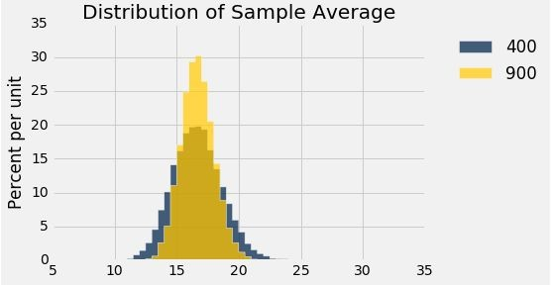
Discussion Question
The gold histogram shows the distribution of
values, each of which is .
(a) 900 (b) 10,000
a randomly sampled flight delay
an average of flight delays

Slide 42
The Two Histograms
The gold histogram shows the distribution of 10,000 values, each of which is an average of 900 randomly sampled flight delays.
The blue histogram shows the distribution of 10,000 values, each of which is an average of 400 randomly sampled flight delays.
Both are roughly bell shaped.
The larger the sample size, the narrower the bell.
(Demo – Notebook 8.3, Distribution of the Sample Average)

Slide 43
Variability of the Sample Average
The distribution of all possible sample averages of a given size is called the distribution of the sample average.
We approximate it by an empirical distribution.
By the CLT, it’s roughly normal:
Center = the population average
SD = (population SD) / √sample size
(Demo – Notebook 8.3, Variability of the Sample Average)
Notes:
This is the standard deviation of the averages of all the possible samples that could be drawn.
*It measures roughly how far off the sample means are from the population mean.

Slide 44
Averages of large samples

Slide 45
The Effect of Sample Size
CLT: If the sample size is large, the distribution of a random sample average is roughly normal.
The bigger the sample, the smaller the spread of the distribution.

Slide 46
Central Limit Theorem
If the sample is large and drawn at random with replacement,
Then, regardless of the distribution of the population,
the probability distribution of the sample average:
is roughly normal
mean = population mean
SD = (population SD) / √sample size
Notes:
The SD of all possible sample means measures how variable the sample mean can be.
As such, it is taken as a measure of the accuracy of the sample mean as an estimate of the population mean.
The smaller the SD, the more accurate the estimate.

Slide 47
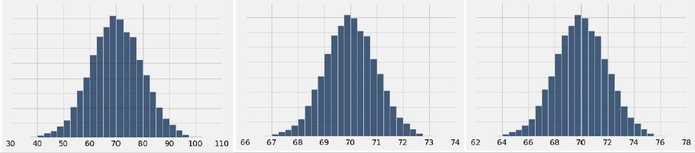
Discussion Question
A population has average 70 and SD 10. One of the histograms below is the empirical distribution of the averages of 10,000 random samples of size 100 drawn from the population. Which one?
(A)
(B)
(C)

Slide 48
Discussion Question
A city has 500,000 households. The annual incomes of these households have an average of $65,000 and an SD of $45,000. The distribution of the incomes [pick one and explain]:
is roughly normal because the number of households is large.
is not close to normal.
may be close to normal, or not; we can’t tell from the information given.
Notes:
The normal distribution does not depend on the population size, neither does the CLT

Slide 49
Discussion Question
A city has 500,000 households. The annual incomes of these households have an average of $65,000 and an SD of $45,000. A random sample of 900 households is taken.
Fill in the blanks and explain:
There is about a 68% chance that the average annual income of the sampled households is in the range
$ plus or minus $

Slide 50
Confidence intervals

Slide 51
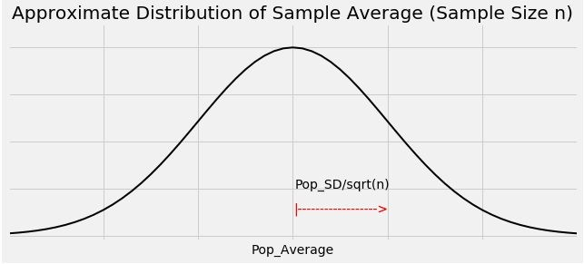
Graph of the Distribution

Slide 52
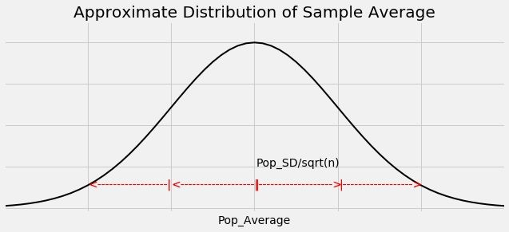
The Key to 95% Confidence
SD above the mean
SDs above the mean
For about 95% of all samples, the sample average and population average are within 2 SDs of each other.
SD = SD of sample average
= (population SD) / √sample size

Slide 53
Constructing the Interval
For 95% of all samples,
If you stand at the population average and look two SDs on both sides, you will find the sample average.
Distance is symmetric.
So if you stand at the sample average and look two SDs on both sides, you will capture the population average.

Slide 54
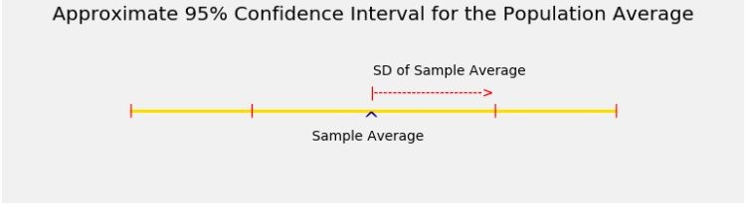
The Interval

Slide 55
Width of the Interval
Total width of a 95% confidence interval for the population average
= 4 * SD of the sample average
= 4 * (population SD) / √sample size

Slide 56
Controlling the Width
Total width of an approximate 95% confidence interval for a population proportion
= 4 * (SD of 0/1 population) / √sample size
The narrower the interval, the more precise your estimate.
Suppose you want the total width of the interval to be no more than 1%. How should you choose the sample size?
Notes:
Use the vote approximation example here to show what the 0/1 population is

Slide 57
The Sample Size for a Given Width
0.01 = 4 * (SD of 0/1 population) / √sample size
Left side: 1%, the max total width that you’ll accept
Right side: formula for the total width
√sample size = 4 * (SD of 0/1 population) / 0.01
(Demo – Notebook 8.4, SD of 0/1 Population)
Notes:
Before going to the demo, mention that if we had the SD of the 0/1 pop here we’d be done
Ask them what to do since we don’t have it
The demo is to motivate why SD is at most 0.5

Slide 58
“Worst Case” Population SD
√sample size = 4 * (SD of 0/1 population) / 0.01
SD of 0/1 population is at most 0.5
√sample size ≥ 4 * 0.5 / 0.01
sample size ≥ (4 * 0.5 / 0.01) ** 2 = 40000
The sample size should be 40,000 or more

Slide 59
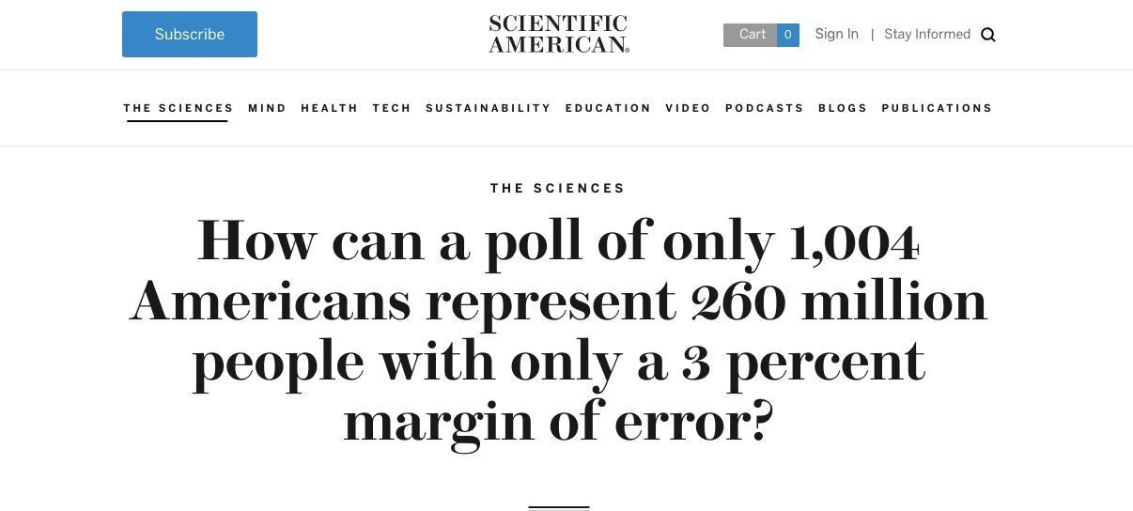
Discussion Question
https://www.scientificamerican.com/article/howcan-a-poll-of-only-100/

Slide 60
Discussion Question
A researcher is estimating a population proportion based on a random sample of size 10,000.
Fill in the blank with a decimal:
With chance at least 95%, the estimate will be correct to within .

Slide 61
Discussion Question
I am going to use a 68% confidence interval to estimate a population proportion.
I want the total width of my interval to be no more than 2.5%.
How large must my random sample be?
2 * (0.5) / sqrt(sample size) = 0.025

Slide 62
Questions?

