Slide 1

Lecture 35
DATA 8
Spring 2023
Classification

Slide 2
Announcements

Slide 3
Prediction

Slide 4
Guessing the Value of an Attribute
Based on incomplete information
One way of making predictions:
To predict an outcome for an individual,
find others who are like that individual
and whose outcomes you know.
Use those outcomes as the basis of your prediction.
Two Types of Prediction
Classification = Categorical; Regression = Numerical

Slide 5
Prediction Example: Spam or Not?

Slide 6
Machine Learning Algorithm
A mathematical model
calculated based on sample data ("training data")
that makes predictions or decisions without being explicitly programmed to perform the task

Slide 7
Classification

Slide 8

Classification Examples

Slide 9
Classification Examples

Slide 10
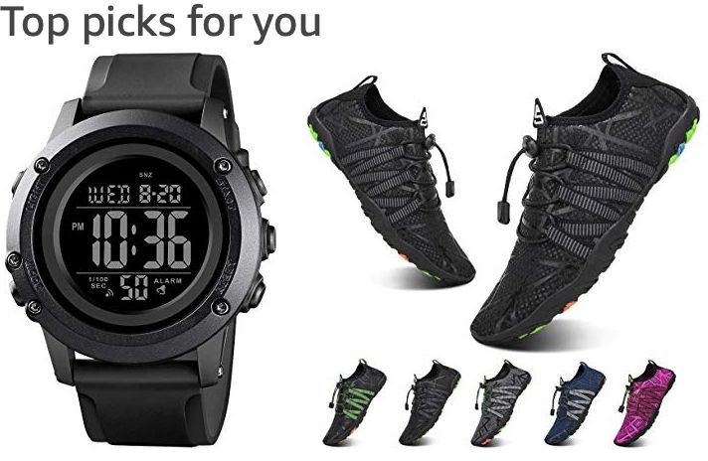

Classification Examples
(Demo)

Slide 11
Classifiers

Slide 12
Training a Classifier
Classifier
Attributes of an example
Predicted label of the example
Model the association between
Population
attributes & labels
Labels
Training
Set
Sample
Estimate the accuracy of the classifier
Test
Set

Slide 13
Nearest Neighbor Classifier
NN Classifier Use the label of the most similar training example
Attributes of an example
Predicted label of the example
Population
Training
Set
Attributes
Labels
Test
Set
(Demo)

Slide 14
Rows

Slide 15
Rows of Tables
Each row contains all the data for one individual
t.row(i) evaluates to ith row of table t
t.row(i).item(j)is the value of column j in row i
If all values are numbers, then np.array(t.row(i))
evaluates to an array of all the numbers in the row.
To consider each row individually, use
for row in t.rows:
… row.item(j) …
t.exclude(i)evaluates to the table t without its ith row

Slide 16
Distance

Slide 17

Pythagoras’ Formula
(x₀, y₀)
y₀ - y₁
(x₁, y₁)
x₀ - x₁

Slide 18


Distance Between Two Points
Two attributes x and y:
Three attributes x, y, and z:
(Demo)
and so on ...

