Slide 1
Beehive health monitoring with .NET Gadgeteer
A project by
Ben Lee-Rodgers

Slide 2
Background
Honeybees are agriculturally important
Millions of beehives house colonies across Europe
Colony survival rate is low - ~30% don’t make it through winter
Reasons not clear – disease, weather?
Little monitoring currently done
Beekeepers need help – don’t visit hives much
Notes:
Honeybees are very important to our economy.
As well as producing honey, more importantly they are key pollinators for a large proportion of our crops (probably in excess of 50% in fact),
In the UK, we have around a quarter of a million beehives, run by a mixture of people from both the amateur and industrial world.
Unfortunately, even experienced beekeepers can struggle to keep their colony alive from one season to the next, and recently the survival rate has been low.
Part of the problem is that the causes of death are not fully understood – though disease, poor weather, and pesticide poisoning have all been blamed.
Additionally, there are a number of other threats such as wild animals (wasps, moles) and human vandals that can disrupt and threaten the hive.
The aim of this project is therefore to help the beekeepers better monitor the health of their hives, and maybe prevent some colony collapses.
Beekepers don’t actually visit the hives much because it’s harmful to the bees to keep disturbing them, so automated monitoring could be a real asset.
Not much is currently done in terms of remote monitoring – some serious research with expensive hardware but no frontend, some commercial efforts, and plenty of hobbyists attempts with things like Arduino but again no frontend or system flexibility. This is why I think there is scope for building a better system that offers this flexibility, easy extensibilty and more sophisticated frontend and data server.

Slide 3
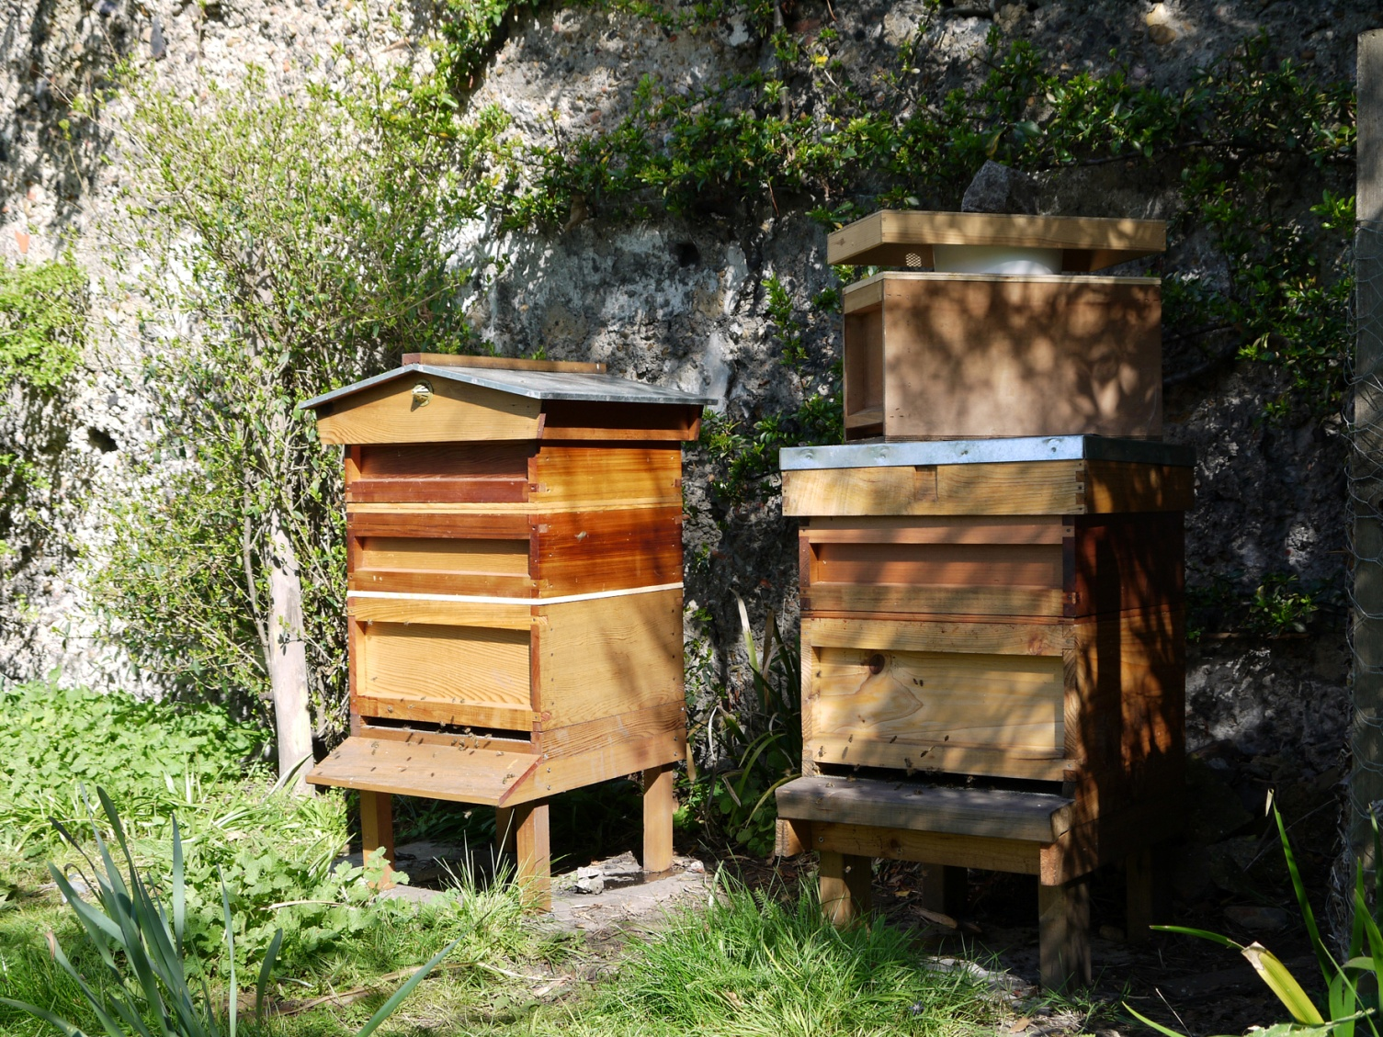
Beehives
Notes:
Here’s a typical beehive in the UK, each one housing a colony of around 50,000 bees at peak.

Slide 4
Gadgeteer Monitoring
Gadgeteer is a hardware + software platform
Useful for embedded applications
Makes prototyping easy compared to e.g. Arduino
This project interested in sensing possibilities -
temperature, light, weight, humidity etc.
Then push data to web service, e.g. Azure
Notes:
The tools for this will be Microsoft’s Gadgeteer platform.
Hardware consists of mainboard (which is just a microprocessor with a lot of sockets) and modules that plug in to these sockets – these could be sensors, networking, cameras, motors etc.
Software is .NET micro-framework plus Gadgeteer SDK for each module and mainboard. Writing a program for a Gadgeteer device is done in C# and is fairly straightforward, though there can be problems with the limited libraries that exist in NET MF because it’s much smaller than .NET.
For beehive health monitoring, the sensor modules are the most interesting – thermometer, accelerometer, light sensor etc.
It’s also possible to build custom sensors as each socket’s pins can be exposed – for example each has a number of analogue pins that could be useful for connecting non-Gadgeteer sensors.
Also useful is the WiFi module for pushing data to the web, and an SD card module for permanent storage.

Slide 5
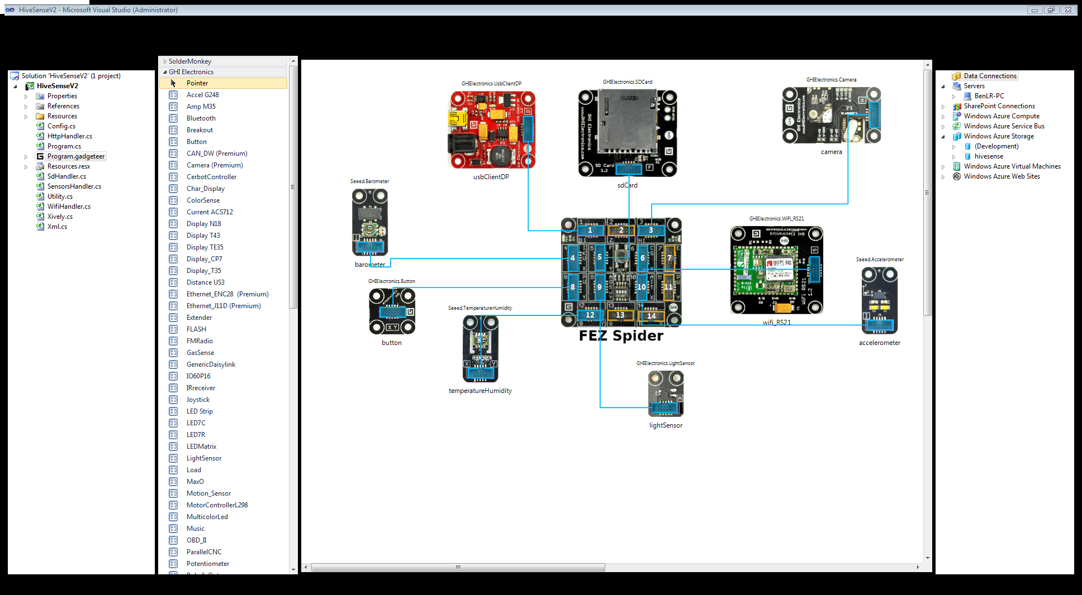
Gadgeteer Design View
Notes:
So, here’s how to actually program a Gadgeteer device.
We have the microprocessor in the middle, and a number of modules available here [toolbox] that are drag and dropped to the stage. Attaching to a socket on the mainboard exposes that module’s SDK to the program.

Slide 6
Web Monitoring
RESTful web service (Node.js)
PUT/POST from the device
GET to the GUI front-end
Storage with Azure Table Service (key-value)
GUI for live monitoring and historical graphs
Server delivers warnings when sensor thresholds breached
Hosted on Azure, deployed with GitHub
Notes:
On the web side, I started off using a RESTful service called Xively which provides all the backend storage and necessary HTTP methods for reading/writing etc.
This worked fine for the first prototype but it is not really flexible enough for my needs, and there are limits on what can be done with the free account.
So, I decided to design and implement my own service, using Node.js and run on the Azure service. Node makes it easy to write scalable and flexible RESTful web services.
The database would ideally be a proper relational one like SQL server, but Azure doesn’t fully support this through Node, so I opted for the Azure Table Service – key/value storage that can be coerced to look relational but without the integrity.
Finally, the frontend would be written in Javascript and designed to show live data from the Gadgeteer device, plus graphs, alarms and other features designed to be useful for beekeepers.

Slide 7
Current Status and Future
Now
Base sensors working and pushing data
Web service operational
Future
Other sensors
Refine web system to be flexible on sensors, allowing arbitrary expansion
Expand on features of GUI
Notes:
Device made-up of the basic ready-made sensors running and pushing data to the Node.js RESTful service.
Basic GUI to GET the data and display it.
What I’m working on now is improving the GUI to make it as useful as possible for beekeepers.
Also making a custom sensor for getting the hive weight (which can give a lot of information and is good for showing the possibilities of expanding Gadgeteer’s sensor base).
Working on the system as a whole to make it easy flexible enough to respond to the arrival of new sensors – for instance making the GUI respond to changes in the number of sensors stored in the database.

Slide 8
Demo
Phone as Wi-Fi Hotspot
Azure-hosted REST web service on Node.js
Azure-hosted GUI
Notes:
Now I’ll give a brief demo of the system design and operation.
Easy to use phone as hotspot because Wi-Fi config is loaded from SD.

Slide 9
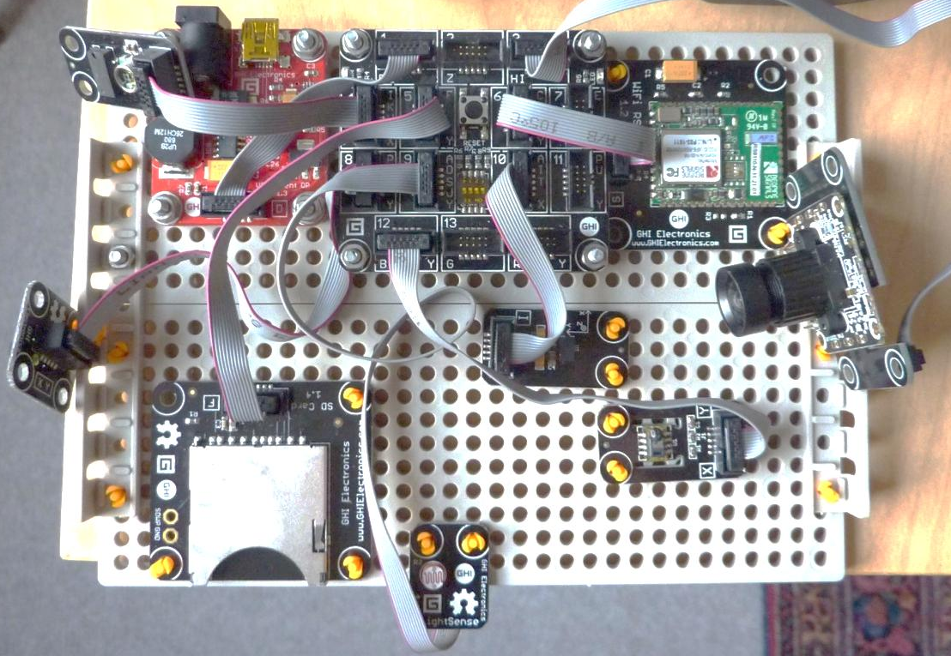
DeviceV1
Notes:
Here’s the current device
[mention mainboard, power, wifi, sensors, camera, sdcard – config, buffereing]
Talk about motion detection then:
So, as mentioned beehives are remote and not oft visited so any issues between visits won’t be know until it’s too late.
I know a beekeeper in NI who came to his beehive one day to removed the lid and had a poke around. In the few days since this happened the hive had died from exposure. This is one problem that my system will be able to solve.

Slide 10
RESTful service - GET
/?recent=2
{
"datastreams": [
{
"id": "Temperature",
"unit": "C",
"datapoints": [
{
"value": 27.1,
"at": 1374494194000
},
{
"value": 27.1,
"at": 1374494134000
},
…
]
},
{
"id": "Humidity",
"unit": "%",
"datapoints": [
{
"value": 59,
"at": 1374494194000
},
{
"value": 60,
],
"updated": "Mon, 22 Jul 2013 11:56:34 GMT"
}
/?current
{
"datastreams": [
{
"id": "Temperature",
"current_value": 24.3
},
{
"id": "Humidity",
"current_value": 63
},
{
"id": "Light",
"current_value": 83
},
…
],
"updated": "Mon, 22 Jul 2013 09:07:41 GMT"
}
Notes:
Here’s the JSON format of the GET requests for data from the Node.js server – current on the left and historical on right (param recent is in hours)

Slide 11
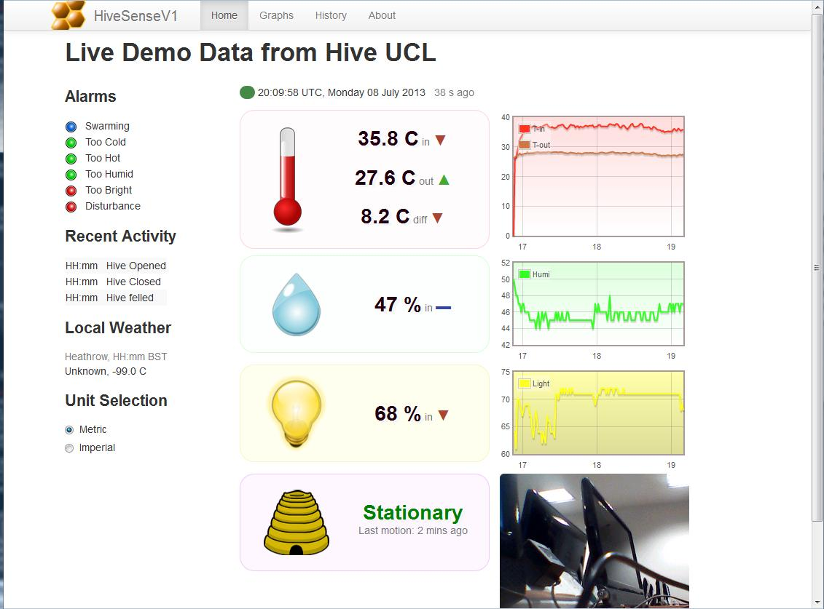
GUI
Notes:
First draft GUI, pending requirements from BEEKs

Slide 12
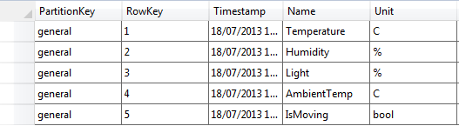
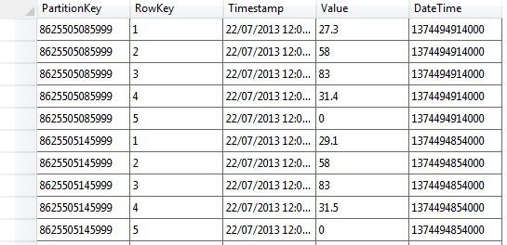
Azure Tables Database
Notes:
Database – top is for each channel/datastream – a single variable produced by a sensor of the device.
Bottom shows data table
Azure tables have three defaults and these can be used to give some relational feel.

