Slide 1

OMA-WID_0293-GotAPI-V1_0-20131223-A
Work Item Document
WI 0292 - Generic Open Terminal API (GotAPI)
Date: 23 December 2013
Availability: Public OMA Confidential
Contact: Bryan Sullivan
Source: AT&T
X
USE OF THIS DOCUMENT BY NON-OMA MEMBERS IS SUBJECT TO ALL OF THE TERMS AND CONDITIONS OF THE USE AGREEMENT (located at http://www.openmobilealliance.org/UseAgreement.html) AND IF YOU HAVE NOT AGREED TO THE TERMS OF THE USE AGREEMENT, YOU DO NOT HAVE THE RIGHT TO USE, COPY OR DISTRIBUTE THIS DOCUMENT.
THIS DOCUMENT IS PROVIDED ON AN "AS IS" "AS AVAILABLE" AND "WITH ALL FAULTS" BASIS.
Intellectual Property Rights
Members and their Affiliates (collectively, "Members") agree to use their reasonable endeavours to inform timely the Open Mobile Alliance of Essential IPR as they become aware that the Essential IPR is related to the prepared or published Specification. This obligation does not imply an obligation on Members to conduct IPR searches. This duty is contained in the Open Mobile Alliance application form to which each Member's attention is drawn. Members shall submit to the General Manager of Operations of OMA the IPR Statement and the IPR Licensing Declaration. These forms are available from OMA or online at the OMA website at www.openmobilealliance.org.

Slide 2
Work Item Title and Registration Name
Work Item Title | Working Group | Registration Name | Version number
Generic Open Terminal API | CD WG | GotAPI | 1.0
Notes:
The Work Item Title is the formal name of the WI. The Work Item Title SHOULD be chosen so that readers can quickly grasp the general idea of the WID and easily associate it with the corresponding WID name. The Work Item Title and Registration Name SHALL NOT include version numbers. Abbreviations SHOULD be avoided. The Version refers to the version of the Enabler Release or Reference Release to be specified by the Work Item.
An example of correct WI naming:
Work Item Title Working Group Registration Name Version Name
Device Management DM DM 3.0
An example of incorrect WI naming:
Work Item Title Working Group Registration Name Version Name
Device Management 3.0 DM DM 3.0

Slide 3
OK, so why now?
Several aspects are driving the motivation to initiate a specific work item for the Device API Framework concept in OMA:
  The existing body of work and expanding work program need alignment, or at least to be captured as key inputs to the development of a common framework
  Common aspects of the framework approach need technical and deployment focused consideration
  Increase in OTT services and evolution of device platform strategies (e.g. SPDY proxies) that risk further relegating access / mobile networks to a bitpipe role, with little or no policy or service enablement ability
  In general, the continued need to ensure that OMA enabler based services are not siloed (unless chosen to be so by specific deployments), but are API-enabled at all important access points, including the end-user device

Slide 4
Description and Objectives
Work Areas:
  Guidelines that list/explore different ways Device APIs may be specified and implemented: issues/options to consider when a Device API is specified; protocols (http, sse, websockets, etc); security options (OAuth2?); use by enablers e.g. for device-to-device communication features of the enabler (e.g. see [1])
  Architecture and specifications for an API framework based upon a localhost API server exposing HTTP-based APIs to apps running in web browsers and as native apps (including but not limited to hybrid native/web apps).
  An API discovery mechanism (e.g. Webfinger, see [2]) for flexible support and deployment of APIs on the device
  Supporting assets, e.g. managed by the OMA code pool initiative, enabling abstractions of common API functions (e.g. discovery, access, session management)
  A registry of well-known API resources for OMA enablers, to be maintained as part of the OMNA.
  Specification of API exposure patterns that are in general globally applicable to native device platforms.
    While there is little chance of aligning native device platform APIs, and distinct native API bindings will be needed for different platforms (though perhaps not defined by OMA), there is value in at least establishing API exposure patterns that are in general globally applicable, with the resulting dialog being useful for identifying where the major pattern-support gaps are across native platforms.
[1] OMA-CD-2013-0094R01-INP_Addressing_SNEW_Device_APIs_requirements
[2] OMA-TP-2013-0293-INP_Discovery_mechanisms_for_OMA_enablers

Slide 5
Example of Device API Approaches
Device API
User Device (Terminal)
Web Runtime Environment
Device APIs are exposed by a resource residing in or running on a Device (e.g. a client of an Enabler running on a mobile device, such as Mobile Codes)
Three options for Device API exposure
  Browser-based virtual API server (e.g. WRAPI)
  Local API server exposed by OS or Native App (e.g. OpenCMAPI, DMClientAPIFw)
  Local HTTP API server (local web server)
Webapp
Webapp
Applications
Webapp
Webapp
1
Other APIs
EventSource API
User
Agent
Web Browser
Widget Runtime
Web Layout Engine
Native
Applications
2
2
Native App
Operating System /
Middleware
OS
3
SIP stack
SMS stack
WAP stack
HTTP
stack
Mobile Network

Slide 6
Description and Objectives
Issues this Work Item aims to solve:
  OMA needs to aggressively expand its API specifications, to ensure that at any usable access point, OMA enablers are open to integration with applications. Lack of open API support at any potential exposure point (especially those were other standards and OTT solutions are supported by APIs) contributes to the risk of isolating OMA enabler-based services from developers and ultimately from users.
  Consistency in API design patterns will be important to that goal, e.g. not only for developers but also for use of such device APIs by OMA enablers
    e.g. for device-to-device communication as an enabler feature; as devices become more connected, the value of OMA enablers can be increased by extending the enablers to operate device-to-device
Market benefits:
  The stakeholders that have supported OMA and deployments of its enablers in the last 10 or so years have substantial investments that need to be leveraged, even as fundamental shifts occur in the standards for internet services (e.g. HTTP 2.0) and deployments (e.g. the rise of secure 3rd-party proxies). The market for OMA enabler-based services can only be preserved by embracing trends such as these where necessary, and mitigating their effects through ensuring that OMA’s service enablers lead the industry in openness.
  Developers (and consequently all the mobile industry ecosystem) will be able to more easily rely on enablers, enhancing the role of the enabler service provider, while opening up new (and potentially provider-independent) ways for developers to access enabler services.

Slide 7
Description and Objectives
Time to market:
  At least in open platforms, products implementing a web-based API framework can be brought to market very quickly. Mobile devices are often shipped with pre-loaded apps, and these can be extended to expose OMA APIs through the device API framework specifications. The capability can also be added to existing devices in many cases, through a simple download.
Expected market acceptance:
  The potential market penetration is at least as large as the currently-served base of users for OMA services, who access those services using devices that are compatible with this framework concept. Varied acceptance of this approach in specific deployments can be expected, e.g. due to variations in the API strategy of specific service providers.

Slide 8
Description and Objectives
Complexity:
  Some of the constraints imposed by various device platforms may pose feasibility issues, and it may be the case that some device platforms will never be open to a local web-based API exposure deployment. Even for those that do, substantially complex issues such as security and privacy need to be carefully considered. These issues are generally perceived to be less significant in closed/silo enablers, but the very intent of API exposure of enablers is to create a more open service environment. This comes with the inherent responsibility to address the limitations of openness, and the likelihood that any new API “surface” will be a new attack vector for malware.
Uniqueness:
  Apart from open-source projects, there are no large-scale implementations of this concept. This is likely due in part to the preference of device platform vendors for exposure of platform capabilities through native APIs (keeping developers thus engaged in their proprietary ecosystems), and the general reluctance of the web standards community for pushing the boundaries of device API openness for web apps, especially browser-based web apps.

Slide 9
Main Use Case(s)
Existing use cases from CSEA
  Managed content delivery (e.g. as envisioned by OMA DCD)
  Context awareness / device information (as envisioned by OMA DPE)
Push-based service enablement
Mobile Codes
Open Connection Management API
SNeW (in particular for proximity-based groups)
RCS (Messaging, Address Book, Presence, etc)
Device Management

Slide 10
Impacts, Relationships and Dependencies
Existing specifications affected:
  Potential influence on future versions of WRAPI, Mobile Codes, OpenCMAPI, and SNeW
Other Work Items affected:
  None
OMA WGs and external organizations affected:
  CD, ARC
Impacts on Architecture, Charging/Billing, Security, Privacy, IOT:

Slide 11
Impacts, Relationships and Dependencies
Service Impacts:
  The API framework can enable exposure of device services locally and device-to-device.
Architecture Impacts:
  The role of the device API framework concept in the OMA architecture should be considered, so that as far as possible device-local API exposure is synergistic with network-based API exposure.
Charging/Billing Impacts:
  None
Security Impacts:
  Security implications of device-local API exposure need consideration.
Privacy Impacts:
  Privacy implications of device-local API exposure need consideration.
IOT Impacts:
  The general patterns of device-local API exposure should be validated through IOT.

Slide 12

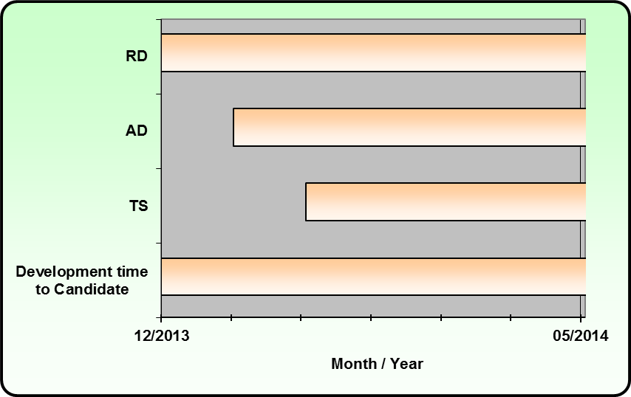
Proposed Timeline
 |  | Approximate duration in months
 | Date
RD start | 2013-12-01
New reqs deadline | 2014-04-01
RD review start | 2014-07-01
RD as Candidate | 2014-10-01 | 10
AD start | 2014-01-01
AD review start | 2014-07-01
AD as Candidate | 2014-10-01 | 9
Detailed spec start | 2014-02-01
Consistency start | 2014-07-01 | 5 | 7
Enabler as Candidate | 2014-10-01 |  |  | 10

Slide 13
Planned deliverables
Requirements
  Combined Release Document for for framework, discovery and access-control/DM
Architecture
  Architecture in Combined Release Document
Development Phase
  Combined Release document
  Data Description Specifications (e.g. Schema, MO, DDS, etc) / White Paper / Deployment Suite
  1 Enabler Test Specification
  1-2 Reference Implementations (code pool)

Slide 14
Planned reviews
Requirements
  RD Review
Architecture
  AD Review
Release
  Consistency Review

Slide 15
Supporting Companies
The companies supporting this work item are:
Company name | Membership type
AT&T | Sponsor
Bell Mobility | Full
Huawei | Full
Telecom Italia | Full
China Unicom | Full

Slide 16
Proposed Resources
The companies supporting this work item are proposing the following resources:
Deliverable/Role | Proposed volunteer editor/champion
Requirements Document (RD)
Requirements Document Review Report (RDRR)
Architecture Document (AD)
Architecture Document Review Report (ADRR)
Technical Specification (TS) | Bryan Sullivan, AT&T
Enabler Test Requirements (ETR)
Enabler Release Definition (ERELD)
Consistency Review Report (CONRR)
WID/WISPR Champion | Bryan Sullivan, AT&T
ARC Champion
IOP Champion

Slide 17
Document History
Approved Versions
Version | Date | Notes
1.0 | 23 Dec 2013 | WI approval via e-vote: OMA-TP-2013-0393-INP_WID_0293_GotAPI_V1.0_for_approval

