Slide 1
AWS Elastic Kubernetes Service (EKS) Fargate QuickStart
Kirk Kalvar
Senior Software Engineer/Principal
KAL Technology
kirk.kalvar@kal.technology
@kskalvar

Slide 2
So How Did I Get Here?
Used Docker for development but quickly realized if you want to do anything serious with containers in production you need orchestration
Wasted way too much time on orchestration engines
Wanted a production grade development environment
Something that could scale easily
Something easy for developers to use without all the drama, tool fatigue, etc.
On demand

Slide 3
Introduction
So Kubernetes has established itself as the leading platform for managing containerized workloads and services.
Run Anywhere
63% of Kubernetes workloads run on AWS today – Cloud Native Computing Foundation (AWS News Blog by Jeff Barr, 29 November 2017)

Slide 4
Why AWS EKS?
AWS Managed Services enables you to quickly and easily deploy your cloud infrastructure
Amazon EKS is already integrated with many AWS services to provide scalability and security for your applications, including the following
Elastic Load Balancing for load distribution
IAM for authentication
VPC for isolation
Amazon EKS runs up-to-date versions of the open-source Kubernetes software. Currently 1.14
You can easily migrate any standard Kubernetes application to Amazon EKS without any code modification required
On Demand

Slide 5
Requirements
AWS Account (root)
An EC2 Instance in which to install kubectl, aws-iam-authenticator, and AWS CLI version 1.15.x or greater
Required Cluster Resources (Customer Responsibility)
A Service Role
A VPC
And three EC2 worker nodes (one for each AWS Availability Zone)
Installation time about 15 minutes based on presentation artifacts

Slide 6
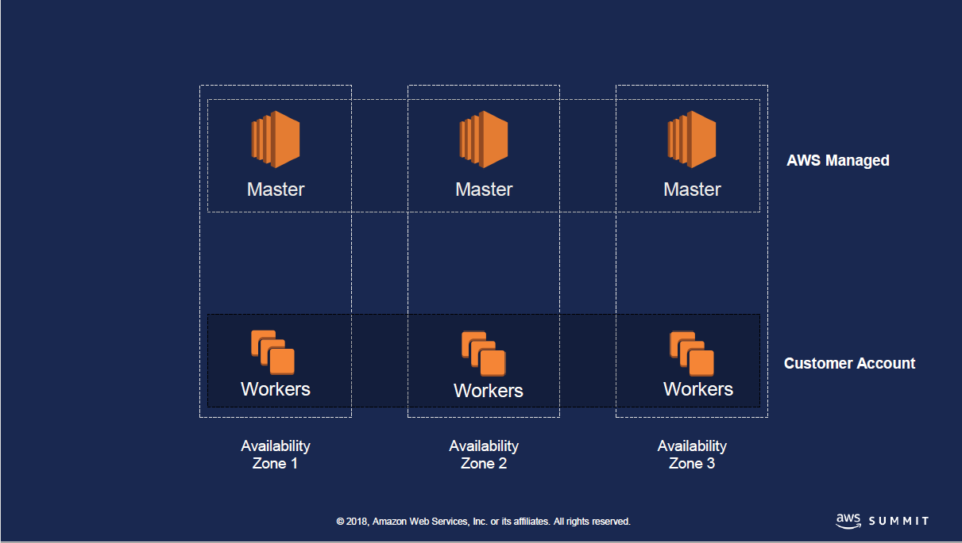

Architecture

Slide 7
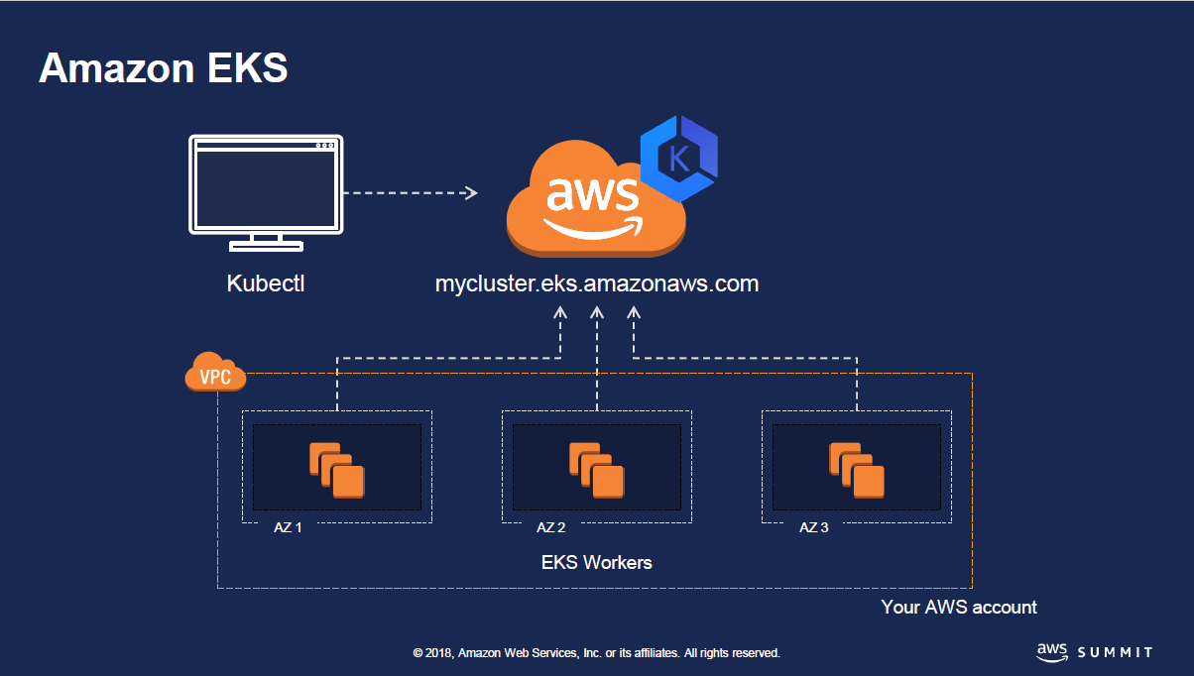
Architecture

Slide 8
Installation Steps
Create an AWS EC2 Instance to act as an EKS Cloud Shell
Create AWS EKS Cluster using eksctl
Create a AWS EKS Fargate Profile with a unique Namespace
Deploy WebApp to Your cluster using that Namespace
Configure the Kubernetes Dashboard (Optional)

Slide 9
Quick Demo
To save time an AWS EKS Cluster and a Fargate Profile created call “web-namespace” has already been configured using eksctl.
We’ll:
Create a deployment and service for a simple webapp
Scale the webapp to show Fargate scaling containers
Should see an unique ip as it is load balanced across the webapp containers
Configure the Kubernetes Dashboard (optional)

Slide 10
Notes
Fargate is limited to 100 Nodes per account initially. This limit is adjustable, and you can request a Quota increase to a higher value based on the requirement. To increase the limit on the number of pods that be launched via EKS Fargate can you provide the following information.
EKS cluster name and region
A small brief on the use case you are trying to achieve
New required limit
AWS account ID
When deleting Fargate Profiles you must delete one at a time.

Slide 11
Conclusions
Cons
Configuring AWS EKS with Fargate requires the use of eksctl right now, not what I would expect for a AWS Managed Service
Still requires some manual configuration of yaml files
Created cloud-init and shell scripts to speed the configuration process
Pros
Provision Kubernetes across AWS Availability Zones
No need to provision node groups
Scales up and down very quickly
On Demand

Slide 12
Questions?

Slide 13
References
AWS EKS Fargate QuickStart
https://github.com/kskalvar/aws-eks-cluster-fargate-quickstart
How do I set up the ALB Ingress Controller on an Amazon EKS cluster for Fargate?
https://aws.amazon.com/premiumsupport/knowledge-center/eks-alb-ingress-controller-fargate

